Slide 1
Figures for Patrick Rotation

Slide 2


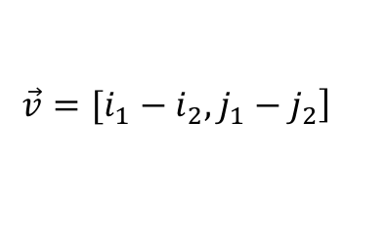
$$Pixel i_{2}j_{2}$$
2.4m
$$\left.\vec{v}=[i_{1}−i_{2}, j_{1}−j_{2}\right]$$
j-axis
2m
$$Pixel i_{1}j_{1}$$
9.6m
i-axis

Slide 3





$$A$$
$$Pixel i_{2}j_{2}$$
$$r$$
$$δΩ=\frac{A}{r^{2}}$$
$$Pixel i_{1}j_{1}$$

Slide 4






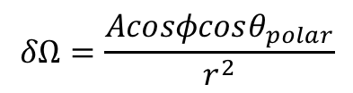


$$z$$
$$A$$
$$r$$
$$Pixel i_{2}j_{2}$$
$$x$$
$$θ_{polar}$$
$$φ$$
$$δΩ=\frac{Acosφcosθ_{polar}}{r^{2}}$$
$$y$$

