Slide 1
Pyramid Simulation
Ralf Ehrlich
University of Virginia
September 30, 2019

Slide 2
Updates
New simulations/reconstruction
Changed counter width from 5cm to 2cm. Previous reconstructions where based on MC information from the end of the tracks with discrete positions (in steps of 2cm) at the counter locations to simulate 2cm wide counters.
Reconstruction now includes events where two neighboring counters are hit. Average position of both counters is used for these cases.
Attempted a 3D reconstruction.

Slide 3
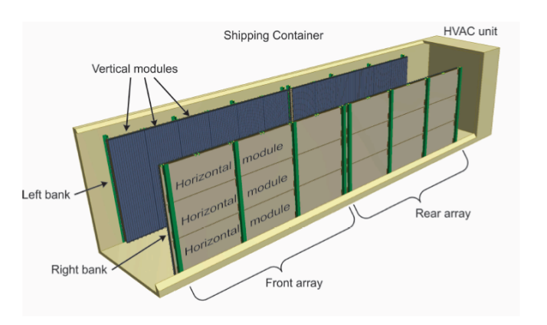
Setup of test run
Currently have a basic GEANT4 model of
A pyramid with empty chamber (spheres with diameters between 1m and 6m)
The correct pyramid model will be implemented later.
The detector consisting of 2x2 containers placed centered at 25 m away from the base of the pyramid.
Container:
Container wall: 5 mm thick aluminum
Distance between left and right bank: 2 m
6 vertical modules per bank and array
40 counters per module
Counter dimensions: 2.4 m x 2 cm x 2 cm
3 horizontal modules per bank and array
40 counters per module
Counter dimensions: 4.8 m x 2 cm x 2 cm
This is one container.
4 of them are placed on two sides of the pyramid.

Slide 4
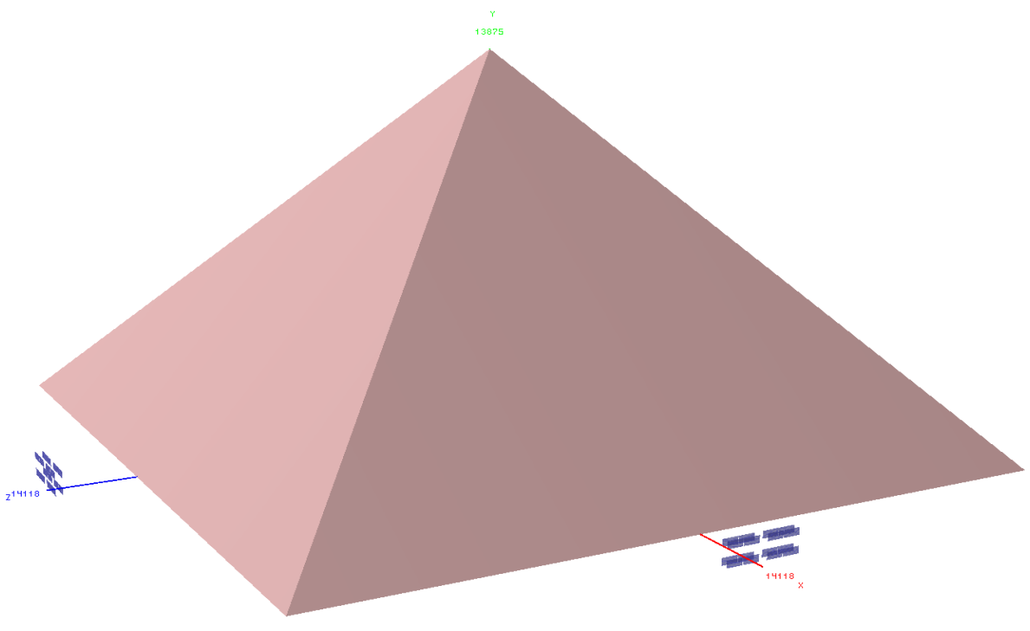
Setup of test run
GDML drawing of the GEANT4 model
y
Height 138.75m
The empty spheres inside of the pyramid are hidden.
2x2 containers
z
25m
230.33m
25m
2x2 containers
230.33m
x
Containers (L:40’, W:8’, H:9.5’ ) made of 5mm thick aluminum not shown in drawing.

Slide 5
Setup of test run and baseline run
Test run setup
Generate cosmic ray muons using Daya Bay cosmic ray muon distribution for an energy interval between 50 GeV and 1 TeV, and zenith angles between 40° and 90°.
12 m high by 26 m wide vertical production planes at detectors on both sides of the pyramid.
Cosmic rate 414 Hz for both production planes combined.
Starting point of the events are projected to the surfaces of the world volume, so that GEANT can simulate the muon trajectories through the pyramid.
Generated 1.0e10 events, which corresponds to 280 days.
Required about 4e5 CPU hours.
Baseline run
Repeat the simulation for a pyramid without voids.
Generated 1.0e10 events, which corresponds to 280 days.
Required about 4e5 CPU hours.
Bug
There was a bug, which caused events which came through one of the containers to be misreconstructed. These events were removed, but reduced the number of usable events by 25%.

Slide 6
Reconstruction
Event selection
Use only events where either only one counter or two neighboring counters per layer has hits.
If two neighboring counters were hit, the average counter position was used.
Not sure, whether it helped or hurt the results to include events with hits in neighboring counters. Perhaps using only events with one counter per layer, but with thinner counters (e.g. 1cm) would be a better option.

Slide 7
Reconstruction (continued)
2D Reconstruction
Calculate direction and location of track at center between both detector banks based on the positions of the counters which were hit.
Projected the tracks back to vertical planes at the pyramid, and fill a 2D histogram for each plane.
This analysis uses planes which are between -50 m and +50 m from the center of the pyramid, in steps of 1 m.
The histograms cover a horizontal range between -50 m and +50 m, and a vertical range between 20 m and 120 m.
Do this 2D reconstruction separately for both sides of the pyramid.
Repeat 2D reconstruction for baseline run (i.e. pyramid without voids).
Subtract the 2D histograms (of each plane) of the baseline run from the histograms of the test run.
Apply TH2F::Smooth() on the 2D histograms of all planes and make a cut on all bins with entries less than a TBD value.

Slide 8
Reconstruction (continued)
3D Reconstruction
Combine the histograms of all planes of the 2D reconstruction into a 3D grid (using a TH3F) separately for both sides of the pyramid.
Multiply each bin of both 3D grids, and put the result into a new 3D grid (again a TH3F), if the number is greater than a TBD value.
This requires that both 3D grids have identical dimensions.

Slide 9
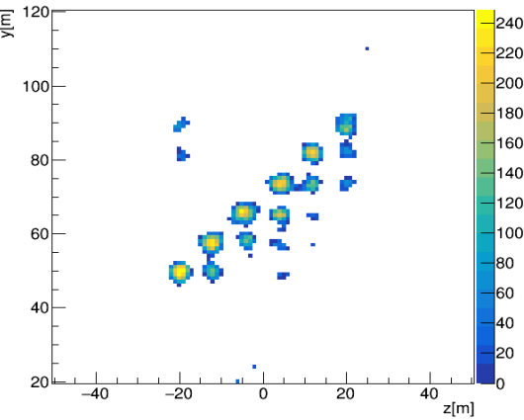
2D reconstruction for detector at +x side
Projection to yz-plane at x=0 at the pyramid
Baseline subtracted.
No energy cut.
1m/bin
Simulated empty spheres at x=0

Slide 10
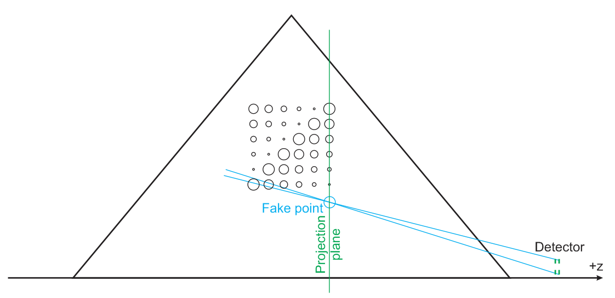
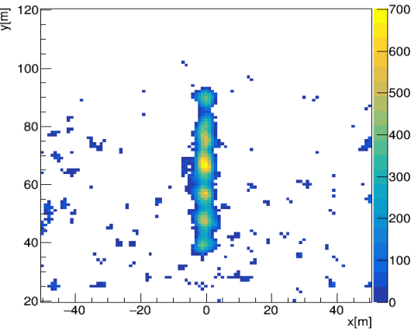
2D reconstruction for detector at +z side
Projection to the center of pyramid (z=+20m)
Baseline subtracted.
No energy cut.
1m/bin
Simulated empty spheres at z=20m
Ghost point

Slide 11
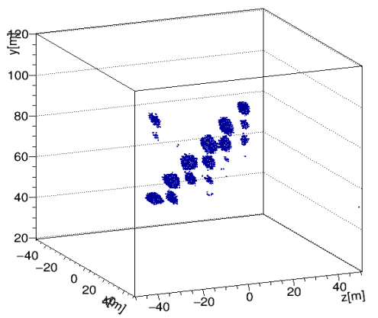
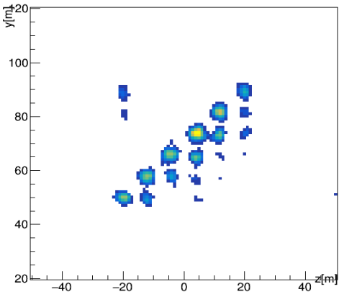
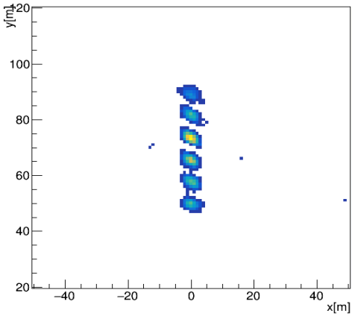
3D reconstruction
yz projection from 3D plot
yx projection from 3D plot
This simple geometry of empty spheres is probably not the best test for the 3D reconstruction, since the voids are located only in one plane.
no ghosts

