Slide 1
Figures for Patrick Rotation

Slide 2


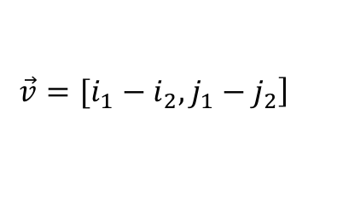
$$Pixel i_{2}j_{2}$$
2.4m
$$\left.\vec{v}=[i_{1}−i_{2}, j_{1}−j_{2}\right]$$
j-axis
2m
$$Pixel i_{1}j_{1}$$
9.6m
i-axis

Slide 3





$$A$$
$$Pixel i_{2}j_{2}$$
$$r$$
$$δΩ=\frac{A}{r^{2}}$$
$$Pixel i_{1}j_{1}$$

Slide 4






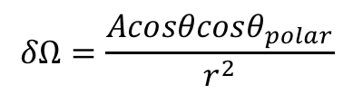


$$z$$
$$A$$
$$r$$
$$Pixel i_{2}j_{2}$$
$$x$$
$$θ_{polar}$$
$$θ$$
$$δΩ=\frac{Acosθcosθ_{polar}}{r^{2}}$$
$$y$$

Slide 5









$$η$$
$$y$$
$$\vec{v}$$
$$ξ$$
$$ψ$$
$$ψ$$
$$φ$$
$$x$$
$$ξ_{0}$$

Slide 6
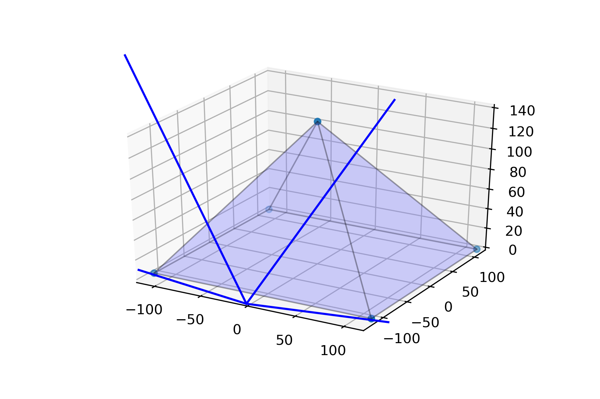



$z$-axis
$y$-axis
$x$-axis

Slide 7
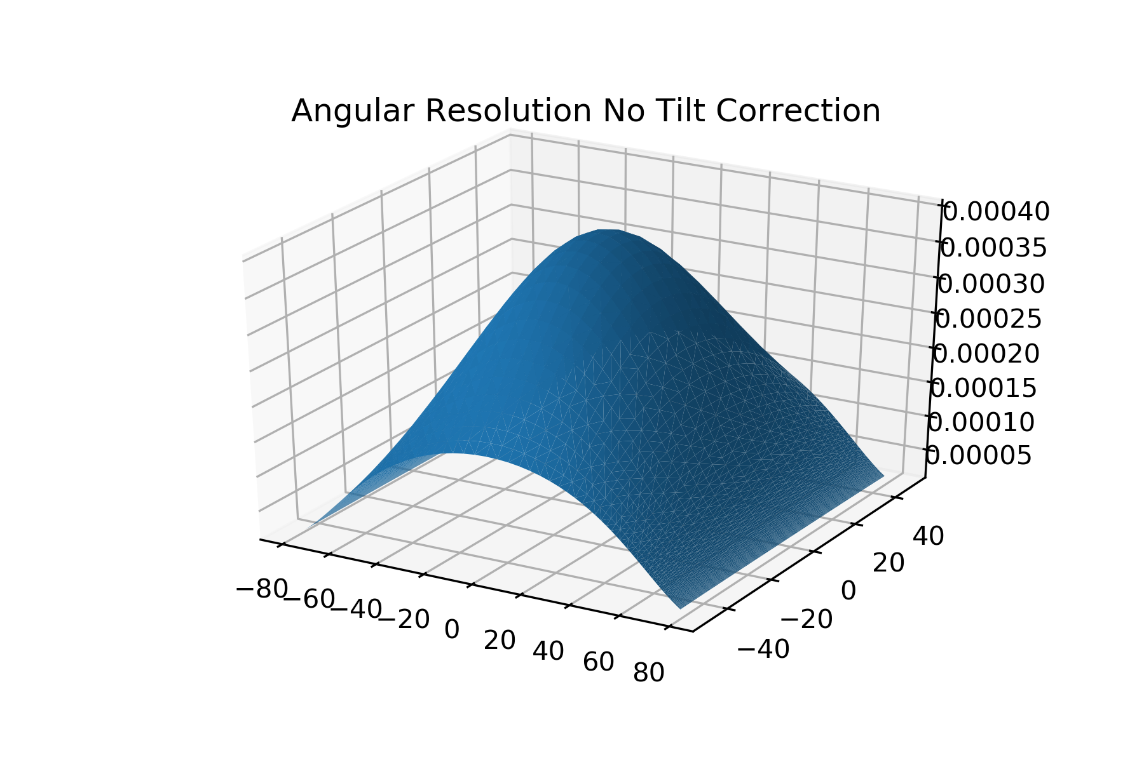



$$sr$$
$$θ_{polar}$$
$$θ_{ }$$

Slide 8
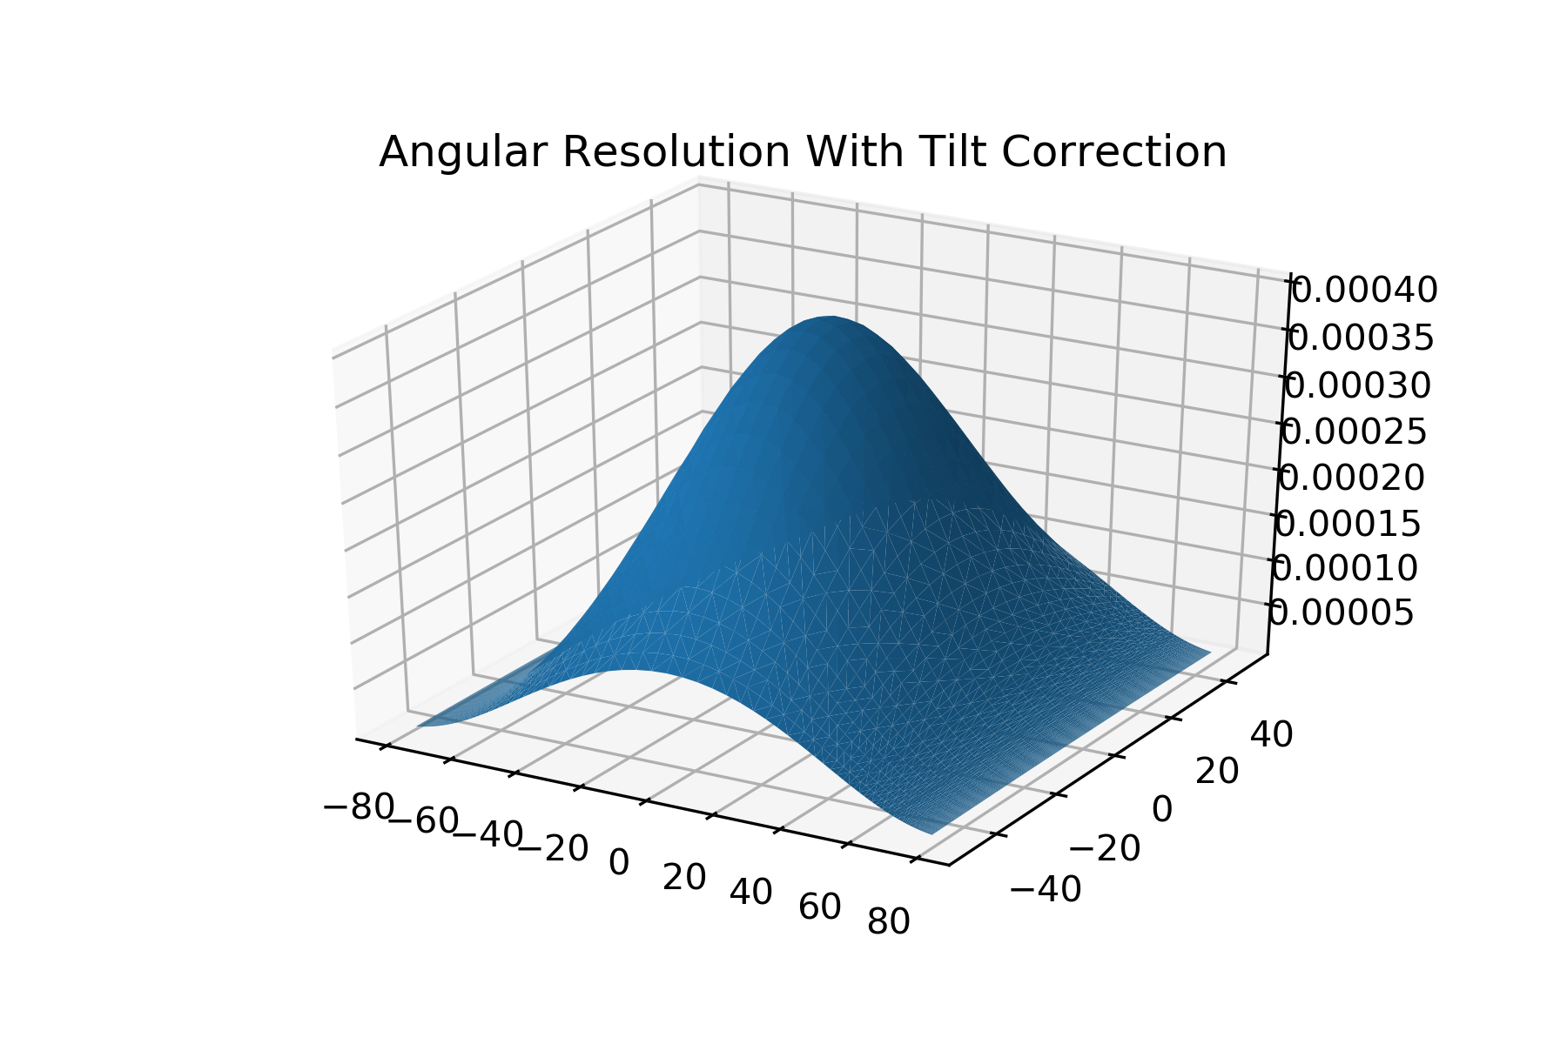

$$sr$$
$$θ_{polar}$$
$$θ_{ }$$

Slide 9
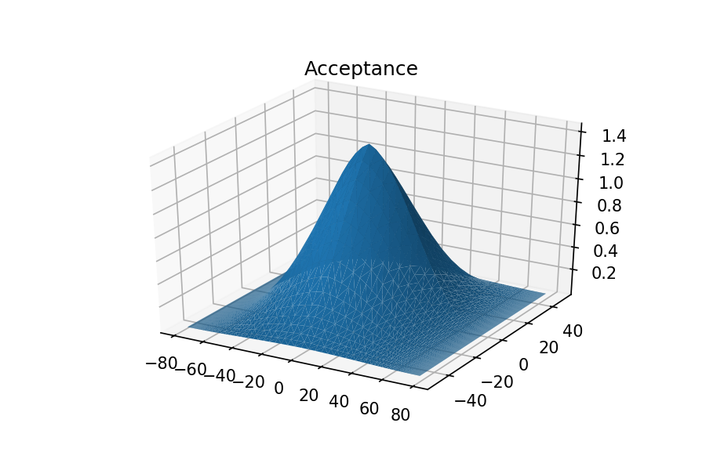

$$cm^{2}sr$$
$$θ_{polar}$$
$$θ_{ }$$

Slide 10
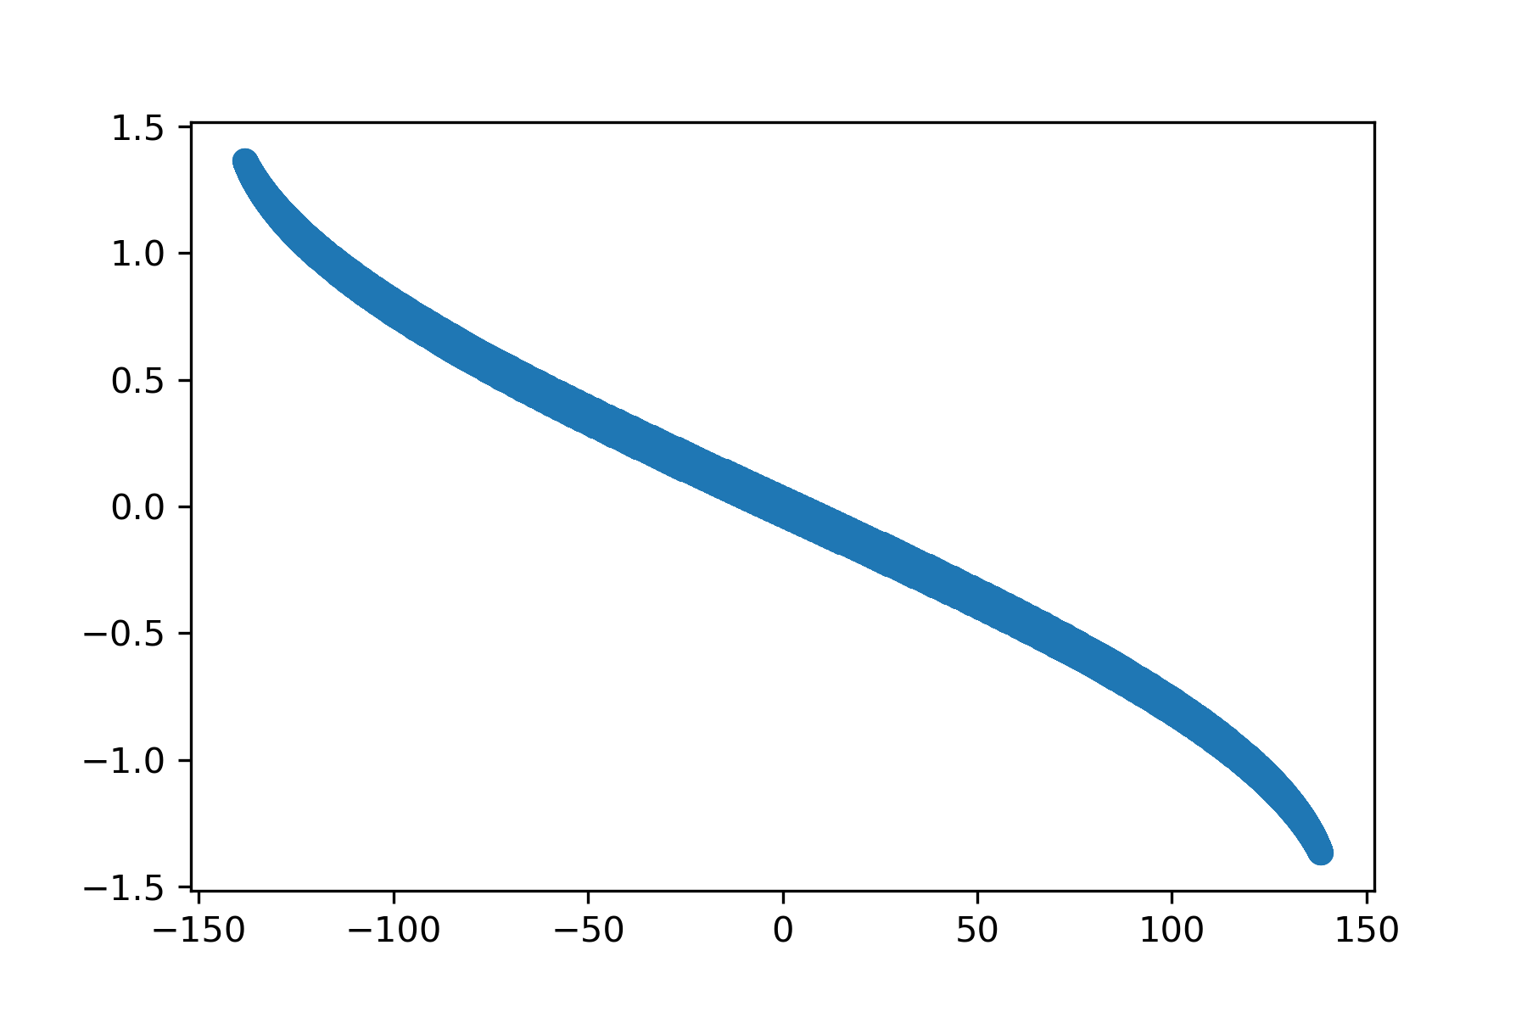

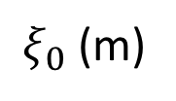
$φ$ (radians)
$ξ_{0}$ (m)

Slide 11
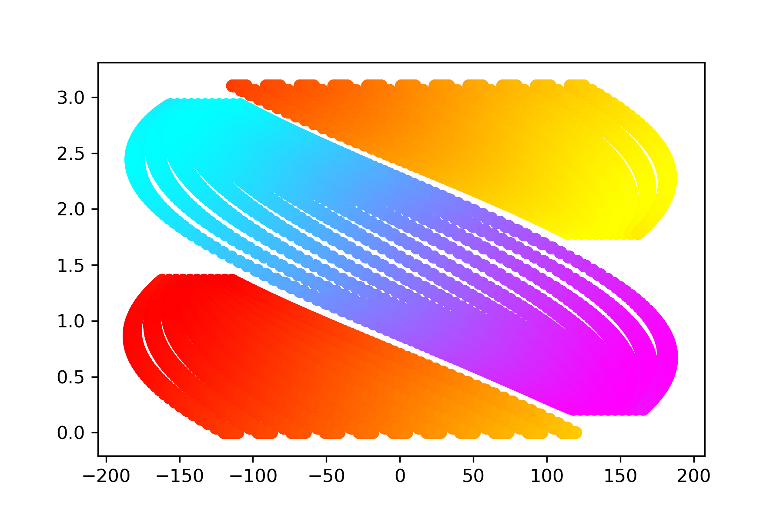
$φ$ (radians)
$ξ_{0}$ (m)

Slide 12
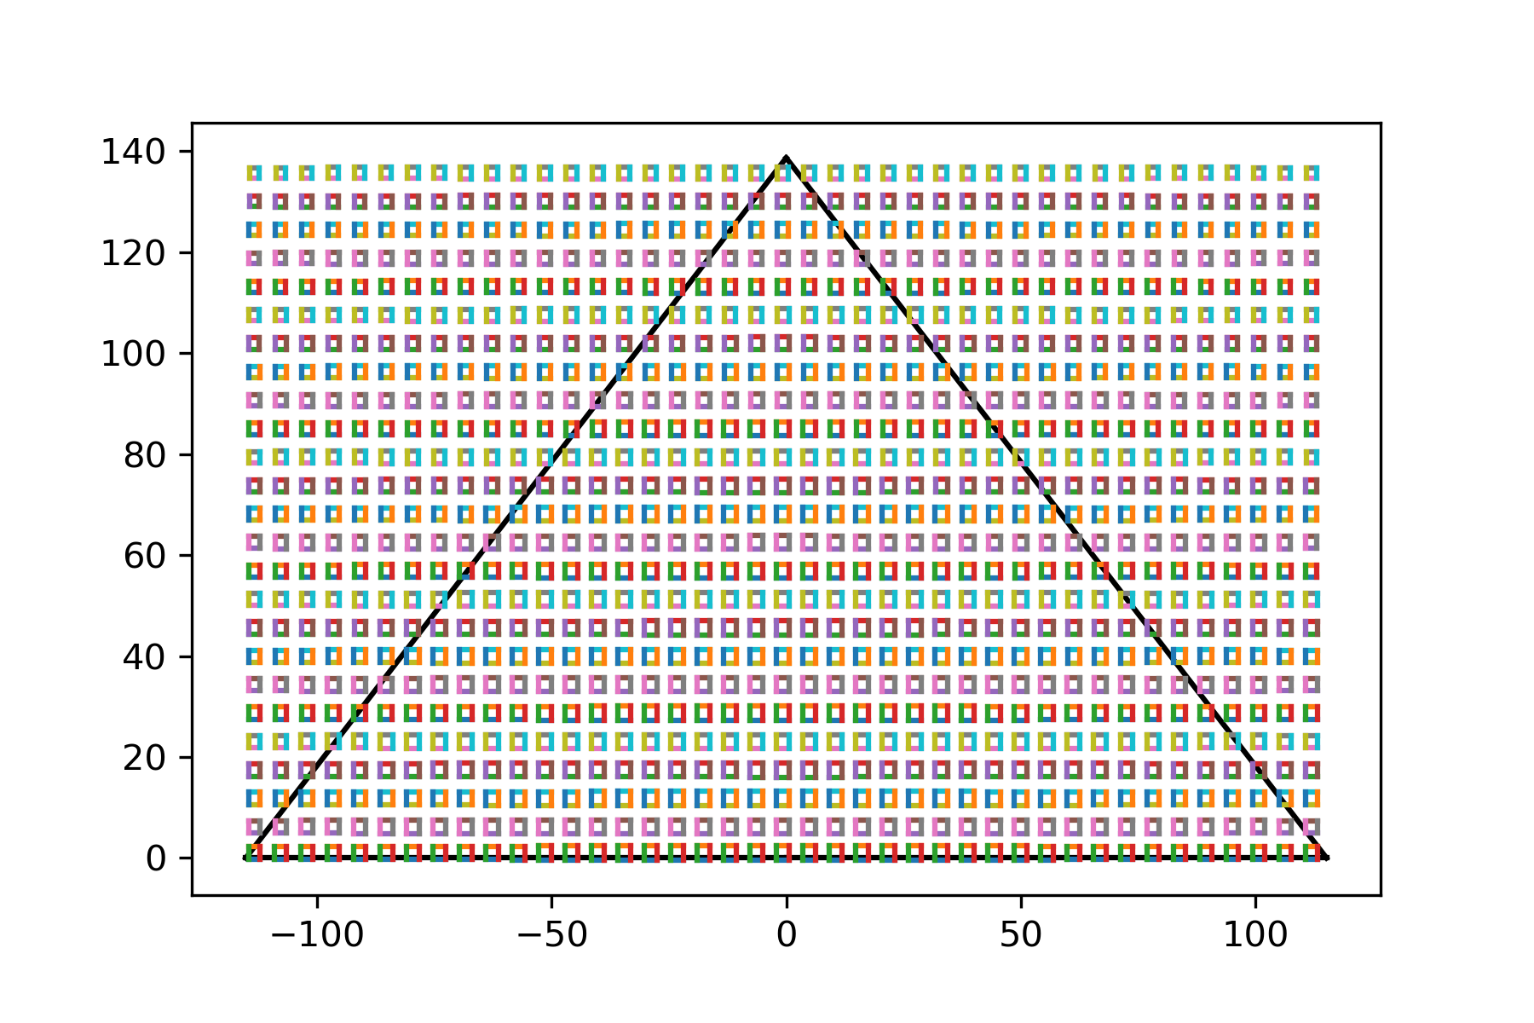

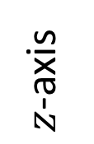
$z$-axis
$x$-axis

