Slide 1
PAIRS project update
Amanda Farnsworth
Dec 17th, 2021

Slide 2
Outline
Wind turbine power model and results (slides 3-4)
Solar power model and results (slides 5-6)
TEA for solar and wind (slides 7-8)
City level comparison (slide 9)
Standard deviation and coefficient of variation (slides 10)
Next steps (slides 11)
Additional solar equations (slides 12)

Slide 3
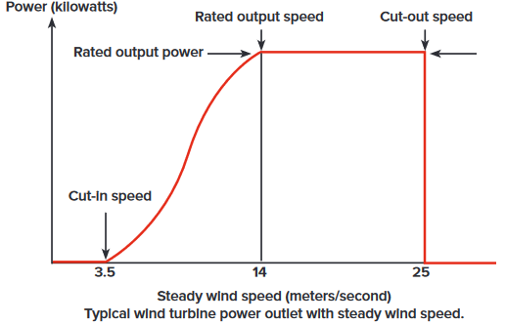
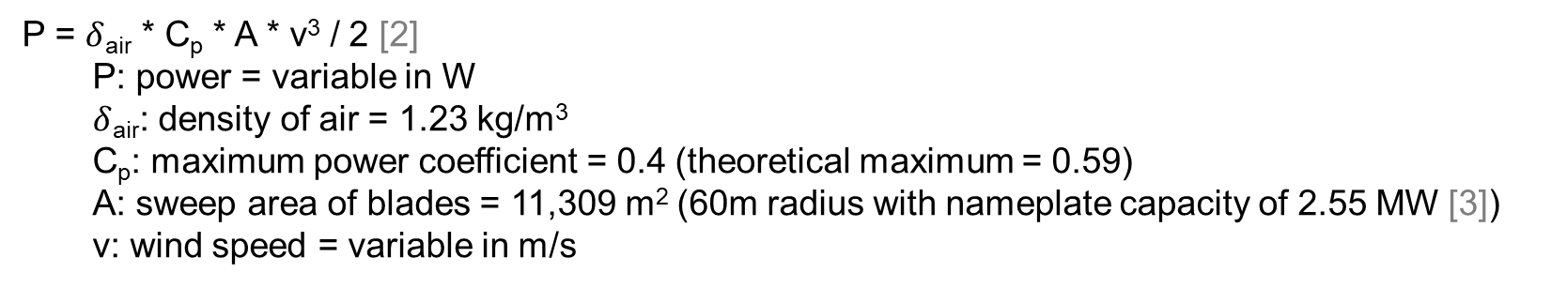
Model for turbine output
[1]
P = $δ$_{air} * C_{p} * A * v³ / 2 [2]
P: power = variable in W
$δ$_{air}: density of air = 1.23 kg/m³
C_{p}: maximum power coefficient = 0.4 (theoretical maximum = 0.59)
A: sweep area of blades = 11,309 m² (60m radius with nameplate capacity of 2.55 MW [3])
v: wind speed = variable in m/s
[1 ]NY-Wind-Energy-Guide.pdf
[2] https://www.raeng.org.uk/publications/other/23-wind-turbine
[3] https://www.energy.gov/eere/articles/wind-turbines-bigger-better

Slide 4
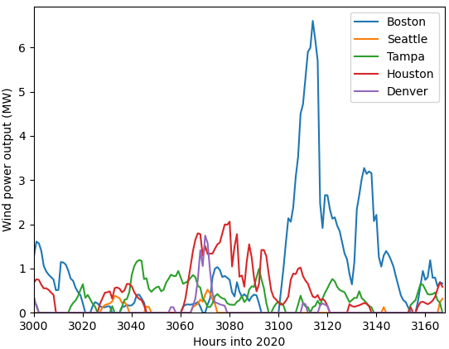
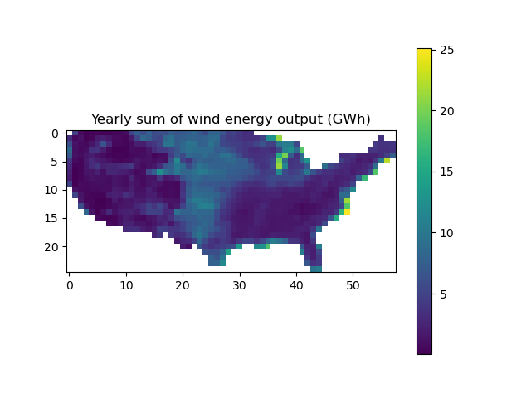
Tracking wind output over time
Extrapolating wind speed from 10m to 40m above the surface
v₂ = v₁ * (z₂/z₁)ª [4]
z: height in m
v: windspeed in m/s
a: wind shear component = 0.2
subscripts 1 and 2 indicate height at 10m and 40m, respectively
*note: a varies hourly and regionally. Incorporate this into next version.
CF = AEO / (366 * 24 * MRC) [5]
CF = capacity factor
AEO = annual energy output in Wh
MRC = manufacturers rated capacity
Check:
CF = 5 * 10⁹ / (366 * 24 * 2.55 * 10⁶)
CF = 22%
*note: some unusually low capacity factors present (lowest = 0.122%)
[4] https://websites.pmc.ucsc.edu/~jnoble/wind/extrap/
[5] https://www.windpowerengineering.com/calculate-wind-power-output/

Slide 5
Model for PV output
Assumptions
Cell type = Si
Installation type = utility, fixed tilt
ILR = 1
Rated efficiency = 26%
Shading losses = 3%
Soiling losses = 2%
Wiring losses = 2%
Connection losses = 0.5%
Degradation losses = 1.5%
Availability losses = 2%
Equations used:
Sandia Temperature model – gives cell temperature (T_{cell}) (slide 12)
1) η = η_{nom} * (1 + γ * (T_{cell} – T_{ref})) [6]
η: efficiency
η_{nom}: rated efficiency
γ: constant -0.47 %/°C
T_{ref}: reference temperature = 25 °C
2) P_{DC} = I * A * η * f_{losses} [7]
A: cell area in m² (slide 6)
I: irradiance in W/m²
f_{losses}: compilation of all listed losses = 0.895
P_{DC}: hourly direct current power output
3) P_{AC} = P_{DC} * η_{inv} [6]
η_{inv}: inverter efficiency
P_{AC}: hourly alternating current power output
[6] Dobos, A. P. PVWatts Version 5 Manual. www.nrel.gov/publications. (2014)
[7] Gilman, P. et al. SAM Photovoltaic Model Technical Reference Update. www.nrel.gov/publications. (2016).

Slide 6
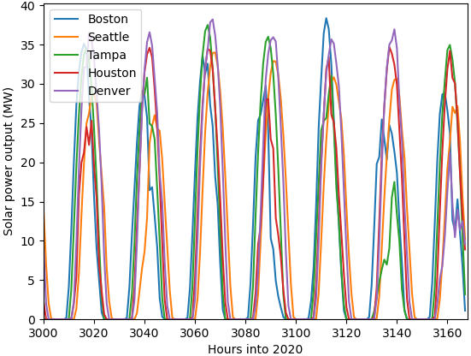
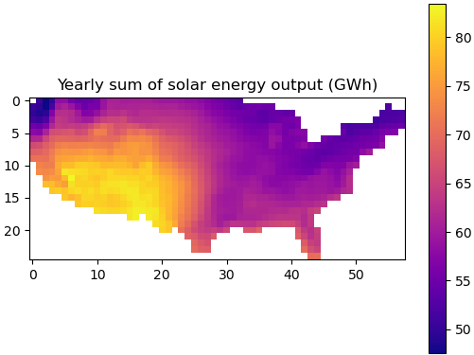
Tracking solar output over time
Assumed: P_{rating} = 50MW [8]
A = P_{rating} / (MRC * I_{stc}) [9]
I_{stc}: irradiance at standard conditions = 1,000 W/m²
A = 50,000,000 / (0.26 * 1,000)
A = 190,000 m²
Check: ~ 5 m² / kW [10]
190,000 / 50,000 = 3.8 m² / kW
CF = AEO / (366 * 24 * MRC) [11]
CF = capacity factor
AEO = annual energy output in Wh
MRC = manufacturers rated capacity
Check:
CF = 60 * 10⁹ / (366 * 24 * 50 * 10⁶)
CF = 14%
[8] https://www.eia.gov/todayinenergy/detail.php?id=38272
[9] https://www.ilumen.be/en/the-difference-between-nominal-and-real-pv-power-explained/
[10] https://www.hisour.com/nominal-power-in-photovoltaic-39514/
[11] https://www.windpowerengineering.com/calculate-wind-power-output/

Slide 7
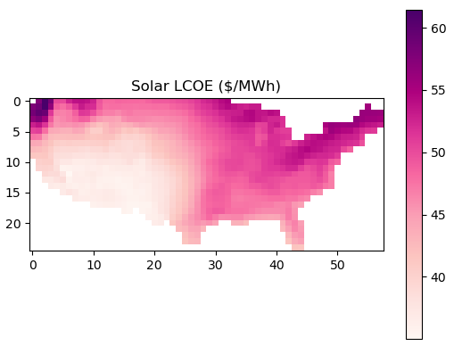
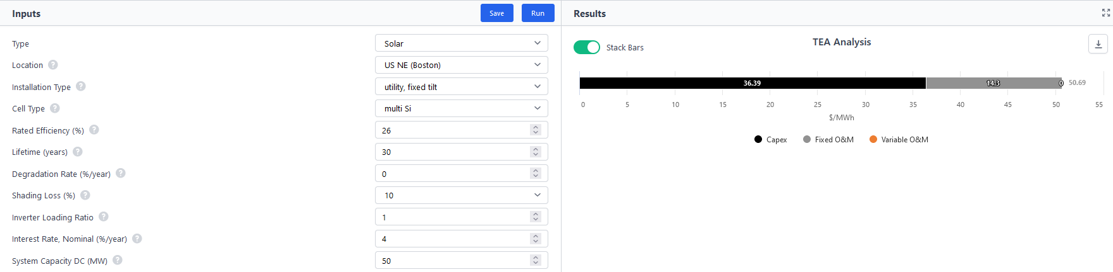
Translation of PV power output to TEA
Assumptions
Lifetime = 30 years
Interest rate = 4%
Check with SESAME (in Boston):
51.7 $/MWh via PAIRS calculations vs. 50.7 $/MWh via SESAME web
2% difference caused by different weather data sources
[12]
[12] https://sesame.mit.edu/app/costs

Slide 8
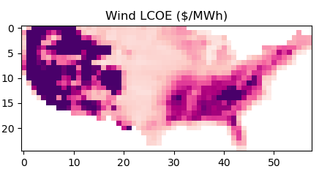
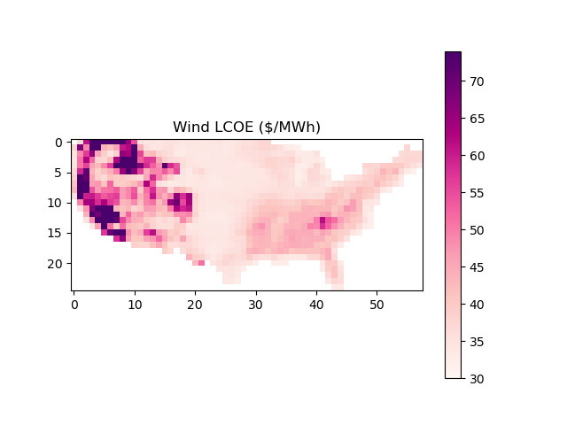
Translation of wind power output to TEA
Assumptions
Lifetime = 30 years
Interest rate = 2.5%
Tax rate = 25.74% (federal and state)
Check with NREL [13]:
37 $/MWh via NREL vs. large range via PAIRS calculations
36.5 $/MWh when LCOE calculations done with NREL assumed capacity factor (0.42)
→ LCOE calculations are sound
→ CF calculations are error source
Suspected source of error:
wind speed extrapolation inaccuracies – wind shear value should be ~0.4 for mountain ranges [14]
Increasing wind shear exponent from 0.2 to 0.4
[13] https://sesame.mit.edu/app/costs
[14] https://www.researchgate.net/publication/329162512_A_Probabilistic_Assessment_Approach_for_Wind_Turbine-Site_Matching

Slide 9
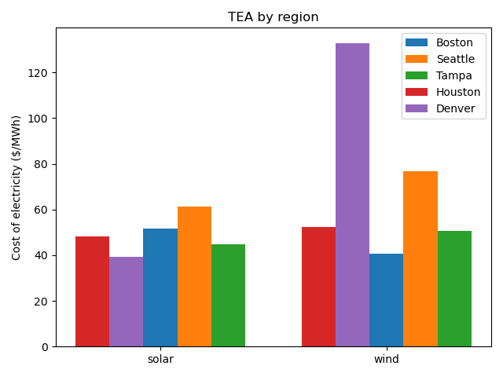
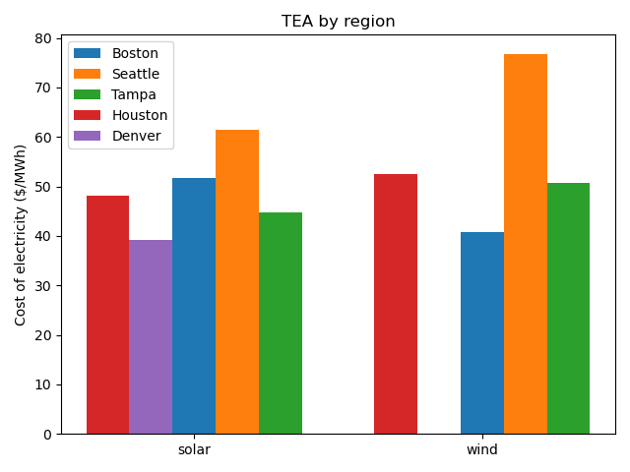
City level comparison
Excluding Denver wind results with a change in y-axis
Solar values are correct vs. wind values need slight correction

Slide 10
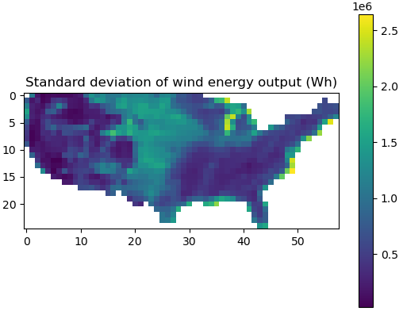
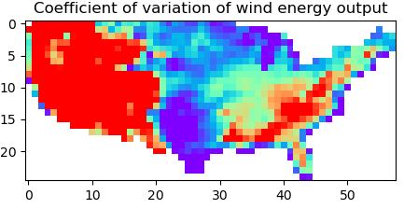
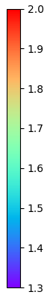


Standard deviation and coefficient of variation
Regions of high output have high variability
Regions of low output have the high coefficient of variation
Wind has a higher coefficient of variation than solar

Slide 11
Next steps
Correct wind extrapolation calculations
Complete LCA for wind and solar
Repeat analysis on different years of data
**check in with another PowerPoint**
Aggregate data and repeat analysis at aggregated level
Compare aggregated results to results at high resolution
Use high resolution data with only irradiance* data aggregated
Compare results to results at high resolution
Repeat with * = wind or temp

Slide 12
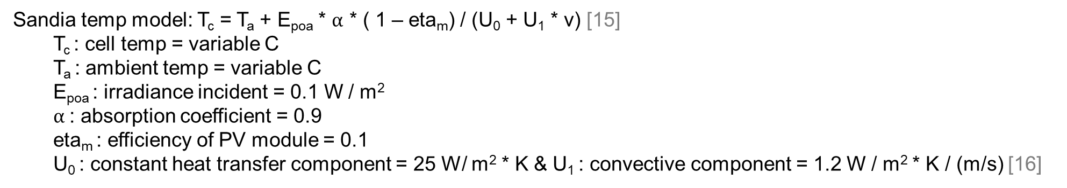
Solar equations
Sandia temp model: T_{c} = T_{a} + E_{poa} * $α$ * ( 1 – eta_{m}) / (U₀ + U₁ * v) [15]
T_{c} : cell temp = variable C
T_{a} : ambient temp = variable C
E_{poa} : irradiance incident = 0.1 W / m²
$α$: absorption coefficient = 0.9
eta_{m} : efficiency of PV module = 0.1
U₀ : constant heat transfer component = 25 W/ m² * K & U₁ : convective component = 1.2 W / m² * K / (m/s) [16]
[15] https://pvpmc.sandia.gov/modeling-steps/2-dc-module-iv/cell-temperature/pvsyst-cell-temperature-model/
[16] https://www.pvsyst.com/help/thermal_loss.htm

