Slide 1
PAIRS project update
Amanda Farnsworth
Feb 17th, 2022

Slide 2
Outline
Additional considerations within PV calculations
Visualization of aggregation
LCA and TEA results at different aggregation levels
Results with input data at different aggregation levels
Next steps

Slide 3
Part 1
Additional considerations within PV calculations
Visualization of aggregation
LCA and TEA results at different aggregation levels
Results with input data at different aggregation levels
Next steps

Slide 4
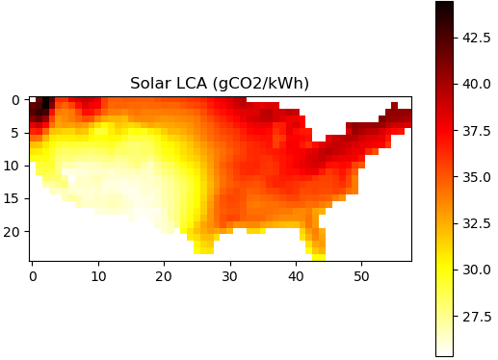
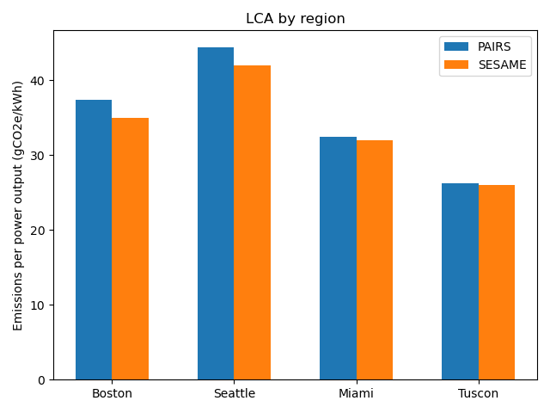
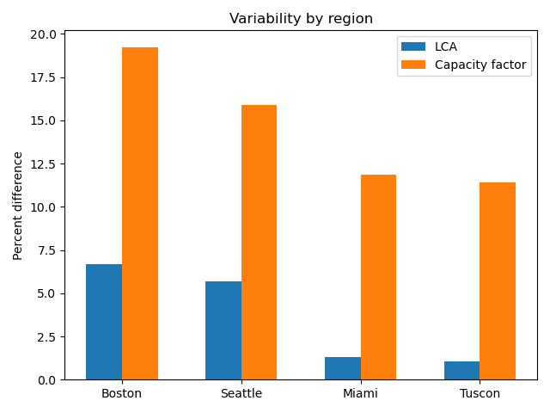
Evaluation of LCA results
PAIRS LCA results are slightly (<10%) “worse” (higher) than SESAME LCA results
Difference originates from capacity factor discrepancies
SESAME assumes optimal tilt vs. PAIRS assumes flat
[1] https://www.sciencedirect.com/science/article/abs/pii/B9780128186343501776?via%3Dihub

Slide 5
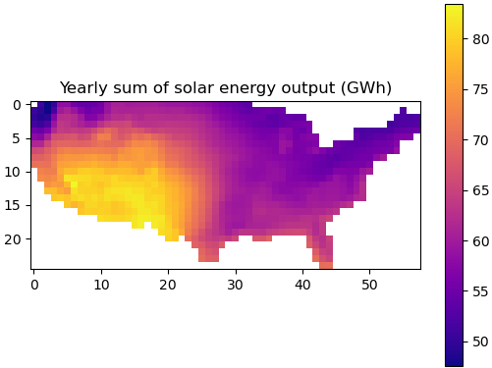
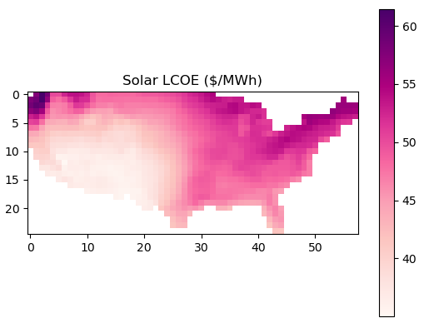
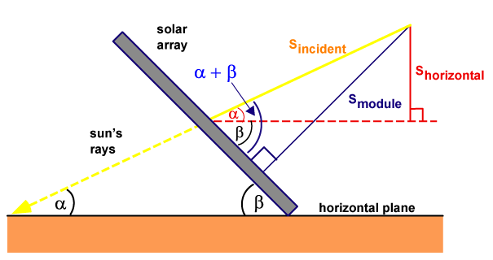
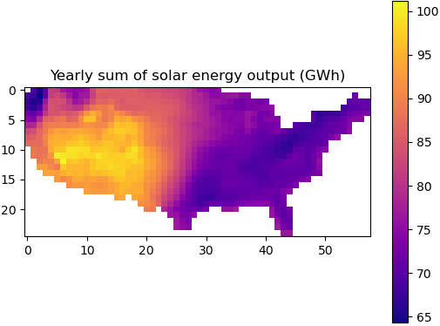
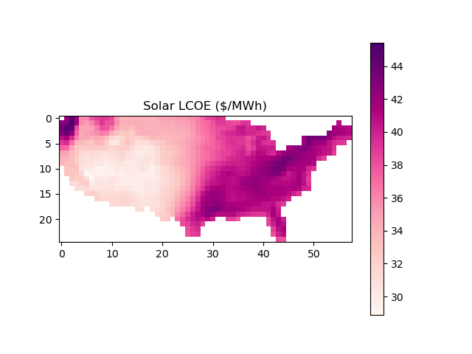
Adding snow and tilt considerations
Tilt considerations involve calculating optimal tilt based on latitude, and converting horizontal irradiance to incident irradiance based on sun angle and module tilt
Snow considerations involve tracking the sliding of snow based on tilt and cell temperature
Adding tilt and snow considerations
Power output improves
Biggest difference seen in the northern part of the USA where tilt is more significant
LCOE values are a bit too “good” (low) because yearly sum is a bit too high
[2] https://www.pveducation.org/pvcdrom/properties-of-sunlight/solar-radiation-on-a-tilted-surface

Slide 6
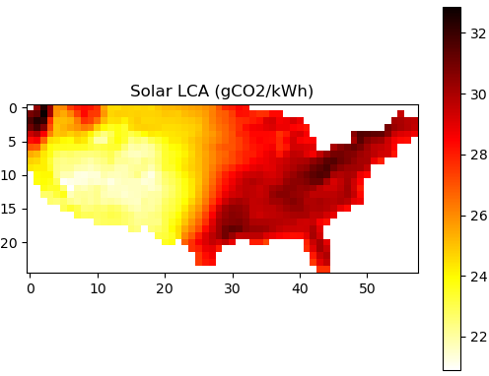
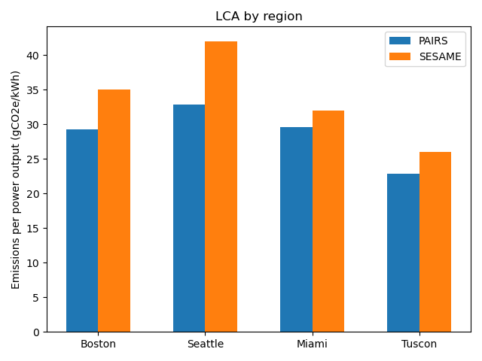
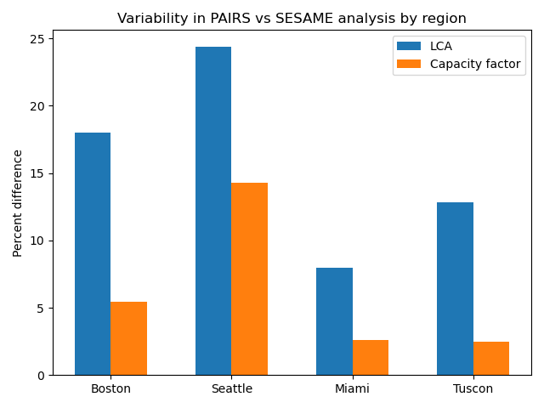
LCA results after considering tilt and snow impacts
General LCA trends make sense: better to install solar panels in Florida than New England
PAIRS LCA values are now too “good” (lower)
As with TEA calculations, LCA values are impacted by high power outputs – this is shown through tracking capacity factors
Adding tilt and snow considerations

Slide 7
Part 2
Additional considerations within PV calculations
Visualization of aggregation
LCA and TEA results at different aggregation levels
Results with input data at different aggregation levels
Next steps

Slide 8
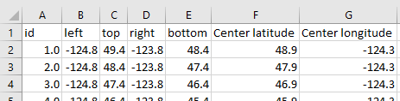
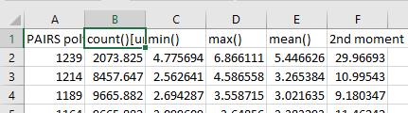
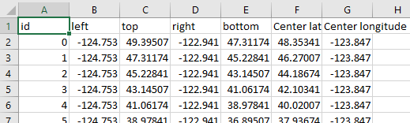
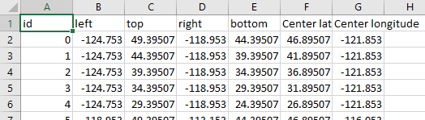
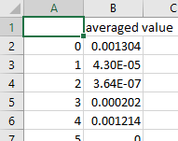
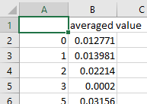
Aggregation methodology
Mapping legend
Incremental data
Level 1 (25 x 58) data
Index indicating the bounding box of each numbered cell in the grid
8760 data sheets containing the temperature* data for each numbered cell at hourly increments
Create 2 new mit-grids with different dimensions
Sort level 1 data into new grids based on latitude and longitude centers
Complete a weighted average based on data count (measurements/area)
Mapping legends
Incremental data sets
Level 2 (12 x 32) and level 3 (5 x 10) data
Index indicating the bounding box of each numbered cell in the grid – same as level 1
8760 data sheets containing the temperature* data for each numbered cell at hourly increments – lost other statistical info (max, min, and 2nd moment)
*snow, wind, and all other weather parameters are aggregated in the same way

Slide 9
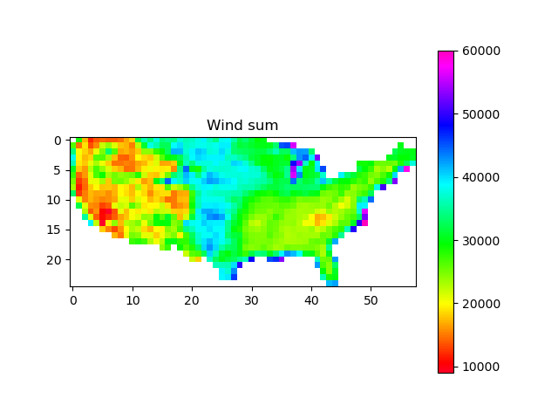
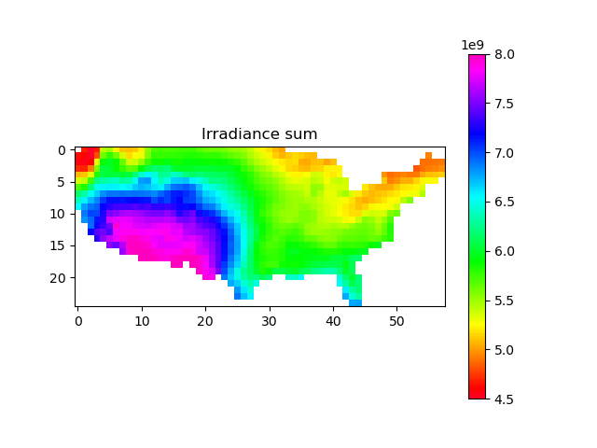
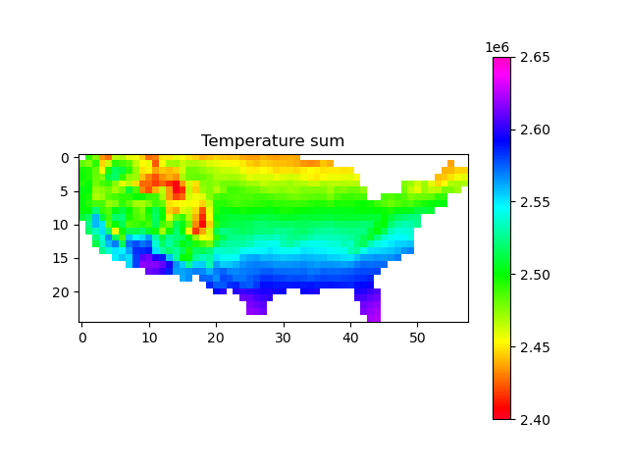
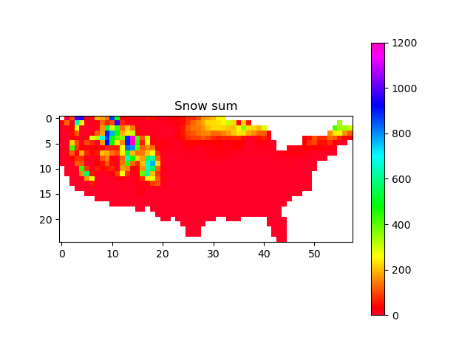
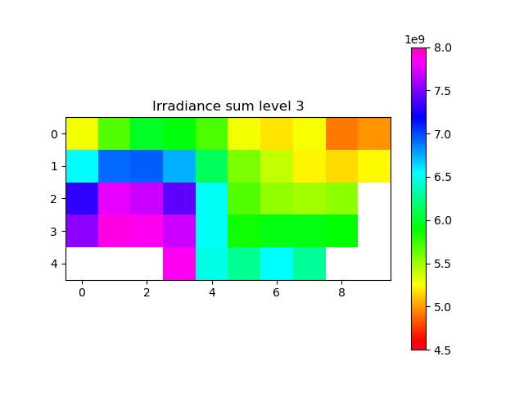
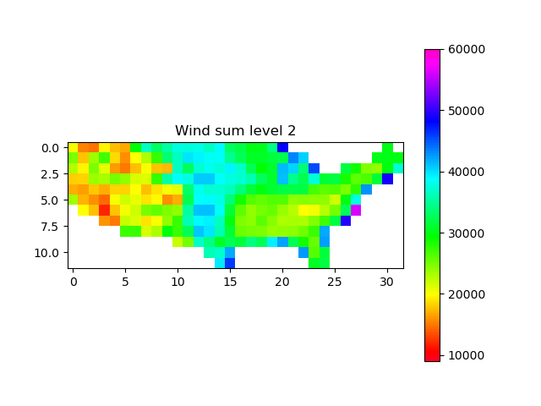
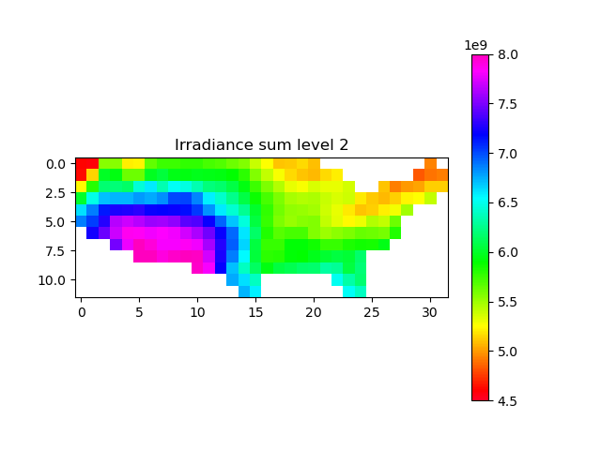
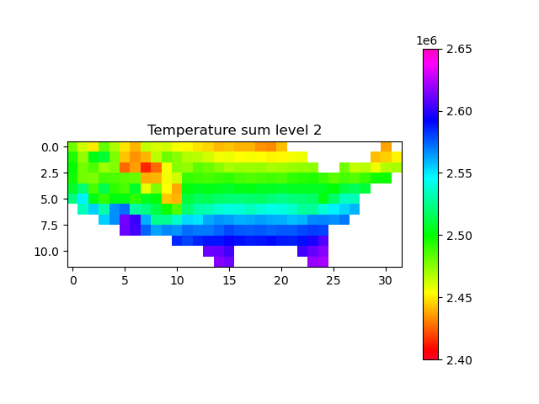
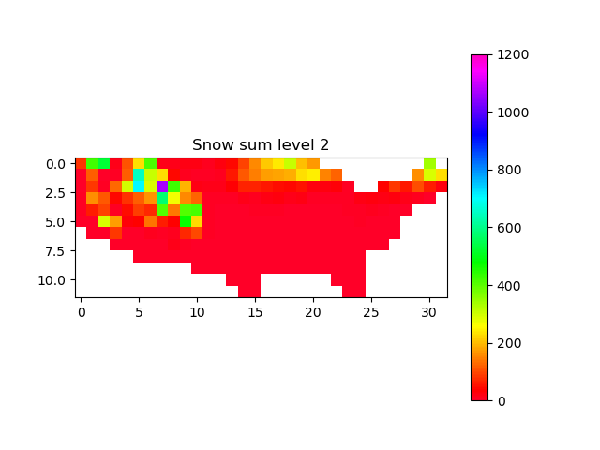
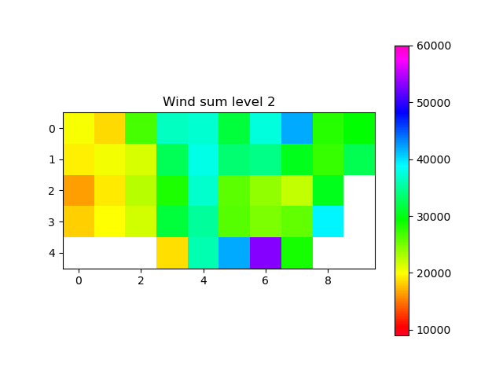
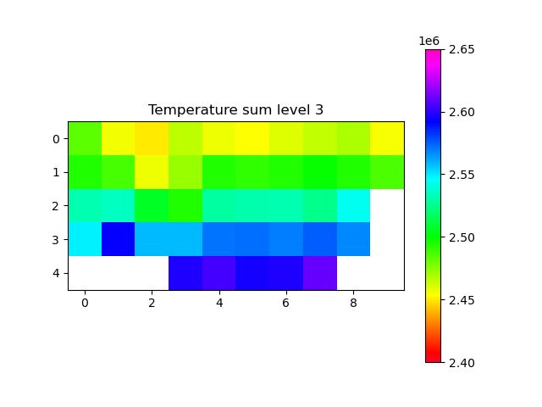
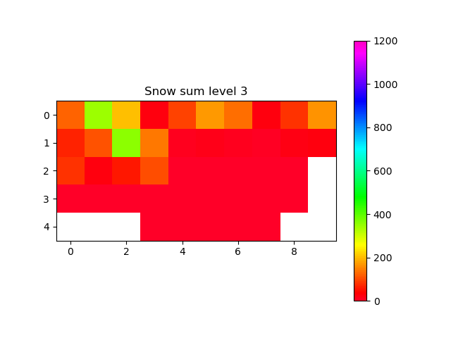
Checking weather aggregation
Wind
Irradiance
Temperature
Snow
Level 1
Level 2
Level 3
Quick check to make sure general trends are correct: summed yearly weather values and compared at all levels to ensure that magnitudes and trends are preserved

Slide 10
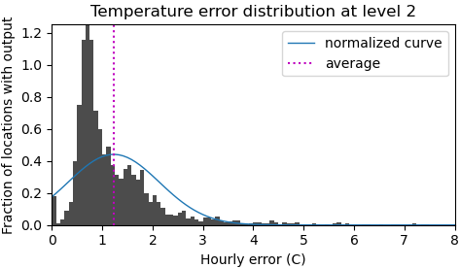
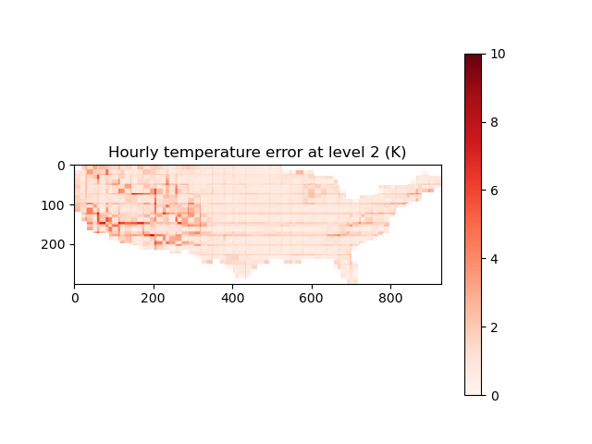
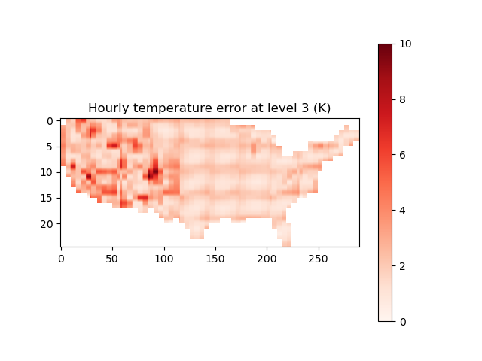
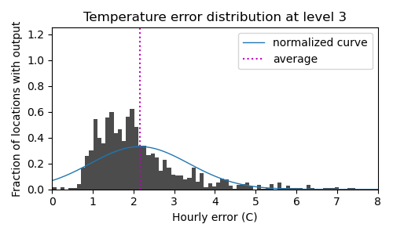
Averaging hourly error in weather aggregation
Compared hourly heatmaps of temperature data at different aggregation levels
Tracked the absolute value of the difference between the two maps at all points
Averaged this difference over all 8760 hours of the year
Converting heatmap results to histogram form
Average hourly error increases in magnitude as aggregation increases

Slide 11
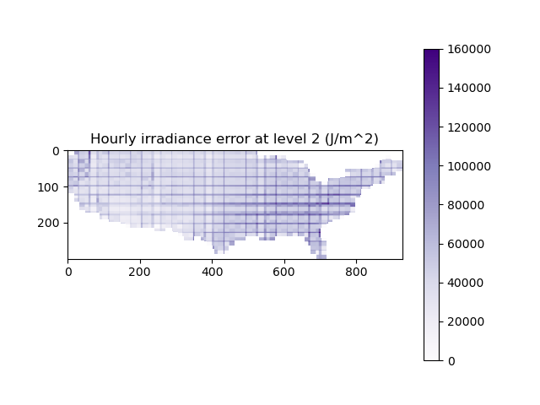
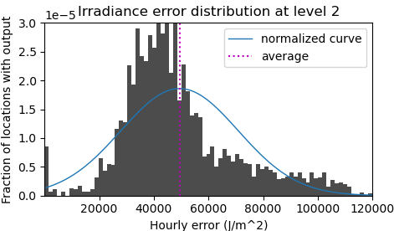
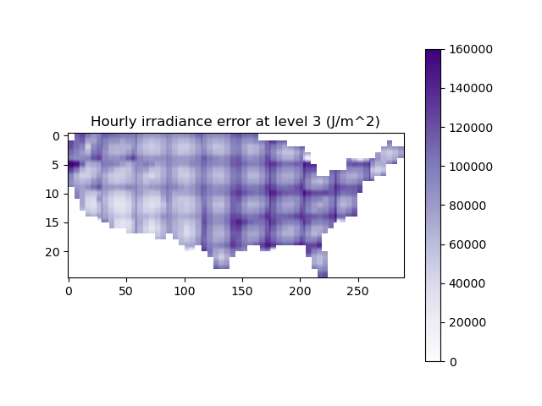
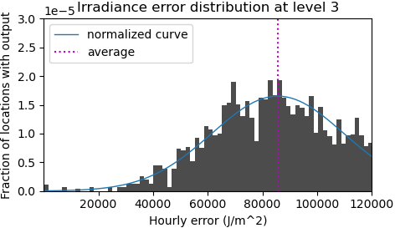
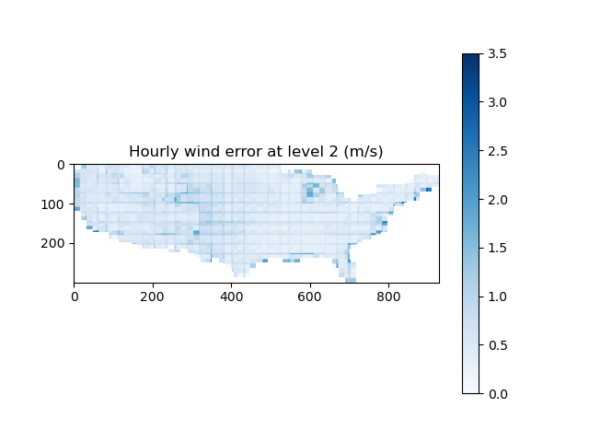
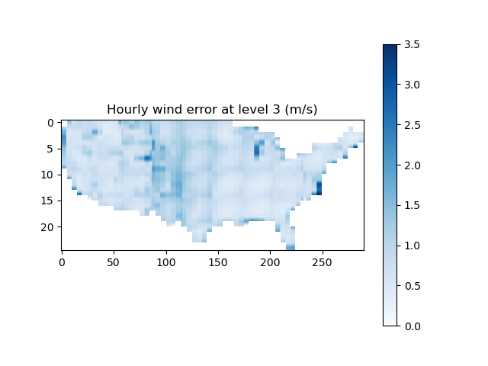
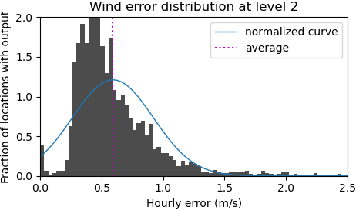
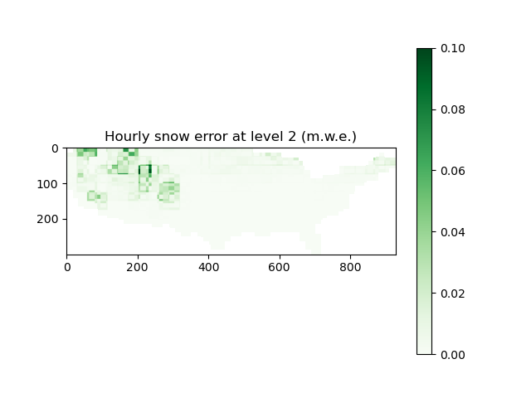
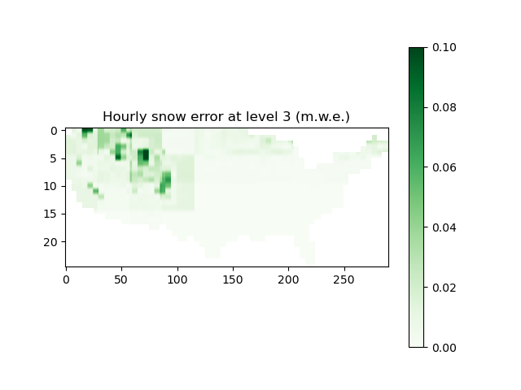
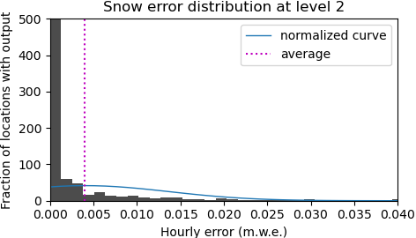
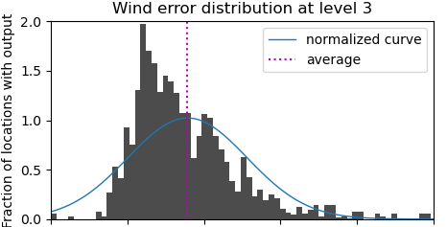
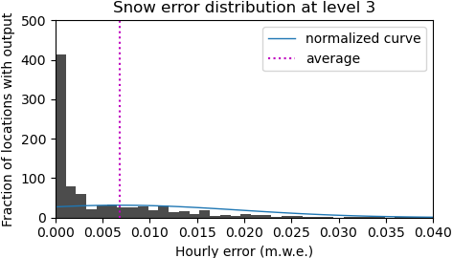
Average hourly error in ALL weather data types
Difficult to compare error of different weather data types because of difference in units
Standard trend of increased average error as aggregation increases

Slide 12
Part 3
Additional considerations within PV calculations
Visualization of aggregation
LCA and TEA results at different aggregation levels
Results with input data at different aggregation levels
Next steps

Slide 13
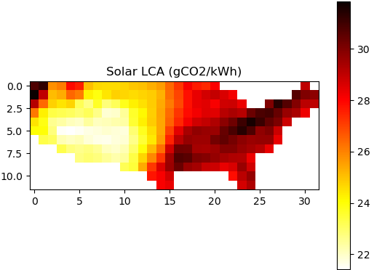
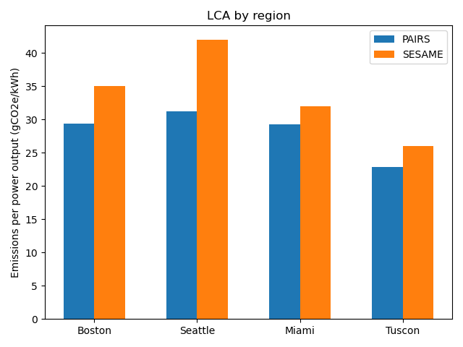
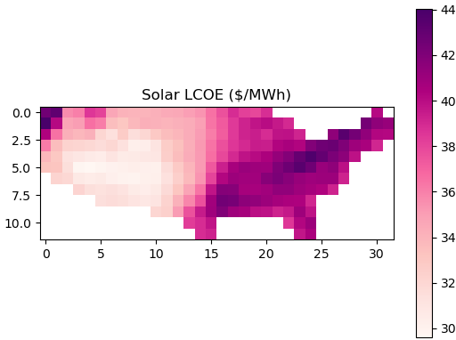
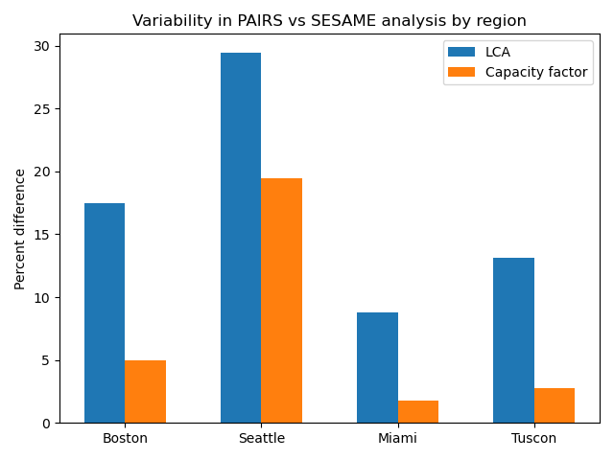
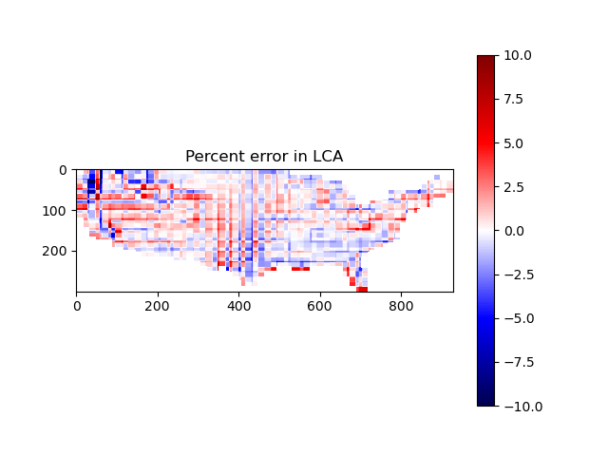

Affect of level 2 aggregation
LCA results
TEA results
Aggregation: (25 x 59) → (12 x 32)
Error calculation
Magnitude of error is ~10% in either direction
LCA and TEA have same error pattern because both calculations are almost linear with respect to power output

Slide 14








Additional aggregation
Level 3 aggregation
Tracking impact of aggregation levels on LCA results
Corresponding error compared to level 1 results
Calculated values
Annual output
Comparing level 2 and level 3 results
Converting to percent error compared to level 1 value
LCA
Magnitude and direction of aggregation results vary from city to city
Level 3 change is usually greater in magnitude than level 2 change
Level 2 and level 3 change are usually in the same direction
TEA

Slide 15
Part 4
Additional considerations within PV calculations
Visualization of aggregation
LCA and TEA results at different aggregation levels
Results with input data at different aggregation levels
Next steps

Slide 16








First “combo” analysis completed
Level 1 data outputs are considered “correct”
Ideally, heatmaps and histograms of aggregated results should look as similar as possible to level 1 figures
Combo analysis should be more accurate than level 3, but lass accurate than level 2
Converting heatmap to histogram
Level 2 irradiance data is used and all other weather inputs are level 3

Slide 17






Quantification of error for different aggregation levels and types
mean = -0.126
std = 1.926
Level 2
mean = 0.673
std = 3.693
Level 3
mean = 0.010
std = 2.030
Level 3 and level 2 I
Error is calculated by comparing output map to output map at highest resolution (level 1)
Combo error distribution looks very similar to level 2 error distribution
Ideally, mean and standard deviation of error distribution would be as small as possible
Level 2 and combo have relatively same size mean and standard deviation of error

Slide 18






Comparing 4 data aggregation combos
Level 2 irradiance and level 3 wind, snow, and temperature
Referencing slide 16, it is clear that irradiance data at higher resolution produces figures that more closely resemble level 2 results
Normalized curve fitted to error distribution is relatively uniform
Level 2 temperature and level 3 wind, irradiance, and snow
Converting heatmap to histogram
Level 2 wind and level 3 snow, irradiance, and temperature
Level 2 snow and level 3 wind, irradiance, and temperature

Slide 19







Comparing 4 combos
Level 2 irradiance and level 3 wind, snow, and temperature
Level 2 temperature and level 3 wind, irradiance, and snow
Level 2 wind and level 3 snow, irradiance, and temperature
It is conclusive that granular irradiance data is significantly more important than granularity of other weather inputs
Level 2 snow and level 3 wind, irradiance, and temperature

Slide 20
Part 5
Additional considerations within PV calculations
Visualization of aggregation
LCA and TEA results at different aggregation levels
Results with input data at different aggregation levels
Next steps

Slide 21
Next steps (in no particular order)
Improve solar calculations
Incorporate snow density data
Improve conversion of normal irradiance to incident irradiance
Improve wind calculations
Repeat analysis with windspeed data 100 meters high – are these values more realistic?
Incorporate spatial roughness variation and new windspeed vectors
Continue aggregation analysis
Introduce new aggregation levels
Continue similar combination exploration
Complete analysis where only irradiance data is used and all other weather values are held constant
Yearly comparison
Complete all analyses for 2021
Identify key similarities and differences

