Slide 1
Ideal Pseudorandom Codes
Omar Alrabiah
UC Berkeley
Prabhanjan Ananth
UCSB
Miranda Christ
Columbia University
Yevgeniy Dodis
NYU
Sam Gunn
UC Berkeley

Slide 2
This talk is about pseudorandom codes [C-Gunn24]
Pseudorandom encryption
Pseudorandom code (PRC)
+
=
Error-correcting code
Notes:
A PRC consists of an encoding algorithm and a decoding algorithm.
A PRC is pseudorandom in that a distinguisher cannot tell whether it is interacting with an encoding oracle on messages of its choice, or the uniform distribution which outputs a fresh random string on each query.
It also satisfies error correction: if x is the output of encode applied to some message, and you add low weight error to x, Decode still recovers the message with overwhelming probability. In this talk, we’ll focus on binary PRCs, because randomness recovery typically works best for binary randomness. You can think of errors as a constant rate of random bit-flips, though in the paper we consider worst-case errors and deletions as well.
In the paper, we also construct public-key PRCs, analogous to public-key encryption.

Slide 3

Motivation: Watermarks for Generative AI
approximate randomness recovery
randomness
=
randomness
pseudorandom codeword:
Enc(1)
content
input/prompt
Notes:
So we propose replacing the randomness with samples from a pseudorandom code instead.
Pseudorandom codes, or PRCs, give you pseudorandomness with a trapdoor detection algorithm that is also robust to errors.
In fact, we will construct PRCs that actually encode messages (with a constant information rate).
This means that we can embed not only watermarks in the generated content, but also arbitrary information like a secret message, a user ID, a timestamp, etc.
And to the best of our knowledge, it wasn’t known how to construct anything like this before our work.

Slide 4
Pseudorandom codes [C-Gunn24]
Pseudorandom encryption
Pseudorandom code (PRC)
+
=
Error-correcting code
Notes:
A PRC consists of an encoding algorithm and a decoding algorithm.
A PRC is pseudorandom in that a distinguisher cannot tell whether it is interacting with an encoding oracle on messages of its choice, or the uniform distribution which outputs a fresh random string on each query.
It also satisfies error correction: if x is the output of encode applied to some message, and you add low weight error to x, Decode still recovers the message with overwhelming probability. In this talk, we’ll focus on binary PRCs, because randomness recovery typically works best for binary randomness. You can think of errors as a constant rate of random bit-flips, though in the paper we consider worst-case errors and deletions as well.
In the paper, we also construct public-key PRCs, analogous to public-key encryption.

Slide 5
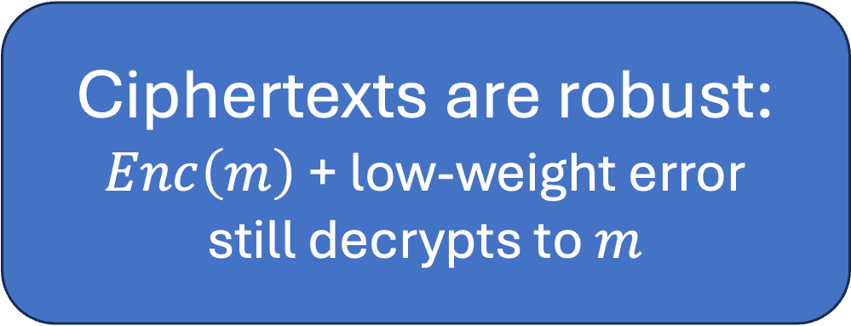
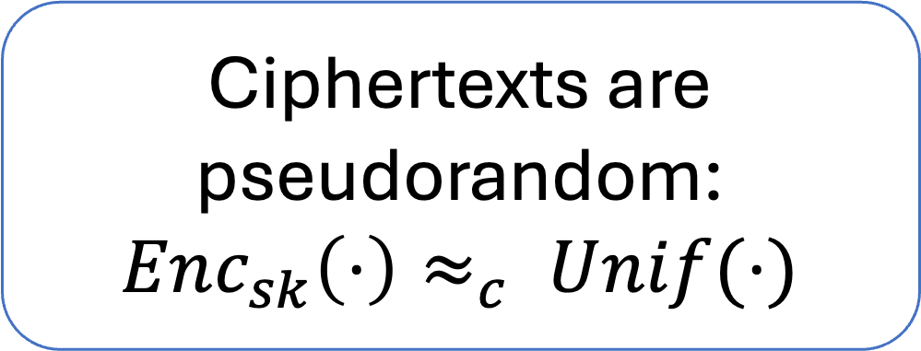
Pseudorandom codes [C-Gunn24]
Ciphertexts are pseudorandom:
$Enc_{sk}\left(⋅\right)≈_{c} Unif(⋅)$
Pseudorandom code (PRC)
+
=
Error-correcting code
Ciphertexts are robust:
$Enc\left(m\right)$ + low-weight error
still decrypts to $m$
Notes:
A PRC consists of an encoding algorithm and a decoding algorithm.
A PRC is pseudorandom in that a distinguisher cannot tell whether it is interacting with an encoding oracle on messages of its choice, or the uniform distribution which outputs a fresh random string on each query.
It also satisfies error correction: if x is the output of encode applied to some message, and you add low weight error to x, Decode still recovers the message with overwhelming probability. In this talk, we’ll focus on binary PRCs, because randomness recovery typically works best for binary randomness. You can think of errors as a constant rate of random bit-flips, though in the paper we consider worst-case errors and deletions as well.
In the paper, we also construct public-key PRCs, analogous to public-key encryption.

Slide 6
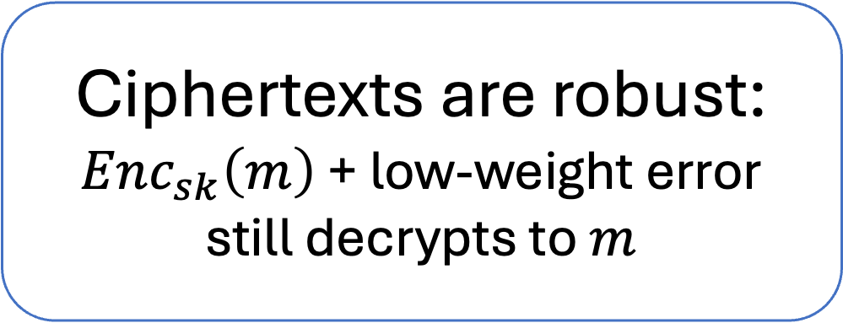
Pseudorandom codes [C-Gunn24]
Ciphertexts are pseudorandom:
$Enc_{sk}\left(⋅\right)≈_{c} Unif(⋅)$
Pseudorandom code (PRC)
+
=
Ciphertexts are robust:
$Enc_{sk}\left(m\right)$ + low-weight error
still decrypts to $m$
Notes:
A PRC consists of an encoding algorithm and a decoding algorithm.
A PRC is pseudorandom in that a distinguisher cannot tell whether it is interacting with an encoding oracle on messages of its choice, or the uniform distribution which outputs a fresh random string on each query.
It also satisfies error correction: if x is the output of encode applied to some message, and you add low weight error to x, Decode still recovers the message with overwhelming probability. In this talk, we’ll focus on binary PRCs, because randomness recovery typically works best for binary randomness. You can think of errors as a constant rate of random bit-flips, though in the paper we consider worst-case errors and deletions as well.
In the paper, we also construct public-key PRCs, analogous to public-key encryption.

Slide 7

Pseudorandom codes [C-Gunn24]
$${\left\{0,1\right\}}^{n}$$
Ciphertexts are pseudorandom:
$Enc_{sk}\left(⋅\right)≈_{c} Unif(⋅)$
Ciphertexts are robust:
$Enc_{sk}\left(m\right)$ + low-weight error
still decrypts to $m$
Encryptions of 1
Notes:
A PRC consists of an encoding algorithm and a decoding algorithm.
A PRC is pseudorandom in that a distinguisher cannot tell whether it is interacting with an encoding oracle on messages of its choice, or the uniform distribution which outputs a fresh random string on each query.
It also satisfies error correction: if x is the output of encode applied to some message, and you add low weight error to x, Decode still recovers the message with overwhelming probability. In this talk, we’ll focus on binary PRCs, because randomness recovery typically works best for binary randomness. You can think of errors as a constant rate of random bit-flips, though in the paper we consider worst-case errors and deletions as well.
In the paper, we also construct public-key PRCs, analogous to public-key encryption.

Slide 8
Pseudorandom codes [C-Gunn24]
Ciphertexts are pseudorandom:
$Enc_{sk}\left(⋅\right)≈_{c} Unif(⋅)$
Ciphertexts are robust:
$Enc_{sk}\left(m\right)$ + low-weight error
still decrypts to $m$
(nearly) all these strings decrypt to 1
Intuition: hard to remove watermark
Notes:
A PRC consists of an encoding algorithm and a decoding algorithm.
A PRC is pseudorandom in that a distinguisher cannot tell whether it is interacting with an encoding oracle on messages of its choice, or the uniform distribution which outputs a fresh random string on each query.
It also satisfies error correction: if x is the output of encode applied to some message, and you add low weight error to x, Decode still recovers the message with overwhelming probability. In this talk, we’ll focus on binary PRCs, because randomness recovery typically works best for binary randomness. You can think of errors as a constant rate of random bit-flips, though in the paper we consider worst-case errors and deletions as well.
In the paper, we also construct public-key PRCs, analogous to public-key encryption.

Slide 9


How hard is it to remove a watermark?
Previous works:
Density of red dots is negligible
[CG24], [GM24], [GG24]
$$=Enc_{sk}(1)$$
What we really want:
Red dots are hard to find
$$Dec_{sk}\left( \right)=0$$
Notes:
A PRC consists of an encoding algorithm and a decoding algorithm.
A PRC is pseudorandom in that a distinguisher cannot tell whether it is interacting with an encoding oracle on messages of its choice, or the uniform distribution which outputs a fresh random string on each query.
It also satisfies error correction: if x is the output of encode applied to some message, and you add low weight error to x, Decode still recovers the message with overwhelming probability. In this talk, we’ll focus on binary PRCs, because randomness recovery typically works best for binary randomness. You can think of errors as a constant rate of random bit-flips, though in the paper we consider worst-case errors and deletions as well.
In the paper, we also construct public-key PRCs, analogous to public-key encryption.

Slide 10

How hard is it to remove a watermark?
What we really want:
Red dots are hard to find
$$=Enc_{sk}(1)$$
Problem: encoding + decoding oracles may leak info about red dots
Ideal PRC (this work): encoding and decoding oracles “look like” a world with no red dots
$$Dec_{sk}\left( \right)=0$$
Notes:
A PRC consists of an encoding algorithm and a decoding algorithm.
A PRC is pseudorandom in that a distinguisher cannot tell whether it is interacting with an encoding oracle on messages of its choice, or the uniform distribution which outputs a fresh random string on each query.
It also satisfies error correction: if x is the output of encode applied to some message, and you add low weight error to x, Decode still recovers the message with overwhelming probability. In this talk, we’ll focus on binary PRCs, because randomness recovery typically works best for binary randomness. You can think of errors as a constant rate of random bit-flips, though in the paper we consider worst-case errors and deletions as well.
In the paper, we also construct public-key PRCs, analogous to public-key encryption.

Slide 11


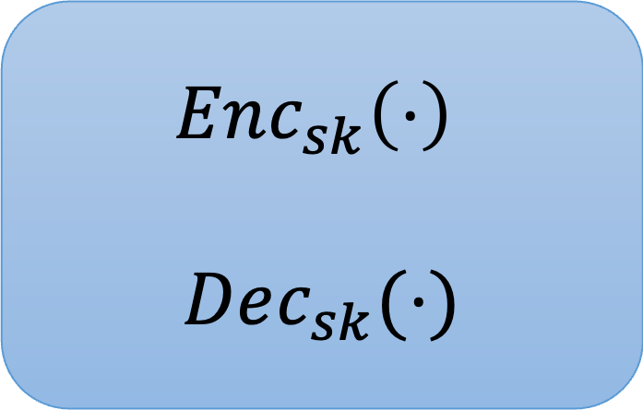
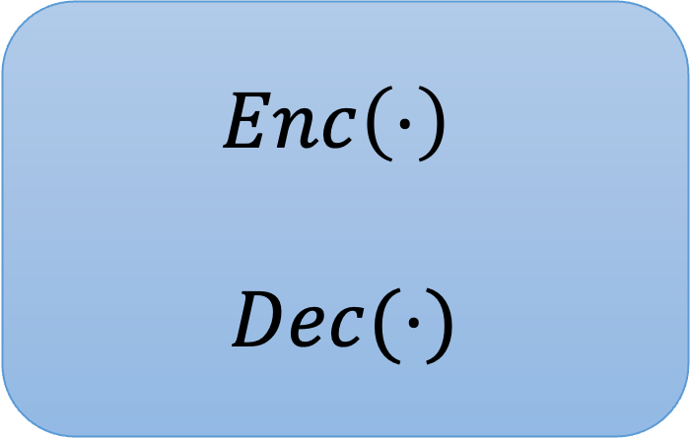

Ideal PRC (this work)
$$Enc_{sk}\left(⋅\right)$$
$$Dec_{sk}(⋅)$$
$$Enc\left(⋅\right)$$
$$Dec(⋅)$$
$$≈$$
A PRC is ideal if it is computationally indistinguishable from the ideal functionality.
Notes:
If time: add mini pictures of red dot/no red dot worlds next to oracles, copies of adv next to each

Slide 12
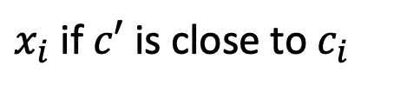
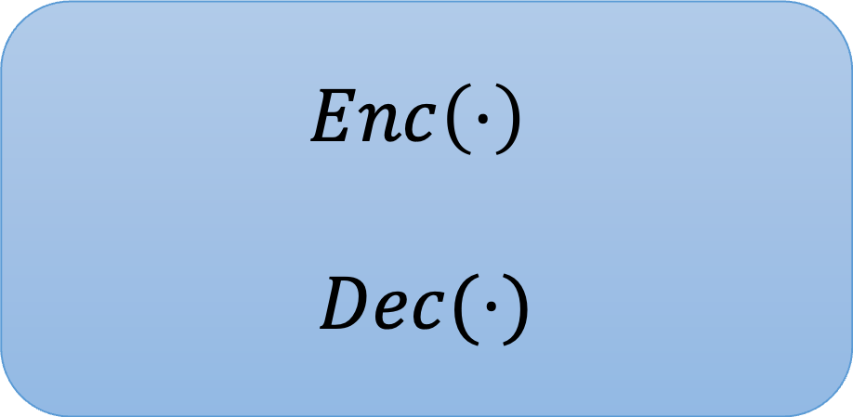
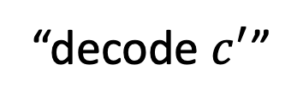
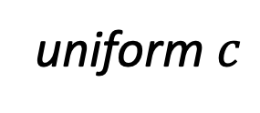
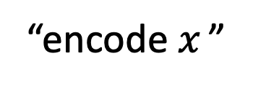
Ideal PRC functionality (this work)
“encode $x_{ }$”
$$Enc\left(⋅\right)$$
$$Dec(⋅)$$
uniform $c$
“decode $c^{′}$”
$x_{i}$ if $c′$ is close to $c_{i}$
Both robust and pseudorandom,
even in the presence of encoding and decoding oracles
Notes:
When I say model, I mean this whole black box that outputs a response

Slide 13
This Work
  Main Theorem: Ideal PRCs exist assuming subexponential LPN.
  Step 1: PRC construction of [CG24] is “encoder-only” ideal
  (hard to find red dots with an encoding oracle)
  Step 2: Generic compiler from encoder-only ideal to ideal
Notes:
Change green

Slide 14
This talk
  Step 1: PRC construction of [CG24] is “encoder-only” ideal
  (hard to find red dots with an encoding oracle)
Up next:
Recap [CG24] PRC construction
Sketch “encoder-only” idealness
Notes:
Change green

Slide 15
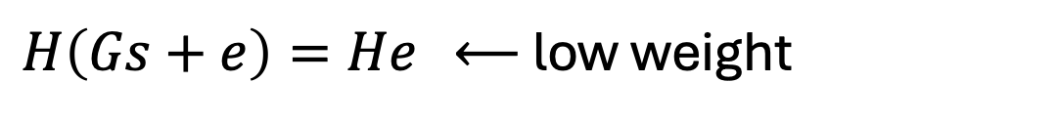
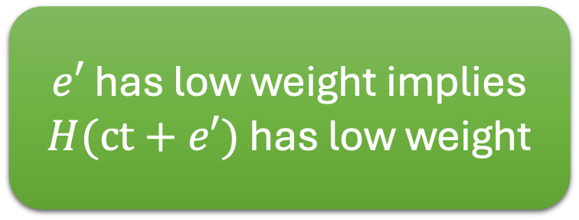
[CG24] PRC scheme
Encode:
G
s
e
u
+
Public key: random 0/1 matrix
Encoding of 1
Encoding of 0
H
G
= all 0
Decode: multiply by H.
high weight ⟶ decrypt as 0
low weight ⟶ decrypt as 1
Secret key:
low-weight parity check matrix
$e′$ has low weight implies $H(ct+e′)$ has low weight
$H\left(Gs+e\right)=He$ ⟵ low weight
[CG24]: can instantiate with extremely low-weight H
yields robustness to a constant error rate
Notes:
Change logn-row-sparse to be clearer
Add dimensions alongside matrices ; avoid field notation
Delete text; animate matrices

Slide 16
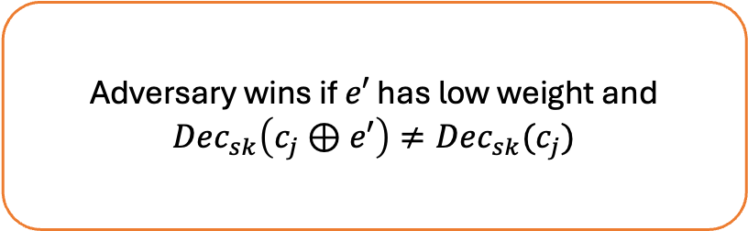
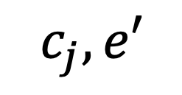



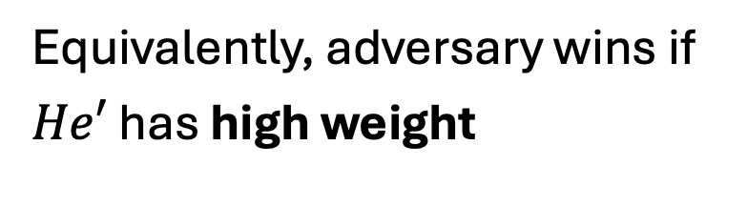
This work: [CG24] PRC is encoder-only ideal
$$m_{i}$$
$$Enc_{sk}\left(⋅\right)$$
Phase 1: query
$$c_{i}$$
$$c_{j}, e′$$
Phase 2: output
Adversary wins if $e′$ has low weight and
$$Dec_{sk}\left(c_{j}⊕e′\right)≠Dec_{sk}(c_{j})$$
Phase 3:
test
Equivalently, adversary wins if
$He′$ has high weight

Slide 17
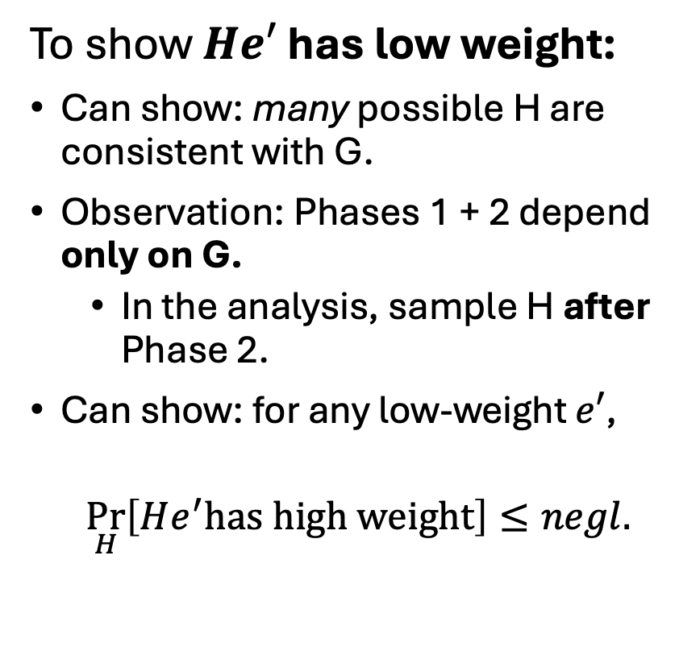
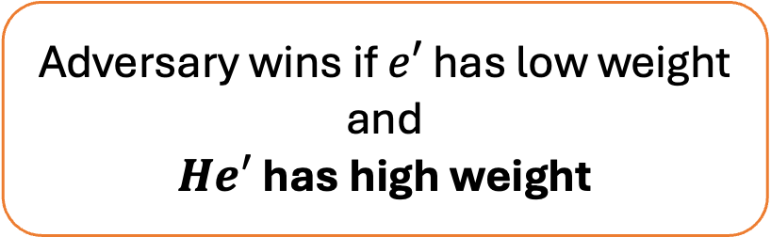
This work: [CG24] PRC is encoder-only ideal
To show $He′$ has low weight:
Can show: many possible H are consistent with G.
Observation: Phases 1 + 2 depend only on G.
  In the analysis, sample H after Phase 2.
Can show: for any low-weight $e′$,
$$\underset{H}{Pr}\left[He^{′}has high weight\right]≤negl.$$
$$m_{i}$$
$$Enc_{sk}\left(⋅\right)$$
Phase 1: query
$$c_{i}$$
$$c_{j}, e′$$
Phase 2: output
Adversary wins if $e′$ has low weight and
$He′$ has high weight
Phase 3:
test
Random H consistent with G

Slide 18
Summary
  Main Theorem: Ideal PRCs exist assuming subexponential LPN.
What we saw
  Step 1: PRC construction of [CG24] is “encoder-only” ideal
  (hard to find red dots with an encoding oracle)
See paper
  Step 2: Generic compiler from encoder-only ideal to ideal
Note: in the paper, “encoder-only ideal” = “adaptively robust”
Notes:
Change green

Slide 19
Takeaway for Watermarks
Ideal PRC-based watermarks are hard to remove*
even with generator (eg, ChatGPT) and detector access
*Without significantly changing the content
Notes:
So we propose replacing the randomness with samples from a pseudorandom code instead.
Pseudorandom codes, or PRCs, give you pseudorandomness with a trapdoor detection algorithm that is also robust to errors.
In fact, we will construct PRCs that actually encode messages (with a constant information rate).
This means that we can embed not only watermarks in the generated content, but also arbitrary information like a secret message, a user ID, a timestamp, etc.
And to the best of our knowledge, it wasn’t known how to construct anything like this before our work.

Slide 20
Open Questions
PRCs without quasipolynomial-time distinguishing attacks?
PRCs with robustness to adversaries with a decoding key?

