Slide 1

First Year Students Are Leaving UofL from Some Majors More Than Others
Spencer Goss, Miranda Pachini, Caroline Clark, German Collado
February 4, 2026
Notes:
Student retention is one of the strongest predictors of institutional success … academically, financially, and reputationally. But retention challenges don’t affect all majors equally
Today we will show where UofL is losing the most first-year students, when those losses occur, and where targeted intervention would have the greatest impact

Slide 2
Overview
Purpose
Analyze first-year student retention across majors
Identify patterns related to persistence and attrition
Data
- 90 cohort–major observations (2016–2024)
-10 entry majors, 8 variables

Slide 3

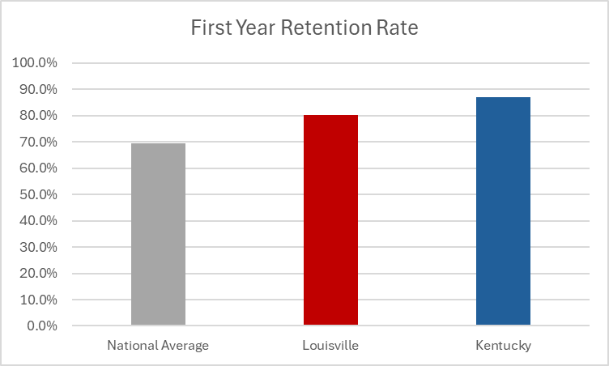
Did you know...
University of Louisville's first to second year retention rate is about 80% ?
This falls above the national average of 69.5%
But BELOW University of Kentucky's of 87%!
Notes:
Carolineeeeeee

Slide 4

Reasons why students may leave their first year
Academic Challenges
Homesickness
Burnout from School
Financial stress

Slide 5

Why retention matters?
Compete with other state universities.
Maintain a strong academic reputation.
Low retention rates can cause lost revenue, less funding and lower graduation rates.
Notes:
cc

Slide 6
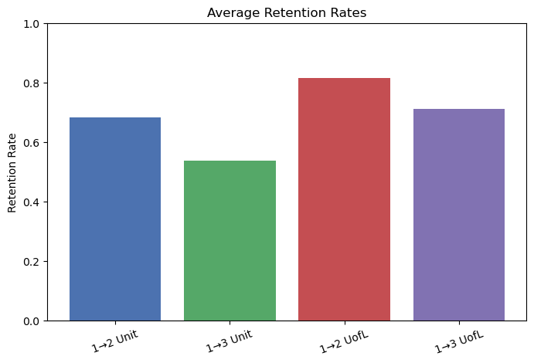
Full retention landscape
UofL retention is higher than unit retention
Largest drop occurs between 1 to 2 and 1 to 3 at the unit level
Many students leave their academic unit but remain enrolled at UofL
These patterns show a direct financial implication for both units and the university
Notes:
mp

Slide 7
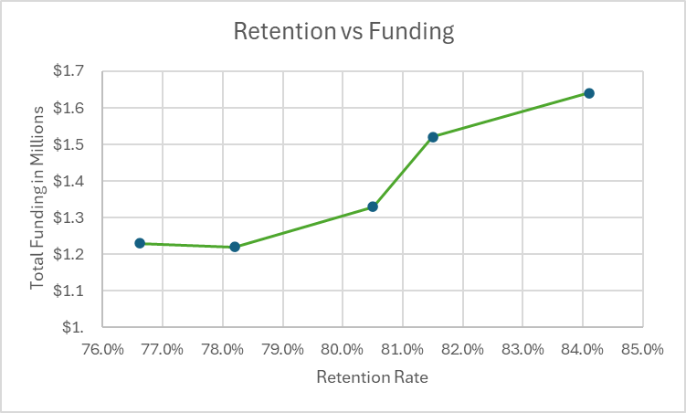
When students stay, money stays
More retention = more money for everyone
Losing students = losing funding fast
Low unit retention drains unit budgets
UofL retention keeps the whole institution afloat
Retention trends shape financial stability
This is exactly why retention work matters
Notes:
cc

Slide 8
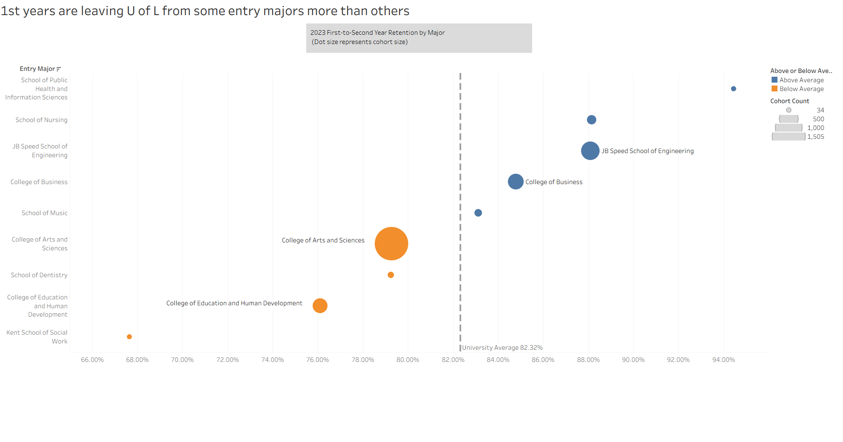
Notes:
- This chart shows first-to-second year retention by entry major for the 2023 cohort. Each dot represents a major, the position of the dot shows retention rate, and the size of the dot reflects cohort size. The dashed line is the university average retention rate of 82.3%.
- What immediately stands out is that retention is not evenly distributed across entry majors. Some colleges are retaining students well above the university average, while others are losing a disproportionate share of students after just one year
- On the right side, we see colleges like Engineering, Business, Nursing, and Public Health performing at or above the university average. These majors not only retain students better, but they also tend to have clearer degree pathways and stronger early academic alignment
On the left side, colleges such as Arts & Sciences, Education, and Social Work fall noticeably below the university average.
What stands out is the college of Arts and sciences, there is both a large cohort size and a bolow average retention rate. This means that there is a large number of students entering this major but also the students entering this major are much more likely to leave after their first year. Even a modest drop in retention translates into hundreds of students leaving the university over the next years, simply because so many students start there
- So what this chart tells us is where the problem begins:

Slide 9
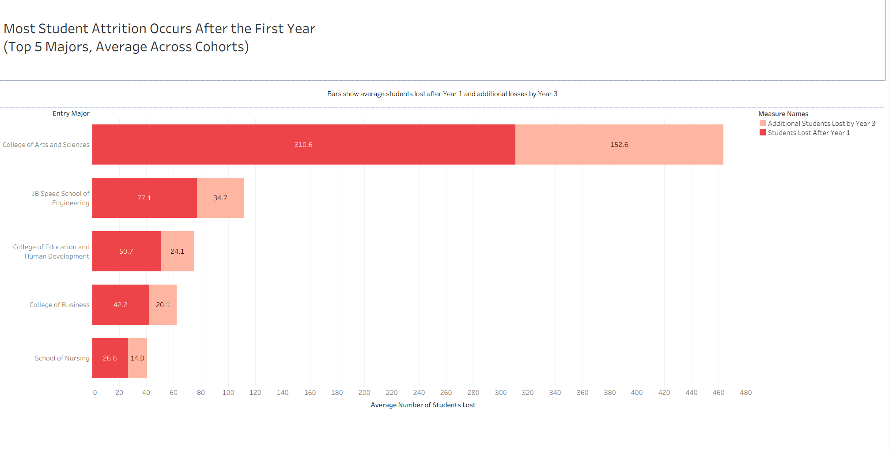
Notes:
This chart builds on the previous one by showing when students are leaving. It displays the top five majors by attrition and separates losses that happen after Year to 2 from additional losses by Year 2 to 3
Across every major shown, the largest loss happens after the first year. In other words, Year 1 is the critical breaking point
Later students that leave still exists, but it’s significantly smaller compared to what happens right after students arrive
Arts & Sciences stands out dramatically. On average, over 300 students are lost after the first year alone, compared to about 150 additional students over the next two years combined
Even in higher-retention colleges like Engineering or Business, we still see that most losses occur after Year 1, just at a smaller scale. This reinforces that the first year is universally important, regardless of major
Students aren’t gradually drifting away they’re making an early decision that the institution, the major, or the support structure isn’t the right fit

Slide 10

Recommendations: support
Provide early academic support during the first year for units with low retention.
Dentistry, Social Work, Education, and Arts & Sciences
Focus resources
Advising
Tutoring
Early-Alert Systems for students in danger of failing
Notes:
The number of students lost is very front heavy so a large portion of student engagement and advising budget should be used within the first year in order to keep these students from leaving the university
CC

Slide 11

Recommendations: large cohorts
Target massive cohorts so small improvements will create large gains
Invest in retention programs
First year seminars:
Improve onboarding
Academic planning
Campus engagement
Peer mentoring
Success Coaching
Notes:
Mp: Can take some funding out of the better retention majors and allocate it to those that are below average retention with large cohorts. Could also help students of these larger cohorts change majors because from a monetary standpoint Kentucky doesn’t care about retention between each unit major but whether they leave the university because they would be missing out on tuition payments

Slide 12



Improving Major switching
Students will leave their major often but stay at UofL
Create smoother cross-unit transfers and improved advising for students interested in changing their majors
Learn from higher retention majors
Business, Music, and Engineering retain students the best
Identify what works for these programs and replicate those practices
Community building
Structured Curriculum
Replicate their advising models
Identify at risk programs and intervene before problems grow
Notes:
Mp:

Slide 13


Summary
Student retention is IMPORTANT!
Putting student's needs first will benefit them AND the University.
While students leave the university/majors for various reasons the university can help by...
Providing early academic support in at risk units.
Helping students in large cohorts feel integrated.
Creating smoother transitions.
Learning from high retention areas.
Notes:
mp

