Slide 1
Bioinformatic Analysis
Renata Miranda and Vinícius Barros

Slide 2
Motivation
Bioinformatic has as main objective to uncover a great amount of data that has been probed through DNA sequences.
As of February 2008 there were 85 759 586 764 bases in 82 853 685 sequences stored in GenBank (Nucleic Acids Research, Database issue) . Now there are 260 806 936 411 bases in 208 831 050.
Sequences of organisms, from viruses to humans and include genes with a diverse arrange of functions. That can be studied from an evolutionary perspective.

Slide 3
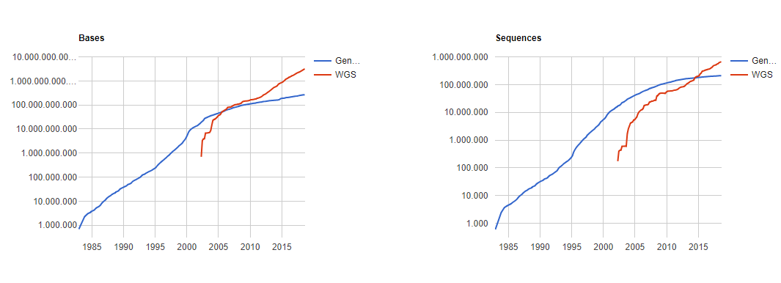
Motivation GenBank and WGS Statistics
Graphics: www.ncbi.nlm.nih.gov/genbank/

Slide 4
Problem Statement
How to describe evolutionary approximations of organisms based on homologous genes[1] ?
Predict which Amino Acids are more likely to be conserved throughout generations.
[1] Two genes are homologous when their DNA sequence derives from a common origin, and may or may not have the same function

Slide 5
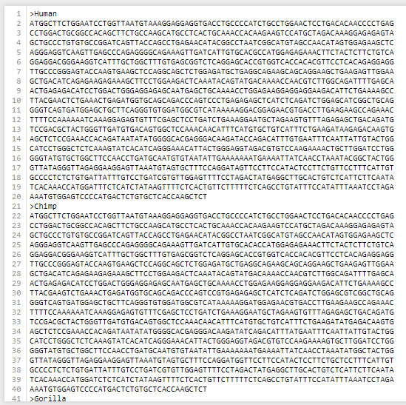
Data Description ftp://ftp.ncbi.nlm.nih.gov/gene/DATA/GENE_INFO/
How large us your data?
2,74 GB
What is it describing?
The TRIM5α gene is a retroviral restriction factor that protects most old world monkey cells against HIV infection.
Where did you get it?
National Center for Biotechnology Information
Image: primatesAA

Slide 6
Methodology
Explore the dataset using the BIO module of python.
Various types of data visualization can be achieved using Matplotlib library in Python.
Use Pandas to collect, clean and transform raw data to prepare for data analysis.
Filter raw data by using tools like NCS and HyPhy.

Slide 7
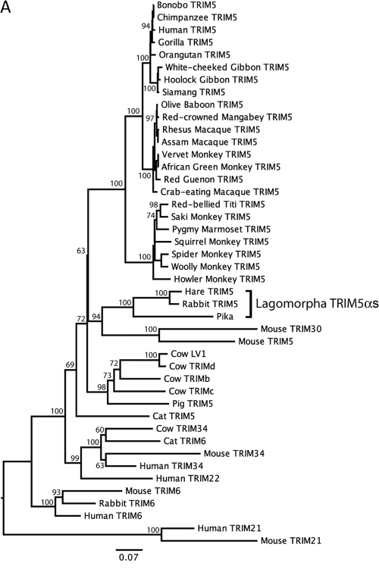
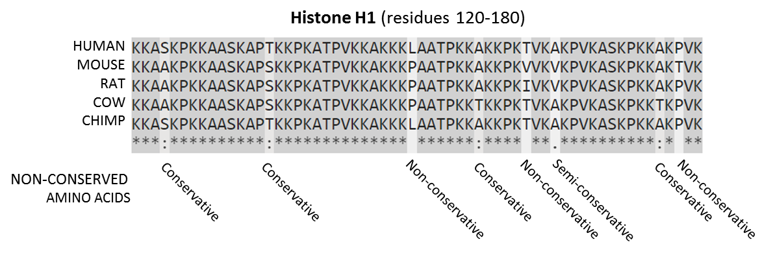
Expected Results: Data Visualization
Describe evolutionary approximations of organisms, creating a phylogenetic tree.
Find Amino Acids conserved in the evolution process.
Image 2: Phylogenetic tree
Image 3: Comparing AA conserved

Slide 8
Expected Results: Predictive Analytics
Construct a phylogenetic tree from homologous genes and update the tree with new data.
Predict amino acid which have higher chances of being conserved across generations.

Slide 9
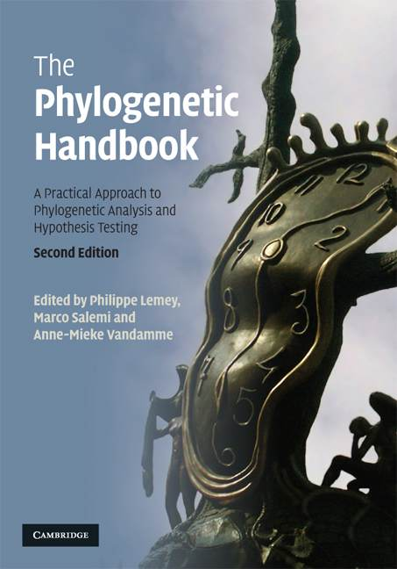
References
The Phylogenetic Handbook: A Practical Approach to Phylogenetic Analysis and Hypothesis Testing.

