Slide 1
Bioinformatic Analysis Partial Project
Renata Miranda and Vinícius Barros

Slide 2
Recaptulation
Bioinformatic has as main objective to uncover a great amount of data that has been probed through DNA sequences.
Objective: To analyze homologous sequences of genes and construct a phylogenetic tree using the TRIM5alpha protein encoded by the TRIM5 gene from 17 different species.

Slide 3
Introduction TRIM5alpha
Tripartite motif-containing protein 5 is a protein that in humans is encoded by the TRIM5 gene. TRIM5α is a retrovirus restriction factor, which mediates species-specific, early block to retrovirus infection.
Old World monkeys cannot be infected with HIV-1, the virus that causes AIDS in humans.
The human version of TRIM5α does not target HIV-1, but can inhibit strains of the murine leukemia virus (MLV)as well as equine infectious anemia virus (EIAV).
Notes:
TRIM5 present in the cytoplasm recognizes motifs within the capsid proteins and interferes with the uncoating process, therefore preventing successful reverse transcription and transport to the nucleus of the viral genome.

Slide 4
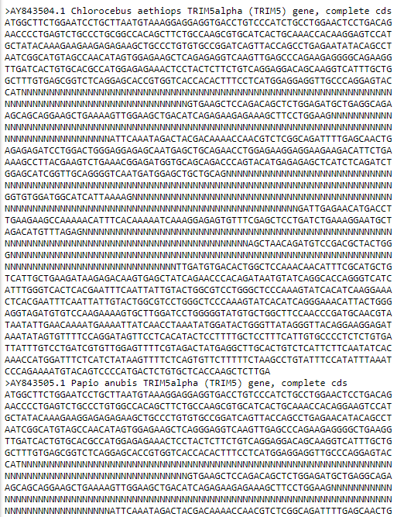
Data
What is it describing?
Image: TRIM5alpha_complet_PopSet

Slide 5
Data
[TRIM5alpha (TRIM5) gene, complete cds']
Chlorocebus
Papio anubis
Pan troglodytes
Colobus guereza
Pygathrix nemaeus
Symphalangus syndactylus
Gorilla gorilla
Alouatta sara
Callithrix pygmaea
Pongo pygmaeus
Erythrocebus patas
Pithecia pithecia
Ateles geoffroyi
Saimiri sciureus
Saguinus labiatus
Callicebus donacophilus
Lagothrix lagotricha
Image: TRIM5alpha_complet_PopSet

Slide 6
Fasta format
Clustal is a series of widely used computer programs used in Bioinformatics for multiple sequence alignment.
ClustalW uses progressive alignment methods, which align the most similar sequences first and work their way down to the least similar sequences until a global alignment is created.
Time complexity of O(N²) because of its use of the neighbor-joing method.
[1] Two genes are homologous when their DNA sequence derives from a common origin, and may or may not have the same function

Slide 7
ClustalW
Clustal is a series of widely used computer programs used in Bioinformatics for multiple sequence alignment.
ClustalW uses progressive alignment methods, which align the most similar sequences first and work their way down to the least similar sequences until a global alignment is created.
Time complexity of O(N²) because of its use of the neighbor-joing method.
[1] Two genes are homologous when their DNA sequence derives from a common origin, and may or may not have the same function

Slide 8
Methodology
Explore the dataset using the BIO module of python.
Various types of data visualization can be achieved using Matplotlib library in Python.
Use Pandas to collect, clean and transform raw data to prepare for data analysis.
Filter raw data by using tools like NCS and HyPhy.

Slide 9
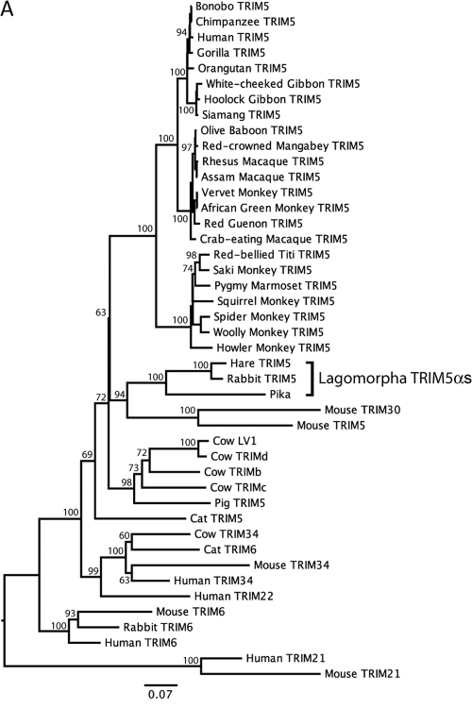
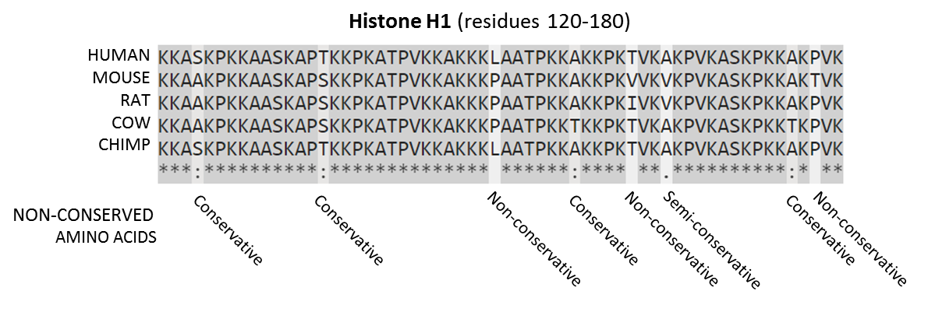
First plots
Describe evolutionary approximations of organisms, creating a phylogenetic tree.
Find Amino Acids conserved in the evolution process.
Image 2: Phylogenetic tree
Image 3: Comparing AA conserved

Slide 10
Expected Results: Predictive Analytics
Construct a phylogenetic tree from homologous genes and update the tree with new data.
Predict amino acid which have higher chances of being conserved across generations.

Slide 11
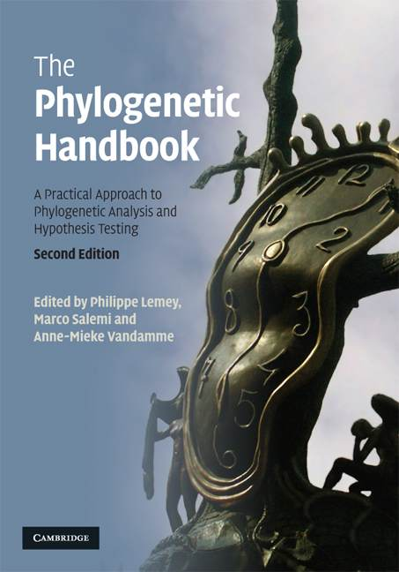
References
The Phylogenetic Handbook: A Practical Approach to Phylogenetic Analysis and Hypothesis Testing.

