Slide 1
Bioinformatic Analysis Midterm Project
Renata Miranda and Vinícius Barros

Slide 2
Recaptulation
Bioinformatic has as main objective to uncover a great amount of data that has been probed through DNA sequences.
Objective: To analyze homologous sequences of genes and construct a phylogenetic tree using the TRIM5alpha protein encoded by the TRIM5 gene from 17 different species.

Slide 3
Introduction TRIM5alpha
Tripartite motif-containing protein 5 is a protein that in humans is encoded by the TRIM5 gene. TRIM5α is a retrovirus restriction factor, which mediates species-specific, early block to retrovirus infection.
Old World monkeys cannot be infected with HIV-1, the virus that causes AIDS in humans.
The human version of TRIM5α does not target HIV-1, but can inhibit strains of the murine leukemia virus (MLV)as well as equine infectious anemia virus (EIAV).
Notes:
TRIM5 present in the cytoplasm recognizes motifs within the capsid proteins and interferes with the uncoating process, therefore preventing successful reverse transcription and transport to the nucleus of the viral genome.

Slide 4
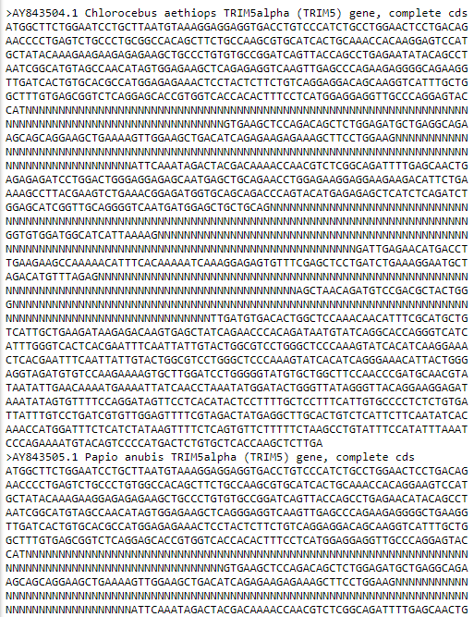
Data
TRIM5alpha (TRIM5) gene, complete from:
Chlorocebus
Papio anubis
Pan troglodytes
Colobus guereza
Pygathrix nemaeus
Symphalangus syndactylus
Gorilla gorilla
Alouatta sara
Callithrix pygmaea
Pongo pygmaeus
Erythrocebus patas
Pithecia pithecia
Ateles geoffroyi
Saimiri sciureus
Saguinus labiatus
Callicebus donacophilus
Lagothrix lagotricha
Image: TRIM5alpha_complet_PopSet

Slide 5
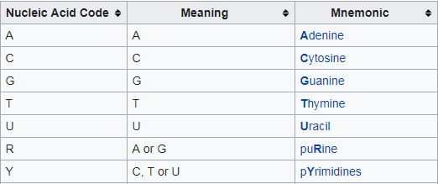
Fasta format
The first line in a FASTA file started either with a ">" (greater-than) symbol or, less frequently, a ";" (semicolon) and was taken as a comment. Subsequent lines starting with a semicolon would be ignored by software.
Sequence represenation:
Table: https://en.wikipedia.org/wiki/FASTA_format

Slide 6
ClustalW
Clustal is a series of widely used computer programs used in Bioinformatics for multiple sequence alignment.
ClustalW uses progressive alignment methods, which align the most similar sequences first and work their way down to the least similar sequences until a global alignment is created.
Time complexity of O(N²) because of its use of the neighbor-joing method.

Slide 7
Biopython
There are lots of algorithms out there for aligning sequences, both pairwise alignments and multiple sequence alignments including ClustalW.
Create Tree objects. The Tree object contains global information about the tree, such as whether it’s rooted or unrooted. It has one root clade, and under that, it’s nested lists of clades all the way down to the tips.

Slide 8
References
The Phylogenetic Handbook: A Practical Approach to Phylogenetic Analysis and Hypothesis Testing.
Positive selection of primate TRIM5α identifies a critical species-specific retroviral restriction domain: Sara L. Sawyer, Lily I. Wu, Michael Emerman, Harmit S. Malik

