Slide 1

CSML1000 Machine Learning in Business Context
Improving Airline Service with Social Media Analytics
Group Members:
Jose German
Araf Mohammed Mir
Luiz Tavares
Abdela Ahmed
Prepared for:
Hashmat Rohian

Slide 2


EXECUTIVE SUMMARY
Today, social media serves as a platform for sharing opinions
Our airline client aims to leverage social media data to enhance the flying experience
A semi-supervised machine learning model to analyze tweets about the airline
Proactively addressing customer feedback

Slide 3


INTRODUCTION
social media platforms as vital sources of real-time feedback for businesses
Recognizing the significance of this trend and aims to leverage it to their advantage
Analyzing Twitter messages related to airline services using a semi-supervised machine learning model

Slide 4
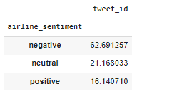
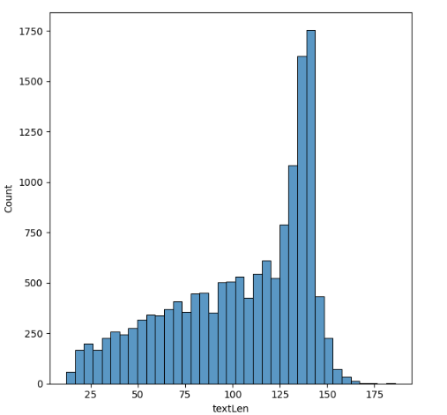
EXPLORATORY DATA ANALYSIS
Data Profile:
Original dataset has 14640 rows and 5 columns.
Calculated Fields:
We have created a field to identify the length of individual Tweets.
Imbalance Data:
63% Tweets ate Negative, 21% are neutral and 16% are positive.
Duplicate Removal: 127 duplicates were removed.
Text Cleaning:
Remove username, http or https:// and any non alphanumeric characters
Transforming the text into lower case
Remove the punctuations
Remove unicodes
Removing the stop words excluding "not"

Slide 5
MODEL DEVELOPMENT
Approach
Traditional method of NLP text classification in Python
Embedding Technique
Bag of Words Term Frequency (BoW-TF)
Sampling Techniques
SMOTE
Hyperparameter Tuning
Grid- Search

Slide 6
MODEL DEVELOPMENT
Classification Algorithms | Evaluation Metrics
 | AUC |  | ACC |  | PREC |  | RECALL
Random Forest | 82.1 | 82.24 | 70.36 | 70.67 | 56.64 | 56.91 | 86.66 | 87.15
Ada Boost | 83.14 | 83.31 | 74.73 | 75.05 | 62.82 | 63.41 | 78.58 | 77.85
Gradient Boost | 82.71 | 83.67 | 74.23 | 75.68 | 62.27 | 64.42 | 77.97 | 77.36
Naive Bayes | 78.71 | 78.84 | 70.99 | 71.27 | 57.83 | 58.13 | 81.4 | 81.4
Logistic Regression | 83.4 | 83.4 | 75.5 | 75.59 | 64.08 | 64.45 | 77.72 | 77.97
SVM | 82.52 | 77.25 | 75.77 | 73.63 | 64.86 | 63.58 | 76.13 | 68.18
KNN | 76.1 | 77.78 | 64.16 | 71.04 | 51.12 | 59.54 | 83.48 | 69.16
Decision Tree | 72.67 | 75.5 | 69.95 | 71.04 | 57.12 | 58.63 | 77.11 | 75.28
LDA | 82.79 | 82.86 | 74.18 | 73.86 | 61.86 | 61.54 | 79.8 | 79.31
LR model outperformed others in terms of AUC and Accuracy metrics

Slide 7
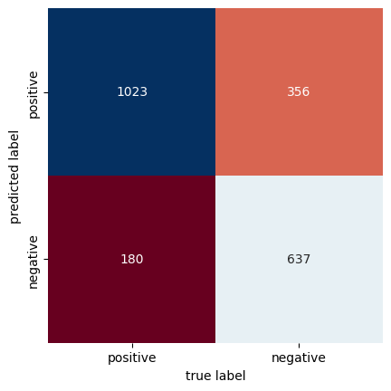
MODEL DEVELOPMENT
Confusion Matrix of the Logistic Regression Model

Slide 8
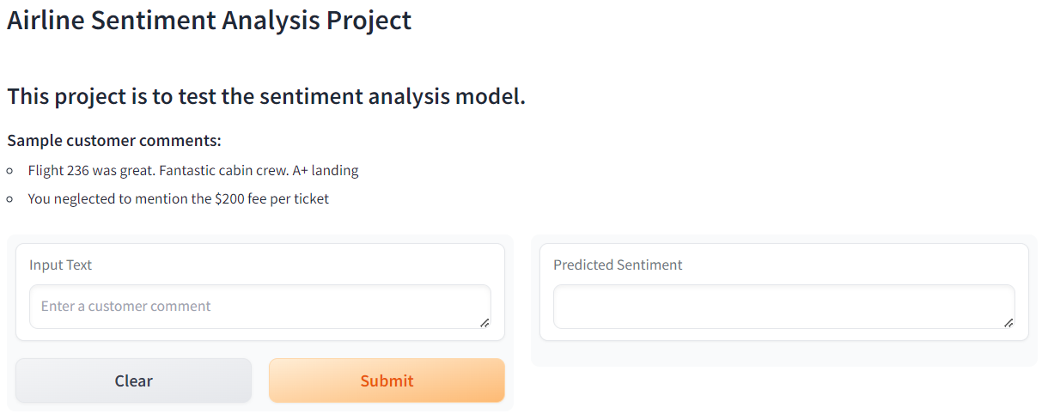
APP DEVELOPMENT
Application development/deployment: https://huggingface.co/
Community based machine learning and data science platform
Facilitates building, training and deploying ML models
Python based Transformers library
Simplifies ML training by utilizing pre-trained based models which can be fine tuned with own data
Hosting
Spaces, datasets, models
Github like file resource management
Demo (Hugging Face)

Slide 9




CONCLUSION
Our proposed solution has immense potential to revolutionize customer satisfaction
Recognizing the significance of this trend and aims to leverage it to their advantage
Laying the foundation for long-term success in the airline industry

