Slide 1
8bit
Cash-discipline
video review
Local AI with timestamps, evidence and rule references
ForteBank Datathon 26
8bit / Datathon 26
01
Notes:
Timing: 20 seconds
We built 8bit to help a reviewer inspect possible cash-discipline violations in video. The reviewer receives the moment, evidence and a regulatory reference in one place. All models execute inside our service. The output supports a human decision.
Sources:
https://github.com/miraskbk/8bit-datathon-2026/blob/main/README.md
ForteBank Datathon 26 brief, sections 1–7

Slide 2
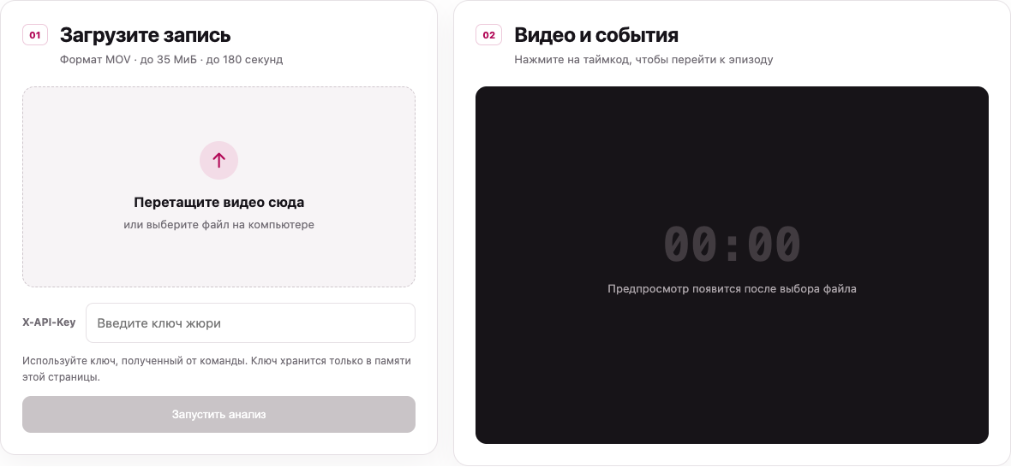
A result the reviewer can inspect
Type and timestamp
1–3 complete JPEGs
Rule and explanation
8bit / Datathon 26
02
Notes:
Timing: 35 seconds
The browser accepts MOV video, starts analysis and polls the same API the jury will use. It shows processing state and the job ID. Each flag includes a type, a timestamp, one to three complete evidence frames, and a rule reference. Clicking the timestamp seeks the preview. The screenshot shows the actual empty interface. It contains no organizer recording. A no-violation result has an empty event list, while a failed analysis has no verdict.
Sources:
https://github.com/miraskbk/8bit-datathon-2026/blob/main/app/static/index.html
https://github.com/miraskbk/8bit-datathon-2026/blob/main/app/static/app.js
Product screenshot captured locally from the release candidate, empty upload state

Slide 3
All inference stays inside the service
01
Detection
RT-DETRv2 and OWLv2 locate people, objects and scene regions
02
Temporal state
Anonymous tracks and DINOv2 classifiers identify candidate moments
03
Local visual questions
Qwen checks selected screen and door states
04
Evidence and rules
Temporal rules select events, timestamps and annotated JPEGs
Weights download during setup. Runtime inference works offline.
8bit / Datathon 26
03
Notes:
Timing: 45 seconds
The API validates and stores a private job, then a supervised process handles inference. RT-DETRv2 and OWLv2 find people, objects and scene regions. DINOv2 features and small state classifiers support safe and cash checks. Local Qwen answers a limited set of screen and door questions. Rules combine these observations over time and select evidence. The tested Mac uses Qwen3-VL-8B in MLX four-bit format. The Linux recipe uses Qwen3-VL-4B with Transformers, so it needs its own benchmark. No video, frame or generated description goes to a cloud AI API.
Sources:
https://github.com/miraskbk/8bit-datathon-2026/blob/main/docs/ARCHITECTURE.md
https://github.com/miraskbk/8bit-datathon-2026/blob/main/tools/download_event_models.py
https://github.com/miraskbk/8bit-datathon-2026/blob/main/README.md#architecture

Slide 4
Visible indicators with qualified explanations
Visible indicator | What still needs human review | Kazakhstan source
Additional person in cash zone | Their role and access permission | Rules № 14, points 8/16
Short visible bag handoff | Inspection outside the visible interval | Rules № 231, points 24/25
Active screen after departure | A short clip cannot prove a 30-minute timeout breach | Requirements № 53, points 26/71
Every flag links the observation to a source. Indirect links remain explicit.
8bit / Datathon 26
04
Notes:
Timing: 40 seconds
We separate an observation from facts the video cannot establish. A person behind the desk does not prove they lack permission. A short bag handoff does not prove there was no inspection outside the recording. An active screen in a short clip does not prove a breach of a thirty-minute automatic-lock requirement. We return the Kazakhstan source and disclose indirect relationships. The source snapshots and interpretation are documented, but current wording and applicability need review before bank deployment.
Sources:
https://github.com/miraskbk/8bit-datathon-2026/blob/main/docs/npa_registry.md
https://github.com/miraskbk/8bit-datathon-2026/blob/main/docs/npa_workstation_lock.md
https://adilet.zan.kz/rus/docs/V1900019680
https://adilet.zan.kz/rus/docs/V2000020075
https://adilet.zan.kz/rus/docs/V2600038336

Slide 5
80% verdict accuracy on 40 development clips
32 / 40
Correct video verdicts
Positive recall: 14 / 21
Seven positive clips missed
20.88 s median
120.71 s maximum
Source-set regression. Classifiers trained on organizer footage.
These figures do not establish unseen-camera accuracy.
8bit / Datathon 26
05
Notes:
Timing: 50 seconds
All forty unique source videos completed. Thirty-two verdicts were correct: fourteen true positives and eighteen true negatives. We missed seven positives and produced one false alarm. That gives eighty percent video accuracy and sixty-six point seven percent positive recall. Median processing took twenty point eight eight seconds, with a maximum of one hundred twenty point seven one. These are development regression results. The classifiers trained on organizer footage, so we do not present this as unseen-camera accuracy. Timestamp and per-type accuracy still need independent labels. Improving missed events on a new camera is a central next step.
Sources:
https://github.com/miraskbk/8bit-datathon-2026/blob/main/docs/EVALUATION.md

Slide 6
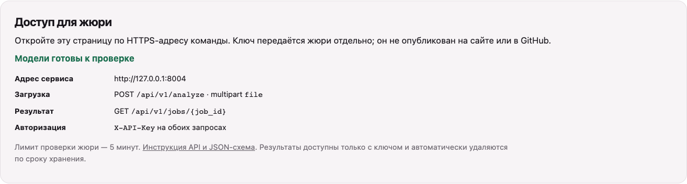
The jury uses the same API as the UI
POST /api/v1/analyze
GET /api/v1/jobs/{job_id}
X-API-Key on both requests. Public HTTPS deployment is pending.
8bit / Datathon 26
06
Notes:
Timing: 40 seconds
The required API is implemented exactly as two steps. The jury uploads a MOV file in the multipart file field, receives a job ID, and polls processing, done or failed. Both endpoints require X-API-Key. The completed response includes the mandatory fields, plus regulatory references and coverage metadata. The guide is served locally without a CDN dependency. We provide a Caddy HTTPS and GPU deployment recipe and a private handoff generator. We have not provisioned a public host yet, so remote jury access is a remaining submission gate.
Sources:
https://github.com/miraskbk/8bit-datathon-2026/blob/main/app/main.py
https://github.com/miraskbk/8bit-datathon-2026/blob/main/app/schemas.py
https://github.com/miraskbk/8bit-datathon-2026/blob/main/docs/DEPLOYMENT.md
Product screenshot captured locally from the release candidate, no key entered

Slide 7
Reliability and private-data handling
27
Bounded work
MOV, size/duration limits and one accepted job at a time
Python checks passed
Failure stays a failure
270-second watchdog, worker reset and restart recovery
Desktop and mobile browser
contract checks passed
Controlled retention
Recordings deleted after processing, evidence expires by TTL
Real local HTTP smoke:
67.47 s positive / 17.22 s negative
Private access
Key before upload parsing, no-store responses and HTTPS recipe
8bit / Datathon 26
07
Notes:
Timing: 35 seconds
We checked twenty-seven Python tests and the desktop and mobile browser flow with synthetic fixtures. A real local positive and negative HTTP smoke test also completed with valid evidence contracts. Those checks establish integration behavior, not independent detection quality. We enforce upload limits, bounded admission and a supervised deadline. Original recordings are deleted after processing, results expire by retention time, and model failures never turn into no-violation results. The deployment adds HTTPS and an isolated inference network. It still needs validation on the real public host.
Sources:
https://github.com/miraskbk/8bit-datathon-2026/blob/main/docs/EVALUATION.md
https://github.com/miraskbk/8bit-datathon-2026/blob/main/tests/test_production_contract.py
https://github.com/miraskbk/8bit-datathon-2026/blob/main/tests/browser.mjs
https://github.com/miraskbk/8bit-datathon-2026/blob/main/docs/DEPLOYMENT.md

Slide 8
Public pilot and acceptance plan
The next pilot needs an independent camera view
Measure missed events, false alarms, timestamp error and relevant evidence on new clips.
Before judging: public GPU host, HTTPS URL and private key handoff.
Pilot acceptance includes independent labels and regulatory review.
github.com/miraskbk/8bit-datathon-2026
8bit / Datathon 26
08
Notes:
Timing: 35 seconds
The next step is a controlled pilot using permitted clips from an independent camera view. We want to measure recall, false alarms, timestamp error and whether the evidence actually supports the observation. Before judging, we must provision the public GPU service and privately hand over the URL and key. Pilot acceptance also requires independently reviewed event labels and regulatory interpretation. We can demonstrate the local product today, with those limits stated clearly.
Sources:
https://github.com/miraskbk/8bit-datathon-2026/blob/main/docs/JURY_REQUIREMENTS.md
ForteBank Datathon 26 brief, section 8 and FAQ 23

Slide 9
Appendix: event coverage and sources
Code | Visible indicator | Primary source mapping
A | Valuable-like objects after departure | № 231, points 20/22
B | Open safe after departure | № 231, points 20/80
C | Cash-like objects when another visitor appears | № 231, point 20
E | Additional person in cash zone | № 14, points 8/16
F | Short visible bag handoff | № 231, points 24/25
G | Personal items / drink interaction | № 231, point 12
H | Open door after entry | № 14, points 8/16
L | Active screen after departure | № 53, points 26/71
Ownership, permission, off-camera inspection and completed transactions remain unverified.
8bit / Datathon 26
09
Notes:
Use this slide for questions about event coverage. Every category describes a visible indicator. Some regulatory relationships are indirect and require context. G drinking and L screen-state matches are particularly indirect. The production pipeline does not verify accounting correctness, document return or banknote authenticity. The type names use cautious wording to avoid treating hidden facts as established.
Sources:
https://github.com/miraskbk/8bit-datathon-2026/blob/main/README.md
https://github.com/miraskbk/8bit-datathon-2026/blob/main/app/visioncore_adapter.py
https://github.com/miraskbk/8bit-datathon-2026/blob/main/docs/npa_registry.md

Slide 10
Appendix: likely jury questions
How accurate is it on a new camera?
Not established yet. Current recall is 14/21 on the development source set.
How are uncertain observations handled?
Coverage warnings identify unreadable regions. A reviewer checks each possible violation.
Does it send video to cloud AI?
No. Models load local weights. Inference and intermediate descriptions stay inside the service.
Is it ready for remote judging?
The API is implemented. A public GPU host, HTTPS checks and a private jury handoff are still required.
8bit / Datathon 26
10
Notes:
Keep answers concrete. The twenty-seven tests check software contracts and boundaries, not unseen accuracy. The source-set study includes seven missed positives, so no claim of negligible misses is supported. Public deployment, CUDA timings and independent camera-angle validation are pending. A bank production deployment requires its own governance, security and independent acceptance process.
Sources:
https://github.com/miraskbk/8bit-datathon-2026/blob/main/docs/JURY_REQUIREMENTS.md
https://github.com/miraskbk/8bit-datathon-2026/blob/main/docs/EVALUATION.md

