Slide 1
Deal or No Deal: Zillow Price Cut Prediction
Molleigh Hughes
Miranda Smith
Hidy Vengalil
Tasha Christensen
Stephanie Santiago-Marti

Slide 2
Many factors influence the home buying process
Supply and Demand
Interest Rates
Balancing home availability and buyer interest shapes pricing and competition.
Fluctuating rates impact borrowing costs, affecting affordability and housing demand.
Local Factors
Seasonality
Regional economic drivers, zoning regulations, and development trends shape neighborhood dynamics.
Demand fluctuates with weather and holidays, affecting buying and selling patterns.

Slide 3
Can we train a model to predict how much of a price cut (%) a listed house in Detroit will receive based on how long it’s been on the market?

Slide 4

Data Points
Days to Pending
Price Cuts
Time
How long it takes homes in Detroit to change to pending status on Zillow.com after first being shown as for sale. The reported figure indicates the mean number of days that it took for homes that went pending during the week being reported, to go pending.
The mean price cut for listings in Detroit during a given time period, expressed as a percentage (%) of list price.
The data was collected weekly across 315 weeks, allowing us to measure data across season and time.

Slide 5
How We “Housed” Our Data
Spark Attempt
After attempting to store our data in Spark, we faced numerous issues. Considering our moderate dataset size and after consulting with our instructor, we opted to host the data on GitHub for better accessibility and management.
We combined some tables downloaded from Zillow based on common collection dates.
Data Cleaning
The data we got from Zillow was already categorized as “smoothed”, meaning noise was already somewhat removed. We had to drop 2 weeks due to mean price reduction percentage being listed as “null”. We scaled the data in an effort to normalize and standardize.

Slide 6
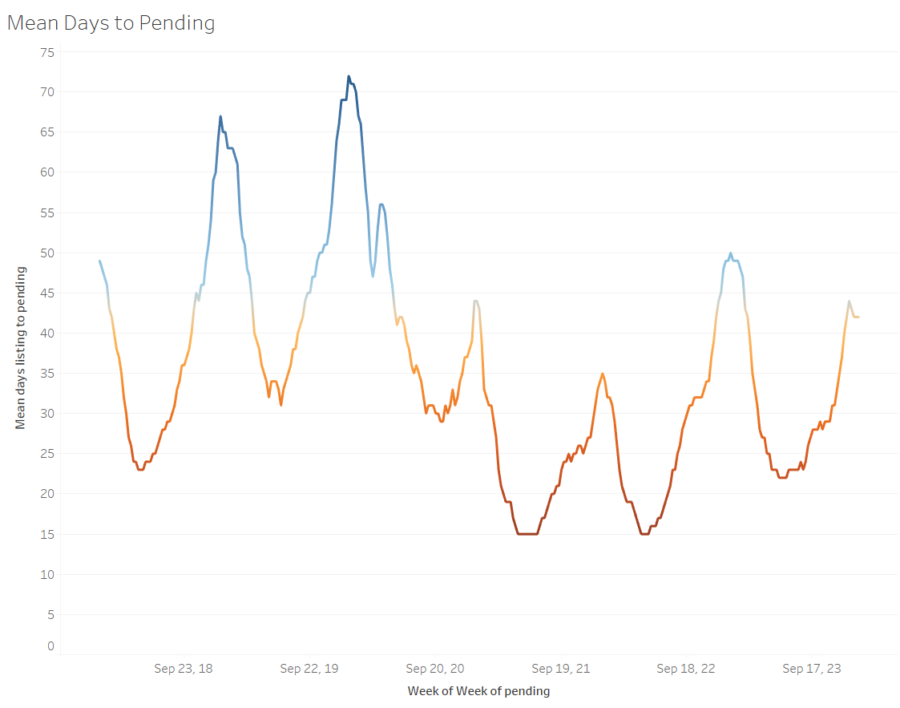

Tableau Data Exploration
In an effort to further explore our data, we examined our variables through Tableau charts. When comparing the week that each home became pending with the mean days till the house was pending, a clear seasonal trend emerged. Houses don’t last long on the market around May-June, while they are more stagnant around December-January.
Post-shutdown drop

Slide 7
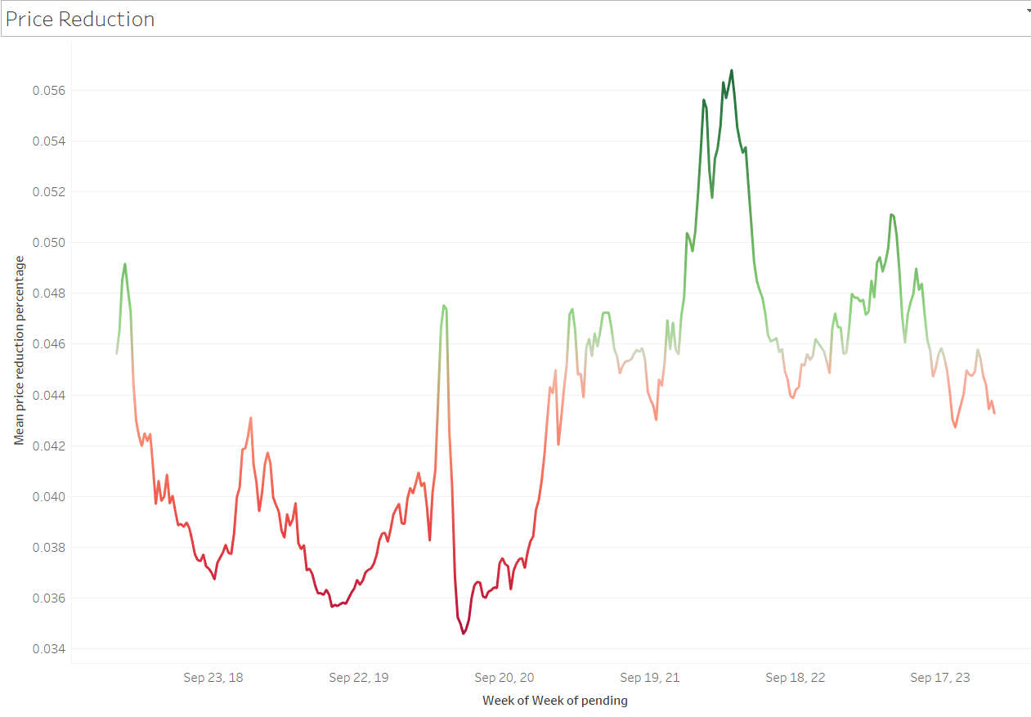

Tableau Continued
Next, we compared the week of pending with the mean price reduction percentage. Higher percentage cuts occurred post-shut down, peaking at 0.56% in the Spring of 2022, while price cuts remained minimal during the shut down.

Slide 8
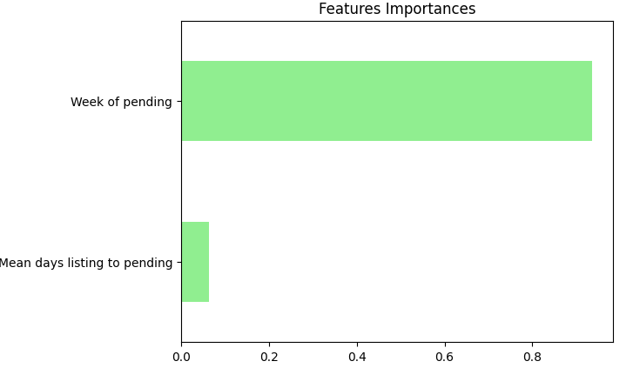
Random Forest Regressor
The Random Forest Regression model compares many different features and determines the best prediction based on which outcome was predicted the most.
Model score = 0.9995553744147414
R² = 0.9995553744147414
MSE = 1.3095197551880405e-08
RMSE = 0.00011443424990744863
STD = 0.005426987263266367
Error = 5.7804842222217705e-05

Slide 9
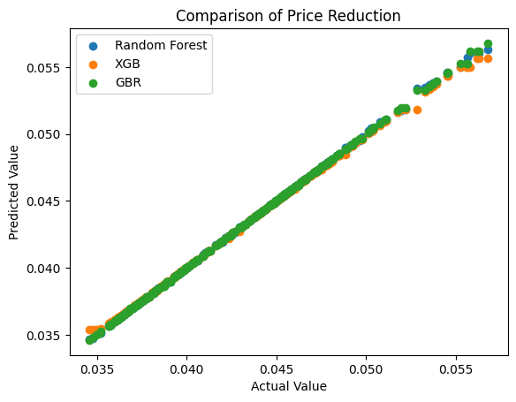
Gradient Boosting Regressor
The Gradient Boosting Regression model is similar to the Random Forest regression model, except instead of tree models learning in tandem, tree models learn sequentially, learning from the previous model and improving with each iteration.
Model score = 0.9995463581799123
R² = 0.9995463581799123
MSE = 1.3360745419963808e-08
RMSE = 0.00011558869070961833
STD = 0.005426987263266367
Error = 6.293934425514186e-05

Slide 10
Extreme Gradient Boosting (XGBoost) Regressor
The Extreme Gradient Boosting Regression model is a more complex & optimized version of Gradient Boosting Regressor, which utilizes (but not limited to): parallelization, tree pruning, cache awareness, and feature importances.
Model score = 0.998024236380367
R² = 0.998024236380367
MSE = 5.8190567013516395e-08
RMSE = 0.00024122721035056636
STD = 0.005426987263266367
Error = 0.00013350071454126876

Slide 11
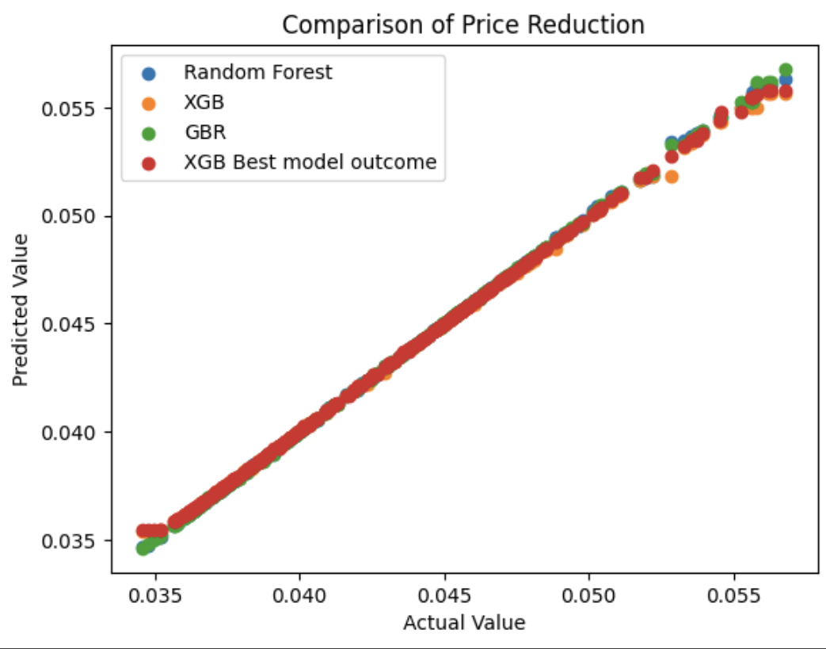
XGBoost with GridSearchCV:
Optimize our ExtremeGradientBoosting
GridSearchCV: exhaustively searches all possible combos of hyperparameters in grid
Trains and evaluates models for each combo using cross-validation
Selects combo that produces best performance metric.
Hyperparameters
Parameters set before learning process and based on domain knowledge or “trial & error”
Significantly affect performance & behavior of model
“Negative mean absolute error” is set for parameter called `scoring`
GridSearch
Method used to search for optimal combo of hyperparameters, and for each combo in grid, the model is trained & evaluated using cross-validation
Cross-Validation
Technique assess performance of model by splitting data into multiple subsets, train the model on subset data, and evaluating it on remaining subset. Process repeated multiple times w/ different subsets each time to ensure robustness of results

Slide 12
Citations
d
Detroit Housing Data | Housing Data. Zillow. (2024, February 1). https://www.zillow.com/research/data/
XGBoost Structure | tatha04. (2021, May 6). GitHub. https://github.com/tatha04/Housing-Prices-Advanced-Regression-Techniques/blob/main/Housing.ipynb

