Slide 1



AUTOBILL
"OUR IOT-DRIVEN PROJECT SIMPLIFIES SHOPPING WITH AUTOMATIC RFID SCANNING FOR AN EFFORTLESS EXPERIENCE."

Slide 2

Overview
IoT : A Closer Look.
AutoBill at a Glance.
AutoBill's Significance.
Hardware Essentials.
Architectural Framework.
Project Mechanics.
Programming Core.
Embracing the Future.
The Conclusion.

Slide 3


IoT : A Closer Look
The Internet of Things (IoT) is a technological paradigm where everyday objects are equipped with sensors and connectivity to exchange data, enabling seamless communication and automation. From smart homes to industrial applications, IoT enhances efficiency and convenience by creating interconnected networks of smart devices. Despite its transformative potential, IoT also presents challenges in terms of data security and privacy. As IoT continues to evolve, it promises to redefine how we live and work, ushering in a more connected and intelligent era.

Slide 4
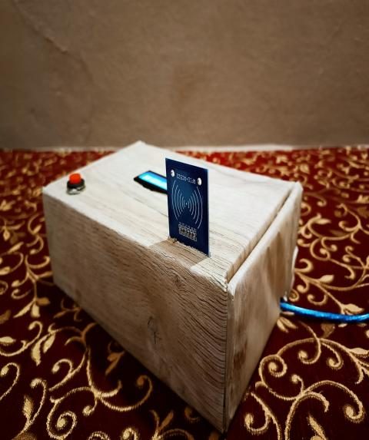


AutoBill at a Glance
Autobill, an IoT-driven solution, automates billing and transactions, delivering time savings, reduced errors, and heightened efficiency. With its autonomous cart scanning, it facilitates swift and accurate online checkouts. Autobill ensures a dependable billing cycle, ensuring a seamless financial management experience. Its scalability makes it invaluable for businesses handling increased transaction volumes, solidifying its role as a technology-driven solution that simplifies financial interactions for individuals and businesses alike.

Slide 5
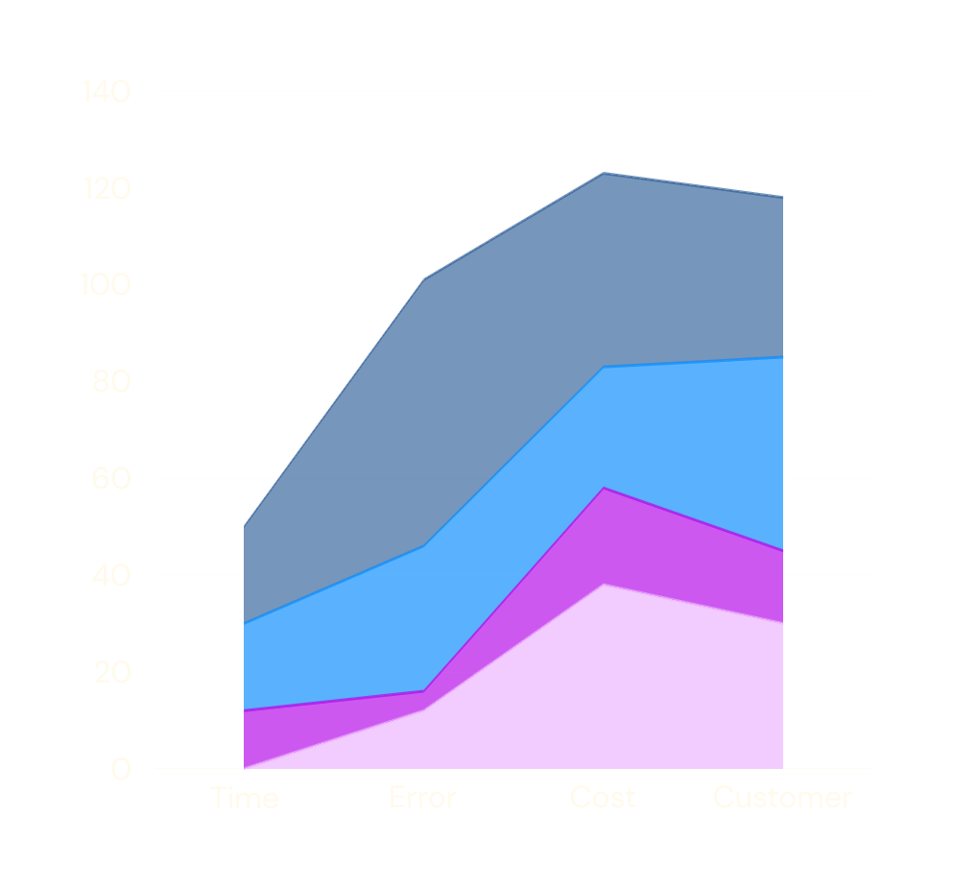

AutoBill's Significance
Autobill's significance lies in its time-saving automation, minimizing errors, ensuring consistency, and providing user-friendly convenience. It streamlines billing processes, improves operational efficiency, and enhances customer satisfaction by delivering a reliable and hassle-free financial experience.
70%
85%
Time Saving
Error Reduction
75%
95%
Cost Reduction
Customer Satisfaction

Slide 6
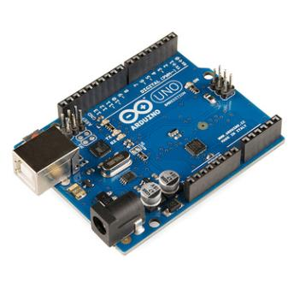
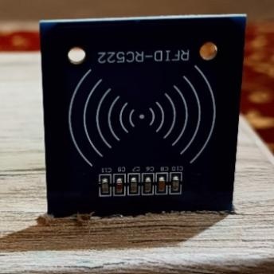
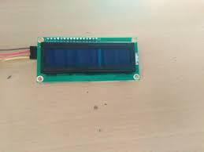
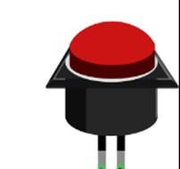
Hardware Essentials
Arduino UNO
RFID RC522
LCD I2C
2 Pin Button
The Arduino Uno is a microcontroller board based on the ATmega328P microcontroller. It has digital and analog input/output pins that can be used to connect to various sensors, actuators, and other devices. Arduino Uno is popular for its ease of use and versatility in creating electronic projects.
The RFID RC522 is a low-cost radio-frequency identification (RFID) module. It is commonly used to read RFID cards or tags and is widely employed in access control systems, time attendance systems, and various other applications.
The I2C LCD is a liquid crystal display (LCD) that uses the I2C communication protocol to connect to microcontrollers like Arduino. It simplifies the wiring and reduces the number of pins required to connect the LCD to the microcontroller.
A button, also known as a push button or tactile switch, is a simple input device that is used to manually control electronic circuits. Pressing the button completes the circuit, allowing current to flow and triggering a response in the connected system.

Slide 7
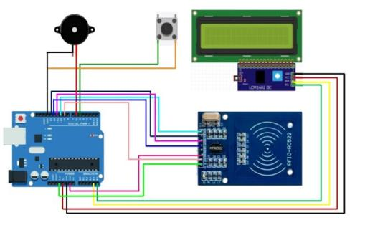
Architectural Framework

Slide 8
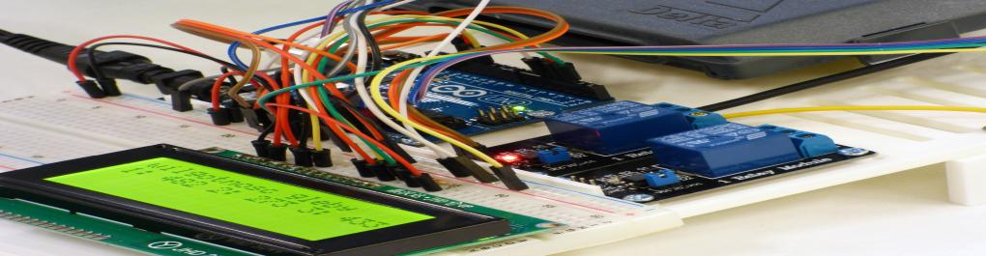
Project Mechanics
RC522 TO Arduino Uno
LCD I2C TO Arduino Uno
Switch TO Arduino Uno
Buzzer TO Arduino Uno
SDA to Arduino Digital Pin 10
SCK to Arduino Digital Pin 13
MOSI to Arduino Digital Pin 11
MISO to Arduino Digital Pin 12
IRQ (Not used, can be left unconnected)
GND to Arduino GND
RST to Arduino Digital Pin 9
3.3V to Arduino 3.3V
SDA to Arduino Analog Pin 4 (A4)
SCL to Arduino Analog Pin 5 (A5)
GND to Arduino GND
VCC to Arduino 5V
One pin to any Digital Pin 4
Other pin to GND
One pin to any Digital Pin 6
Other pin to GND

Slide 9
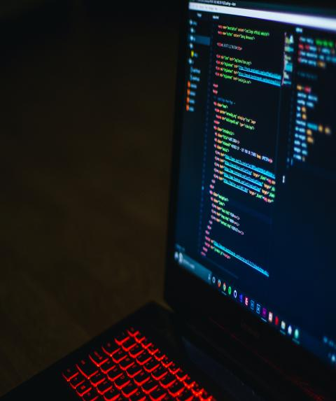
Source Code :
#define RST_PIN 9 // Reset pin (not used)
#define SS_PIN 10 // Slave Select pin
#define BUTTON_PIN 4 // Push button pin
#define BUZZER_PIN 6 // Buzzer pin x
#include <LiquidCrystal_I2C.h>
#include <MFRC522.h>
LiquidCrystal_I2C lcd(0x27, 16, 2); // Set the LCD address to 0x27 for a 16 chars and 2 line display
MFRC522 mfrc522(SS_PIN, RST_PIN); // Create MFRC522 instance
#define PRODUCT1_UID "C3 FC 66 32" // Replace with the UID of the first product
#define PRODUCT2_UID "51 4E EE CF" // Replace with the UID of the second product
int product1Price = 100; // Replace with the price of the first product
int product2Price = 200; // Replace with the price of the second product
int total = 0;
void setup() {
Serial.begin(9600); // Initialize serial communication
SPI.begin(); // Init SPI bus
mfrc522.PCD_Init(); // Init MFRC522 card
lcd.init(); // Init LCD
lcd.backlight(); // Turn on LCD backlight
pinMode(BUTTON_PIN, INPUT_PULLUP); // Set push button pin as input with internal pull-up resistor
pinMode(BUZZER_PIN, OUTPUT); // Set buzzer pin as output
Serial.println("Try AutoBill!!");

Slide 10
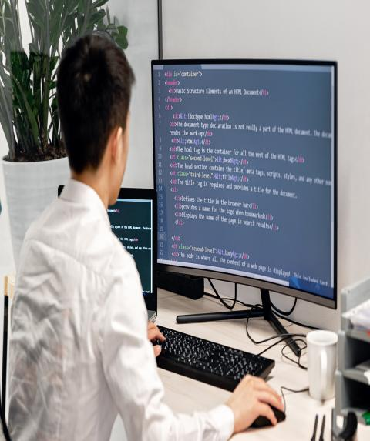
Source Code
lcd.setCursor(0, 0);
lcd.print(" Try using ");
lcd.setCursor(0, 1);
lcd.print(" AutoBill!! ");
}
void loop() {
static bool buttonPressed = false;
if (digitalRead(BUTTON_PIN) == LOW) {
if (!buttonPressed) {
buttonPressed = true;
total = 0; // Reset the total to zero
lcd.clear();
lcd.setCursor(0, 0);
lcd.print(" Cart Cleared ");
lcd.setCursor(0, 1);
lcd.print(" successfully ");
delay(2000);
lcd.clear();
lcd.print("Scan Items Again");
delay(1500);
lcd.clear();
lcd.print(" Try using ");
lcd.setCursor(0, 1);
lcd.print(" AutoBill!! ");
}
} else {
buttonPressed = false;
}
if (mfrc522.PICC_IsNewCardPresent() && mfrc522.PICC_ReadCardSerial()) {
Serial.print("UID tag :");
String content = "";
byte letter;
for (byte i = 0; i < mfrc522.uid.size; i++) {
Serial.print(mfrc522.uid.uidByte[i] < 0x10 ? " 0" : " ");

Slide 11

Source Code
Serial.print(mfrc522.uid.uidByte[i], HEX);
content.concat(String(mfrc522.uid.uidByte[i] < 0x10 ? " 0" : " "));
content.concat(String(mfrc522.uid.uidByte[i], HEX));
}
Serial.println();
Serial.print("Message : ");
content.toUpperCase();
lcd.clear();
if (content.substring(1) == PRODUCT1_UID) {
Serial.println("Rice added to cart");
lcd.print("1kg Rice added");
lcd.setCursor(0, 1);
lcd.print(" to your cart ");
tone(BUZZER_PIN, 1000, 100);
delay(150);
noTone(BUZZER_PIN);
total += product1Price;
} else if (content.substring(1) == PRODUCT2_UID) {
Serial.println("1L Milk added to cart");
lcd.print("1L Milk added");
lcd.setCursor(0, 1);
lcd.print(" to your cart ");
tone(BUZZER_PIN, 1500, 100);
delay(150);
noTone(BUZZER_PIN);
total += product2Price;
}
delay(2000);
lcd.clear();
lcd.setCursor(0, 0);
if (content.substring(1) == PRODUCT1_UID) {
lcd.print("Item Price : ");
lcd.print(product1Price);

Slide 12
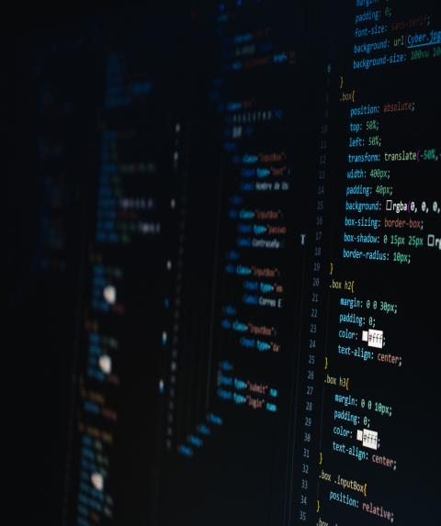
Source Code :
} else if (content.substring(1) == PRODUCT2_UID) {
lcd.print("Item Price : ");
lcd.print(product2Price);
}
delay(2000);
lcd.clear();
lcd.print("Grand total: ");
lcd.print(total);
delay(2000);
lcd.clear();
lcd.print(" Thank You :) ");
lcd.setCursor(0, 1);
lcd.print(" for shopping ");
delay(2000);
lcd.clear();
lcd.setCursor(0, 0);
lcd.print(" Add More ");
lcd.setCursor(0, 1);
lcd.print(" Items ");
delay(2000);
lcd.clear();
lcd.setCursor(0, 0);
lcd.print(" Try using ");
lcd.setCursor(0, 1);
lcd.print(" AutoBill!! ");
mfrc522.PICC_HaltA();
mfrc522.PCD_StopCrypto1();
delay(500); // Add a small delay to prevent immediate scanning
}
}

Slide 13




Embracing the Future
1 Integration with Smart Home Devices
Expanding the AutoBill project to integrate with smart home devices presents a promising avenue for future development. By connecting to devices 57 such as smart thermostats, lighting systems, and appliances, the system can offer users more granular control over their energy consumption.
Machine Learning for Predictive Billing
Incorporating machine learning algorithms into the AutoBill system opens up opportunities for predictive billing. By analyzing historical usage patterns and taking into account external factors such as weather conditions, the system can anticipate future consumption trends.
Expanded Industry Applications
The AutoBill framework is adaptable to various service-based industries beyond utilities. Exploring applications in areas such as parking facilities, subscription services, and shared resource usage (e.g., coworking spaces) could extend the project's impact.

Slide 14

The Conclusion
Autobill marks a transformative leap in financial technology, offering an efficient and error-minimized approach to billing and transactions. With its integration of IoT technology, Autobill streamlines processes, providing significant time savings and heightened operational efficiency. The autonomous cart scanning feature ensures quick and precise online checkouts, fostering a seamless user experience. Its adaptability to scalability needs caters to businesses experiencing transaction volume growth, making it a versatile solution.
The innovative nature of Autobill extends beyond automation, aiming to simplify financial interactions for both individuals and businesses. By ensuring a more predictable and reliable billing cycle, Autobill contributes to a stress-free financial management experience. The emphasis on minimizing errors and enhancing efficiency aligns with the evolving landscape of modern finance. Autobill's role as a technology-driven solution underscores its significance in optimizing billing processes and simplifying financial interactions in an ever-evolving digital landscape.

Slide 15
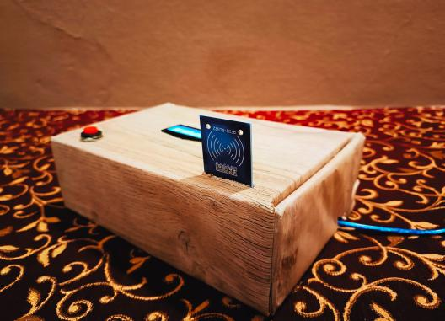
THANK YOU.

