Slide 1
CSE 303 – COMPILER DESIGN
DataScript: Design and Development of a Mini Compiler
Department of Computer Science and Engineering, MIST
Team Members
About This Project
S M Sabit Uz Zaman Arpon
ID 202414077
Nasimul Goni Sakir
ID 202414095
DataScript is a self-defined mini programming language with a fully functional compiler pipeline — from source code to executable — built entirely in Python with GCC backend integration.

Slide 2
SLIDE 2 OF 9
Project Objectives
The DataScript compiler project pursues six core objectives that together demonstrate a complete, end-to-end compiler design implementation.
1
Language Design
Design a simplified, purpose-built programming language named DataScript with well-defined syntax and semantics tailored for data manipulation.
2
Compiler Development
Develop a fully functional compiler that processes DataScript source files through all required compilation phases without errors.
3
Phase Implementation
Implement all required compiler phases: lexical analysis, syntax analysis, AST construction, semantic analysis, and code generation.
4
IR Generation
Generate a well-structured intermediate representation that bridges the gap between high-level DataScript code and low-level C code.
5
Executable Output
Produce a final executable binary (.exe) by generating C code and invoking GCC for compilation and linking.
6
Demonstration
Demonstrate the working compiler end-to-end, validating the full pipeline from DataScript source to running executable.

Slide 3
SLIDE 3 OF 9
Requirements
Functional Requirements
Technical Requirements
Data Structures
Implementation Language
Dataset declaration and record insertion for structured data management within programs.
Python — used for all compiler phases from lexer to C code generator.
Backend Compiler
Computation
GCC — invoked to compile generated C code into a native executable binary.
Variables, arithmetic operations, aggregation functions: sum(), average(), maximum(), minimum(), count().
Target Platforms
Windows and Linux — cross-platform compatibility for broad usability.
Control & Output
Conditional statements, comparison operators, print output, and robust error handling throughout the pipeline.

Slide 4
SLIDE 4 OF 9
Project Scope
Language Features Supported
Compiler Phases in Scope
Data Primitives
1
Frontend
Dataset declaration, record insertion, and variable definitions as the foundational data layer of DataScript programs.
Lexical analysis, syntax analysis, and AST construction — transforming raw source into a structured tree representation.
2
Middle-End
Arithmetic Expressions
Semantic analysis with a full symbol table, type checking, and intermediate representation (IR) generation.
Full support for arithmetic operations enabling mathematical computation within DataScript source code.
3
Backend
Aggregation Functions
C code generation from IR, GCC invocation, and final .exe binary production.
sum() · average() · maximum() · minimum() · count() — five built-in dataset aggregation operations.
Control Flow & Output
if/else conditional blocks with comparison operators, and print statements for program output.

Slide 5
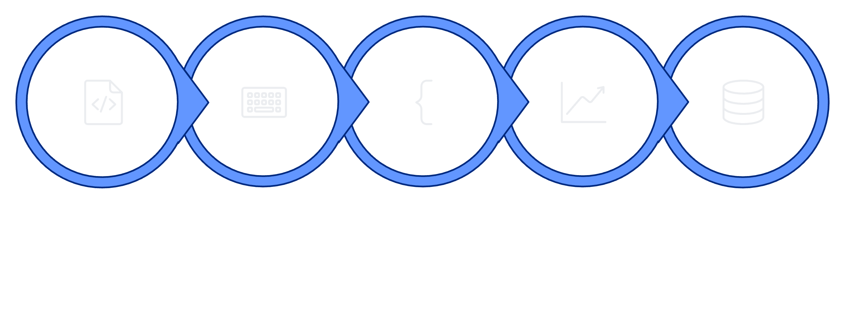
SLIDE 5 OF 9
Compiler Workflow Pipeline
The DataScript compiler operates as a sequential 9-stage pipeline. Each stage transforms its input into a refined representation, ultimately producing a native executable from a .ds source file.
Source .ds
Lexical
Syntax
AST
Semantic
Frontend (Stages 1–4)
Middle-End (Stages 5–7)
Backend (Stages 8–9)
Source ingestion through lexical tokenization, grammar-driven parsing, and abstract syntax tree construction — all implemented in Python.
Semantic validation, symbol table population, type checking, IR generation, and C code synthesis — the analytical core of the compiler.
Generated C source is handed off to GCC for native compilation and linking, producing the final platform-executable binary.

Slide 6
SLIDE 6 OF 9
Use Case Diagram
The DataScript compiler system exposes eight primary use cases — all performed by a single actor: the DataScript User.
Actor
DataScript User
Any developer or student authoring programs in the DataScript language. The user interacts with the compiler system through source file authorship and command invocation.
Write DataScript Program
Compile Program
Author .ds source files using DataScript syntax.
Invoke the compiler to process the source file end-to-end.
System Boundary
DataScript Compiler System
Encapsulates all compiler functionality — from source parsing to executable generation — as a single cohesive system.
Detect Errors
Generate IR & C Code
Receive lexical, syntax, and semantic error messages.
Produce intermediate representation and C source output.
Generate & Run Executable
Build and execute the final .exe binary, viewing program output.

Slide 7
SLIDE 7 OF 9
Compiler Flowcharts
Seven key flowcharts map the internal logic of the DataScript compiler — from the top-level pipeline down to each individual phase.
1
2
3
Overall Compiler Flow
Lexical Analysis
Syntax Analysis
Source → Lexer → Parser → AST → Semantic Analysis → IR → C Generator → Executable
Input Stream → Token Recognition → Token Stream
Token Stream → Grammar Rules → Parse Tree → AST
4
5
6
Semantic Analysis
IR Generation
C Code Generation
AST → Type Checking → Symbol Table → Validated AST
Validated AST → Intermediate Code Generation → IR
IR → C Code Synthesis → C Source File (.c)
7
Executable Generation
C Source → GCC Compilation → Linking → Executable (.exe)

Slide 8



SLIDE 8 OF 9
Complete Work Plan
The project is structured across three focused weeks, each targeting a distinct compiler layer — frontend, middle-end, and backend — culminating in a fully demonstrated working compiler.
Week 1 — Language & Frontend
Week 2 — Semantic Analysis & IR
Week 3 — Backend & Finalization
DataScript syntax design
Token definition
Grammar specification
Lexer implementation
Parser implementation
AST construction
Symbol table design
Semantic analysis implementation
Type checking
IR design
IR generation
C code generator implementation
GCC integration
.exe generation
Testing & debugging
Documentation
Final demonstration

Slide 9
SLIDE 9 OF 9
Project Planning Summary
Final Goal
A functional compiler for the self-defined DataScript language — demonstrating all phases of compiler design from lexical analysis through executable generation.
Input
DataScript source file (.ds) — authored by the programmer using DataScript language syntax.
Language
Processing Pipeline
DataScript
Lexer → Parser → AST → Semantic Analysis → IR → C Code Generator
Implementation
Python
Output
Backend
C source file (.c) → Native executable (.exe) via GCC.
GCC
This project fulfills the CSE 303 Compiler Design Presentation 1 requirements — covering objectives, requirements, scope, workflow, use cases, flowcharts, and a structured three-week work plan.

