Slide 1
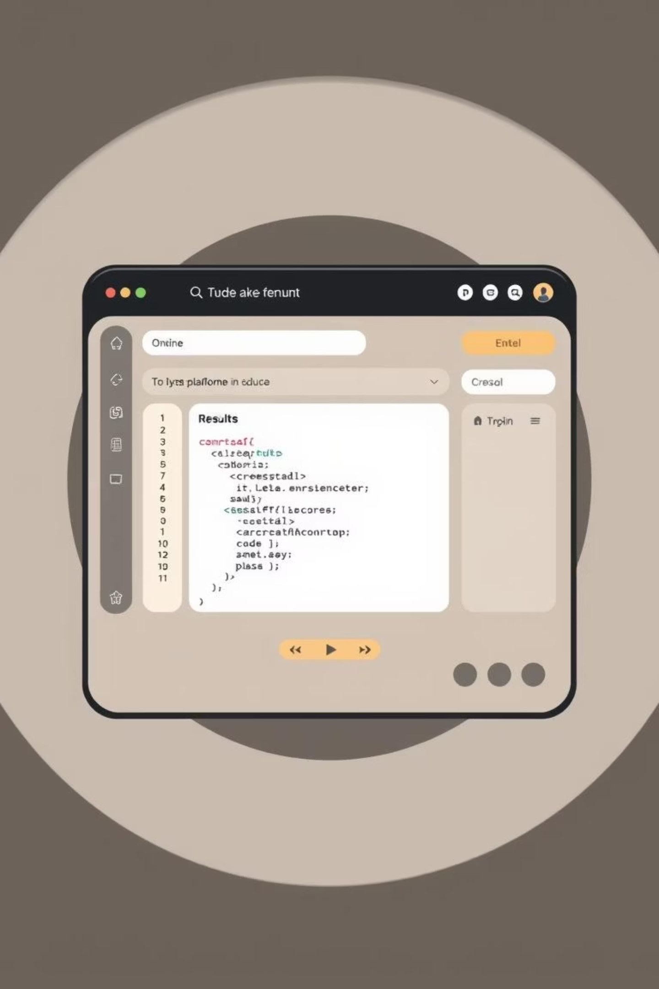
AUTOMATED ONLINE JUDGE & CONTEST PLATFORM
Revolutionizing coding education and competition with advanced judging and AI-powered feedback.

Slide 2

PROJECT OBJECTIVES: ENHANCING CODING EXPERIENCE
ROBUST JUDGING ENGINE
Develop a reliable, high-performance backend to evaluate C, C++, and Java code efficiently.
DYNAMIC CONTEST PLATFORM
Create a user-friendly site mirroring platforms like Codeforces for competitive programming events.
AI-POWERED FEEDBACK
Integrate AI for intelligent partial marking, offering detailed insights for coding exams.
MCC COMMUNITY HUB
Foster a vibrant learning and competition environment for students and enthusiasts.

Slide 3
CORE FEATURES & TECH STACK: A JAVA-POWERED SOLUTION
CORE FEATURES
TECH STACK
MULTI-LANGUAGE SUPPORT
FRONTEND: JAVAFX / SPRING BOOT (THYMELEAF)
1
1
C, C++, Java compilation and execution.
Rich, responsive user interface.
AUTOMATED TEST CASES
BACKEND: SPRING BOOT
2
2
Secure execution, time/memory limits.
Scalable, robust application logic.
REAL-TIME LEADERBOARDS
DATABASE: POSTGRESQL
3
3
Live updates during contests.
Reliable data storage for users, problems, submissions.
AI PARTIAL SCORING
AI INTEGRATION: JAVA ML LIBRARIES
4
4
Intelligent feedback, not just pass/fail.
For intelligent code analysis and partial marking.
PROBLEM MANAGEMENT
CONTAINERIZATION: DOCKER
5
5
Easy creation and organization of challenges.
Isolated and secure judging environments.

