Slide 1

Project Presentation on Fruits and Vegetables Classification

Slide 2
Presented By: Mohammad Kamrul Hasan(C193072) Munir Uddin Rohan(C201066) Miraj Uddin Chowdhury(C201074)

Slide 3
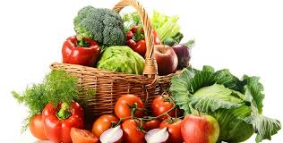
Introduction
Classification of fruits and vegetables is needed for dietary guidance materials to help people select appropriate types of these foods to meet their nutrient and health needs. Many countries have food guides with graphic depictions of the food groups and subgroups along with recommendations for consumption.
The goal of this project is to build a model that can classify different kinds of images of fruits and vegetables.

Slide 4
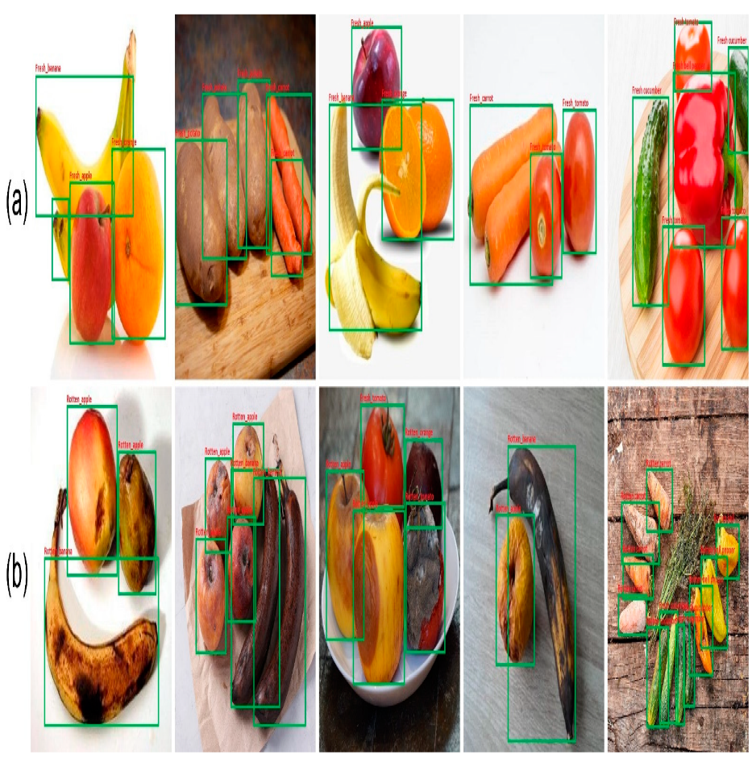
Problem Statement
Classification of fruits and vegetables is one of the key challenges in the agricultural field. It consumes a lot of money, time and needs more manpower. Time is one of the factors which affects classification. The fruits or vegetables may get spoil due to the time consumption. Therefore, an automated system to classify fruits and vegetables is required. With the help of Artificial Intelligence (AI)and Machine Learning (ML), this research can develop an automatic fruit classification system with an information dataset of each fruit.

Slide 5
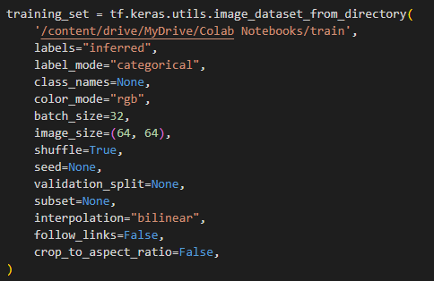
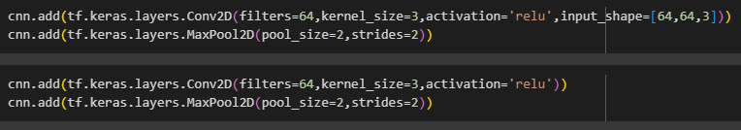
Methodology
Upload Image
Image Pre-processing
Use CNN Algorithm
Model Trained

Slide 6
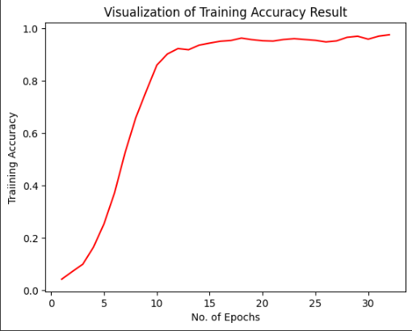
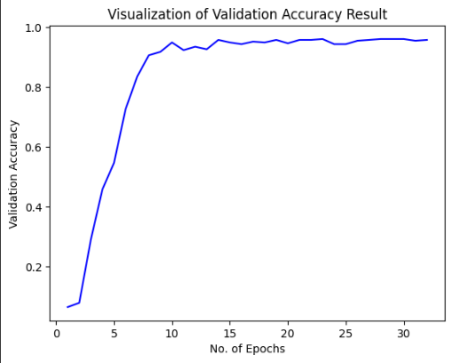
Accuracy of results
Fig: Training accuracy visualization
Fig: Validation accuracy visualization

Slide 7
Accuracy of results
The final test accuracy is :
95.82%

Slide 8
Conclusion
Mainly this project evaluates the basic method flow of fruit and vegetable classification. The implementation of deep learning models has significantly improved the accuracy of fruit and vegetable classification. By reducing the dependency on manual labor, AI-driven classification systems lower operational costs. Deep learning models are inherently scalable, capable of handling diverse and large datasets. The improvements in accuracy, efficiency, cost reduction, scalability, and reliability introduced by AI not only enhance current operations but also pave the way for innovative future applications.
Dataset Link: https://www.kaggle.com/datasets/kritikseth/fruit-and-vegetable-image-recognition

Slide 9
The End
Thank you

