Slide 1
How to lose 200.000 data points
(took 4 months to gather)
Mircea Ionescu

Slide 2

What is a data point
A timestamp of one rotation

Slide 3
What is a data point
A timestamp of one rotation
Equivalent to 2.2 m

Slide 4
What is a data point
A timestamp of one rotation
Equivalent to 2.2 m
Used to compute metrics
(speed, distance, acceleration)

Slide 5
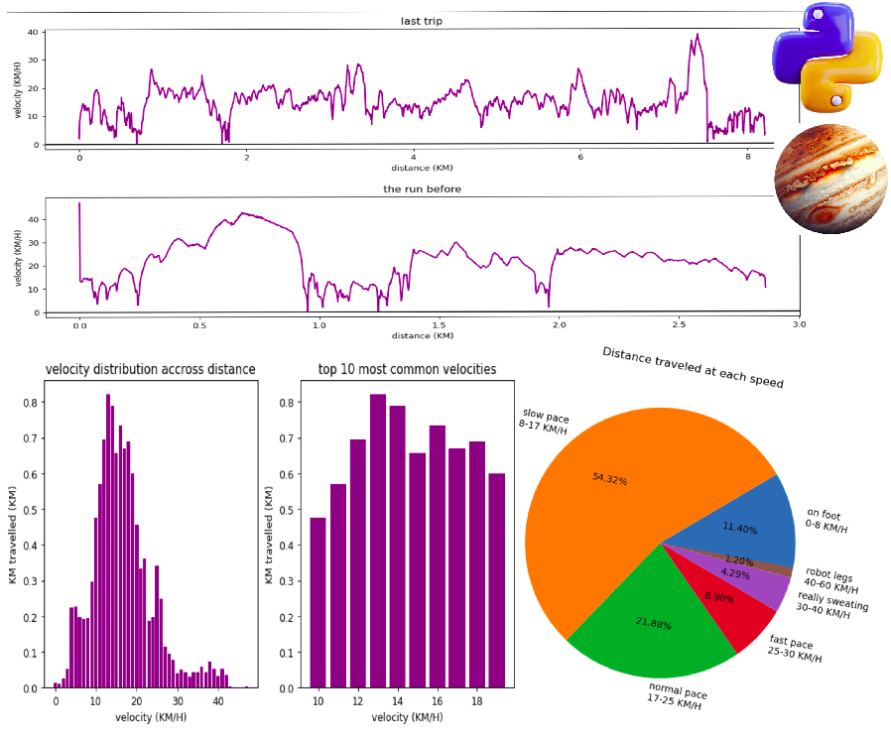
What is a data point

Slide 6
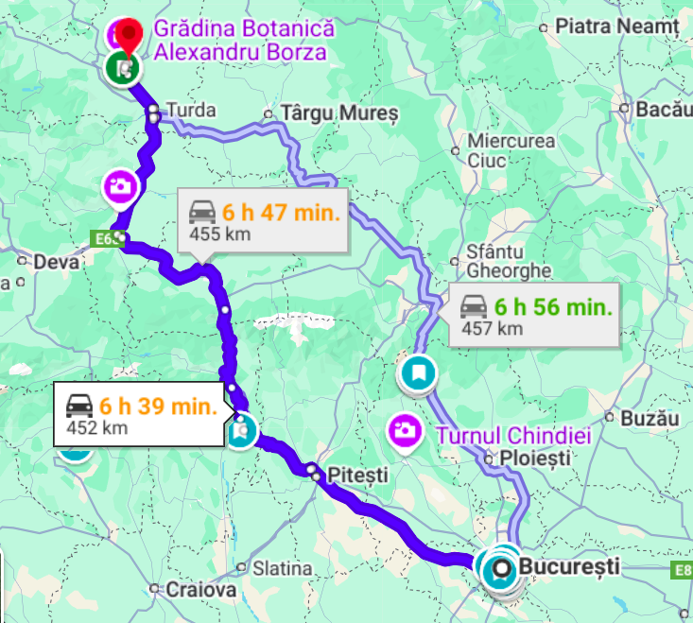
Equivalent to 500 KM of data
Distance from here to Cluj

Slide 7
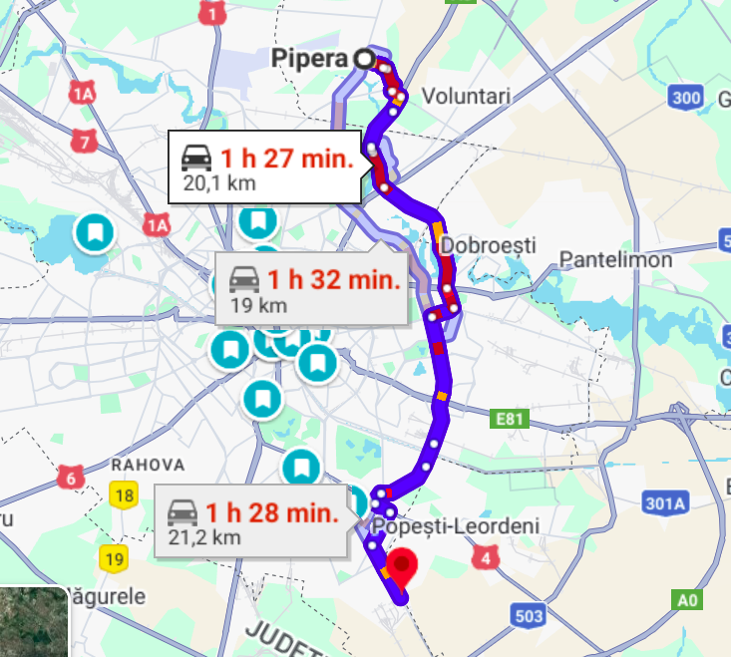
Equivalent to 500 KM of data
Distance from here to Cluj
Pipera-Berceni 25 times

Slide 8
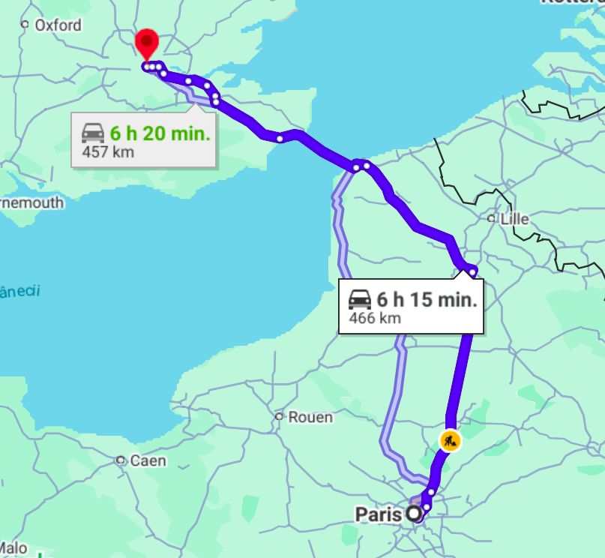
Equivalent to 500 KM of data
Distance from here to Cluj
Pipera-Berceni 25 times
London-Paris

Slide 9
Equivalent to 500 KM of data
Distance from here to Cluj
Pipera-Berceni 25 times
London-Paris
BY BIKE

Slide 10
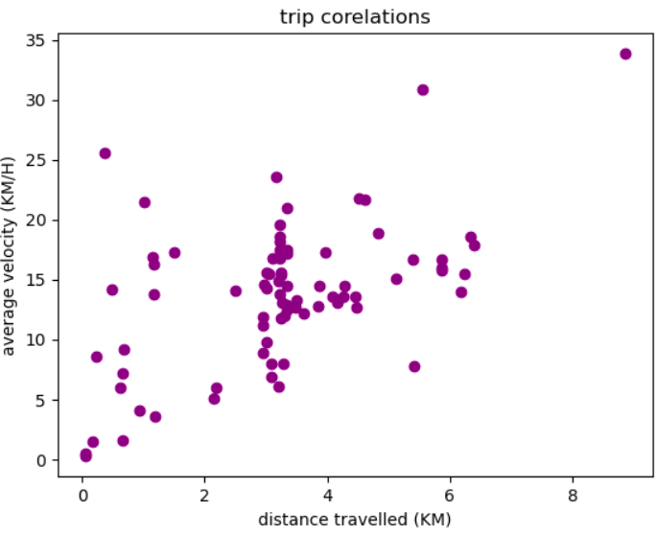
First 250 KM
Started from an attempt to filter short trips

Slide 11
First 250 KM
Started from an attempt to filter short trips

Slide 12
First 250 KM
Started from an attempt to filter short trips
Tried to delete them with
os.remove(file)

Slide 13
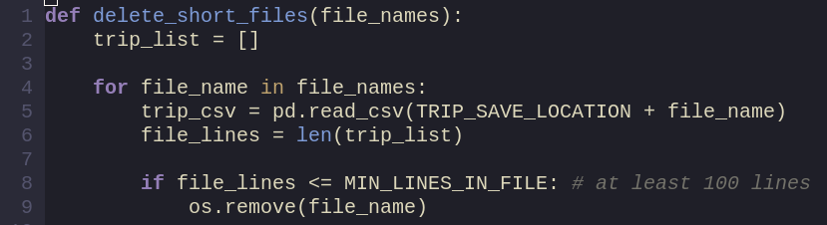
First 250 KM
Started from an attempt to filter short trips
Tried to delete them with
os.remove(file)

Slide 14
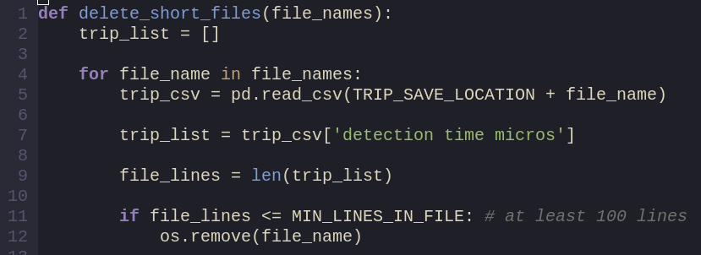
First 250 KM
Started from an attempt to filter short trips
Tried to delete them with
os.remove(file)

Slide 15
First 250 KM
Started from an attempt to filter short trips
Tried to delete them with
os.remove(file)

Slide 16
Another 250 KM later...

Slide 17
Do you remember this plot?

Slide 18

Something’s not right...

Slide 19

How is my data stored?
On the mcu the files are equal in size
File 1
File 2
File 3
File 4

Slide 20
How is my data stored?
On the mcu the files are equal in size
On the PC, they are organised in trips
File 1
File 2
File 3
File 4
Trip 1
Trip 2
Trip 3
Trip 4

Slide 21
What does that function look like?
The file naming convention is: 1_file.csv

Slide 22
What does that function look like?
The file naming convention is: 1_file.csv
I sort those files by the index in the beginning

Slide 23
What does that function look like?
The file naming convention is: 1_file.csv
I sort those files by the index in the beginning
Look for csv line start to split in trips

Slide 24
What does that function look like?
The file naming convention is: 1_file.csv
I sort those files by the index in the beginning
Look for csv line start to split in trips
Something like: files.sort(key=sortMethod)

Slide 25
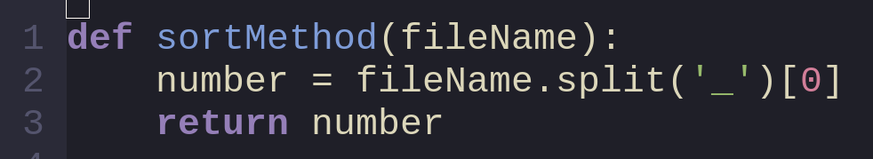
Where are the 250 KM lost?
In the sorting function…

Slide 26
Where are the 250 KM lost?
In the sorting function…
The file naming convention is: “1_file.csv”

Slide 27
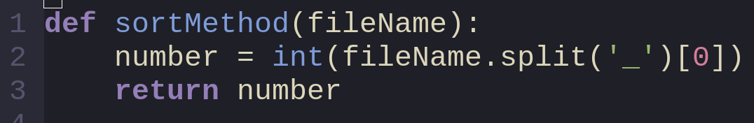
Where are the 250 KM lost?
In the sorting function…

Slide 28


Questions you may have

Slide 29
READ THE TITLE BUCKO
It’s how to LOSE 200.000 data points
Not how to protect 200.000 data points

