Slide 1
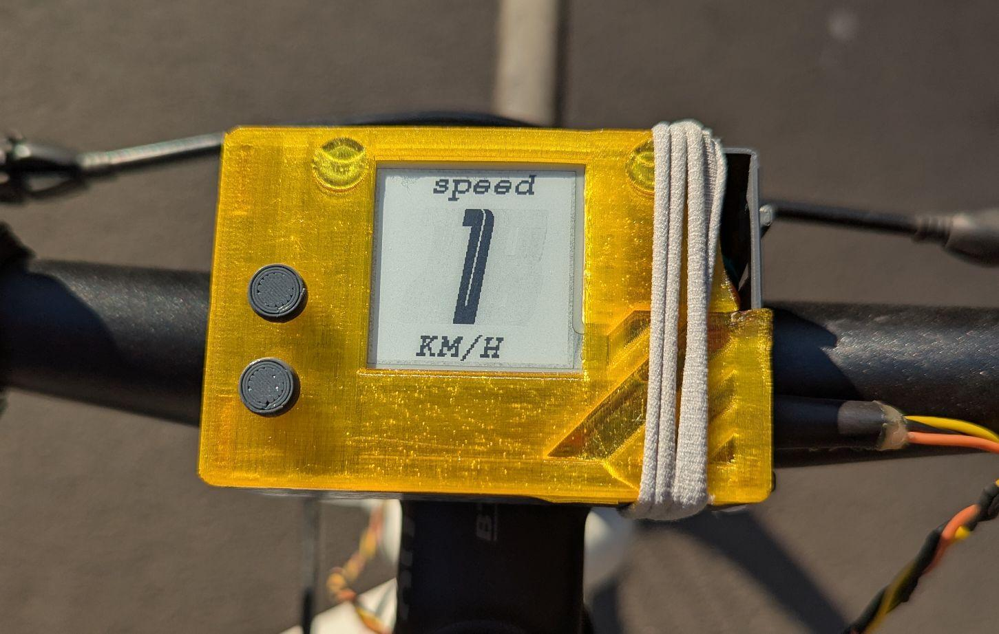
Concurrency in Bike System

Slide 2
About the Project
Consists of 3 main components

Slide 3
About the Project
Consists of 3 main components
One strongly relies on concurrency

Slide 4
About the Project
Consists of 3 main components
One strongly relies on concurrency
Another uses it to work faster

Slide 5
The Bike Computer
Computes various real time metrics

Slide 6
The Bike Computer
Computes various real time metrics
Displays them on the E-paper display

Slide 7
The Bike Computer
Computes various real time metrics
Displays them on the E-paper display
Stores every data point on a micro SD

Slide 8
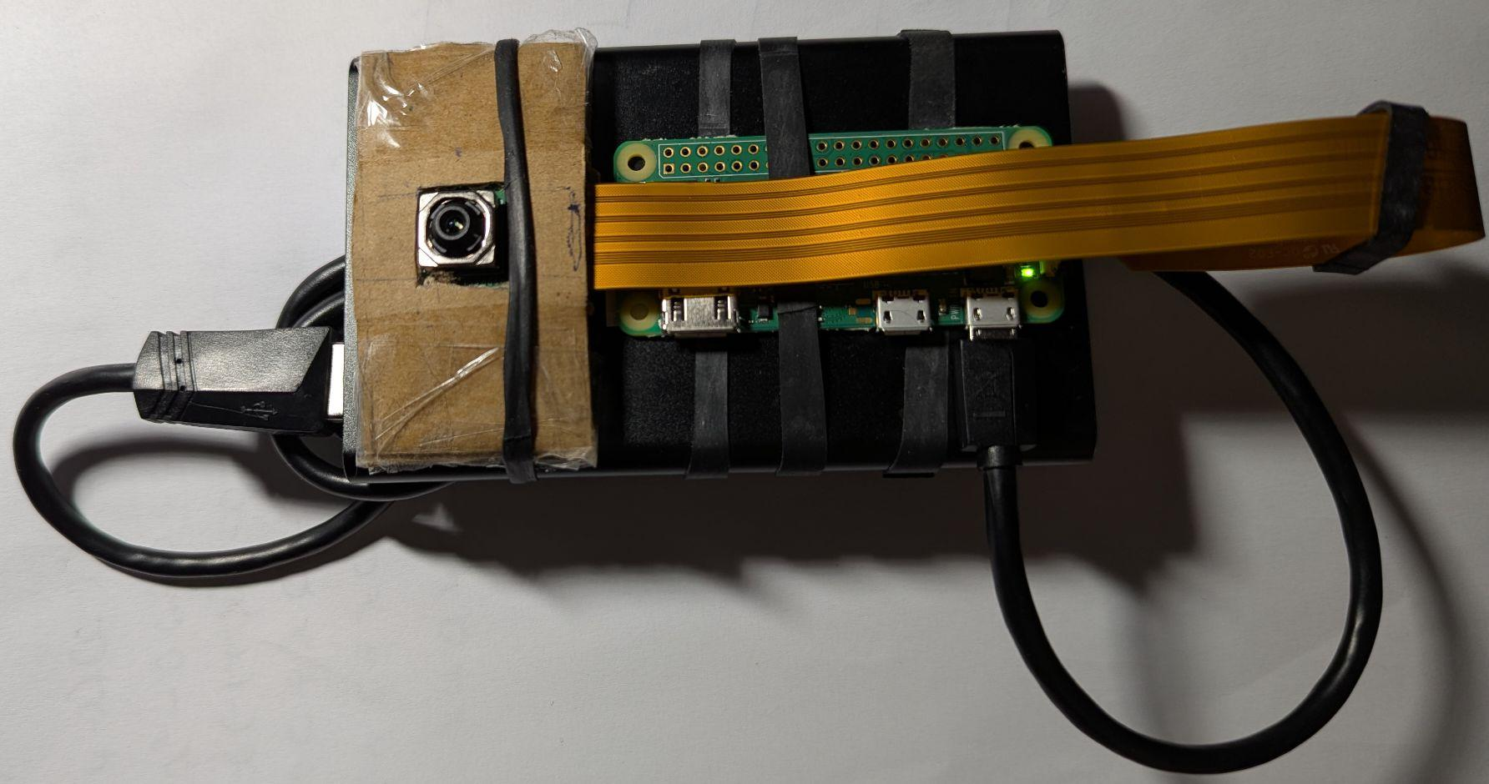
The Bike Camera
A separate module mounted in front of the bike computer

Slide 9
The Bike Camera
A separate module mounted in front of the bike computer
Takes photos and scans for street signs

Slide 10
The Bike Camera
A separate module mounted in front of the bike computer
Takes photos and scans for street signs
Sends data about the detected signs to the bike computer to log

Slide 11
The Data Analysis Part
A python script looks at the logged data and displays various metrics

Slide 12
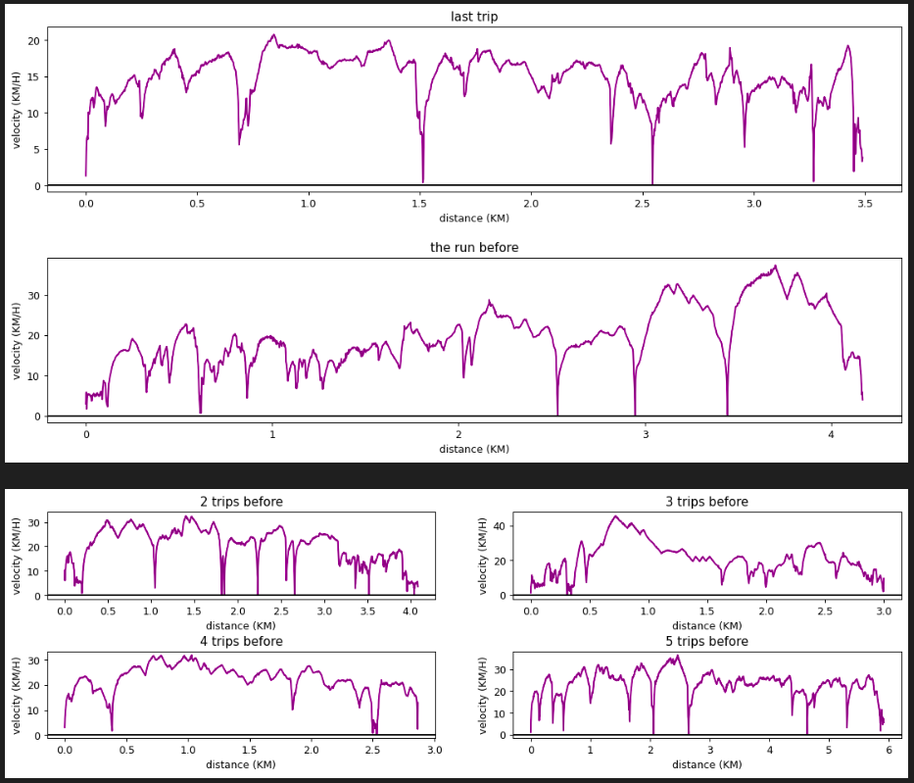
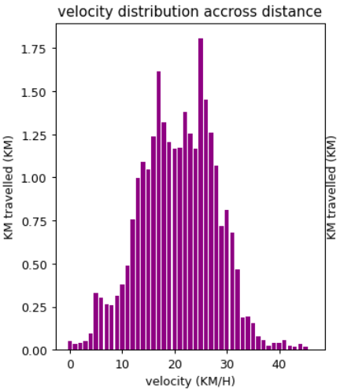
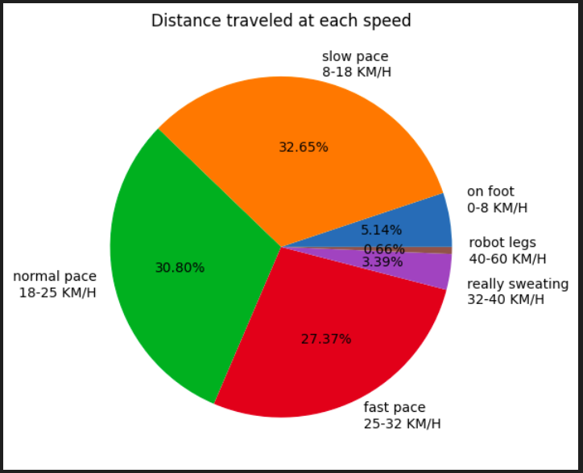
The Data Analysis Part
A python script looks at the logged data and displays various metrics

Slide 13
Concurrency in Bike Calculator
Would not work without it

Slide 14
Concurrency in Bike Calculator
Would not work without it
3 main tasks:
  One to read the data from the sensors and buttons

Slide 15
Concurrency in Bike Calculator
Would not work without it
3 main tasks:
  One to read the data from the sensors and buttons
  One to log the data to the micro SD

Slide 16
Concurrency in Bike Calculator
Would not work without it
3 main tasks:
  One to read the data from the sensors and buttons
  One to log the data to the micro SD
  One to display user information to the E-paper display

Slide 17
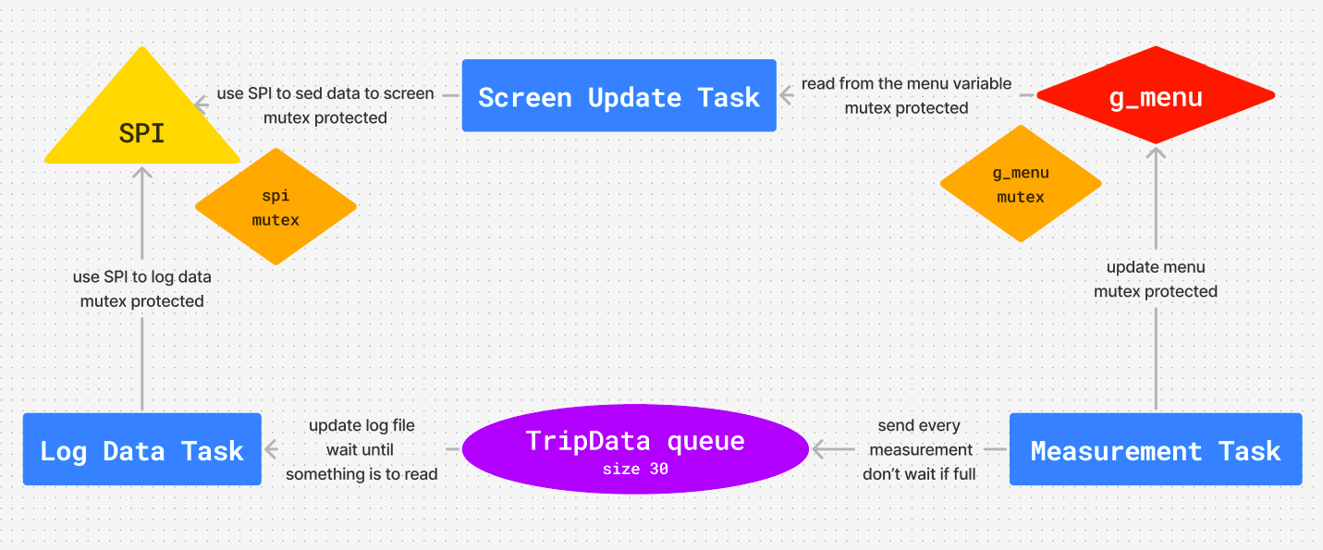
Process Diagram

Slide 18
The Measurement Task
Recieves sensor data and updates the global menu variable to display most recent state

Slide 19
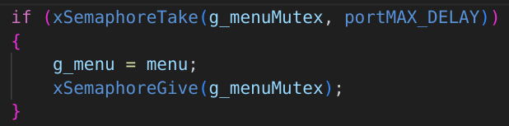
The Measurement Task
Recieves sensor data and updates the global menu variable to display most recent state
This operation is protected by a mutex:

Slide 20
The Measurement Task
Recieves sensor data and updates the global menu variable to display most recent state
This operation is protected by a mutex
portMAX_DELAY tells the mutex how much to wait for the resource if busy

Slide 21
The Measurement Task
Also sends an object of type TripData to a message queue for logging

Slide 22
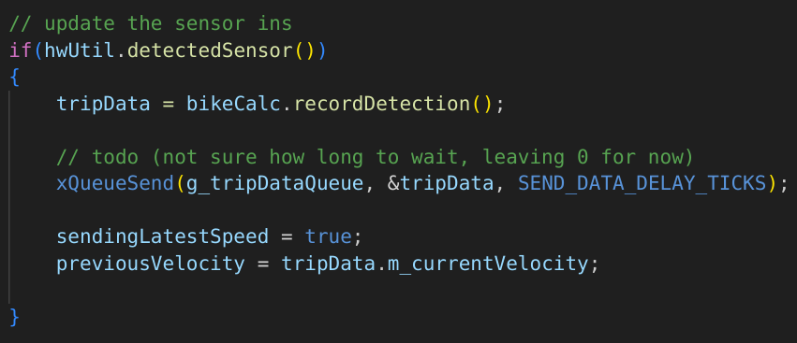
The Measurement Task
Also sends an object of type TripData to a message queue for logging
The function takes as arguments the queue, a refference to the object to send and the time to wait in case the queue is full

Slide 23
The Logging Task
Recieves data from the TripData waiting queue

Slide 24
The Logging Task
Recieves data from the TripData waiting queue
If the queue is empty restarts the loop (busy waiting)

Slide 25
The Logging Task
The SPI (serial periphelar interface) is a short distance communication protocol

Slide 26
The Logging Task
The SPI (serial periphelar interface) is a short distance communication protocol
Works on a Master-Slave model, where the ESP32 is the main device orchestrating communication with the E-paper display and, in this case, the micro SD data writing by driving the clock and chip select signals

Slide 27
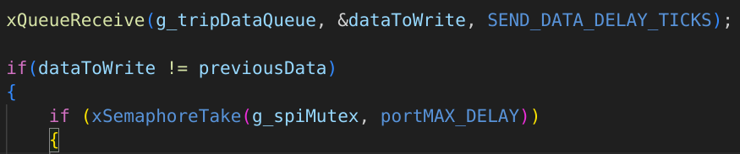
The Logging Task
A semaphore is used to synchronise SPI use between the logging and the display task

Slide 28
The Logging Task
A semaphore is used to synchronise SPI use between the logging and the display task
If the SPI is busy, wait as long as possible

Slide 29
The Logging Task
A semaphore is used to synchronise SPI use between the logging and the display task
If the SPI is busy, wait as long as possible
This is done so no recording is left un-logged

Slide 30
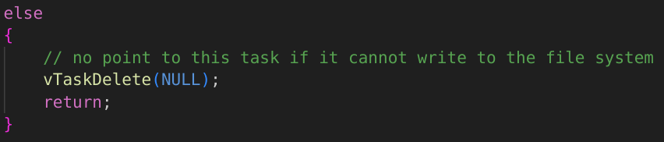
The Logging Task
An interesting aspect of this task
  If no micro SD card is inserted, it kills itself in order to let the Screen Update Task take full advantage of the SPI

Slide 31
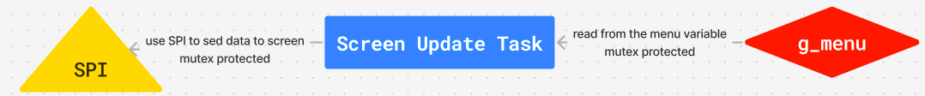
The Screen Update Task
Reads the g_menu value which is protected by a mutex

Slide 32
The Screen Update Task
Reads the g_menu value which is protected by a mutex
Uses the SPI protocol to update what is shown to the user

Slide 33
The Screen Update Task
Reads the g_menu value which is protected by a mutex
Uses the SPI protocol to update what is shown to the user
This takes between 0.2 and one second depending on the type of refresh

Slide 34
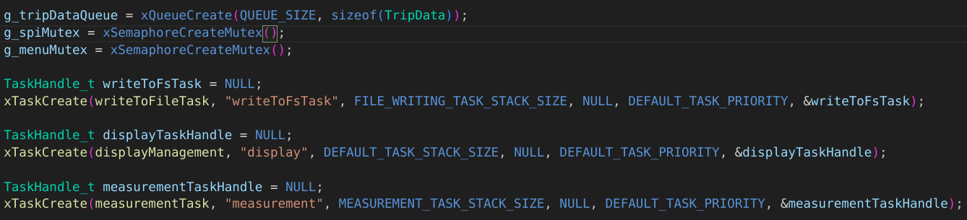
The main loop task
Its purpose is:
  Create the other tasks

Slide 35
The main loop task
Its purpose is:
  Create the other tasks
  Create the waiting queues and semaphores

Slide 36
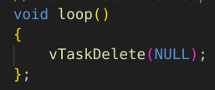
The main loop task
Its purpose is:
  Create the other tasks
  Create the waiting queues and semaphores
After that is kills itself:

Slide 37
ESP-IDF
Esspressif IoT Development Framework

Slide 38
ESP-IDF
Esspressif IoT Development Framework
Based on FreeRTOS (real time operating system)

Slide 39
ESP-IDF
Esspressif IoT Development Framework
Based on FreeRTOS (real time operating system)
Supports:
  Tasks and Co-routines

Slide 40
ESP-IDF
Esspressif IoT Development Framework
Based on FreeRTOS (real time operating system)
Supports:
  Tasks and Co-routines
  Queues, mutexes and semaphores

Slide 41
ESP-IDF
Esspressif IoT Development Framework
Based on FreeRTOS (real time operating system)
Supports:
  Tasks and Co-routines
  Queues, mutexes and semaphores
  Task notifications

Slide 42
Tasks and Co-routines
A task is similar to a regular process:
  Has its own stack

Slide 43
Tasks and Co-routines
A task is similar to a regular process:
  Has its own stack
  Is not aware of context switching

Slide 44
Tasks and Co-routines
A task is similar to a regular process:
  Has its own stack
  Is not aware of context switching
  Supports prioritisation

Slide 45
Tasks and Co-routines
A task is similar to a regular process:
  Has its own stack
  Is not aware of context switching
  Supports prioritisation
  Supports full preemption

Slide 46
Tasks and Co-routines
Co-routines are not used as often as tasks

Slide 47
Tasks and Co-routines
Co-routines are not used as often as tasks
Exist only to serve very limited devices

Slide 48
Tasks and Co-routines
Co-routines are not used as often as tasks
Exist only to serve very limited devices
Are similar to regular threads in nature:
  Share a stack with all other co-routines

Slide 49
Tasks and Co-routines
Co-routines are not used as often as tasks
Exist only to serve very limited devices
Are similar to regular threads in nature:
  Share a stack with all other co-routines
  Use prioritised cooperative scheduling (need to yeld to let other co-routines run)

Slide 50
Tasks and Co-routines
Co-routines are not used as often as tasks
Exist only to serve very limited devices
Are similar to regular threads in nature:
  Share a stack with all other co-routines
  Use prioritised cooperative scheduling (need to yeld to let other co-routines run)
  Work in an application with other preemptive tasks

Slide 51
Queues, mutexes and semaphores
Work as expected:
  Queues are the primary form of inter-task communication and are used as thread safe FIFO buffers

Slide 52
Queues, mutexes and semaphores
Work as expected:
  Queues are the primary form of inter-task communication and are used as thread safe FIFO buffers
  Binary semaphores and mutexes are used for mutual exclusion and syncronisation purposes

Slide 53
Queues, mutexes and semaphores
Work as expected:
  Queues are the primary form of inter-task communication and are used as thread safe FIFO buffers
  Binary semaphores and mutexes are used for mutual exclusion and syncronisation purposes
  A task notification is an event sent directly to a task, rather than indirectly to a task via an intermediary object such as a queue

Slide 54
Queues, mutexes and semaphores
Work as expected:
  Queues are the primary form of inter-task communication and are used as thread safe FIFO buffers
  Binary semaphores and mutexes are used for mutual exclusion and syncronisation purposes
  A task notification is an event sent directly to a task, rather than indirectly to a task via an intermediary object such as a queue
  It can be 45% faster for unblocking a task than an intermediary object such as a mutex for example

Slide 55
Concurrency in Bike Camera
A regular C++ executable running on Linux
Uses std::thread to parallelize finding signs rather than trying to find each sign in sequence

Slide 56
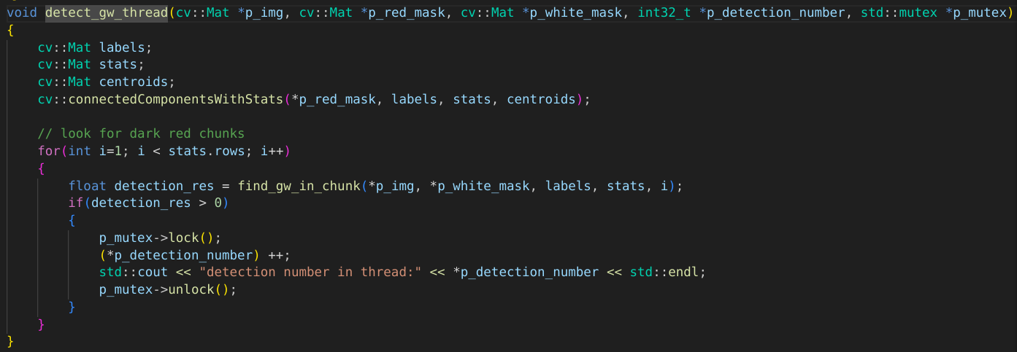
Concurrency in Bike Camera

Slide 57
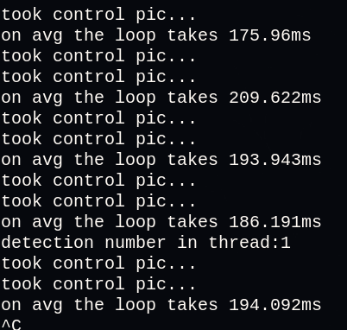
Performance improvement
Sequential performance

Slide 58
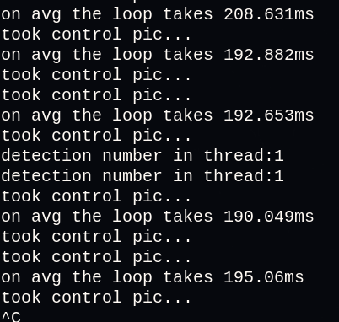
Performance improvement
Sequential performance
Concurrent performance

Slide 59
Things left to improve
Use both processors on ESP32

Slide 60
Things left to improve
Use both processors on ESP32
Try to use notifications rather than mutexes

Slide 61
Things left to improve
Use both processors on ESP32
Try to use notifications rather than mutexes
Eliminate the busy waiting in Logging Task

Slide 62
Things left to improve
Use both processors on ESP32
Try to use notifications rather than mutexes
Eliminate the busy waiting in Logging Task
Only start the std::thread on the Raspberry pi once then only send the cv::Mat objects to them every time

