Slide 1


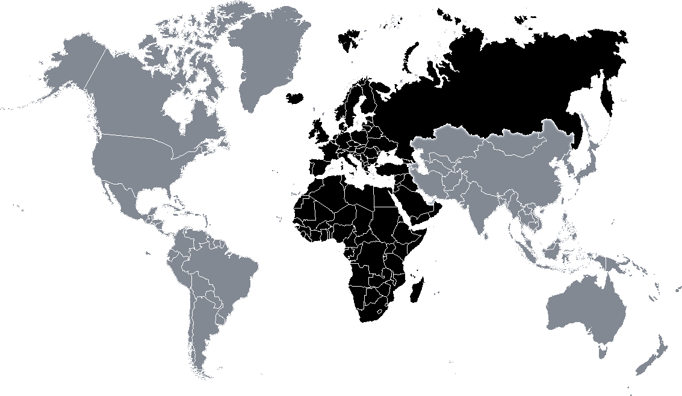
VHF 2m
144 - 146 MHz (2 MHz band)
UHF 70cm
430 - 440 MHz (10 MHz band)
Satellite exclusive
439.800
Digital comm link
145.800 ISS
439.5875
145.806
Space Comm
Repeater in R1 (12.5 kHz / 7.6 MHz)
145.794
438.650
Multimode
145.575
 |  | VHF 2m | UHF 70cm
Authorized Peak Envelope Power (PEP) per class (W) | I | 400 | 200
 | II | 200 | 100
 | III | 100 | 50
 | IV | 50 | 30
438.550
Digital comm repeater
145.500 FM Calling
438.200
Digital comm
Repeater out
438.000
Satellite service
DATV / Data
145.225 FM Calling
437.000 DATV / Data center
145.206
Space Comm
145.194
Repeater in
144.975
436.000
Satellite service
144.794
144.800 APRS
435.000
Repeater out R1 (25 kHz / 1.6 or 2 MHz)
144.750 ATV talk back
434.790
Repeater in (25 kHz / 1.6 MHz)
434.594
Digital comm channels (by exception)
144.600 Data center
434.000
434.000 Digital experim. center
144.500 Image center
432.491
434.775
Digital comm channels
LORA (125 kHz max bw)
144.500
Beacons
144.491
433.600
433.500 FM call
432.400
433.450 Digital voice call
144.400
433.400
433.400 SSTV
Repeater in (25 kHz / 1.6 MHz)
Repeater out (25 kHz / 1.6 MHz)
144.300 SSB center
433.000
Repeater in (25 kHz / 2 MHz)
432.600
Repeater out
432.500
432.500 New APRS
144.150
432.100
Beacons
144.174 FT8
432.370 MS center
144.050 Random MS
432.350 MW talkback center
144.050 CW center
432.200 SSB center
432.000
432.050 CW center
144.025
Satellite downlink only
431.625
Repeater in (12.5 kHz / 1.6 MHz)
430.000 - 431.200 MHz not part of radio amateur service
431.200
Repeater in R1 (12.5 kHz / 7.6 MHz)
In countries without access to the full 70 cm band, the following 12.5 kHz repeater channels with a 1.6 MHz separation between uplink and downlink can be implemented:
a. Input Frequencies (uplink) 431.225 - 431.600 MHz
b. Output Frequencies (downlink) 432.825 - 433.200 MHz
431.050
unavailable
Multimode
430.925
Digital comm repeater
430.600
Digital comm link
430.400
Repeater out (12.5 kHz / 1.6 MHz)
Modes:
Bandwidth:
See verso
IARU Region 1
2m & 70cm Band Plan
All modes
None
CW
20 kHz
Beacons excl.
12 kHz
MGM
Ver 1.2
Based on IARU-R1 VHF Handbook v9.01 March 2021
SSB
FM / Dig. voice
Sources:
National Authority for Management and Regulation in Communications of Romania - Radio amateur services regulations
ITU Radio Regulations, 2020 Edition
IARU-R1 VHF Handbook
Sat. service
ISM
YO3MIO - Feel free to print, distribute and modify this document while maintaining the source and author Source documents here: https://github.com/mircea84/VHFHamBands/
Thanks radioamator.ro community for support!

Slide 2
VHF 2m
144-146 MHz (2 MHz band)
Based on IARU-R1 VHF Handbook v9.01 March 2021
(*) See notes from Handbook
Frequency segment (MHz) | Max Bw. | Mode | Usage
144.000 -144.025 | 2700 Hz | All modes | Satellites downlink only (*)
144.025 -144.100 | 500 Hz | Telegraphy (*) | 144.050 Telegraphy calling 144.100 Random MS (*)
144.100 - 144.150 | 500 Hz | Telegraphy MGM | 144.110-144.160 CW and MGM EME (*)
144.150 - 144.400 | 2700 Hz | Telegraphy SSB MGM | 144.300 SSB center of activity
144.400 - 144.490 | 500 Hz | Telegraphy MGM | Beacons exclusive (*)
144.491 - 144.493 | 500 Hz | Personal weak signal MGM Beacons | Experimental MGM
144.500 - 144.794 | 20 kHz | All mode (*) | 144.500 Image mode center (SSTV, Fax,...) 144.600 Data center of activity (MGM, RTTY,..) 144.750 ATV talk back
144.794 - 144.9625 | 12 kHz | MGM (*) Digital communications | 144.800 APRS 144.8125 DV internet voice gateway 144.8250 DV internet voice gateway 144.8375 DV internet voice gateway 144.8500 DV internet voice gateway 144.8625 DV internet voice gateway
144.975 - 145.194 | 12 kHz | FM / Digital Voice | Repeater input exclusive (*)
145.194 - 145.206 | 12 kHz | FM / Digital Voice (*) | Space Communication (*)
145.206 - 145.5625 | 12 kHz | FM / Digital Voice (*) | 145.2375 FM Internet voice gateway 145.2875 FM Internet voice gateway 145.3375 FM Internet voice gateway 145.375 Digital voice calling 145.500 FM calling
145.575 - 145.7935 | 12 kHz | FM / Digital Voice | Repeater output exclusive (*)
145.794 - 145.806 | 12 kHz | FM / Digital Voice (*) | Space communication (*)
145.806 -146.000 | 12 kHz | All modes (*) | Satellite exclusive
UHF 70cm
430-440 MHz (10 MHz band)
Frequency segment (MHz) | Max Bw. | Mode | Usage
430.000 - 431.975 (national band planning) (*) |  | All modes | 430.025 - 430.375 FM repeater out (12.5 kHz spacing / 1.6 MHz shift) 430.400 - 430.575 Digital communications link (*) 430.600 - 430.925 Digital communications repeater channels (*) 430.925 - 431.025 Multimode channels (*) 431.050 - 431.825 Repeater in IARU-R1 (12.5 kHz spacing / 7.6 MHz shift) (*) 431.625 - 431.975 Repeater in (12.5 kHz spacing / 1.6 MHz shift) (*)
432.000 - 432.100 | 500 Hz | Telegraphy (*) MGM | 432.050 Telegraphy center of activity
432.100 - 432.400 | 2700 Hz | Telegraphy SSB MGM | 432.200 SSB center of activity 432.350 Microwave talkback center of activity 432.370 Meteor Scatter center of activity
432.400 - 432.490 | 500 Hz | Telegraphy MGM | Beacons exclusive (*)
432.491 -432.493 | 500 Hz | EMGM | Experimental MGM
432.500 - 432.975 | 12 kHz | All modes | 432.500 New APRS frequency 432.600 - 432.9875 Repeater in IARU-R1 (25 kHz spacing / 2 MHz shift) 432.600 - 432.975 UK - Repeater out
433.000 - 433.375 | 12 kHz | FM / Digital Voice repeaters (*) | 433.000 - 433.3875 Repeater in (12.5 kHz spacing / 1.6 MHz shift) (*) 433.000 - 433.375 UK Repeater out (25 kHz spacing / 1.6 MHz shift)
433.400 - 433.575 | 12 kHz | FM / Digital Voice (*) | 433.400 SSTV (FM/AFSK) 433.450 Digital Voice calling 433.500 FM calling Simplex channels 25 kHz spacing
433.600 - 434.000 |  | All modes | 433.625 - 433.775 Digital communications channels (*) 434.000 Centre frequency of digital experiments (*) LORA (*)
434.000 - 434.594 | 12 kHz (*) | All modes / ATV (*) | 434.450 - 434.575 Digital communications channels (by exception) (*)
434.594 - 434.981 | 12 kHz (*) | All modes | 434.600 - 434.9875 Repeater Out IARU-R1 (12.5 kHz spacing / 1.6 or 2 MHz shift) (*)
435.000 - 436.000 |  | Satellite service
436.000 - 438.000 |  | Satellite service DATV / data (*) | 437.000 DATV / data center of activity
438.000 - 440.000 |  | All modes | 438.025 - 438.175 Digital communication channels (*) 438.200 - 438.525 Digital communication repeater channels (*) 438.550 - 438.625 Multimode channels (*) 438.650 - 439.425 Repeater out IARU-R1 (12.5 kHz / 7.6 MHz shift) (*) 439.800 - 439.975 Digital communication link channels (*)

Slide 3
MS - Meteor Scatter
MGM – Machine Generated Mode
EMGM -
EME – Earth Moon Earth
CW – Continuous Wave – Morse code
SSB – Single Side Band
ATV – Amateur Television
DATV
SSTV
RTTY
FT8
DV – Digital Voice
APRS
FM
F/PA/ON ??

Slide 4
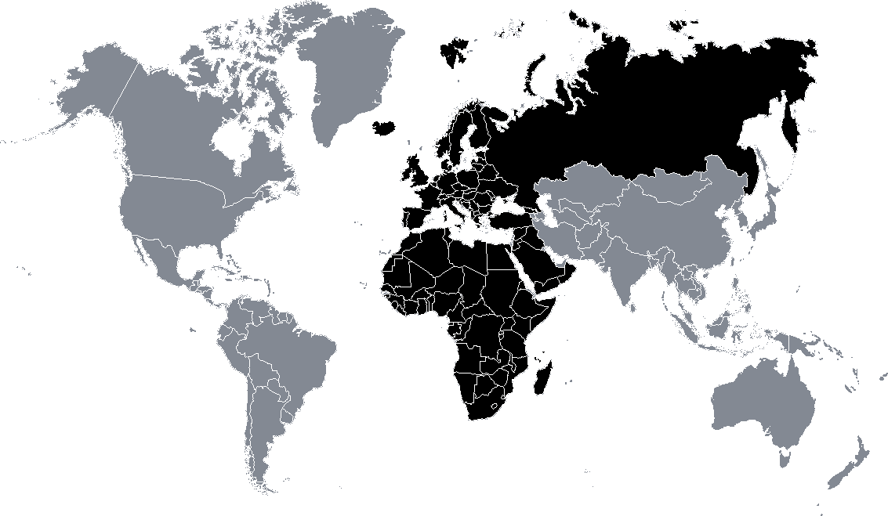
VHF 2m
144-146MHz (2MHz band)
UHF 70cm
430-440MHz (10MHz band)
144.025
Satellite Downlink
144.050 CW calling
430.375
Repeater out (1.6MHz shift)
144.300 SSB Center
431.050
431.200¹
432.100
431.625
Repeater in (7.6MHz shift)
432.000
Repeater in (1.6MHz shift)
144.500
432.400
432.500
432.500 New APRS
433.000
Repeater in (25kHz ch. / 2MHz shift)
432.493
Repeater in (25kHz ch. / 1.6MHz shift)
433.400 SSTV
144.794
144.800 APRS
433.450 Digital voice call
433.600
433.500 FM call
144.975
Repeater in
434.600
Repeater out
(25kHz ch. / 1.6 or 2MHz shift)
145.194
Space Comm
434.790
145.206
435.000
145.575
145.500 FM Calling
Satellite service
Repeater out
145.794
145.800 ISS
145.806
Space Comm
Satellite exclusive
438.000
 | Authorized Peak Envelope Power (PEP) per class (W)
 | I | II | III | IV
VHF - 2m | 400 | 200 | 100 | 50
UHF - 70cm | 200 | 100 | 50 | 30
438.650
Repeater out (7.6Mhz shift)
439.425
¹ 430.000 - 431.200 MHz not part of radio amateur service
IARU Region 1
2m & 70cm Band Plan
All modes
CW
See verso
MGM
none
SSB
20 kHz
Based on IARU-R1 VHF Handbook v9.00 November 2020
Ver 1.1
FM / Dig. voice
12 kHz
Sat. service
Sources:
National Authority for Management and Regulation in Communications of Romania - Radio amateur services regulations
ITU Radio Regulations, 2020 Edition
IARU-R1 VHF Handbook
ISM
YO3MIO - Feel free to print, distribute and modify this document while maintaining the source and author https://github.com/mircea84/VHFHamBands/

Slide 5
VHF 2m
144 - 146 MHz (2 MHz band)
UHF 70cm
430 - 440 MHz (10 MHz band)
Satellite exclusive
439.800
Digital comm link
145.800 ISS
439.5875
145.806
Space Comm
Repeater in R1 (12.5 kHz / 7.6 MHz)
145.794
438.650
Multimode
145.575
438.550
Digital comm repeater
145.500 FM Calling
438.200
Digital comm
Repeater out
438.000
Satellite service
DATV / Data
145.225 FM Calling
437.000 DATV / Data center
145.206
Space Comm
145.194
Repeater in
144.975
436.000
Satellite service
144.794
144.800 APRS
435.000
Repeater out R1 (25 kHz / 1.6 or 2 MHz)
144.750 ATV talk back
434.790
Repeater in (25 kHz / 1.6 MHz)
434.594
Digital comm channels (by exception)
144.600 Data center
434.000
434.000 Digital experim. center
144.500 Image center
432.491
434.775
Digital comm channels
LORA (125 kHz max bw)
144.500
Beacons
144.491
433.600
433.500 FM call
432.400
433.450 Digital voice call
144.400
433.400
433.400 SSTV
Repeater in (25 kHz / 1.6 MHz)
Repeater out (25 kHz / 1.6 MHz)
144.300 SSB center
433.000
Repeater in (25 kHz / 2 MHz)
432.600
Repeater out
432.500
432.500 New APRS
144.150
432.100
Beacons
144.174 FT8
432.370 MS center
144.050 Random MS
432.350 MW talkback center
144.050 CW center
432.200 SSB center
432.000
432.050 CW center
144.025
Satellite downlink only
431.625
Repeater in (12.5 kHz / 1.6 MHz)
 | Authorized Peak Envelope Power (PEP) per class (W)
 | I | II | III | IV
VHF - 2m | 400 | 200 | 100 | 50
UHF - 70cm | 200 | 100 | 50 | 30
431.200
Repeater in R1 (12.5 kHz / 7.6 MHz)
431.050
unavailable
Multimode
430.000 - 431.200 MHz not part of radio amateur service
430.925
Digital comm repeater
In countries without access to the full 70 cm band, the following 12.5 kHz repeater channels with a 1.6 MHz separation between uplink and downlink can be implemented:
a. Input Frequencies (uplink) 431.225 - 431.600 MHz
b. Output Frequencies (downlink) 432.825 - 433.200 MHz
430.600
Digital comm link
430.400
Repeater out (12.5 kHz / 1.6 MHz)
Modes:
Bandwidth:
See verso
IARU Region 1
2m & 70cm Band Plan
All modes
None
CW
20 kHz
Beacons excl.
12 kHz
MGM
Ver 1.2
Based on IARU-R1 VHF Handbook v9.01 March 2021
SSB
FM / Dig. voice
Sources:
National Authority for Management and Regulation in Communications of Romania - Radio amateur services regulations
ITU Radio Regulations, 2020 Edition
IARU-R1 VHF Handbook
Sat. service
ISM
YO3MIO - Feel free to print, distribute and modify this document while maintaining the source and author Source documents here: https://github.com/mircea84/VHFHamBands/
Thanks radioamator.ro community for support!

