Slide 1


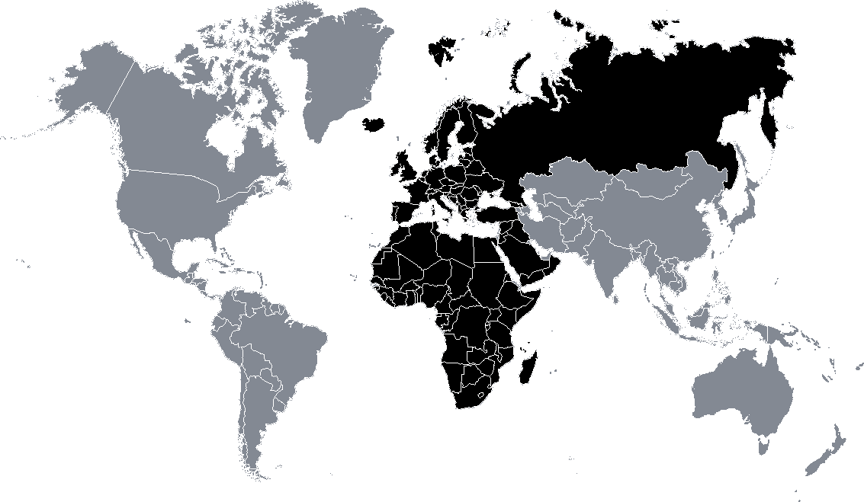
VHF 2m
144-146MHz (2MHz band)
UHF 70cm
430-440MHz (10MHz band)
Satellite exclusive
145.806
Space Comm
439.425
145.794
145.800 ISS
Repeater out (7.6Mhz shift)
Repeater out
438.650
145.575
145.500 FM Calling
438.000
145.206
Space Comm
Satellite service
145.194
Repeater in
144.975
144.794
144.800 APRS
435.000
Repeater out
(25kHz ch. / 1.6 or 2MHz shift)
434.790
434.600
144.500
432.493
433.600
433.500 FM call
433.450 Digital voice call
432.400
433.400 SSTV
433.000
Repeater in (25kHz ch. / 1.6MHz shift)
144.300 SSB Center
Repeater in (25kHz ch. / 2MHz shift)
432.500
432.500 New APRS
144.050 CW calling
432.100
432.000
144.025
Satellite Downlink
431.625
Repeater in (1.6MHz shift)
 | Authorized Peak Envelope Power (PEP) per class (W)
 | I | II | III | IV
VHF - 2m | 400 | 200 | 100 | 50
UHF - 70cm | 200 | 100 | 50 | 30
Repeater in (7.6MHz shift)
431.050
431.200¹
¹ 430.000 - 431.200 MHz not part of radio amateur service
430.375
Repeater out (1.6MHz shift)
All modes
IARU Region 1
2m & 70cm Band Plan
CW
See verso
MGM
None
SSB
20 kHz
FM / Dig. voice
12 kHz
Based on IARU-R1 VHF Handbook v9.00 November 2020
Ver 1.1
Sat. service
Sources:
National Authority for Management and Regulation in Communications of Romania - Radio amateur services regulations
ITU Radio Regulations, 2020 Edition
IARU-R1 VHF Handbook
ISM
YO3MIO - Feel free to print, distribute and modify this document while maintaining the source and author https://github.com/mircea84/VHFHamBands/
Thanks radioamator.ro community for support!

Slide 2
VHF 2m
144-146MHz (2MHz band)
UHF 70cm
430-440MHz (10MHz band)
144.025
Satellite Downlink
144.050 CW calling
430.375
Repeater out (1.6MHz shift)
144.300 SSB Center
431.050
431.200¹
432.100
431.625
Repeater in (7.6MHz shift)
432.000
Repeater in (1.6MHz shift)
144.500
432.400
432.500
432.500 New APRS
433.000
Repeater in (25kHz ch. / 2MHz shift)
432.493
Repeater in (25kHz ch. / 1.6MHz shift)
433.400 SSTV
144.794
144.800 APRS
433.450 Digital voice call
433.600
433.500 FM call
144.975
Repeater in
434.600
Repeater out
(25kHz ch. / 1.6 or 2MHz shift)
145.194
Space Comm
434.790
145.206
435.000
145.575
145.500 FM Calling
Satellite service
Repeater out
145.794
145.800 ISS
145.806
Space Comm
Satellite exclusive
438.000
 | Authorized Peak Envelope Power (PEP) per class (W)
 | I | II | III | IV
VHF - 2m | 400 | 200 | 100 | 50
UHF - 70cm | 200 | 100 | 50 | 30
438.650
Repeater out (7.6Mhz shift)
439.425
¹ 430.000 - 431.200 MHz not part of radio amateur service
IARU Region 1
2m & 70cm Band Plan
All modes
CW
See verso
MGM
none
SSB
20 kHz
Based on IARU-R1 VHF Handbook v9.00 November 2020
Ver 1.1
FM / Dig. voice
12 kHz
Sat. service
Sources:
National Authority for Management and Regulation in Communications of Romania - Radio amateur services regulations
ITU Radio Regulations, 2020 Edition
IARU-R1 VHF Handbook
ISM
YO3MIO - Feel free to print, distribute and modify this document while maintaining the source and author https://github.com/mircea84/VHFHamBands/

Slide 3
VHF 2m
144-146MHz (2MHz band)
Based on IARU-R1 VHF Handbook v9.00 November 2020
Frequency segment | Max Bw. (Hz) | Preferred mode and usage
144.000 -144.025 | 2700 | All mode | sattelite downlink only
144.025 -144.100 | 500 | Telegraphy | 144.050 Telagraphy calling 144.100 Random MS
144.100 - 144.150 | 500 | MGM Telegraphy | 144.110-144.150 CW and MGM EME
144.150 - 144.400 | 2700 | SSB Telegraphy MGM | 144.195-144.205 Random MS SSB 144.300 SSB Centre of activity
144.400 - 144.490 | 500 | MGM Telegraphy | Beacons exclusive
144.491 - 144.493 | 500 | Personal weak signal MGM Beacons | Experimental MGM
144.500 - 144.794 | 20 kHz | All mode | 144.500 Image mode centre (SSTV, Fax,...) 144.600 Data Centre of activity (MGM, RTTY,..) 144.750 ATV Talk back
144.794 - 144.9625 | 12 kHz | MGM Digital Communication | 144.800 APRS 144.8125 DV internet voice gateway 144.8250 DV internet voice gateway 144.8375 DV internet voice gateway 144.8500 DV internet voice gateway 144.8625 DV internet voice gateway
144.975 - 145.194 | 12 kHz | FM/Digital Voice | Repeater input exclusive
145.194 - 145.206 | 12 kHz | FM/Digital Voice | Space Communication
145.206 - 145.5625 | 12 kHz | FM/Digital Voice | 145.2375 FM Internet Voice Gateway 145.2875 FM Internet Voice Gateway 145.3375 FM Internet Voice Gateway 145.375 digital voice calling 145.500 FM calling
145.575 - 145.7935 | 12 kHz | FM/Digital Voice | Repeater output exclusive
145.794 - 145.806 | 12 kHz | FM/Digital Voice | Space Communication
145.806 -146.000 | 12 kHz | All mode | Satellite exclusive
UHF 70cm
430-440MHz (10MHz band)
Frequency segment | Max Bw. (Hz) | Preferred mode and usage
430.000 - 431.975 | 20 kHz | All mode | 430.025 - 430.375 FM repeater output (1.6 MHz shift) 430.400 - 430.575 digital communications 430.600 . 430.925 digital communications repeater channels 430.925 - 431.025 multimode channels 431.050 - 431.825 Repeater input channel freqs 7.6 MHz shift 431.625 - 431.975 Repeater input channels (1.6MHz shift)
432.000 - 432.100 | 500 | MGM Telegraphy | 432.050 Telegraphy Centre of activity
432.100 - 432.400 | 2700 | MGM Telegraphy SSB | 432.200 SSB center of activity 432.350 Microwave talkback center of activity 432.370 Meteor Scatter center of activity
432.400 - 432.490 | 500 | MGM Telegraphy | Beacons Exclusive
432.491 -432.493 | 500 | EMGM | Experimental MGM
432.500 - 432.975 | 12 kHz | All mode | 432.500 New APRS frequency 432,600-432,9875 REPEATER INPUT REGION 1 STANDARD, 25 kHz spacing, 2 MHz shift (Channel freqs 432.600 - 432.975MHz)
433.000 -433.375 | 12 kHz | FM / Digital Voice repeaters | REPEATER INPUT REGION 1 STANDARD, 25 kHz spacing, 1.6 MHz shift
433.400 - 433.575 | 12 kHz | FM / Digital Voice | 433.400 SSTV (FM/AFSK) 433.450 Digital Voice calling 433.500 FM calling
433.600 - 434.000 | None | All mode | 433.625 - 433.775 Digital communications channels 434.000 Centre frequency of digital experiments
434.000 - 434.594 | 12 kHz | All mode - ATV | 434.450-434.575 Digital communications channels
434.594 - 434.981 | 12 kHz | All mode | 434.600-434.9875 Repeater Output (25 kHz spacing 1.6 or 2MHz shift)
435.000 -436.000 | None | Satellite service
436.000 -438.000 | None | Satellite service DATV/data | DATV/data center of activity
438.000 -440.000 | None | All mode | 438.025 - 438.175 Digital communication channels 438.200 - 438.525 Digital communication repeater channels 438.550 - 438.625 Multi mode 438.650 - 439.425 Repeater output channels (7.6 MHz shift) 439.800 - 439.975 Digital communication link channels

