Slide 1

Machine Learning Trading Algorithm
Project 4

Slide 2
Objective
Predict the direction of the next move in the price of a stock.
Source
Yahoo Finance

Slide 3
Method
The algorithm uses the RandomForestClassifier made of decision trees.
The output of the algorithm is a binary choice: 1 for UP and 0 for Down.
The model takes as input the daily stock prices for the past 25 years. That represents over 6,000 rows.
In the initial phase, the model is trained on the first 5,700 rows and tested on the last 300 rows.
The predictors used are: Open, High, Low, Close prices and the Volume.

Slide 4
Optimization
In this phase, the model is optimized by adding new predictors:
SMA 5 days, SMA 50 days, SMA 200 days,
RSI, Trend 5, 50, 200 days
Close ratio 5, 50, 200 days
Backtesting method:
the model is trained on the first 2,500 rows - corresponding to 10 years of data
the model is tested on the next 250 rows (the 11th year)
the 11th year is added to the testing dataset and model is trained on the first 11 years
the model is tested on the 12th year and so on.

Slide 5
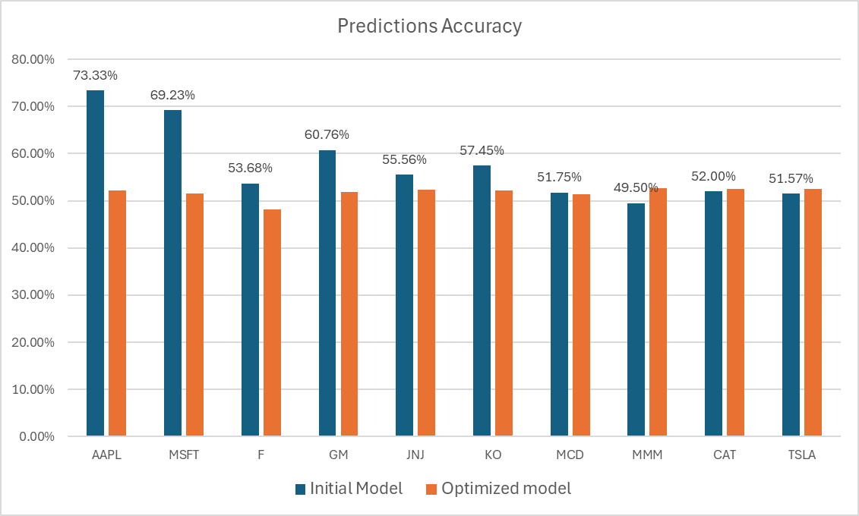
Results

