Slide 1
Online School System
Presentation
By Miroslav Mirchev

Slide 2
General Description

Slide 3
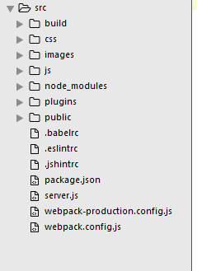
This is the root folder of the project.

Slide 4
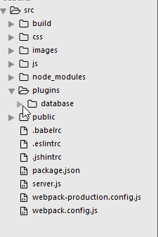
The backend is separated in a plugin.

Slide 5
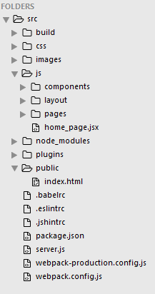
The production build
The react view files
The root of the system is the “public” folder.

Slide 6
Back End

Slide 7
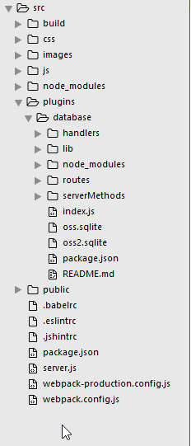
In the backend we have the index file,
Sqlite db and package.json

Slide 8
Then we have the folders for
The project routes, handlers and server methods

Slide 9
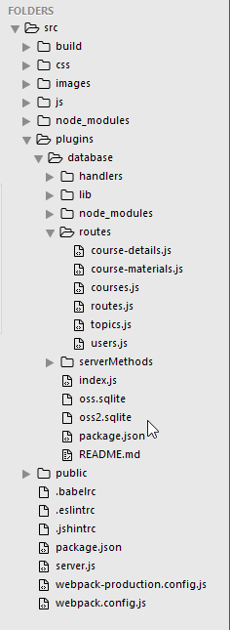
We've got the following routes

Slide 10
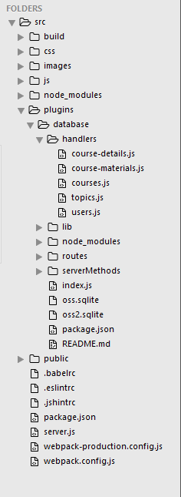
And handlers

Slide 11
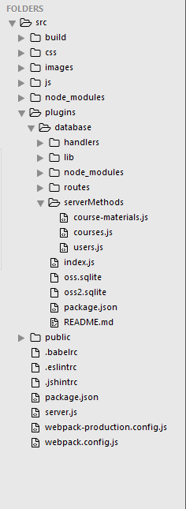
And server methods

Slide 12
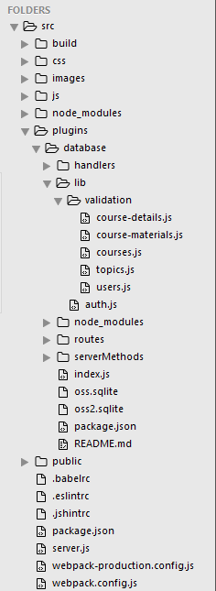
8
We've got also libraries for
Validation and authentication.

Slide 13
Front End

Slide 14
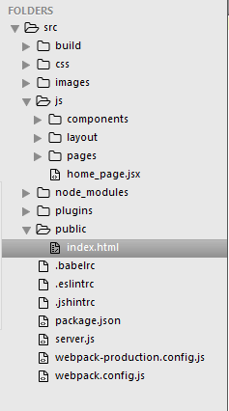
Our project consists of only one html page,
Located at the public folder of the project.

Slide 15
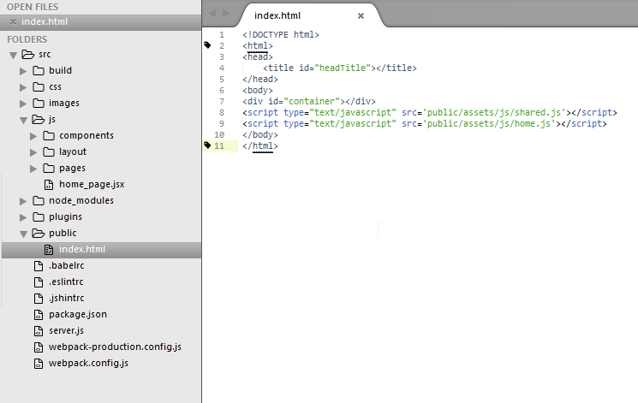
The index folder has only one container div, where is filled the content of the react views.

Slide 16
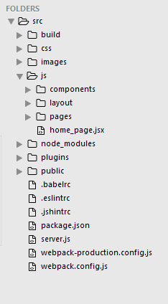
In the js folder are located all
React view pages

Slide 17
They are separated into components,
Layout and pages.
The home_page.jsx is the page
Where we define the front-end
Routes of the project and include all
React component pages.

Slide 18
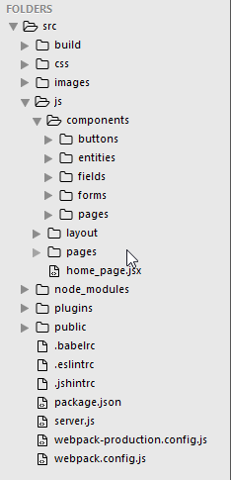
This is the content of the
Components folder

Slide 19
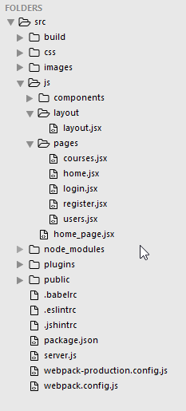
This is the content of the layouta nd pages folders

