Slide 1


Midi Classification using Similarity Metric based on Kolmogorov Complexity
Faculty of Information Engineering, Computer Science and Statistics
M.Sc. in Artificial Intelligence and Robotics
AA 2016-2017
Professor:
Aurelio Uncini
Presenters:
Irvin Aloise, Mirco Colosi

Slide 2
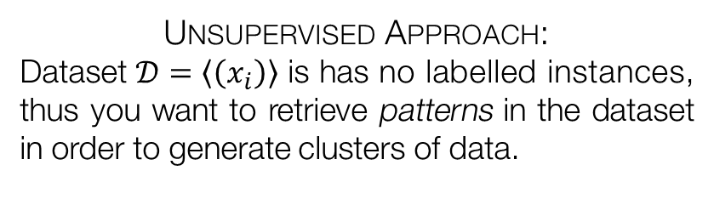
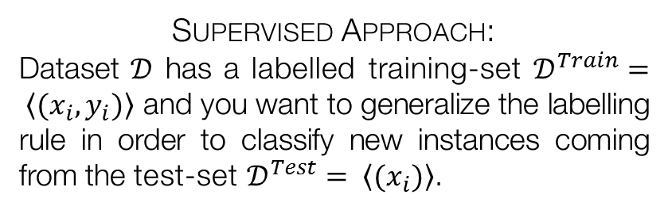
Introduction
The project proposes a method to classify MIDI files by author, evaluating a similarity measure based on the concept of Kolmogorov complexity.
In general, classification is the task of assigning instances to one of several predefined categories, called labels. This task has main two sub-categories.
Supervised Approach:
Dataset $𝒟$ has a labelled training-set $𝒟^{Train}= \left\langle (x_{i}, y_{i})\right\rangle$ and you want to generalize the labelling rule in order to classify new instances coming from the test-set $𝒟^{Test}= \left\langle (x_{i})\right\rangle$.
Unsupervised Approach:
Dataset $𝒟=\left\langle \left(x_{i}\right)\right\rangle$ is has no labelled instances, thus you want to retrieve patterns in the dataset in order to generate clusters of data.
In this case, it has been used a k-NN classifier to generate label, exploiting the similarity metric based on the Kolmogorov complexity of the files.

Slide 3
Motivations
Kolmogorov complexity’s main feature is that it is universal and, thus, can be employed potentially for every data-type without loss of generality.
Why is MIDI suitable for such task?
Popular
Light-weight
Musical information
Easy to manage

Slide 4
Related Works
Classify MIDI songs is a well-known problem in the literature, especially to infer the genre of the song in order to identify related songs.
Several different approaches have been tried:
Coarse-grain features
This approach exploits MIDI raw musical feature to classy files by genre. Examples of features are: Melodic intervals, instrument classes, drum-kits, meter, note extension.
Classes represent the style of the song e.g. Bass, Lead, Rhythm, Acoustic. A large set of audio feature is exploited, from simple statistics – mean pitch, pitch SD, etc. – to more complex ones – coverage, liricality and so on .
Complex audio features
Audio features & similarity metric
Similar to the one used in this project, composed by two parts:
NCD-based classifier
Feature-based classifier

Slide 5
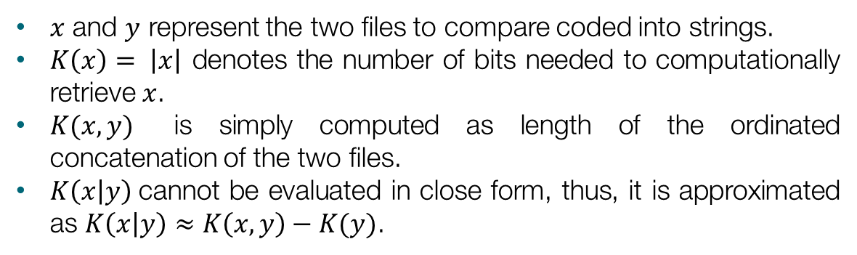
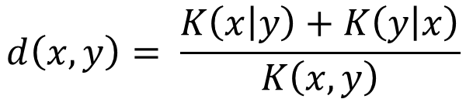
Similarity metric based on Kolmogorov Complexity
Kolmogorov complexity can be intended as the length of the file’s ultimate compression. Thus, the similarity between two object is defined as follows:
$$d\left(x,y\right)= \frac{K\left(x | y\right)+K\left(y | x\right)}{K\left(x,y\right)}$$
$x$ and $y$ represent the two files to compare coded into strings.
$K\left(x\right)= \left|x\right|$ denotes the number of bits needed to computationally retrieve $x$.
$K(x,y)$ is simply computed as length of the ordinated concatenation of the two files.
$K\left(x | y\right)$cannot be evaluated in close form, thus, it is approximated as $K\left(x | y\right)≈K\left(x,y\right)−K(y)$.

Slide 6
Dataset description
It has been implemented a k-NN classifier in order to assign the author to MIDI files, using the previously specified distance.
MIDI Dataset:
Population
This Dataset is composed by 600 files, divided into 100 files for each authors taken in consideration. The chosen composers are: Bach, Beethoven, Mozart, Schubert and Vivaldi.
The dataset has been divided as follows:
60 files for each author as training set
40 files for each author as test set
Training - Test sets
Experiments have been done using the raw MIDI dataset and a cloned version of itself that has been pre-processed:
Timing and expression information have been removed.
Suppression of multi-tracks.

Slide 7
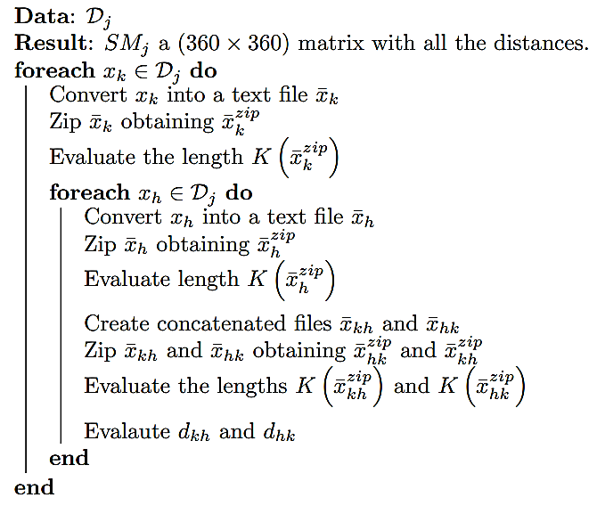
Algorithm implementation
Firstly, it has been evaluated the similarity between all the files in the training set, obtaining a $\left(360×360\right)$ matrix in which all distances are stored.
It has been exploited the following algorithm on both datasets:

Slide 8
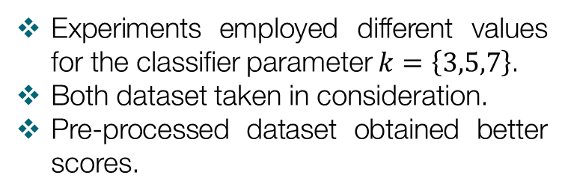
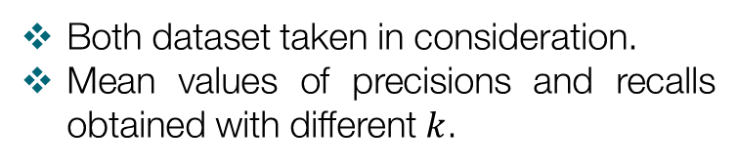
Experimental results
Each new instance of the test-set as been classified, predicting the author label using a k-NN classifier built on the similarity metric previously described.
Outcomes:
Confusion Matrices
Precision and recall
Experiments employed different values for the classifier parameter $k=\left\{3,5,7\right\}$.
Both dataset taken in consideration.
Pre-processed dataset obtained better scores.
Both dataset taken in consideration.
Mean values of precisions and recalls obtained with different $k$.

Slide 9
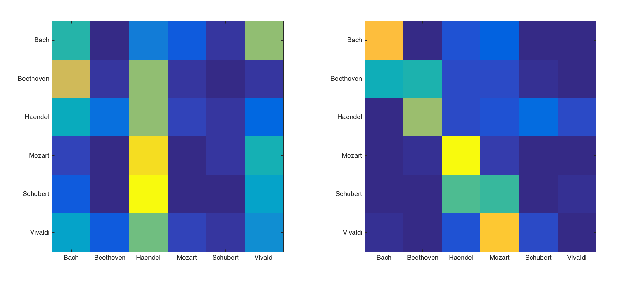
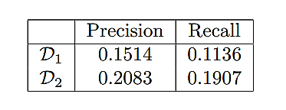
Experimental results
Each new instance of the test-set as been classified, predicting the author label using a k-NN classifier built on the similarity metric previously described.
Outcomes:
Confusion Matrices
Precision and recall

Slide 10
Conclusions and future works
The project provides a classification system for MIDI files, based on a k-NN that uses the Similarity Metric computed through the evaluation of the Kolmogorov Complexity.
Experiments ran on a 600-files-dataset shown two main outcomes:
Pre-processing is required
Cloned dataset provides better results both in precision and recall.
Same execution time for both datasets.
Weak classification performances
Classification using only a similarity metric is not accurate.
Embedding into a bigger classification system – based on audio features – would improve performances.

