Slide 1
Introduction into Data Science
Project: Activity Recognition
Mirco Pyrtek
Ralf Bleymehl

Slide 2
Topics
Motivation
What is the current situation?
What is the data?
What could be done with the data?
What value could be extracted from the data?
Derived business models
Implementation
Machine Learning approach
Score Map
Results
Model selection
Activity classification
Perspectives

Slide 3
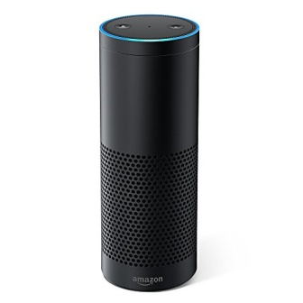
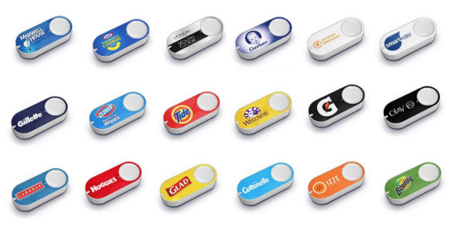
Motivation What is the current situation?
Technologies enable society to „get what they wish for“ with a minimal amount of effort
e.g. Speech-Assisstants, One-Click-Buy-Options
Has an impact of their users fitness
Leads to mental and physical health issues
Machine Learning as a counter measure
Proposition: Model that tracks the users activity and maps it to a score

Slide 4
Motivation What is the data?
Data collected as part of master thesis
Vital signs and movement patterns ascertained
Acceleration: chest, left ankle, right wrist
Gyro: left ankle, right wrist
Magnetometer: left ankle, right wrist
Electrocardiogram

Slide 5
Motivation What value could be extracted from the data?
Data used to classify an executed physical ability
Total of twelve different activities
Standing still
Sitting
Lying Down
Running
Jogging
…
Idea: Using a machine learning approach to predict an activity
Mapping of score to the predicted activity
Used to calculate a daily activity score

Slide 6
Motivation Derived business models
Model that is used in several sectors
Smart Home – react to fitness of resident
Insurance – construct business models
Healthcare – Early detection of health issues

Slide 7
Implementation Machine Learning Approach
Data preparation
Training Data
Validation Data
Test Data
50%
25%
25%
Classifiers of scikit-learn package
K-nearest neighbors
Gradient boosting
Support vector machine
Most simple approach of these three
„If the models perform mostly equal choose the simplest one“
Well performing with big amounts of data (high sampled sensory data)
Fast in predictive time, slow while training
Well founded approach in machine learning
Easy control over complexity with C parameter

Slide 8
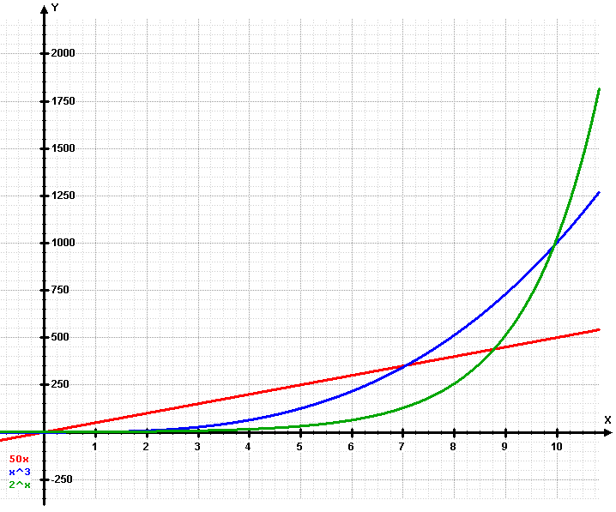
Implementation ScoreMap
Maps certain activities to an ordinal scale
E.g. Sitting -> 0, Walking -> 1, Running -> 2
Computes scores with different strategies
Linear strategy as default
Quadratic strategy
Kubic strategy
Exponetial strategy
Formula for the score:
y = a + b * strategy(activity)
with strategy as the strategy function e.g. exp, a as bias, b as multiplicator
Quelle: https://upload.wikimedia.org/wikipedia/commons/5/53/Exponential.png

Slide 9
Results Model Selection
K-nearest neighbors
Gradient boosting
Support vector machine
Parameters:
N_neigbors:
[1, …, 81]
Validation accuracy:
93.27%
Parameters:
N_estimators:
[1, 2, 4, …, 256]
Learning_rate:
[1e-05, 0.0001, …, 10]
Validation accuracy
98.13%
Parameters:
C:
[[1e-06, 1e-05, …, 100000]
Gamma:
[1e-06, 1e-05, …, 10]
Validation accuracy:
97.51%
The gradient boosting model was selected as the best performing model
Test accuracy: 98.44%

Slide 10
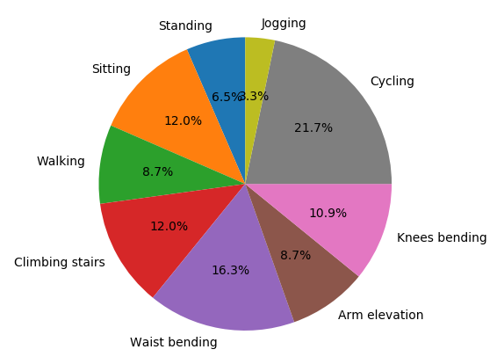
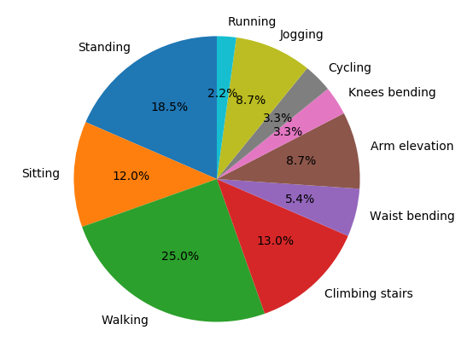
Results Activity classification
Scoring strategy: exponential
Subject 1: Total score of 134
Subject 2: Total score of 80

Slide 11
Perspectives
Controlled experiments and field studies for achieving a good foundation of the activity score model (what is fit, what is lazy behaviour)
Integration into daily life
Healthcare:
Information about upcoming health risks
Preventive measures (healthcare as motivation)
Smart Home:
Set up a cozy homecoming scenario (light, heat) if the user had a hard day
Set up cold water if the user comes from sports
Motivate the user if he was sitting the whole day (e.g. music as motivation)
Insurancy companies:
New business model dynamic to activity behaviour of ist users
User has the opportunity of lower prices if he behaves almost healthy
Motivation to change activity behaviour (money as motivation)

Slide 12
Thank you for your attention.
Questions?

