Slide 1
Introduction into Data Science
Project: Activity Recognition
Mirco Pyrtek
Ralf Bleymehl

Slide 2
Topics
Motivation
What is the data?
What could be done with the data?
What value could be extracted from the data?
Derived business models
Implementation
Machine Learning approach
Score Map
Results
Model selection
Activity classification
Perspectives

Slide 3
Implementation Machine Learning Approach
Data preparation
Training Data
Validation Data
Test Data
50%
25%
25%
Classifiers of scikit-learn package
K-nearest neighbors
Gradient boosting
Support vector machine
Most simple approach of these three
„If the models perform mostly equal choose the simplest one“
Well performing with big amounts of data (high sampled sensory data)
Fast in predictive time, slow while training
Well founded approach in machine learning
Easy control over complexity with C parameter

Slide 4
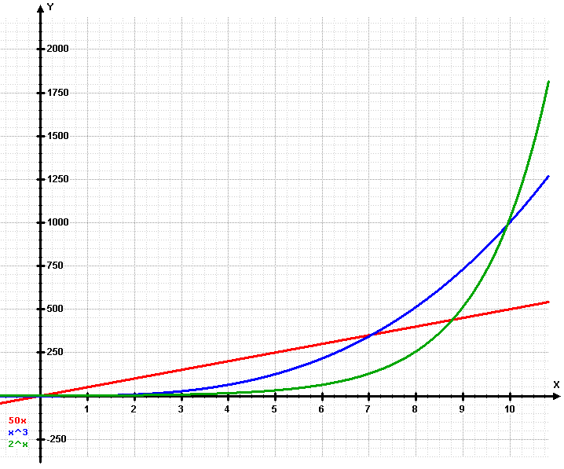
Implementation ScoreMap
Maps certain activities to a ordinal scale
E.g. Sitting -> 0, Walking -> 1, Running -> 2
Computes scores with different strategies
Linear strategy as default
Quadratic strategy
Kubic strategy
Exponetial strategy
Formula for the score:
y = a + b * strategy(activity)
with strategy as the strategy function e.g. exp, a as bias, b as multiplicator
Quelle: https://upload.wikimedia.org/wikipedia/commons/5/53/Exponential.png

Slide 5
Results Model Selection
K-nearest neighbors
Gradient boosting
Support vector machine
Parameters:
N_neigbors:
[1, …, 81]
Validation accurracy:
93.27%
Parameters:
N_estimators:
[1, 2, 4, …, 256]
Learning_rate:
[1e-05, 0.0001, …, 10]
Validation accurracy
98.13%
Parameters:
C:
[[1e-06, 1e-05, …, 100000]
Gamma:
[1e-06, 1e-05, …, 10]
Validation accurracy:
97.51%
The gradient boosting model was selected as the best performing model
Test accurracy: 98.44%

Slide 6
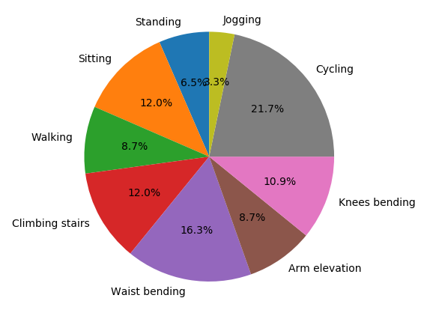
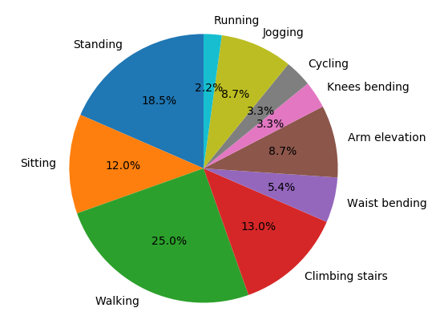
Results Activity classification
Scoring strategy: exponential
Subject 1: Total score of 134
Subject 2: Total score of 80

Slide 7
Perspectives
Controlled experiments and field studies for achieving a good foundation of the activity score model (what is fit, what is lazy behaviour)
Integration into daily life
Healthcare:
Information about upcomming health risks
Preventive measures (healthcare as motivation)
Smart Home:
Set up a cozy homecoming scenario (light, heat) if the user had a hard day
Set up cold water if the user comes from sports
Motivate the user if he was sitting the whole day (e.g. music as motivation)
Insurancy companies:
New business model dynamic to activity behaviour of ist users
User has the opportunity of lower prices if he behaves almost healthy
Motivation to change activity behaviour (money as motivation)

Slide 8
Thank you for your attention.
Questions?

