Slide 1
Ubiquitous Big Data Engineering and Analytics as a Service Demo v2.0
This presentation is linked to the Postman collection available at:
https://github.com/mircosoderi/State-of-the-art-Artifacts-for- Big-Data-Engineering-and-Analytics-as-a-Service /blob/main/demov2.postman_collection.json

Slide 2
Background
Refer to publications by Mirco Soderi, [Vignesh Kamath], John G. Breslin, all affiliated at the Data Science Institute, National University of Ireland Galway, dated from June 2021 onward, to get some background knowledge about what is presented in this demo.
Also refer to the OpenAPI 3.0 yaml spec files published at: https://github.com/mircosoderi/State-of-the-art-Artifacts-for-Big-Data-Engineering-and-Analytics-as-a-Service and regarding the Network Factory, the Service Node, and the Transformation Library, for a deeper understanding of the API calls made in this demo.

Slide 3
Get started
A Docker Engine, and the msoderi/network-factory Docker image is the very minimum that you need to get started.
Create a container from the mentioned image. Map the container TCP port 1880 to your local port 585 to run the demo collection as is.

Slide 4
Initial network initialization
Whatever the purpose of the computation is, there is a minimal set of nodes and a minimal “infrastructure” that are always needed.
API calls from #1 to #5 are for that. The AI server is not needed for the very first example and is not created. It will be added later.

Slide 5
Alert based on a configured threshold (1)
API calls from #6 to #11 are specific to the very first example that we see in this demo. They create virgin Service Nodes, all to be configured.
API calls from #12 to #194 are for configuring the Service Nodes so that they could accomplish what we want for this first example.
Once configured, they must be started (calls from #195 to #199). What we start it is not the Docker containers (they are automatically started at creation), instead we enable the Business Logic flows inside the containers, that are disabled by default at startup to prevent errors from temporary misconfigurations.

Slide 6
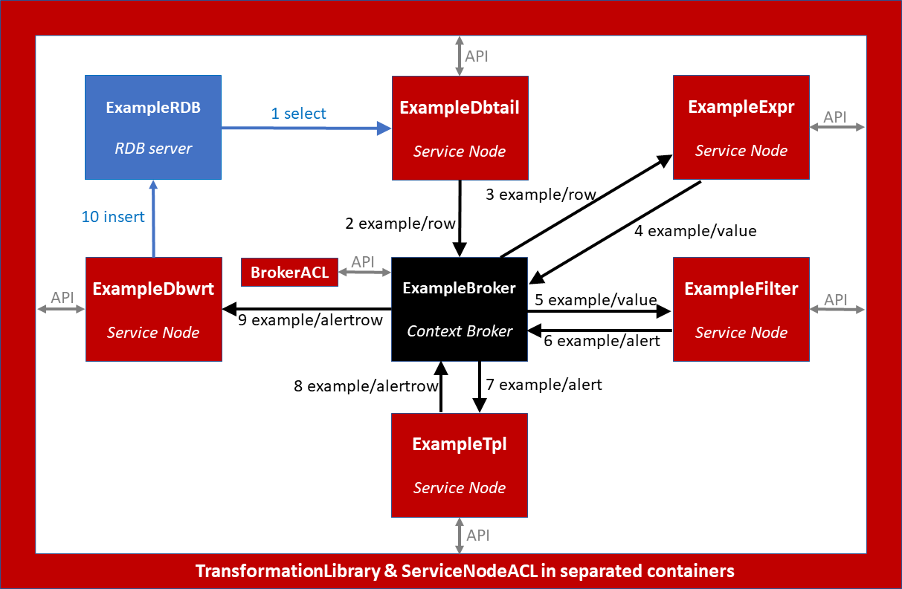
Alert based on a configured threshold (2)

Slide 7
Alert based on a configured threshold (3)
In this example, we read from a configured (source) database table, and if the read value is greater than a configured threshold (100), we write to a configured (alert) database table.
Once that all what described in the previous slides is done, we are ready to test.
We will then get a shell of the RDB container, and run mysql to access the AlertDatabase as root with password root
We will feed input values by running queries such as: insert into source(value,datetime) values (10, unix_timestamp())
We will inspect the alert table to verify that things work

Slide 8
Alert based on a configured threshold (4)
In version 2 of the demo, which is the one to which we refer in this presentation, a folder named “Crazy Alerting System # 1” is present.
Through the APIs contained in that folder, a Web interface is built for testing the alert based on a configured threshold.
The interface consists of a textbox where you have to enter values, and then press ENTER to submit the value to the system.
Below the textbox, a colored text is displayed that indicates if the last inserted value is normal (green), or out of boundaries (red).

Slide 9
Clustering-based alert (1)
In the second example, the alert is raised performing a clustering of the seen values and raising an alert if the last seen value falls in the cluster that is the highest in average. So, this involves machine learning, and it is when the AI server enters the scene.
In calls from #200 to #203 we create and start the AI server and enable the ExampleFilter Service Node to interact with it.
In calls from #204 to #206 we reconfigure the ExampleFilter: it now must not apply a threshold taken from its own configuration, but it must “ask” to the AI server if the value is “high”.
Test is accomplished exactly the same as in the previous example.

Slide 10
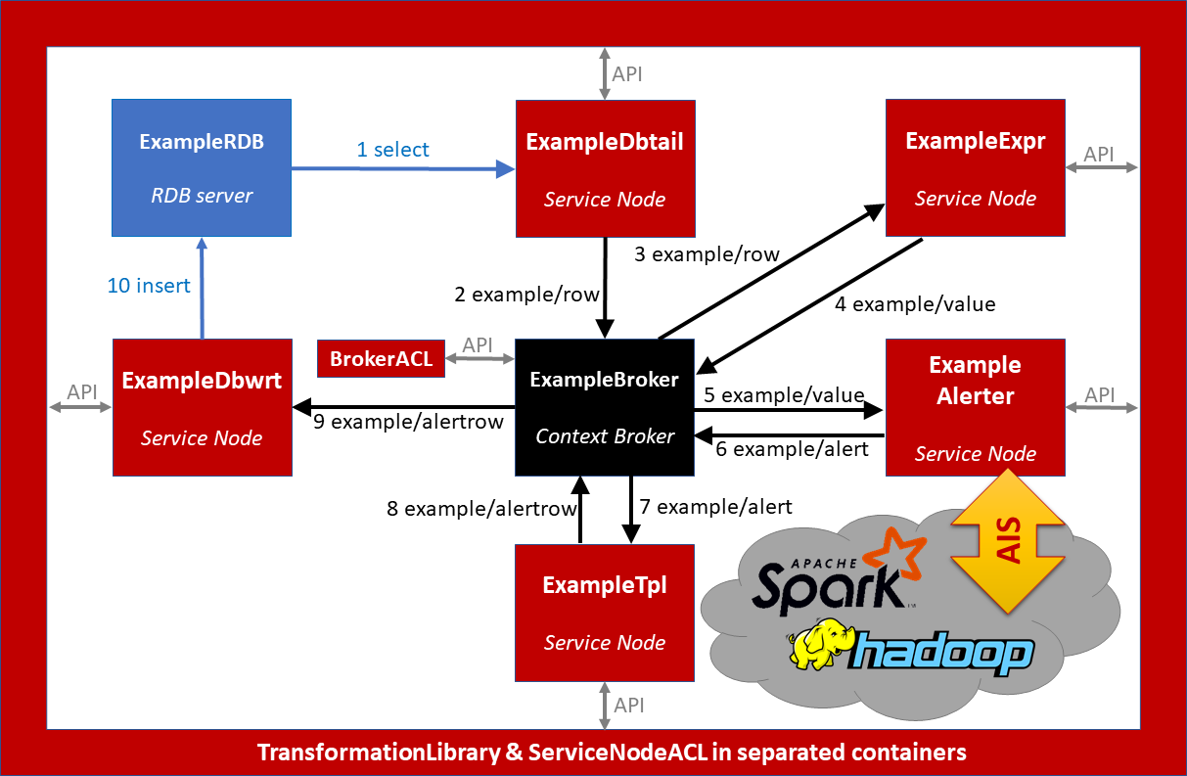
Clustering-based alert (2)

Slide 11
Clustering-based alert (2)
In version 2 of the demo, which we are referring to in this presentation, a folder named “Crazy Alerting System # 2” is present.
The folder contains only one API call, which is enough for converting the Web interface built in “Crazy Alerting System # 1” and making it suitable for interfacing with the clustering-based alerting system.
In particular, after having filled the textbox and pressed ENTER, the value is displayed below the textbox colored in red, yellow, or green, depending on the cluster where it fell.
The Web interface can be reached at the same URL of the # 1.

Slide 12
Display alert on Web page (1)
Instead of relying on RDB queries for testing, we now want to display the alert on a Web page. The input values are still sent via RDB query.
We pretend not to have a module/subflow available in the Transformation Library that allows to display a value on a Web page (actually, the html subflow would be suitable for that), and we add the module via API call, to show how functionalities can be added to the library at runtime and then used in Service Nodes.

Slide 13
Display alert on Web page (2)
Call #207 adds the module to the Transformation Library
Call #208 creates the Service Node that will use the new module
Calls #209 to #223 configure the newly created Service Node
Call #224 starts the newly created Service Node
To test:
Connect to https://localhost:1998/ui where “high” values will be displayed
Send input values via RDB insert query to the source table as usual

Slide 14
Cleaning
In the following examples we no longer need the Service Nodes that we have created so far. So, we stop, switch off, and destroy them.
This is what calls #225 to #244 do
In version 2 of the demo, which we are referring to in this presentation, a folder named “Crazy Alerting System # 3” is present. It contains APIs for stopping and deleting the Crazy Node where the Web interface for the alerting system is implemented.

Slide 15
Preparing For Big Data Eng. And Analytics (1)
The following examples will show how Big Data Engineering and Analytics also including Machine Learning can be accomplished using the same components that we have seen so far (Service Nodes, Transformation Library, AI server), together with single-node Cloud apps such as Spark and HDFS (suitable for dev/test/demo purposes).
The computation network is created and configured using the APIs exposed by the Network Factory (for creating the nodes) and the APIs exposed by the different Service Nodes (for configuring each of them singularly). See next slide for a picture of the computation network.
API calls #245 to #495 create, configure, and start all what is needed

Slide 16
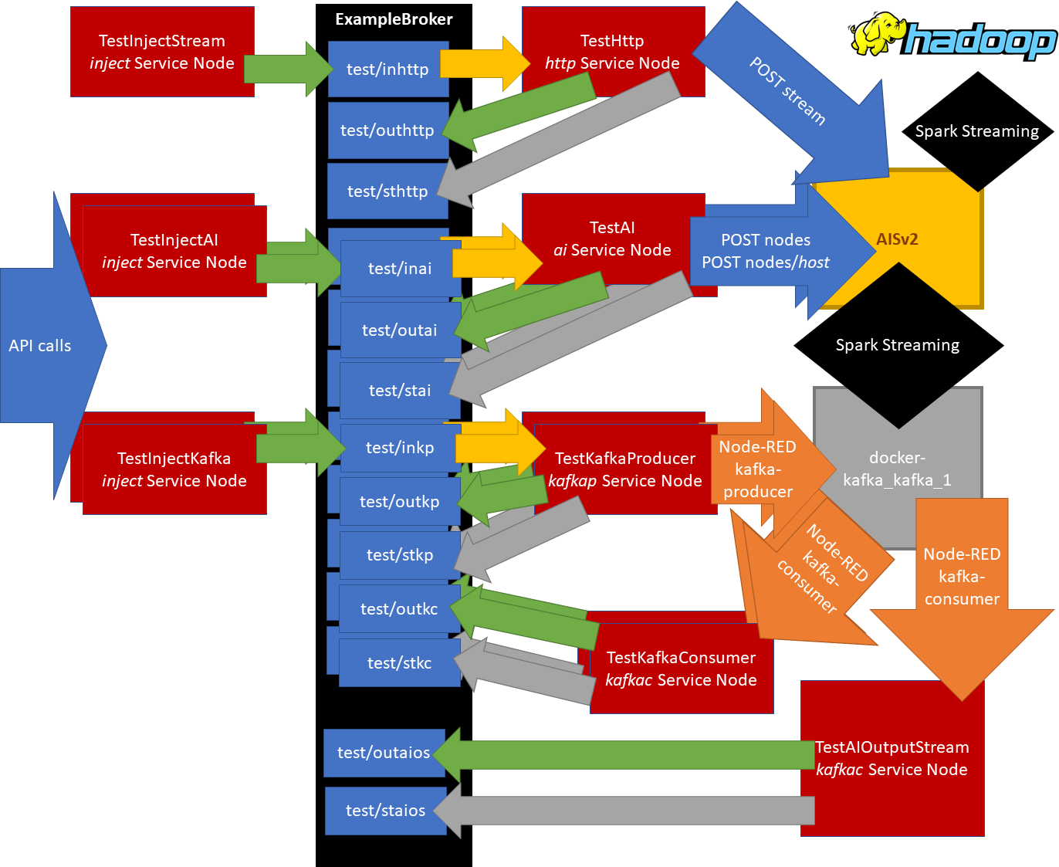
Preparing For Big Data Eng. And Analytics (2)

Slide 17
Crazy Big Data End AI # 1
In version 2 of the demo, which we are referring to in this presentation, a folder named “Crazy Big Data End AI # 1” is present.
In that folder, APIs are contained that create a Web interface for testing the stream forward, filter, and expression functionalities, and also the stream clustering and classification.
Values can be inputted into the system using the textbox on the left (press ENTER to submit), and responses are displayed on the right.
This way, it is possible to test the functionalities without using the Control Room.

Slide 18
Stream Forward
The first example of Big Data engineering is the most basic that one can imagine. It just forwards messages coming from a configured Kafka topic/stream, to a different configured Kafka topic.
API calls #496 to #546 configure the Service Node so that it could properly interface with the AI server and obtain the above
API calls #547 to #550 are for testing purposes. Open the ControlRoom and focus on messages coming from the test/outaios MQTT topic to have evidence that things work.

Slide 19
Stream Filter
The second Big Data engineering example does something similar to the Stream Forward example, but this time messages are forwarded only if they satisfy a configured condition. In the example, the condition is that the value must be between 50 and 100.
API calls #551 to #553 reconfigure the same Service Node used for Stream Forward, so that it could now have this filtering done by the AI server.
API calls #554 to #559 are for test purposes. Open the ControlRoom and focus on messages coming from the test/outaios MQTT topic to have evidence that things work.

Slide 20
Stream Expression
In this third example of Big Data engineering, for each message coming from a configured Kafka stream, a configured expression is computed, and the result is written to a different configured Kafka stream.
API calls #560 to #562 reconfigure the same Service Node used in the previous examples, so that the above could be accomplished
API calls #563 to #567 are for testing the functionality. Open the ControlRoom and focus on messages coming from the test/outaios MQTT topic to have evidence that things work.

Slide 21
Generating a demo training set for ML (1)
In the following examples, things will get even more interesting, since we will see some of the Machine Learning capabilities currently installed in the AI server in operation.
For this purpose, we first need to produce a demo dataset to be used for the training. The dataset will be first created as a CSV file, and then converted to libsvm, and stored on our single-node HDFS.
API calls #568 to #694 are for configuring and starting the Service Nodes so that a CSV file could be created, filled, and stored on HDFS
API calls #695 to #720 are for starting the stream tasks the server side, and sending the values to be stored in the CSV

Slide 22
Generating a demo training set for ML (2)
API calls #721 to #727 are for verifying that the CSV has been created successfully. The size is checked, and a preview is also obtained. Open the ControlRoom and focus on messages coming from the test/outaios MQTT topic to display them.
API calls #728 to #732 are for configuring the Service Node that will interface with the AI server to transform the CSV to Libsvm
API call #733 is the one that actually triggers the transformation
API calls #734 to #740 are for verifying that the Libsvm file has been generated successfully. Again, check the ControlRoom for displaying size and preview of the Libsvm file.

Slide 23
Clustering (1)
In this example, we will train the K-Means model that comes with Spark and store the trained model on HDFS.
Then, we will see how the trained model can be used to obtain one-shot predictions, where the value is sent by a Service Node via API call, and its associated cluster is (asynchronously) provided back by the AI server to the same Service Node that made the request.
Finally, we will perform stream predictions, still using the same model trained above, so the Service Node controls (starts/stops) the AI server task, which reads from a configured Kafka stream, and outputs its predictions (associated clusters) to a different configured stream.

Slide 24
Clustering (2)
API calls #741 to #743 are for configuring the Service Node that must interface with the AI server to train the K-Means model
API call #744 is the one that triggers the training, and stores the trained model on HDFS
API calls #745, #746 configure the Service Node so that one-shot predictions could be obtained from its interfacing AI server
API calls #747, #748 test the functioning against two values
API calls #749 to #757 configure the Service Node for stream pred.
API calls #758 to #761 are for verifying stream pred. (remember how?)

Slide 25
Classification
After having see something about clustering, we now see something about classification.
The logistic regression model that comes with Spark is used
The same training dataset used for clustering is used
What we do it is to train the model using the demo training dataset and store the trained logistic regression model to HDFS
Then, we configure what is needed, and we make API calls for getting one-shot classifications in first, and stream classifications then
API calls #762 to #781 do what is described in this slide

Slide 26
Crazy Big Data Eng AI # 2
Before stepping to data visualization, a folder named “Crazy Big Data End AI # 2” is present in version 2 of the demo, which is the one we are referring to in this presentation.
The folder contains just three API calls, for stopping and deleting the crazy node where the Web interface is implemented that is used for testing the big data stream engineering and analytics functionalities.

Slide 27
Big Data Visualization
We are now ready to go ahead and see how the same building blocks that we have seen so far can be used for displaying Big Data on customized line plots, pie charts, histograms, and possibly any other kind of representation.
The tasks that are currently available in the AI server as for data visualization are for line plots, pie charts, and histograms, and all of them are covered by this demo.
But before of that, we must do some cleaning. API calls #782 to #847 stop, switch off, and remove everything that we used for the examples that we have run so far.

Slide 28
Big Data Visualization: initialization
API calls #848 to #869 recreate the Transformation Library, MQTT broker with its related ACL API (placeholder), the AI server, all the needed Service Nodes with their related ACL API (placeholder). Briefly, everything’s needed for demonstrating Big Data visualization.

Slide 29
Basic Tabular Visualization (1)
API calls #870 to #1030 are aimed at configuring the very minimum Service Nodes that are necessary for the first of the Big Data visualization examples included in this demo, that is:
On one side, a Service Node that gets values via API and publishes them to a MQTT broker topic, and a second Service Node that reads from the MQTT broker topic and publishes to a Kafka topic/stream
On the other side, a Service Node that interfaces with the AI server for producing the HTML markup from messages read from a configured Kafka stream, and a second Service Node that displays the generated markup.

Slide 30
Basic Tabular Visualization (2)
In this first extremely basic example of data visualization, we are not able to generate keys, so only the value is filled in each message in the Kafka stream. The why of this is that the Node-RED module that implements the Kafka client is… bugged.
API calls #1031 to #1036 are for testing this first data visualization functionality. Connect to https://localhost:2130/ui first.

Slide 31
Basic Tabular Visualization (3)
In version 2 of the demo, which we are referring to in this presentation, a folder named “Crazy Big Data Viz” is present.
The folder contains APIs that build a Web interface through which it is possible to input values into the system and see them displayed on the table. The input and output part of the interface are on the same node. You can switch between the two using the menu on the top left corner.
The Web interface is built by modifying the Web interface that was already available in version 1, and which was only suitable for displaying the table, while the values were sent via API calls.

Slide 32
Advanced publishing to Kafka streams (1)
To enjoy the Big Data visualization functionalities at their most, we must be able to publish messages to Kafka stream that include both a meaningful key, and a value.
That’s not trivial. The Node-RED Kafka client does not implement that. So, we need two Service Nodes, and two corresponding tasks on the AI server, one of which writes to the AI server filesystem, while the other listens for changes to the file system and publishes them to a Kafka stream. That’s what we have on the left, in the next slide, and that’s what API calls #1037 to #1113 are for.

Slide 33
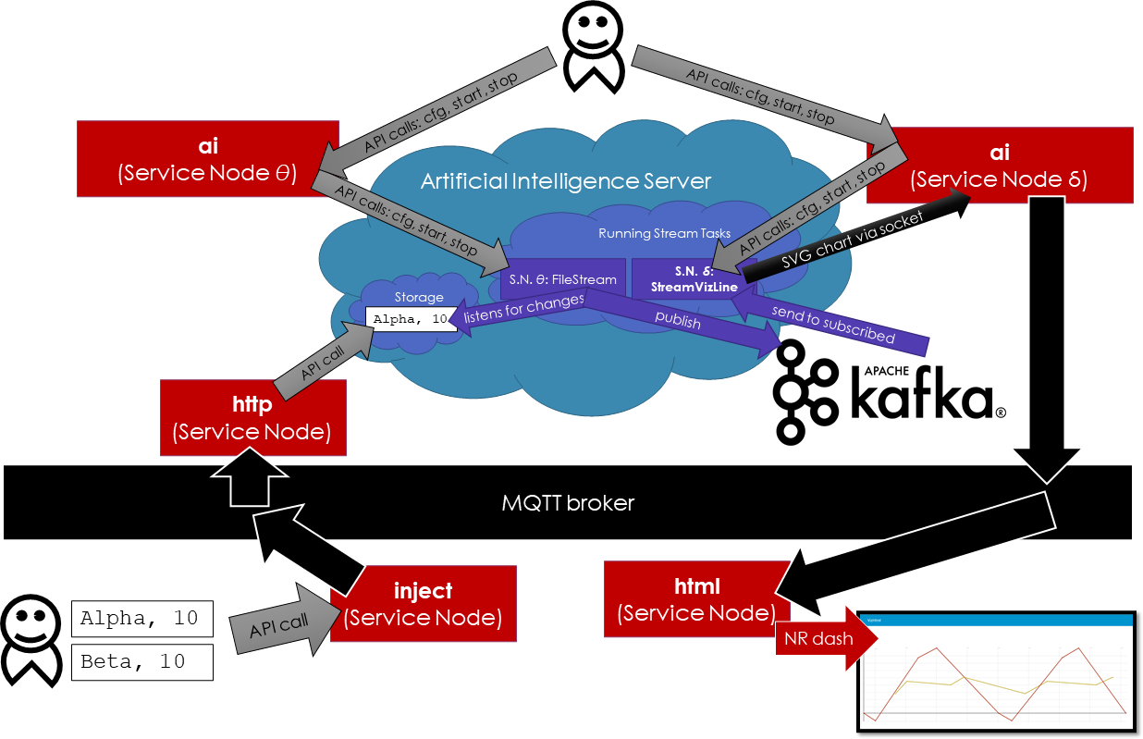
Advanced publishing to Kafka streams (2)

Slide 34
Improved Tabular Visualization
In this second example of Big Data visualization, data are still represented as simple rows in a HTML table, but this time we have both the key and the value filled.
The task that generates the HTML for the table reading from a Kafka stream, in the AI server, is the same already used for the basic tabular visualization. What it changes, it is how messages are produced and published to the Kafka stream from where they are then read.
API calls #1114 to #1122 are for testing this visualization. Connect to https://localhost:2130/ui first.

Slide 35
Line Plot
Interestingly, what it changes stepping from a visualization (say, a HTML table) to another (say, a line plot, or a pie chart, or any other) it is only the task that, in the AI server, produces the markup based on the messages that come from the configured input (Kafka) stream.
So, producing a line plot is just a matter of reconfiguring the Service Node that interfaces to the AI server and that controls what task must be used for producing the visualization. This is what API calls #1123 to #1127 do.
API calls #1128 to #1140 are for testing this visualization. Connect to https://localhost:2130/ui first.

Slide 36
Pie chart
API calls #1141 to #1143 reconfigure the Service Node that controls what is the task run in the AI server for the generation of the markup of the visualization, in such a way that pie charts (one per key) could be generated based on the messages from the configured input (Kafka) stream.
API calls #1144 to #1160 are for testing this visualization. Connect to https://localhost:2130/ui first.

Slide 37
Histogram
API calls #1161 to #1165 reconfigure the Service Node that controls what is the task run in the AI server for the generation of the markup of the visualization, in such a way that histograms (one per key) could be generated based on the messages from the configured input (Kafka) stream.
API calls #1166 to #1181 are for testing this visualization. Connect to https://localhost:2130/ui first.

Slide 38
Cleaning
API calls #1182 to #1227 are for stopping, switching off, and removing all nodes used for this last part of the demo, so again having a completely empty fence, ready to be filled of new nodes, with new configurations, for new computations.

