Slide 1

Directions for mobility investments
DO EXACTLY WHAT IS NEEDED, WHERE IT IS NEEDED.

Slide 2
Efficiency is intelligent laziness.
- David Dunham

Slide 3
Summary
This project aims to help identifying those areas that are relatively poor of mobility services and infrastructures, considering their relatively high attractiveness, within the boundaries of a city.
Exploiting Open Street Map and FourSquare data, the project allows assign a rate (good, quite good, poor) to different areas in the city, as for their mobility services, and attractiveness.
Observing the gap between the two rates, it is possible to identify those areas within the boundaries of the city where it makes the more sense to make some more investment in mobility.
The one presented here, is a demo analysis conducted for the town of Montelupo Fiorentino, in the nearby of Florence, Italy, that is where I live. The Jupiter notebook that is the main artifact of the project, is anyway though to be easily customizable to analyze any territory of your interest.

Slide 4
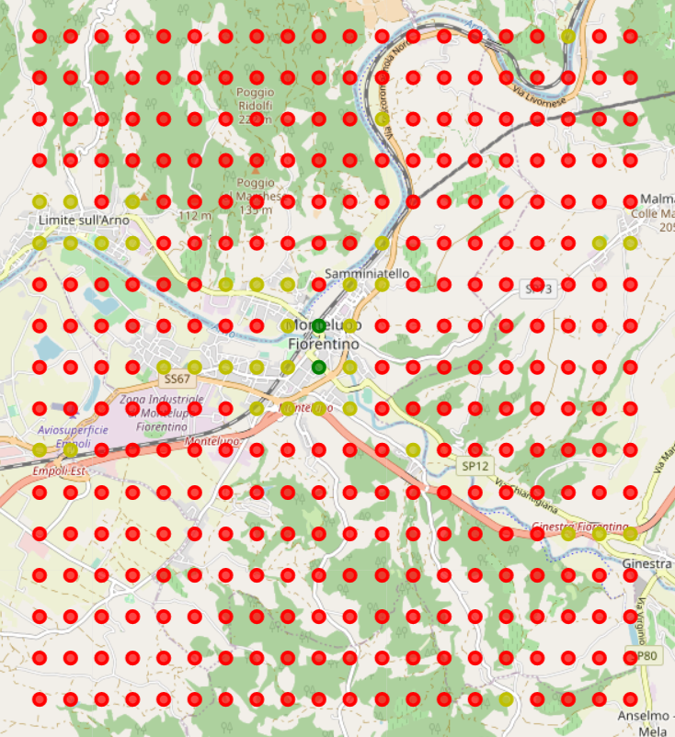
Assessing Mobility
Open Street Map provides:
Public Transport
Highways
Parking
Rental services

Slide 5
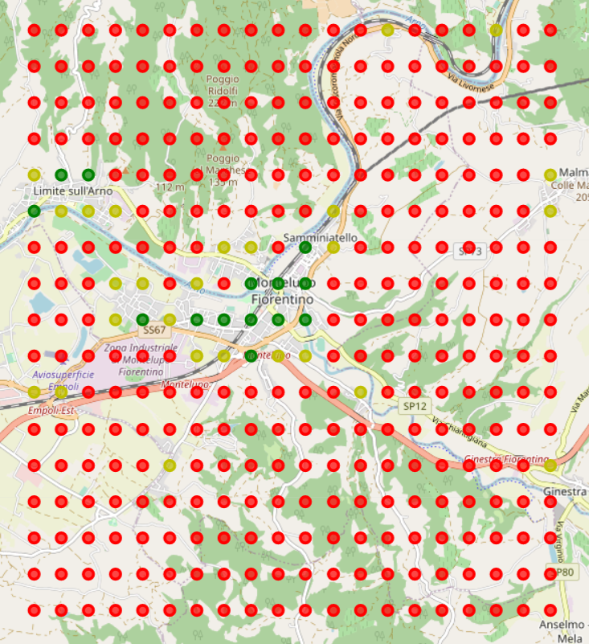
Assessing Attractiveness
Open Street Map provides:
Map density (# of OSM nodes)
FourSquare provides:
Venues
Likes per venue

Slide 6
Mobility services vs Attractiveness
Mobility services
attractiveness

Slide 7
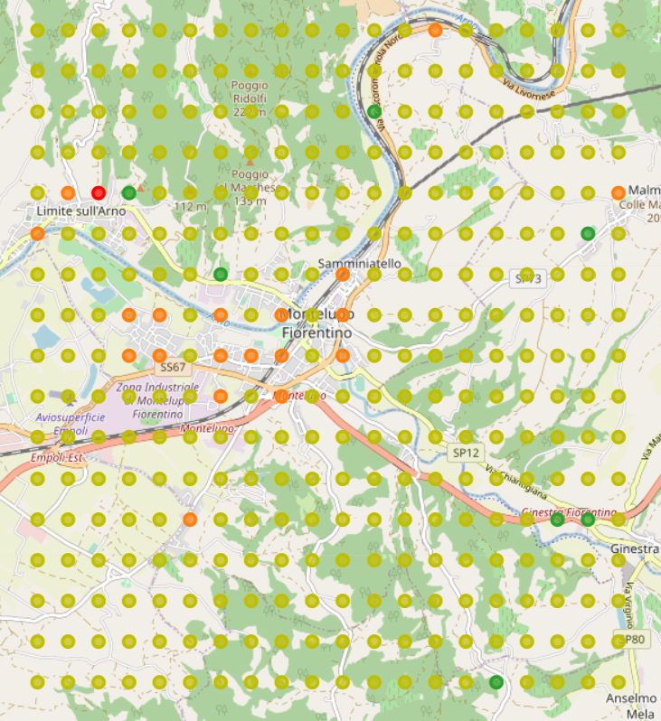
Identifying lacks
Mobility | Attractive | Result
Good | Good | Good
Medium | Good | Alert
Poor | Good | Alarm
Good | Medium | Good
Medium | Medium | Good
Poor | Medium | Alert
Good | Poor | Good
Medium | Poor | Good
Poor | Poor | Good

Slide 8
Do It Yourself
Download the Jupiter Notebook from mobilityplanner GitHub repository at:
https://github.com/mircosoderi/mobilityplanner
Run the notebook in a runtime environment of your preference such as:
https://labs.cognitiveclass.ai/
https://www.ibm.com/it-it/cloud/watson-studio
Follow instructions in the notebook:
🙇 means Make your hands dirty! (assisted config, install, coding)
🙆 means Enjoy! (just run cells and relax)
Let me know if you are in trouble:
mirco.soderi@gmail.com
… and also if you are not!

Slide 9
References
https://www.coursera.org/specializations/ibm-data-science
https://www.coursera.org/learn/applied-data-science-capstone/home/welcome
https://www.ibm.com/it-it/cloud/watson-studio
https://www.openstreetmap.org/relation/42586
https://developer.foursquare.com/docs/api-reference/venues/search/
https://developer.foursquare.com/docs/api-reference/venues/likes/
https://github.com/mircosoderi/mobilityplanner
https://www.linkedin.com/in/mirco-soderi-3b470525/

