Slide 1
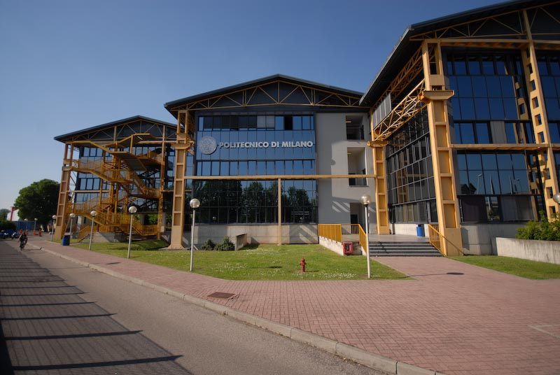

Titolo presentazione sottotitolo
Scaling performance of a DNS solver written in CPL
Mirco Meazzo - 873477
Milano, XX mese 20XX
Relatore: Prof. Maurizio Quadrio

Slide 2
Summary
The Code
Simulations Results
Conclusions
Introduction
Mirco Meazzo - 873477

Slide 3
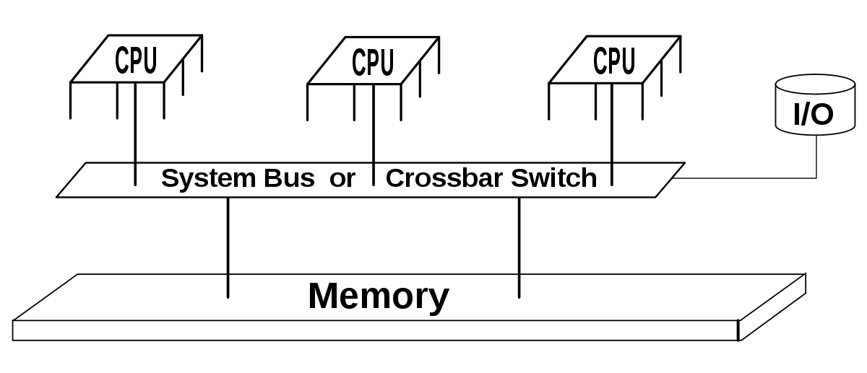
Introduction
Starting point:
Shared memory DNS solver
Mirco Meazzo - 873477

Slide 4
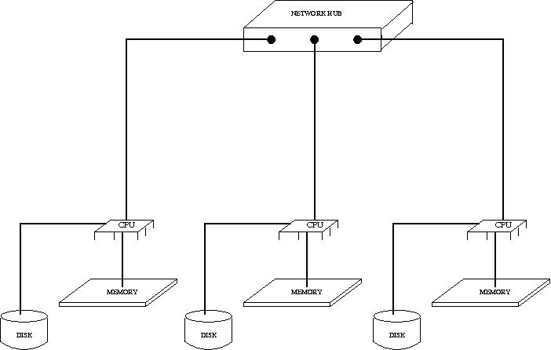
Introduction
Our goal:
Realize a Distribuited shared memory DNS solver
MPI Technology
Mirco Meazzo - 873477
Notes:
Basato su ark a memoria distribuita,
Impiegare tech MPI,

Slide 5
Introduction
MPI Technology
«Message Passing Interface (MPI) is a standardized and portable message-passing standard»
«The standard defines the syntax and semantics of a core of library routines useful to a wide range of users writing portable message-passing programs»
«The MPI interface is meant to provide essential virtual topology, synchronization, and communication functionality between a set of processes»
Mirco Meazzo - 873477
Notes:
Basato su ark a memoria distribuita,
Impiegare tech MPI,

Slide 6
Introduction
Architecture Pros:
Scales well with a large number of nodes
Provides large virtual memory space
No need to replicate data
Uses cheaper hardware
Mirco Meazzo - 873477
Notes:
Tecnologia basata MPI vantaggi,
Principale possibilità di scalare elevato n nodi

Slide 7
Introduction
Architecture Drawbacks:
Message passing latency
Bandwidth limitations
Difficult troubleshooting
Mirco Meazzo - 873477
Notes:
Tecnologia basata MPI svantaggi,
latenza dovuta al passaggio messaggi,
larghezza banda della connessione

Slide 8
Summary
The Code
Simulations Results
Conclusions
Further tests
${Re}_{τ} 1000$ Statistics
〖𝑅𝑒〗_𝜏 1000 Statistics
${Re}_{τ} 180$ Statistics
〖𝑅𝑒〗_𝜏 180 Statistics
${Re}_{τ}$ comparison
〖𝑅𝑒〗_𝜏 comparison
Introduction
Mirco Meazzo - 873477

Slide 9
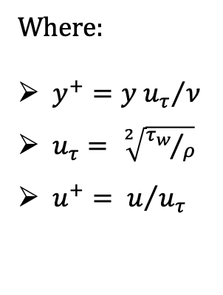

Simulations Results
${Re}_{τ}=180$ Statistics
Where:
$y^{+}={y u_{τ}}/ν$
$u_{τ}= \sqrt[2]{{τ_{w}}/ρ}$
$u^{+}= u/{u_{τ}}$
Mirco Meazzo - 873477
Notes:
Validare solutore,
Legge di parete,
Aritmetica moderna >> KMM 1986
Tau_w= wall shear stress

Slide 10
Simulations Results
${Re}_{τ}=180$ Statistics
Mirco Meazzo - 873477
Notes:
Confronto,
Fluttuazioni RMS,
Andamento a parete componente fluttuante vs KMM

Slide 11
Simulations Results
${Re}_{τ}=180$ Statistics
Mirco Meazzo - 873477

Slide 12

Simulations Results
${Re}_{τ}=1000$ Statistics
Mirco Meazzo - 873477
Notes:
Elevato costo computazionale,
Da Parete a regione logaritmica ok
regione esterna in assestamento

Slide 13
Simulations Results
${Re}_{τ}=1000$ Statistics
Mirco Meazzo - 873477
Notes:
200-300y+ iniziano imperfezioni,
Andamento a parete vv+

Slide 14

Simulations Results
$${Re}_{τ} comparison$$
Mirco Meazzo - 873477
Notes:
Panoramica legge parete,
U_mean

Slide 15
Simulations Results
$${Re}_{τ} comparison$$
Mirco Meazzo - 873477
Notes:
Componenti sforzo di taglio (channel_units) al var di RE
Curve rispettano aspettative

Slide 16
Simulations Results
$${Re}_{τ} comparison$$
Mirco Meazzo - 873477
Notes:
Panoramica legge parete,
U_mean

Slide 17
Simulations Results
$${Re}_{τ} comparison$$
Streamwise fluctuations term is close to develop a logarithmic behaviour
Higher Re needed
Spanwise fluctations term exhibit logaritmic behaviour
Mirco Meazzo - 873477
Notes:
Funzione Predittore andamento logaritmico

Slide 18
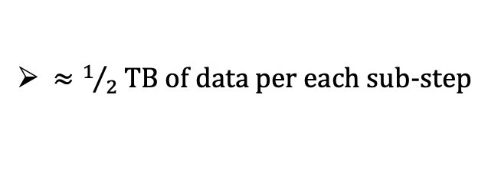
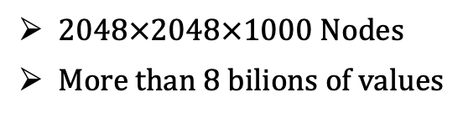

Pushing Beyond
${Re}_{τ}=2000$ Test
2048$×$2048$×$1000 Nodes
More than 8 bilions of values
$≈1/2$ TB of data per each sub-step
Mirco Meazzo - 873477
Notes:
Costo computazionale,
Dati parziali,
1gg di lavoro partendo da 48x48x1000

Slide 19
Summary
The Code
Simulations Results
Conclusions
Introduction
Mirco Meazzo - 873477

Slide 20
Conclusions
Possibility to handle very large simulations
Good scalability reached
Mirco Meazzo - 873477

Slide 21
Conclusions
BUT,
Today’s market trend has moved from «Raise Clock Frequency» towards «Raise the cores number»
OpenMP implementation is recommended to increase the efficiency of the solver over present and future clusters family processors
Mirco Meazzo - 873477

Slide 22
Titolo presentazione sottotitolo
Thanks for the attention
… And these unforgettable years!
Milano, XX mese 20XX

