Slide 1

INCREASING THE PARALLEL EFFICIENCY OF A SOLVER FOR THE DIRECT NUMERICAL SIMULATION OF TURBULENCE
Milano, XX mese 20XX
Mirco Meazzo - 873477
Relatore: Prof. Maurizio Quadrio

Slide 2
The Direct Numerical Simulation
In order to get an insight of the turbulence phenomena the only way towards knowledge is the direct numerical simulation (DNS) of the Navier-Stokes equations.
This computational technique does not involve turbulence models, therefore requires exceptional computational power in order to investigate all spatial scales, from the dissipative ones up to the integral length.
RANS
LES
DNS
Industry
Academy
Mirco Meazzo - 873477
Notes:
Dal punto di vista numerico unico strumento affidabile,
DNS non si avvale,
Non adottare modelli .. Costi molto elevati computazionale,
Solo ambito accademico,
Scopo approfondire conoscenza turbolenza al fine di creare modelli affidabili

Slide 3
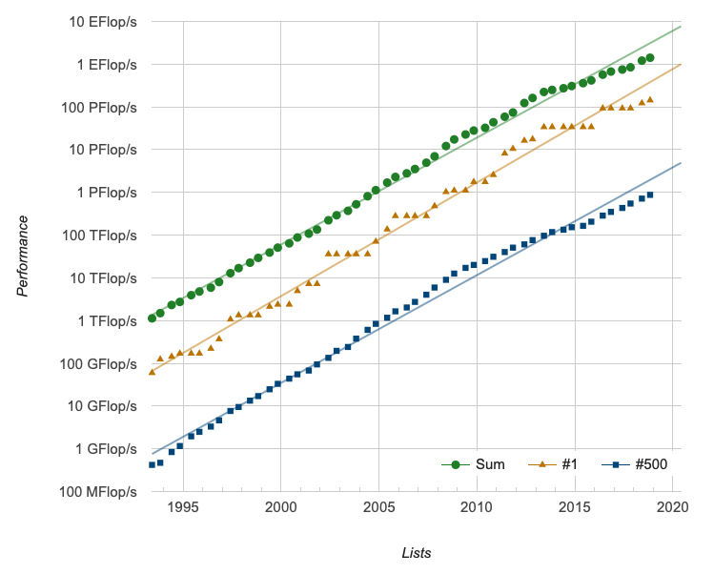
High Performance Computing
The solution is rely in HPC, however, to exploit the theoretical performances we must design the solver using a parallel strategy
Mirco Meazzo - 873477
Notes:
Costi computazioni -> HPC
Figure testimoniano trend allineati, ma non proporzionali
HPC necessario sviluppo solutore parallelizzati

Slide 4
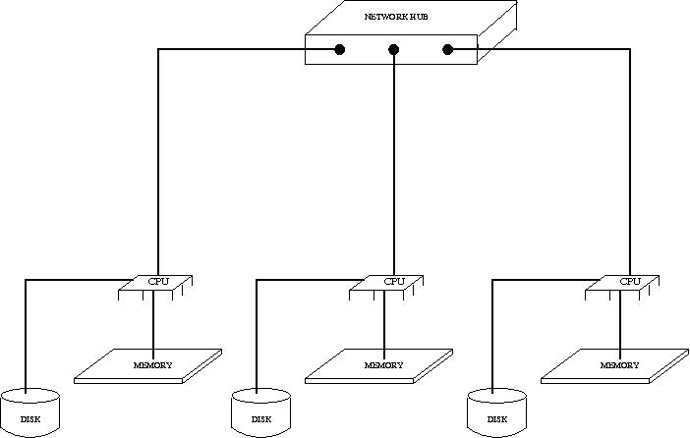
Distribuited Shared Memory
Starting point: "A low-cost parallel implementation of direct numerical simulation of wall turbulence", P. Luchini and M. Quadrio, JCP (2005)
Our goal was to realize a massively parallel solver, starting from the original low-parallelized implementation
MPI Technology
Mirco Meazzo - 873477
Notes:
Punto di partenza è stato codice a memoria distribuita
bassa efficienza parallela
Al fine di aumentare efficienza
innanzitutto introdotto MPI:
Libreria che contiene un insieme di funzioni pensate per gestire la comunicazione tra processori appartenenti alla stessa rete

Slide 5
Distribuited Shared Memory
Paradigm Pros:
Scales well with a large number of nodes
Provides large virtual memory space
No need to replicate data
Use cheaper hardware
Paradigm Drawbacks:
Message passing latency
Bandwidth limitations
Difficult troubleshooting
Mirco Meazzo - 873477
Notes:
Adozione MPI richiede apposito metodo di programmazione
1 codice 4000 cores
Vantaggi di questo modello di programmazione
Principale possibilità di scalare elevato n nodi
utilizzo di hardware standard rispetto a CUDA
Svantaggi: latenza messaggi,
dipendenza larghezza banda

Slide 6
Solver Features
Written partially in CPL and partially in C
Based on Fourier expansion series along homogenous directions
Compact finite differences along wall normal direction
Convolutions computed in time domain to reduce computational cost
Massively parallel thanks to MPI implementation
1D or 2D domain decomposition
MPI
fftMPI
Communication
Array Transpose
Mirco Meazzo - 873477
Notes:
Il nostro solutore è caratterizzato da..
Use estensivo delle seguenti librerie esterne,
…Grazie all’uso di fftMPI

Slide 7
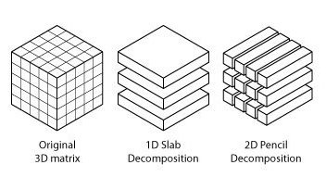
Domain Decomposition
Mirco Meazzo - 873477
Notes:
decomposizione 2D arrays,
consente maggiore scalabilità del codice,
sposta limite teorico scaling,
prodotto tra i 2 modi più piccoli

Slide 8
Scaling Performance (1/2)
128x128x128 Grid
256x256x512 Grid
Mirco Meazzo - 873477
Notes:
Benchmark, S=t_single/t_p
128^3 cpl vs mpi
Mentre Decomp 1D non presenta sensibilità al #CORES
256x256x512 f(CORES)

Slide 9
Scaling Performance (2/2)
256x256x512 Grid
Speedup vs Mesh Size
Mirco Meazzo - 873477
Notes:
Su suggerimento del Cineca -> adottato Intel 18,
Autovettorizzazione codice
Picco Scaling f(#modi)
Hyperthreading poco efficace,

Slide 10
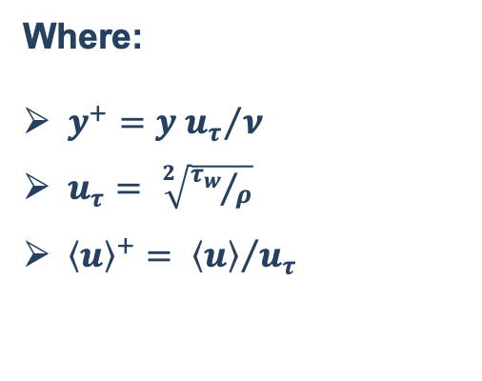

Validation
${Re}_{τ}=180$ Statistics
Buffer Region
Where:
$y^{+}={y u_{τ}}/ν$
$u_{τ}= \sqrt[2]{{τ_{w}}/ρ}$
${\left\langle u\right\rangle }^{+}= {\left\langle u\right\rangle }/{u_{τ}}$
Viscous Sublayer
Logarithmic Region
Mirco Meazzo - 873477
Notes:
Validare solutore, Re=5600
Legge di parete: brevemente …,
Aritmetica moderna >> KMM 1986
Tau_w= wall shear stress

Slide 11

Increasing ${Re}_{τ}$ to ${Re}_{τ}$=1000
2 Billions of DOF
40 GB of data per step
Mirco Meazzo - 873477
Notes:
Panoramica legge parete,
U_mean
Componenti sforzo di taglio (channel_units) al var di RE
…Re2000
17miliardi di gdl, ½ TB per step

Slide 12
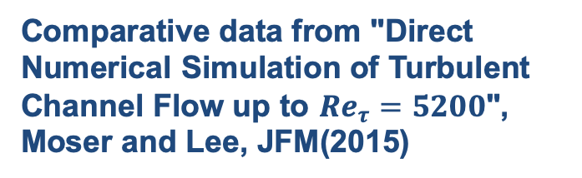
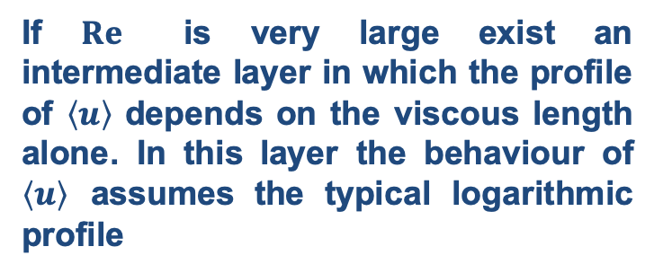
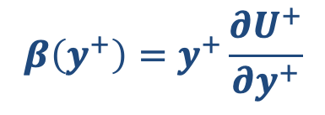

Interest in Increasing $Re$
If $Re$ is very large exist an intermediate layer in which the profile of $\left\langle u\right\rangle$ depends on the viscous length alone. In this layer the behaviour of $\left\langle u\right\rangle$ assumes the typical logarithmic profile
A well established indicator function has been used with the purpose to identify such regions
$$β\left(y^{+}\right)=y^{+}\frac{∂U^{+}}{∂y^{+}}$$
Comparative data from "Direct Numerical Simulation of Turbulent Channel Flow up to ${Re}_{τ}=5200$", Moser and Lee, JFM(2015)
Mirco Meazzo - 873477
Notes:
se log -> B=1/K (K=Von Karman)

Slide 13
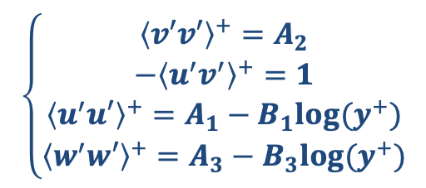
Fluctuations Behaviour at High Re (1/2)
How does the high Re condition modify our fluctuations profiles?
Townsend’s attached eddy hypothesis:
Logarithmic region
Hierarchy of self-similar eddies
Velocity field extent to the wall
Eddy size scales with wall distance
$$\left\{\begin{aligned}{\left\langle v′v′\right\rangle }^{+}=A_{2} \\ −{\left\langle u^{′}v^{′}\right\rangle }^{+}=1 \\ {\left\langle u^{′}u′\right\rangle }^{+}=A_{1}−B_{1}log⁡(y^{+}) \\ {\left\langle w^{′}w′\right\rangle }^{+}=A_{3}−B_{3}log⁡(y^{+})\end{aligned}\right.$$
Mirco Meazzo - 873477

Slide 14
Fluctuations Behaviour at High Re (2/2)
Streamwise fluctuations term is close to develop a logarithmic behaviour
Higher Re needed
Spanwise fluctations term exhibit logaritmic behaviour
Mirco Meazzo - 873477
Notes:
Funzione Predittore andamento logaritmico

Slide 15
Conclusions
Possibility to handle very large simulations
Good scalability reached
BUT,
Today’s market trend has moved from «Raise Clock Frequency» towards «Raise the cores number»
OpenMP implementation is recommended to increase the efficiency of the solver over present and future clusters families processors
Mirco Meazzo - 873477

Slide 16
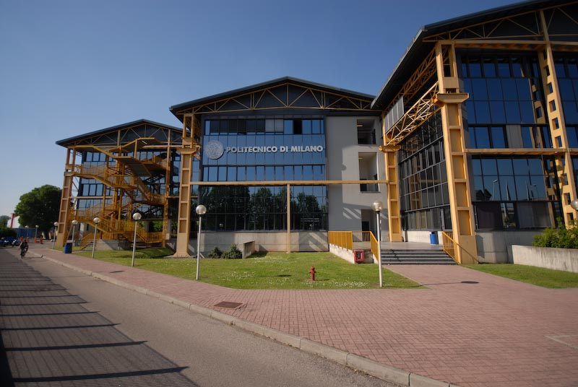
Titolo presentazione sottotitolo
Thanks for the attention
… And these unforgettable years!
Milano, XX mese 20XX

