Slide 1
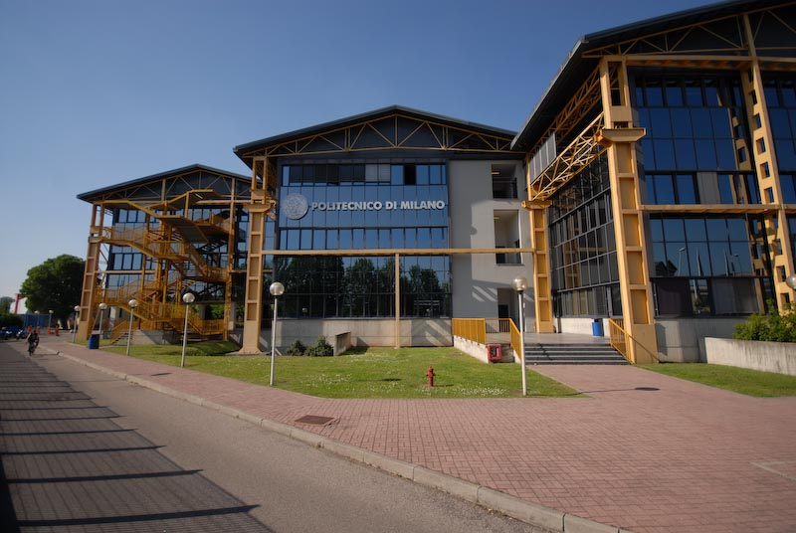

Titolo presentazione sottotitolo
Scaling performance of a DNS solver written in CPL
Mirco Meazzo - 873477
Milano, XX mese 20XX
Relatore: Prof. Maurizio Quadrio

Slide 2
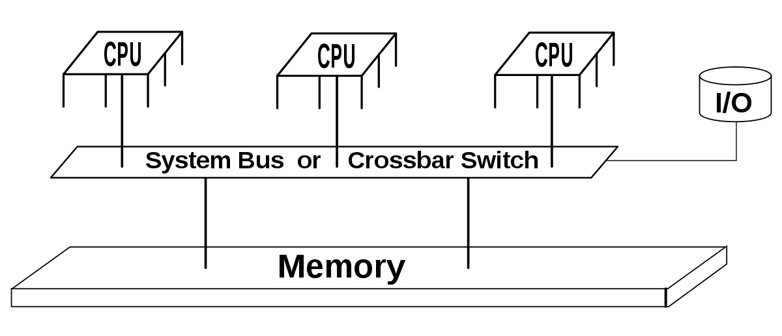
Introduction
Starting point:
Shared memory DNS solver
Mirco Meazzo - 873477

Slide 3
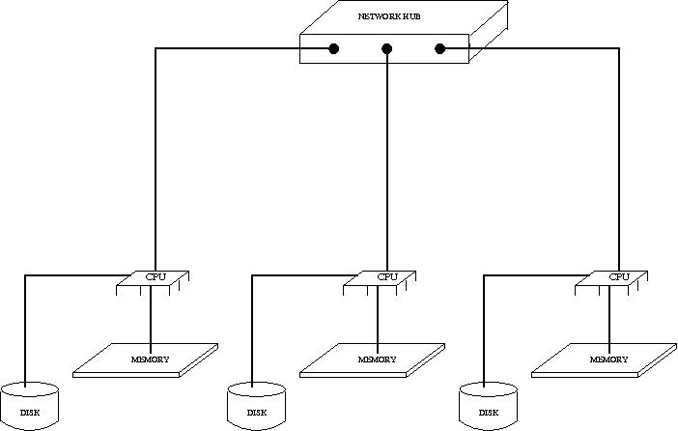
Introduction
Our goal:
Realize a Distribuited memory DNS solver
Mirco Meazzo - 873477

Slide 4
Mirco Meazzo - 873477

Slide 5
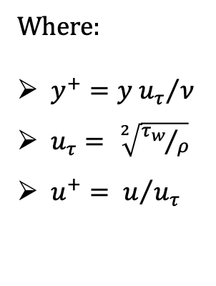

Simulation Results
${Re}_{τ}=180$ Statistics
Where:
$y^{+}={y u_{τ}}/ν$
$u_{τ}= \sqrt[2]{{τ_{w}}/ρ}$
$u^{+}= u/{u_{τ}}$
Mirco Meazzo - 873477
Notes:
Validare solutore,
Legge di parete,
Aritmetica moderna >> KMM 1986
Tau_w= wall shear stress

Slide 6
Simulation Results
${Re}_{τ}=180$ Statistics
Mirco Meazzo - 873477
Notes:
Confronto,
Fluttuazioni RMS,
Andamento a parete componente fluttuante vs KMM

Slide 7
Simulation Results
${Re}_{τ}=180$ Statistics
Mirco Meazzo - 873477

Slide 8

Simulation Results
${Re}_{τ}=1000$ Statistics
Mirco Meazzo - 873477
Notes:
Elevato costo computazionale,
Da Parete a regione logaritmica ok
regione esterna in assestamento

Slide 9
Simulation Results
${Re}_{τ}=1000$ Statistics
Mirco Meazzo - 873477
Notes:
200-300y+ iniziano imperfezioni,
Andamento a parete vv+

Slide 10

Simulation Results
$$Statistics comparison$$
Mirco Meazzo - 873477
Notes:
Panoramica legge parete,
U_mean

Slide 11
Simulation Results
$$Statistics comparison$$
Mirco Meazzo - 873477
Notes:
Componenti sforzo di taglio (channel_units) al var di RE
Curve rispettano aspettative

Slide 12
Simulation Results
$$Statistics comparison$$
Mirco Meazzo - 873477
Notes:
Panoramica legge parete,
U_mean

Slide 13
Simulation Results
$$Statistics comparison$$
Streamwise fluctuations term is close to develop a logarithmic behaviour
Higher Re needed
Spanwise fluctations term exhibit logaritmic behaviour
Mirco Meazzo - 873477
Notes:
Funzione Predittore andamento logaritmico

Slide 14
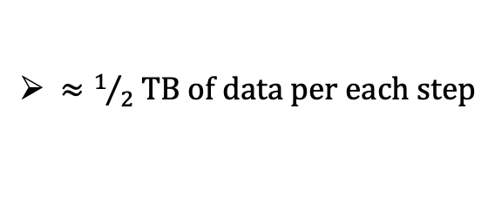
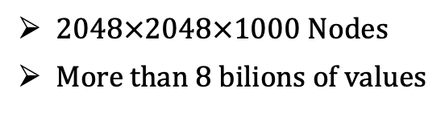

Pushing Beyond
${Re}_{τ}=2000$ Test
2048$×$2048$×$1000 Nodes
More than 8 bilions of values
$≈1/2$ TB of data per each step
Mirco Meazzo - 873477
Notes:
Costo computazionale,
Dati parziali,
1gg di lavoro partendo da 48x48x1000

Slide 15
Conclusions
Possibility to handle very large simulations
Good scalability reached
Mirco Meazzo - 873477

Slide 16
Conclusions
BUT,
Today’s market trend has moved from «Raise Clock Frequency» towards «Raise the cores number»
OpenMP implementation is recommended to increase the efficiency of the solver over present and future clusters family processors
Mirco Meazzo - 873477

Slide 17
Titolo presentazione sottotitolo
Thanks for the attention
… And these unforgettable years!
Milano, XX mese 20XX

