Slide 1

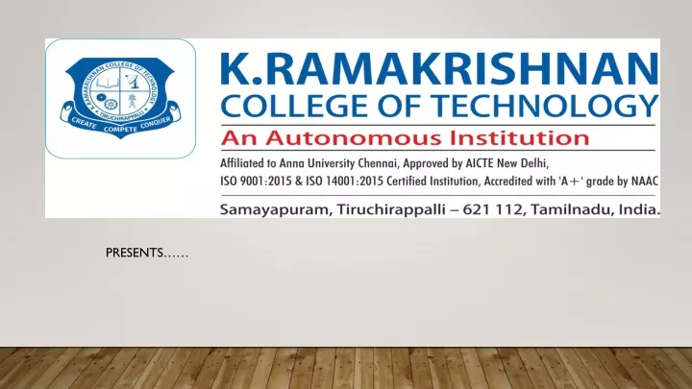

A NOVEL REAL-TIME AGRICULTURE MONITORING AND SEED SPRAYING ROVER USING
IOT
TEAM MEMBERS:
1.Divya C - 811721243015
2.Mirdula S - 811721243028
3.Swetha S - 811721243056
4.SriAshika M - 811721243304
GUIDE NAME
Mr. Joshua Isaac Assistant Professor (AI)

Slide 2
OBJECTIVE
To design and develop a real-time automated seed spraying rover using IoT that enables precise seed sowing, efficient resource management, and continuous environmental monitoring, thereby optimizing agricultural productivity and reducing manual labour.

Slide 3
PROBLEM DEFINITION
EXISTING SYSTEM:
Manual monitoring
No advanced technology used in crop monitoring with low cost.
PROPOSED SYSTEM:
Real time monitoring with advance technical effort to reduce human labor issues.
Especially in cost and Detects accurate readings.

Slide 4
LITERATURE SURVEY
S.NO | Title | Year | Author | Technique used | Demerits
1. | IOT Based Seed Planting and Watering Rover" | 2022 | G. Nagarjuna Reddy, G. Maheedhar Reddy, G. Balaji, CH Muni Harish | ESP8266 Node MCU for communication DHT11 and soil moisture sensors for environmental monitoring. | Requires constant internet connectivity for data transmission.
2. | Implementing Smart Agriculture with IoT and Monitoring Plant Diseases. | 2022 | Monagi H . Alkinani and Wazir Zada Khan | Autonomous robot for planting, ploughing, and fertilizing. | Dependency on internet connectivity for full functionality.

Slide 5
S.NO | Title | Year | Author | Technique used | Demerits
3. | Smart Agriculture Monitoring Rover for Small-Scale Farms in Rural Areas. | 2021 | Anjana Menon, R. Prabhakar. | Automatic irrigation system and disease detection through cameras. | Connectivity and data transmission issues in remote areas .
4. | IoT Based Smart Agriculture and Automatic Seed Sowing Robot. | 2020 | Pravin Ramdas Kshirsagar. | Wireless sensor networks for soil monitoring. | High power consumption for sensors and devices.

Slide 6
S.NO | Title | Year | Author | Technique used | Demerits
5. | Development of IoT Controlled Agri-Rover for Automatic Seeding. | 2017 | Aditya Vishwas Kanade, Arockia Selvakumar, Dnyanesh Jalamkar, Prabaharan Sengodan, Yousef Jbara. | IoT-based Agri-Rover using Arduino. | High initial setup cost for automation Complexity in programming and system maintenance

Slide 7

ARCHITECTURE DIAGRAM
POWER SUPPLY
Front end sensor Unit
App Unit
ESP8266
SERVER
IOT
HUMIDITY SENSOR
Internet Unit
SEED SPRAYER
TEMPERATURE SENSOR
Output Unit
PESTICIDES CONTROL/
SOIL MOISURE SENSOR
MOTORS
Controlling Unit

Slide 8
SYSTEM & SOFTWARE SPECIFICATIONS
HARDWARE SYSTEM CONFIGURATION:
Computer - minimum of 4GB RAM & dual-core processor.
Stable internet connection.
Storage
SOFTWARE SYSTEM CONFIGURATION
Platform: ESP8266/ESP32
Programming Languages: Embedded C,HTML
Communication Protocols: HTTP, Wi-Fi

Slide 9
MODULES
Sensors Module
Data Acquisition and Control Module
Communication Module
Cloud/Server Module
User Interface Module

Slide 10
SENSORS MODULE
This module is responsible for gathering data from the environment. The sensors collect real-time data on various agricultural parameters, such as soil moisture, temperature, humidity, and crop health.
Components:
Humidity Sensor: Continuously measures air moisture to determine chemical spray suitability.
Temperature Sensor: Reads environmental temperature to adjust seed sowing application.

Slide 11
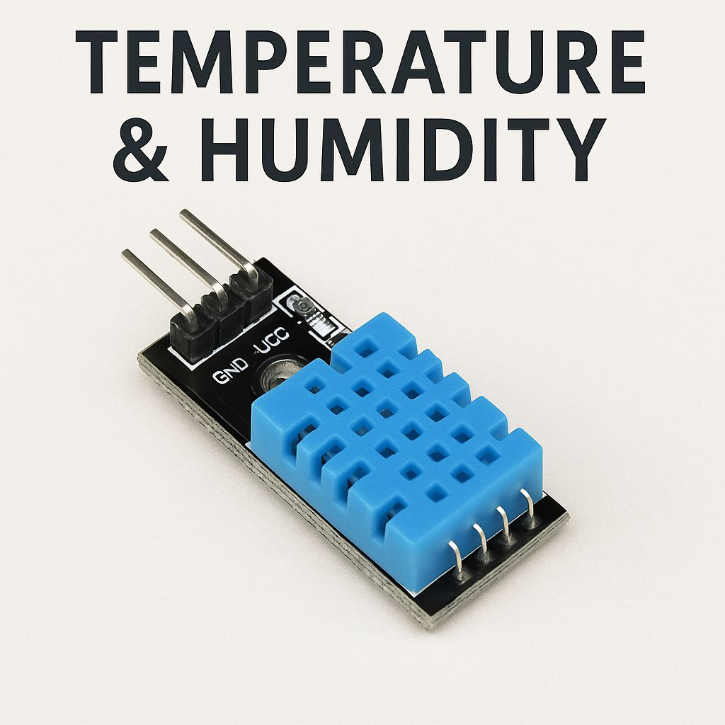
ESP8266/ESP32 Microcontroller: Processes sensor readings and communicates data to the mobile app.
Power Supply: Provides a stable 5V DC source for all connected sensors and the microcontroller.
Wires & Connectors: Used for linking the sensor module with the central control system.
Data Output: Produces analog or digital signals that indicate moisture levels

Slide 12
DATA ACQUISITION AND CONTROL MODULE
This Module acts as the brain of the rover, collecting real-time sensor data and making decisions based on environmental thresholds. It bridges sensor inputs and robotic actions, enabling movement for efficient field operations.
Components
ESP8266 / ESP32 Microcontroller: Central processing unit for data collection, decision-making, and communication.
Sensor Interfaces: Connects the humidity, temperature, and moisture sensors to the microcontroller.

Slide 13
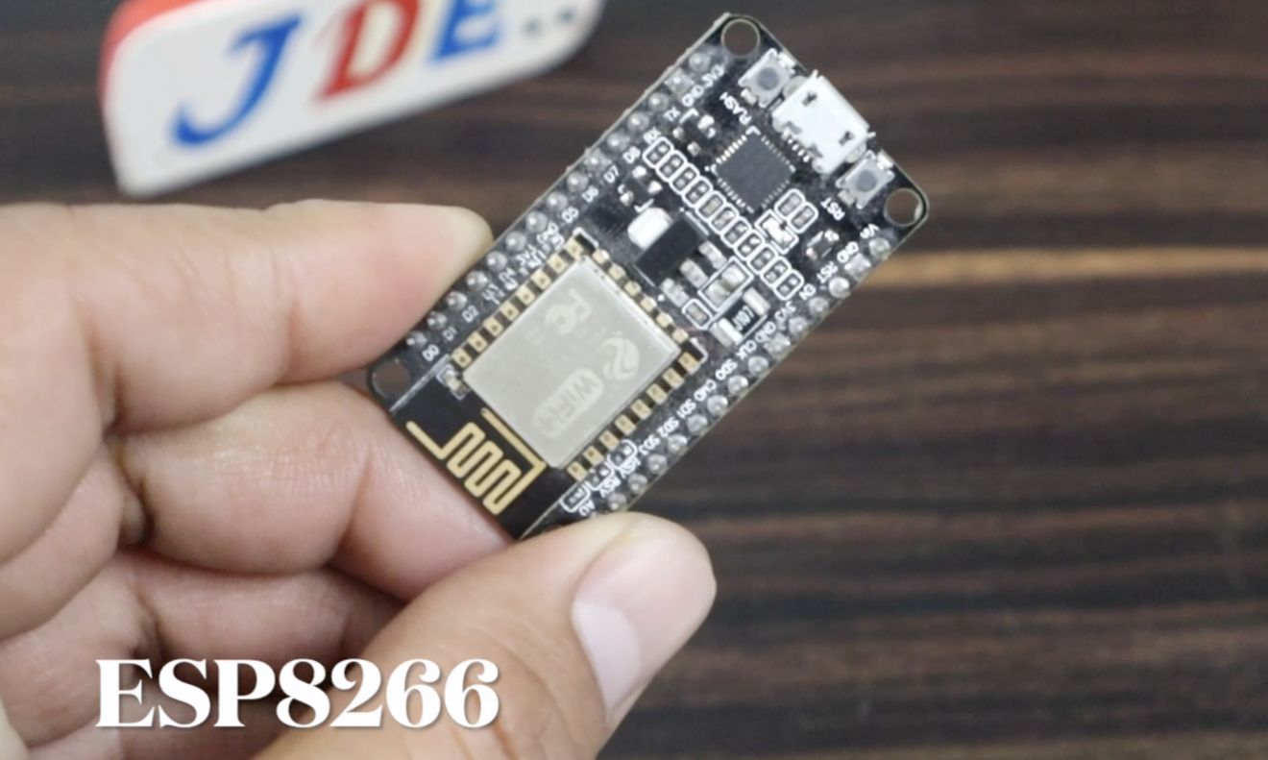
Power Supply: Typically 5V/12V DC to support sensors, actuators, and the controller.
Motor Driver (e.g., L298N): Controls wheel movement based on logic commands.
Relay / Pump Control Circuit: Manages the on/off state of the spraying system.
Data Output:
Control signals to actuators (e.g., motor movements, spray operation).
Sensor data processed for decision-making.

Slide 14
COMMUNICATION MODULE
This module is responsible for transmitting sensor data from the rover to the cloud and receiving commands from the user interface for controlling the rover.
Component:
Wi-Fi Module (e.g., ESP8266/ESP32): Connects to the internet and communicates with the cloud server or user application.
Antenna (integrated in ESP module): For wireless signal transmission.
Power Supply (5V): Provides power to the communication circuit.

Slide 15
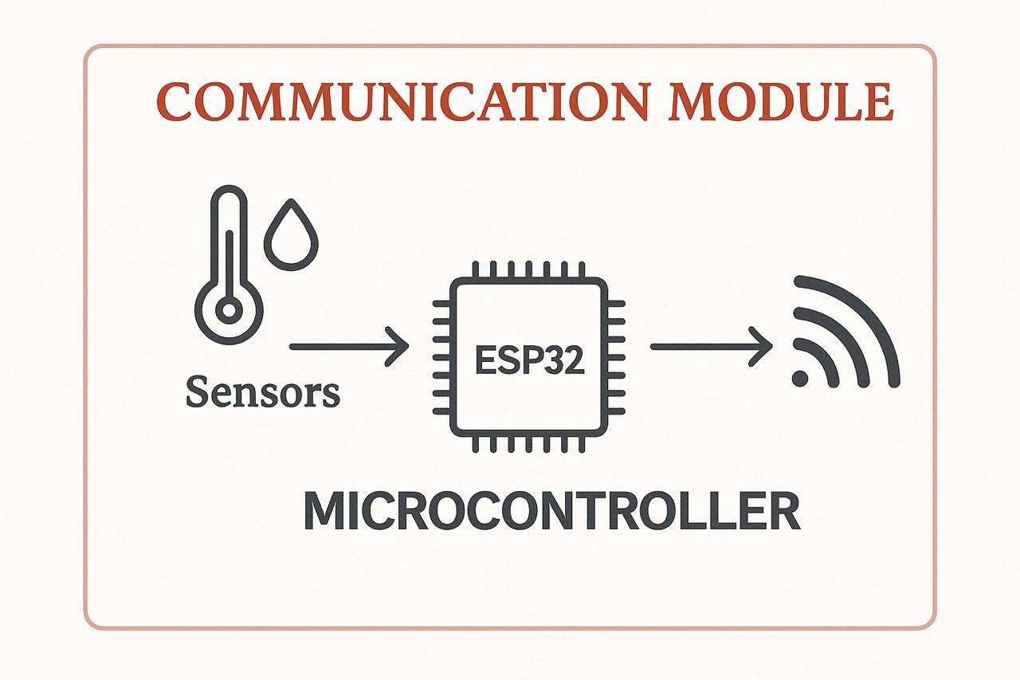
Microcontroller Interface: Ensures proper data flow between sensors/controllers and the communication module.
Data Output:
Sends environmental data collected by sensors to the cloud for storage and visualization.
Receives operational commands from the user interface to control the rover.

Slide 16
CLOUD/SERVER MODULE
This module processes the data received from the rover, stores it, and makes it accessible to the user through a web or mobile application.
It is responsible for data analysis, visualization, and control logic.
Components:
Cloud Platform: Services like ThinkSpeak or Firebase are used to store and visualize incoming data.
Database:SQL/NoSQL databases (e.g.,ThinkSpeak Data Streams) for storing sensor logs.

Slide 17
Web API / Endpoints: Interface to receive data from the rover and send commands back.
Server-side Scripts: Used to handle incoming data, run logic, and generate outputs.
Web Interface: Browser or dashboard built with HTML/CSS/JavaScript for user interaction.
Data Output:
Data analytics and visualization.
Historical and live data logs.

Slide 18
USER INTERFACE MODULE
This module allows the user to interact with the IoT system, monitor the rover's performance, and send commands.
Components:
Web/Mobile Dashboard: Built using HTML, CSS, and JavaScript, displays real-time sensor values and rover status.
Authentication System: Uses IP-based access control to restrict unauthorized users.
Control Panel: UI elements (buttons/sliders) for manual rover control.

Slide 19
Visualization Tools: Graphs or charts to represent environmental trends.
API Integration: Interfaces with cloud platforms (like ThinkSpeak) to fetch and send data.
Data Output:
Real-Time Sensor Data Display: Numerical values showing temperature, humidity, and soil moisture.
Control Feedback: Displays the status of the rover.
User Commands: Sends manual inputs (e.g., start, stop) to the rover.

Slide 20
ADVANTAGES
Enhanced precision and efficiency.
Real-time monitoring and control.
Labor and cost reduction.
Weather adaptability.
Scalability.

Slide 21
APPLICATIONS
Weather-Adaptive farming.
Smart irrigation management.
Seed sowing robots with IoT integration.
Fertilizer optimization system.
Labour reduction in rural agriculture
Remote field monitoring

Slide 22
CONCLUSION
The integration of intelligent irrigation scheduling and autonomous spraying systems marks a significant step forward in precision agriculture. These systems enhance efficiency and sustainability by optimizing resource use, though challenges such as design limitations, flow constraints, and coordination between sectors still need addressing. Autonomous spraying systems deliver safe even in complex environments.

Slide 23
REFERENCES
Farhan Zaman Ha-mim, Safina Islam Aboni, Marufa Akhter Mim, Mohammad Rejwan Uddin, Mahady Hasan, "IoT-Based Automatic Seed Sowing and Plant Nutrition System," ResearchGate, April 2024.
G Nagarjuna Reddy, G Maheedhar Reddy, G Balaji, CH Muni Harish, CH Kethan, "IOT Based Seed Planting and Watering Rover," International Journal of Scientific Research & Engineering Trends, Volume 8, Issue 3, May-Jun-2022.
"IoT Based Seed Sowing Robot," International Research Journal of Engineering and Technology (IRJET), Volume 8, Issue 3, March 2021.
"Development of IoT Controlled Agri-Rover for Automatic Seeding," International Journal of Pure and Applied Mathematics, Volume 114 No. 11, 2017.

Slide 24
THANK YOU

