Slide 1
Forecasting Daily Electricity Generation in Spain
Capstone Forecasting Project
Time Series Analysis
Team: Spanish Forecasters

Slide 2
Team & Contributions.
Enrique Ruiz:
  Data parsing/cleaning
  Modelling
  Evaluation
  Plots
  Business value
Mireia Montoya:
  Documentation
  Slide deck
  Interpretation of results
  Presentation speaking roles
  Plots

Slide 3
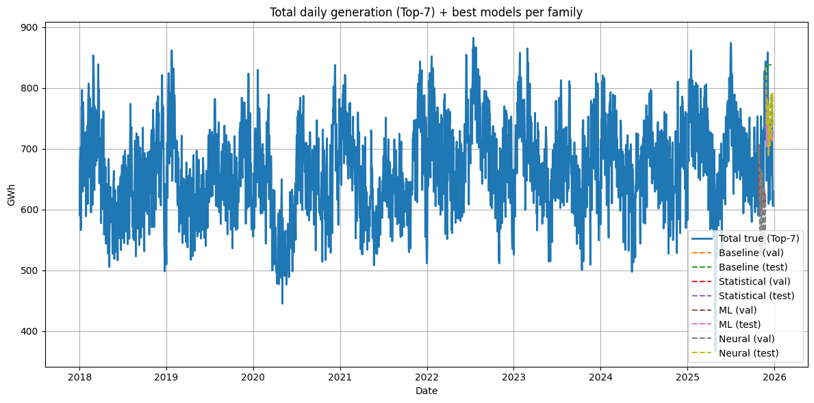
Business Problem
Problem: Electricity generation varies due to the weather, demand or seasonality. This creates uncertainty for system planning.
Goal: Forecast daily electricity generation for Spain by production technology for January 2026.

Slide 4
Why Forecasting Matters?
Accurate forecast support:
  Operational planning and balancing
  Resource scheduling
  Markt decisions and risk management
Without forecast:
  Reactive decisions
  Higher operational risk
  Potential extra costs

Slide 5
Solution Overview
Business understanding: define the forecasting goal and the value.
Data understanding: inspect the dataset, frequency, trends, seasonality, missing values.
Data preparation: clean, reshape, and build a final time series dataset.
4. Feature engineering: create lag features, calendar features…
5. Modelling: train model families used in class (baselines, statistical, ML, neural)
6. Evaluation: time-based validation/test split, metrics and plots.
7. Output: forecast January 2026, export predictions, save metrics for reporting.

Slide 6
Dataset Info
Source: Spanish Electric Network (REE)
Frequency: daily
Target: electricity generation (GWh)
Level: production technology
Focus:
Top-7 technologies by average generation

Slide 7
Data Preparation
From Raw Data to Panel Dataset
Convert raw data to panel format:
  unique_id: technology
  ds: date
  y: daily generation
Clean dates and numeric values
Ensures complete daily calendar
Validate and handle missing days

Slide 8
Model Families Tested
Baselines:
  Naive
  Moving average
Statistical:
  AutoARIMA
Machine Learning:
  Random Forest
  Gradient Boosting
  Lag, calendar & rolling features
Deep Learning:
  NBEATS
  NLinear

Slide 9
Evaluation Strategy
Time-Based Evaluation
Model Selection
No shuffling (time series CV)
Split:
  Train
  Validation (H = 31 days)
  Test (H = 31 days)
Metrics:
  MAPE
  MAE
  RMSE
  OPE
  R2
Best MAE on validation
Baselines excluded from final forecast

Slide 10
Results & Forecast
January 2026 Forecast
Best overall model selected across technologies
Daily forecast for Jan 2026
Outputs:
  CSV (and Parquet if available)
Uncertainty
Empirical prediction intervals
Based on validation residual quantiles (95%)

Slide 11
Value & Conclusion
Value Generated:
  Better planning of energy balance and reserves
  Improved risk-aware decision-making
  Useful even with uncertainty
Conclusion:

