Slide 1
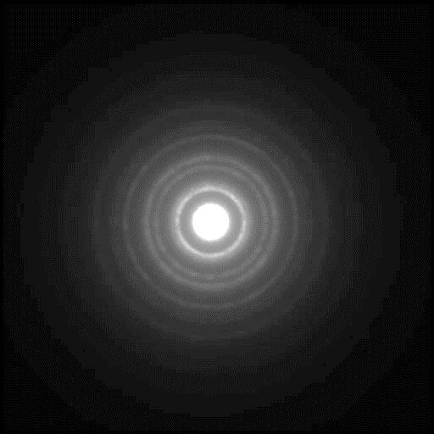
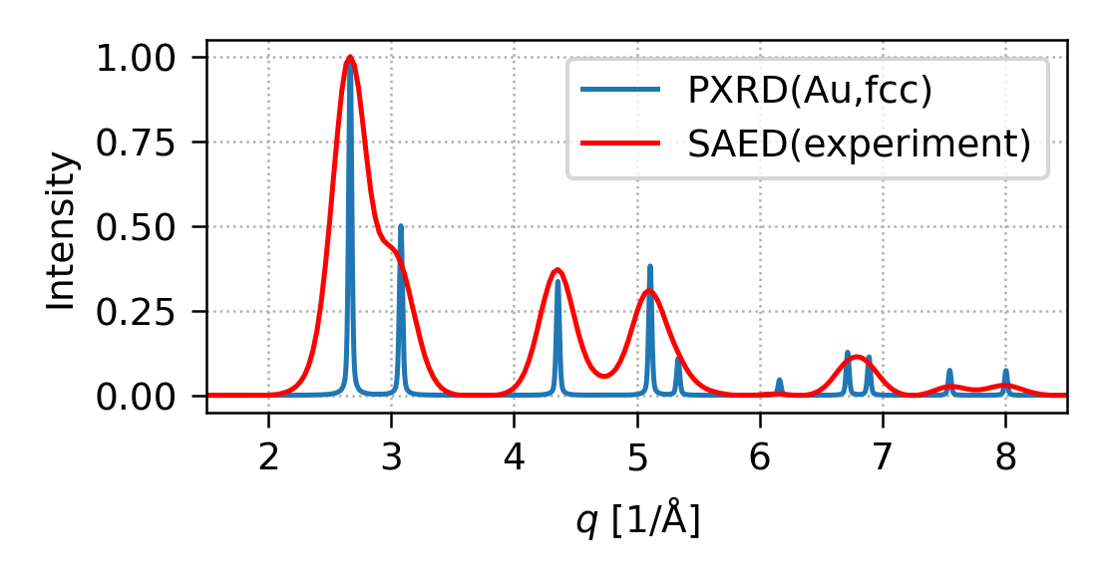
(2) EDIFF processing
calculate theoretical XRD
process experimental ELD
compare ELD and XRD
(1) Input :: 2D powder diffractogram.
(3) Output :: Comparison of ELD and XRD.
Usually a 2D-electron diffraction pattern (ELD),
which is compared with theoretical X-ray pattern (XRD).
If the experimental ELD overlaps with theoretical XRD,
the crystal structure of the sample is identified.

