Slide 1
Ramdump on exynos V920
Name: Manoj Kumar R
Date: 27 April 2023

Slide 2

Contents
Ramdump in linux
DSS(Debug snapshot) in exynos
Ramdump sequence diagram
Steps for collecting and storing Ramdump data
Crash triggering in different scenarios in SYS side
Crash triggering in different scenarios in IVI side

Slide 3
Ramdump in Linux - I
Used for forensic analysis of a crashed or freeze kernel/system.
Divided into three sections
===================
The whole design is divided into three sections based on how ramdump is entered, transferred and stored.
1) Support in kernel to enter into ramdump mode when kernel crashes or freezes.
2) Support in boot-loader to detect ramdump, wait for a host tool to initiate ramdump and send the data to host.
3) A host tool which can receive data from device and save it on host PC file system.

Slide 4
Ramdump in Linux - II
Boot-loader Support
===============
Monitor SRAM register on boot.
if MAGIC_FREEZE (0x87654321) or MAGIC_CRASH(0x12345678 ) then ramdump mode, else normal boot
Kernel Support
===============
Kernel has to handle panic or freeze scenario and manage the magic numbers to be written in SRAM register, this is done by Ramdump driver.
This driver write MAGIC_FREEZE in SRAM register and register for reboot and panic kernel notifiers.
Nothing done for freeze, but for crash, flush cache, save registers, change SRAM to MAGIC_CRASH.
On normal reboot, driver clears SRAM and exit.

Slide 5
Ramdump in Linux - III
HOST side tool
============
Host side tool receive the data and saves to file system. Generally Fastboot based solution.
Analyzing ramdump
==============
Ramdump can be analysed using T32 simulator or use crash utility (https://crash-utility.github.io/crash_whitepaper.html)
You need the corresponding vmlinux.
NOTE:
After a crash, device reboots and bootloader will be loaded again to RAM, which corrupts some part of the ram. This is something which cannot be avoided, unless ram contents are saved to a partition on device.

Slide 6
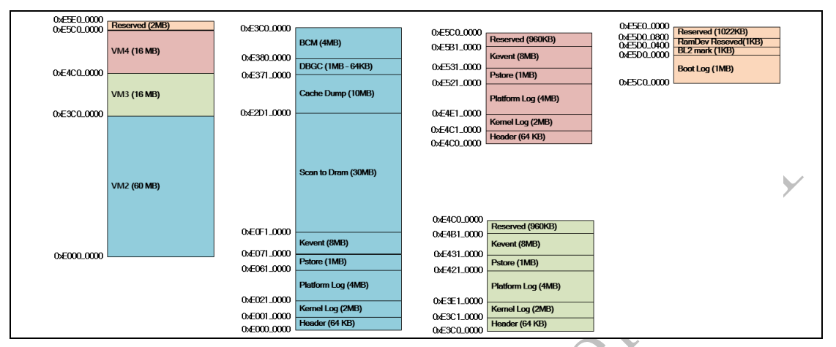
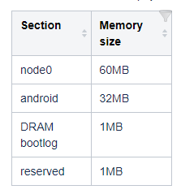
DSS(Debug Snapshot)
DSS is a debugging tool for debugging Exynos SoC and is applied to Linux kernel.
DSS reserves 94 MB for physical region for restoring the critical data in case of panic.
Fig: DSS memory map

Slide 7
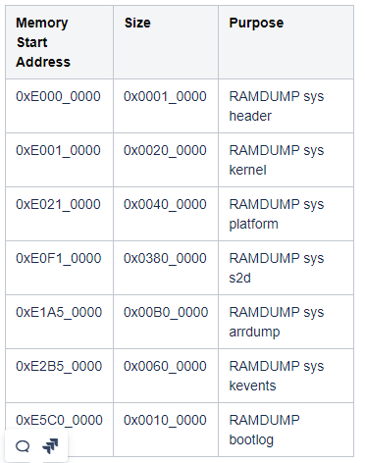
Continue….
DSS saves each core's MMU and CPU registers value in DSS header region.
Below table the is default memory region for DSS from SLSI. These regions can be modified by developer from dts(exynosauto9-sadk-en-debug.dtsi).
One of the feature for DSS to log logging,
Ex: Kernel log, bootloader log and Kernel Event log.
All kernel "printk" logs are stored in the DSS Memory
region of "log_kernel" i.e RAMDUMP sys kernel.
Kernel event logging stores the information
such as TASK, WORK, INTERRUPT related to lockup features.

Slide 8
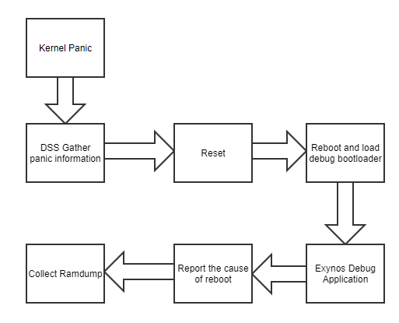
Ramdump sequence diagram
Below is the sequence diagram for ramdump due to kernel panic.

Slide 9
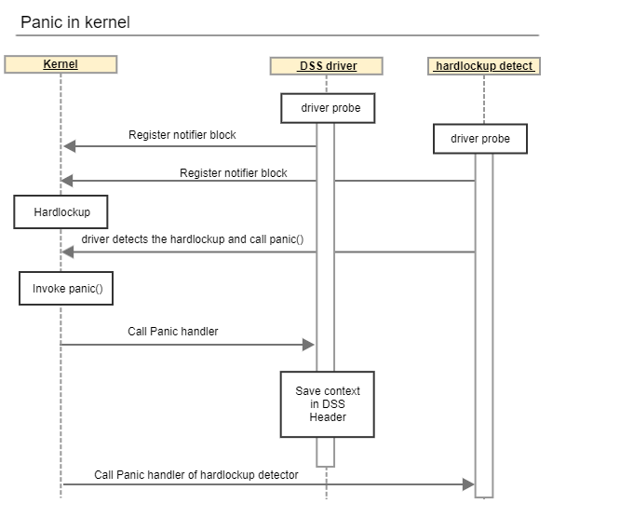
Ramdump sequence diagram
Below is the sequence diagram for freeze

Slide 10
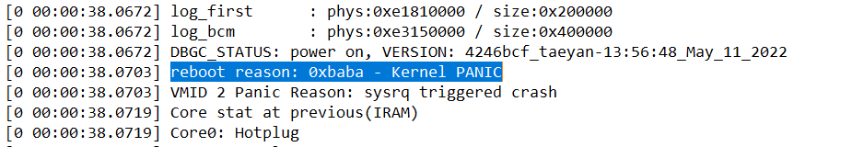
Continue…
Ramdump action is not started just after issue happened.
After kernel panic Debug snapshot(DSS) gathers debug information for the issue happened and target will reset.
Then reset, debug bootloader will load and run the shell and exynos debug application. The reason for reboot is printed on console and LK starts the ramdump.
ssh://gerrit1.harman.com:29418/GTC_Foundation_Software/Integration/Elina/Project/Samsung_KITT/automotive/EA/tool/ramdump

Slide 11
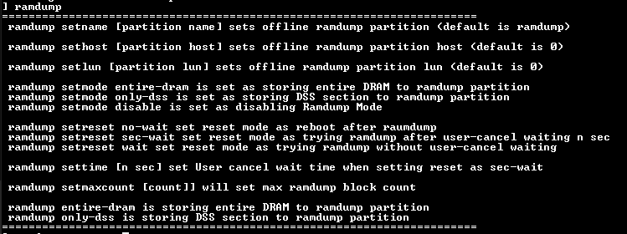
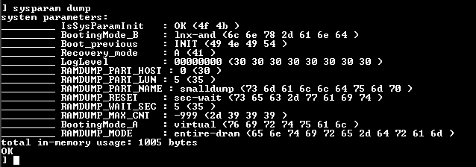
Controlling Ramdump
only-dss works for IDCevo, since not able to set a proper partition with the required size.
By default BMW build, if user didn’t enter fastmode, it does normal boot.
IDCevo, by default stop at LK.

Slide 12
Manual and automatic Ramdump.
Board giving an opportunity to go to Fastboot in LK and allow running script.
Booting from LK here hangs IDCevo
Board automatically writes ramdump to ramdump partition and boots.

Slide 13
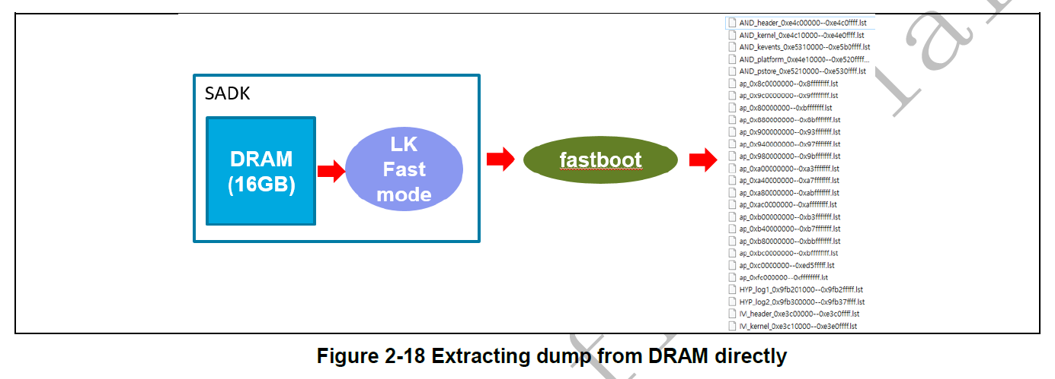
Two type of Ramdump retrieval I

Slide 14
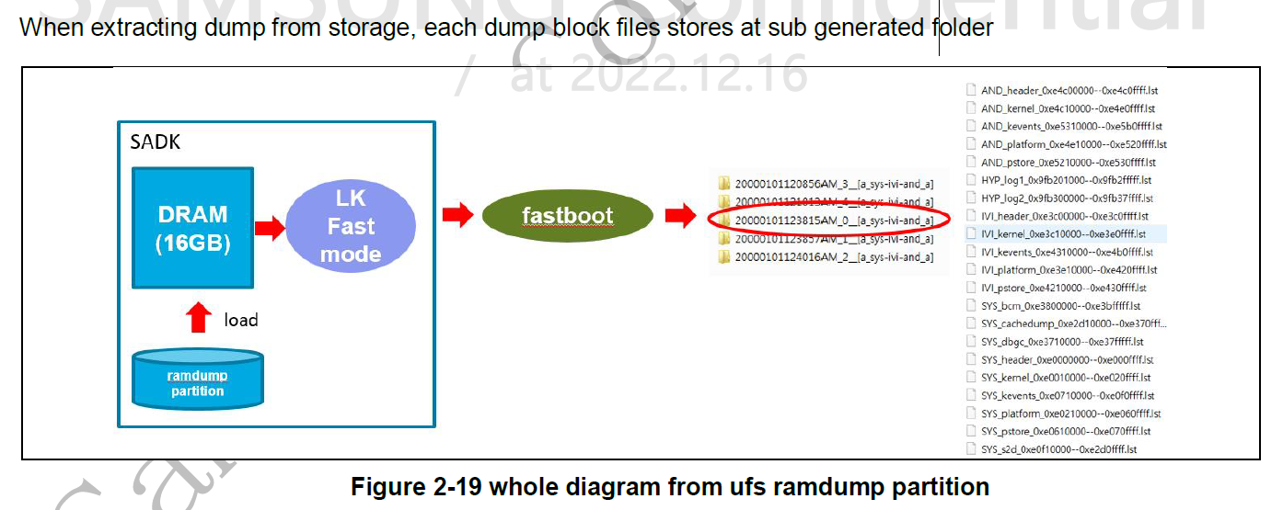
Two type of Ramdump retrieval II

Slide 15
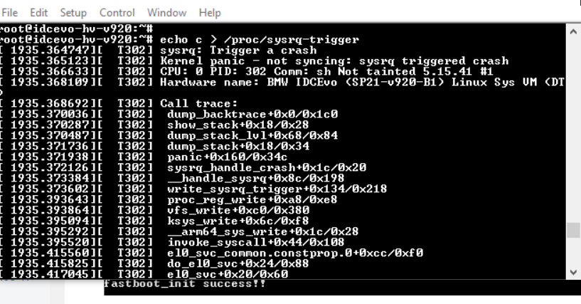
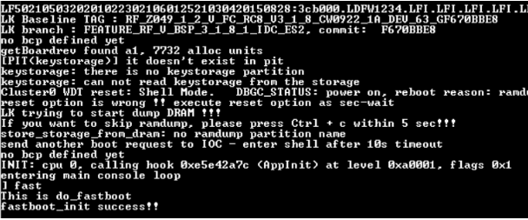
Steps for collecting and storing Ramdump data
Kernel Panic:
Below steps shows collecting ramdump data when kernel panic happened.
Crash is triggered in SYS or IVI side by using below command.
echo c > /proc/sysrq-trigger
Logs are printed with back strace on console. After systems crashes it reboots, store data in ramdump partition of UFS and stops at LK. Enter fast for collecting ramdump.

Slide 16
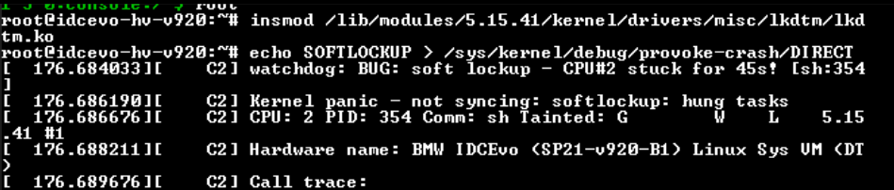
Crash triggering in different scenarios in SYS side
The Linux kernel can act as a watchdog to detect both soft and hard lockups.
Soft Lockup :
A ‘softlockup’ is defined as a bug that causes the kernel to loop in kernel mode for more than 20 seconds without giving other tasks a chance to run.
Soft lockup is triggered with Linux kernel Dump Test Module(LKDTM).
Commands: # insmod /lib/modules/5.15.41/kernel/drivers/misc/lkdtm/lkdtm.ko
# echo SOFTLOCKUP > /sys/kernel/debug/provoke-crash/DIRECT

Slide 17
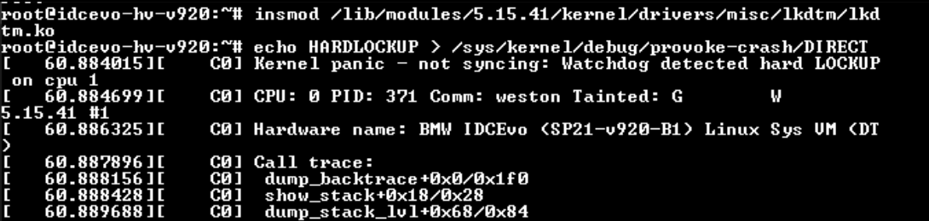
Continue…
Hard lockup:
A ‘hardlockup’ is defined as a bug that causes the CPU to loop in kernel mode for more than 10 seconds, without letting other interrupts have a chance to run.
Hard lockup is triggered with Linux kernel Dump Test Module(LKDTM).
# echo HARDLOCKUP > /sys/kernel/debug/provoke-crash/DIRECT

Slide 18
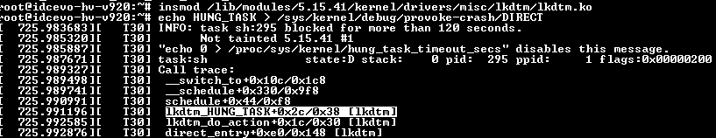
Continue…
Hung_Task:
The hung task is detected by linux kernel by parsing processes with uninterruptible sleep state(which are waiting for some event or resource and is usually not going to move forward) for long time and which are stalled into this D state.
root@idcevo-hv-v920:~# zcat /proc/config.gz | grep HUNG_TASK CONFIG_DETECT_HUNG_TASK=y CONFIG_DEFAULT_HUNG_TASK_TIMEOUT=120 CONFIG_BOOTPARAM_HUNG_TASK_PANIC=y CONFIG_BOOTPARAM_HUNG_TASK_PANIC_VALUE=1
# echo HUNG_TASK > /sys/kernel/debug/provoke-crash/DIRECT

Slide 19
Continue…
Spin lockup:
The spinlock is a very simple single-holder lock.
If a process attempts to acquire a spinlock and it is unavailable, the process will keep trying (spinning) until it can acquire the lock.
This simplicity creates a small and fast lock.
#echo SPINLOCKUP > /sys/kernel/debug/provoke-crash/DIRECT
After triggering panic it reboots enter fast in LK terminal for collecting the ramdump data and run python script file for extracting dump files.
Before IR220307
To Extract ramdump from memory.
eautodump.py -d virt command on PC
From IR220307
eautodump.py or eautodump.py -m all command on PC

Slide 20
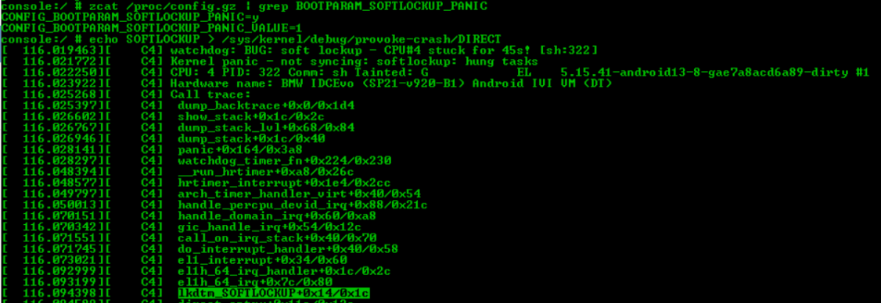
Crash triggering in different scenarios in IVI side
Soft Lockup :
Soft lockup is triggered with Linux kernel Dump Test Module(LKDTM).
For this need to enable two configs.
CONFIG_BOOTPARAM_SOFTLOCKUP_PANIC=y CONFIG_BOOTPARAM_SOFTLOCKUP_PANIC_VALUE=1
Verified the back traces with softlock its generating the back traces which causes the crash we can see that with below image. For analyzing with ramdump need a separate tool because it's in binary format.

Slide 21
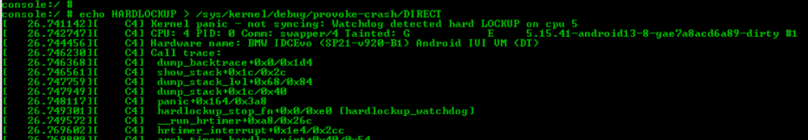
Continue…
Hard Lockup :
Below are the steps to trigger hard LOCKUP in IVI
CONFIG_LKDTM=y this config should be enabled for this there are two dependencies as mentioned below.
#CONFIG_RUNTIME_TESTING_MENU=y #CONFIG_DEBUG_FS=y
Verified Back traces with hardlock crash its generating the appropriate function call which causing the panic.

Slide 22
KEVENT
Pase kevent log through keventparser.
Keventparser parses kevent area with System.map of kernel to get symbol name of kernel.
The tool is in "sources/tool/ramdump/keventparser/src"
You can build with "make"
./parser -k kevent.log -m System.map > out.txt
For example:
./parser -k VM3_kevent_0xe1810000--0xe1a0ffff.lst -m System.map > out.txt

