Slide 1
Understanding Kernel Address Sanitizer
Enhancing Software Security in the Kernel

Slide 2
Contents
1
Introduction
2
Memory Bugs and Vulnerabilities
3
Kasan parts
4
Compiler Module
5
Runtime Parts
6
Generic KASAN Summary

Slide 3
Introduction
Definition of Kernel Address Sanitizer (KASAN):
Kernel Address Sanitizer is a runtime memory error detector designed for the Linux kernel. It helps identify various types of memory-related bugs and vulnerabilities in software.
Overview of its role in software development:
KASAN plays a crucial role in enhancing software security by detecting and addressing memory-related issues early in the development process. It is particularly valuable for identifying complex bugs that may not be easily caught by traditional debugging tools.

Slide 4
Memory Bugs and Vulnerabilities
Common memory-related issues in software:
Buffer Overflows
Buffer overflows occur when a program writes more data to a buffer (e.g., an array) than it can hold, causing the excess data to overflow into adjacent memory locations.
Use-After-Free
Use-after-free occurs when a program continues to use a pointer that points to memory that has already been deallocated (freed).
Out-of-Bounds Access
Out-of-bounds access occurs when a program reads or writes data beyond the boundaries of an allocated memory block.
Notes:
Buffer Overflows:
Description: Security Implications:
Attackers can exploit buffer overflows to overwrite critical data structures, such as function pointers or return addresses on the call stack.
This can lead to the execution of arbitrary code, allowing attackers to gain control over the program and potentially compromise the entire system.
System Instability:
Buffer overflows can corrupt the program's memory space, leading to unpredictable behavior, crashes, or even system instability.
In some cases, they may enable attackers to inject malicious code that disrupts normal program execution.
Use-After-Free:
Description: Use-after-free occurs when a program continues to use a pointer that points to memory that has already been deallocated (freed).
Security Implications:
Attackers can exploit use-after-free vulnerabilities to manipulate or control the memory contents after it has been freed.
This can lead to the execution of malicious code or the manipulation of program behavior, potentially compromising the security of the system.
System Instability:
Use-after-free bugs can result in unpredictable behavior, crashes, or data corruption.
As the program accesses memory that has been freed, it may lead to memory corruption and compromise the integrity of the program's execution.
Out-of-Bounds Access:
Description: Out-of-bounds access occurs when a program reads or writes data beyond the boundaries of an allocated memory block.
Security Implications:
Attackers can exploit out-of-bounds access to read sensitive data or overwrite adjacent memory, leading to unintended consequences.
This can be particularly dangerous when dealing with data structures, as it may allow attackers to manipulate the program's internal state.
System Instability:
Out-of-bounds access can lead to memory corruption, crashes, and unpredictable behavior.
In some cases, it may result in the compromise of critical data structures, affecting the stability and reliability of the entire system.

Slide 5
Kasan parts
Compiler module
Instruments memory access when building the kernel.
Inserts redzones for stack and global variables.
Runtime part
Maintains shadow memory to track memory state.
Hooks into kernel allocators to track alloc/free events.
Prints bug reports.
Notes:
Compiler module is implemented in client and gcc
Runtime part is implemented in the Linux Kernel
Lets see what each of the part does…

Slide 6
Kasan parts
Compiler module
Instruments memory access when building the kernel.
Inserts redzones for stack and global variables.
Runtime part
Maintains shadow memory to track memory state.
Hooks into kernel allocators to track alloc/free events.
Prints bug reports.

Slide 7
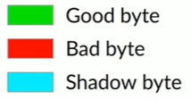
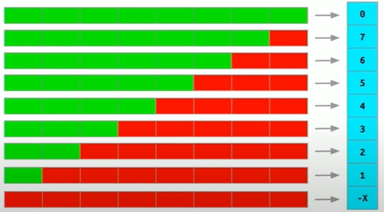
Shadow Byte
Any 8-Aligned byte usually have 9 states
N good bytes and (8-N) bad bytes where (0<=N<=8)
All 8 bytes accessible
…
First 4 bytes accessible
…
All 8 bytes Inaccessible
Notes:
Shadow memory reflects the state of the KERNEL memory like which memory is accessible and which memory is not.
It is common that most of the memory allocated in general comes in contigious chunks
Shadow memory routines for x86-64
During early boot, shadow mapped to a zero page
Once page is initialized, proper shadow is mapped
After boot shadow gets mapped to for vmalloc/vmap areas.

Slide 8
Kasan parts
Compiler module
Instruments memory access when building the kernel.
Inserts redzones for stack and global variables.
Runtime part
Maintains shadow memory to track memory state.
Hooks into kernel allocators to track alloc/free events.
Prints bug reports.

Slide 9
Compiler instrumentation: 8 byte access
*a = …;
char *shadow = (a >> 3) + Offset;
if (*shadow)
kasan_report(a);
*a = …;
Notes:
So after the KASAN is enables it is going to add a few checks to
Calculate the address of the shadow of the corresponding shadow byte
We add offset to where the shadow memory starts
It checks the value of the shadow byte
If the value of shadow is 0, it means that all the 8 bytes are accessible.

Slide 10
Kasan parts
Compiler module
Instruments memory access when building the kernel.
Inserts redzones for stack and global variables.
Runtime part
Maintains shadow memory to track memory state.
Hooks into kernel allocators to track alloc/free events.
Prints bug reports.

Slide 11
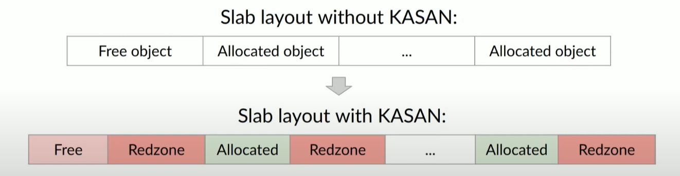
Slab layout (FOR slub)
Slab is fully poisoned (marked as inaccessible) when allocated.
Objects in SLAB are unpoisoned when allocated.
It adds a Redzone between 2 objects which is always poisoned, which in turn helps the KASAN to detect buffer overflows
Notes:
Whenever the object is freed it is poisoned because when the object is freed the kernel should not be accessing it.

Slide 12
Quarantine for freed memory
When memory is freed, its typically immediately reallocated
So detecting use-after-free is hard
KASAN implements quarantine for slab objects
Freed objects are not returned to allocator immediately.
Instead, they are put into delayed reuse queue.
Higher chance to detect use-after-free.
Notes:
Queue has a fixed size i.e 1/32 of the RAM size

Slide 13
Kasan parts
Compiler module
Instruments memory access when building the kernel.
Inserts redzones for stack and global variables.
Runtime part
Maintains shadow memory to track memory state.
Hooks into kernel allocators to track alloc/free events.
Prints bug reports.

Slide 14
Compiler instrumentation: stack variables[1/2]
void foo() {
char x[10];
<---------------------Original function code--------------------->
}

Slide 15
Compiler instrumentation: stack variables[2/2]
void foo() {
char rz1[32];
char x[10];
char rz2[22];
// Compiler-inserted code to unpoison x and poison redzones.
<---------------------Original function code--------------------->
// Compiler –inserted code to unpoison stack frame.
}
Notes:
It adds redzones while compiling the function
It helps in detection out-of-bounds for stack variables.

Slide 16
Compiler instrumentation: global variables
char x[10];
struct {
char original[10];
char redzone[54]; // Poisoned via constructors
} x;

Slide 17
Kasan parts
Compiler module
Instruments memory access when building the kernel.
Inserts redzones for stack and global variables.
Runtime part
Maintains shadow memory to track memory state.
Hooks into kernel allocators to track alloc/free events.
Prints bug reports.

Slide 18
Reporting bugs
When KASAN detects a bug, it prints a bug report
Reports should be detailed to be useful
Among other things, KASAN keeps and prints alloc and free stack traces
For slab(and page_alloc via page owner)
Stack traces saved in stack depot
Alloc stack trace handle is stored in redzone
Free stack trace handle is stored either in object or in redzone.

Slide 19
Generic kasan summary
Dynamic memory corruption detector for Linux Kernel
Finds out-of-bounds, use-after-free, buffer-overflow bugs
Supports slab, page_alloc, vmalloc, stack, and global memory
Requires compiler support: implemented in both Clang and GCC
Relatively fast : ~2x slowdown
RAM impact: shadow(1/8 RAM) + quarantine (1/32 RAM) + ~x1.5 for slab
Basic usage: enable and run tests

Slide 20
Thank you

