Slide 1
Suspend to RAM ( Linux + QNX ) Use case @ Automotive Presenter: Vimal Kumar

Slide 2
SUSPEND-TO-RAM ( S2R )
What is Suspend-to-RAM (S2R) ?
How S2R works in Linux?
How S2R works in HQX (QNX + Android)?
Automotive use case for S2R

Slide 3
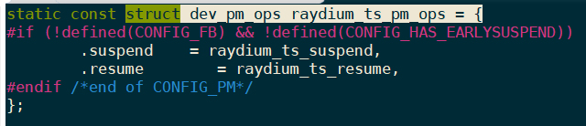
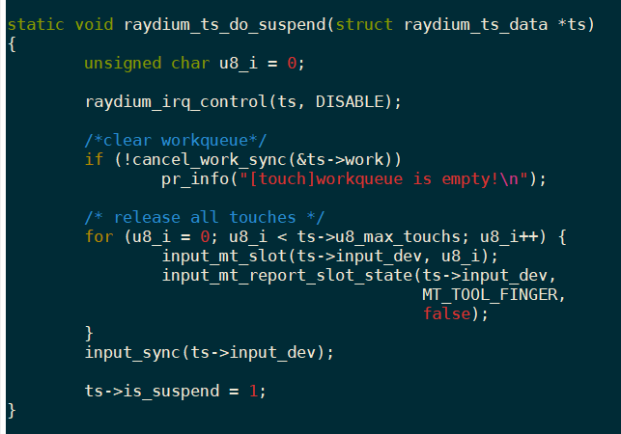
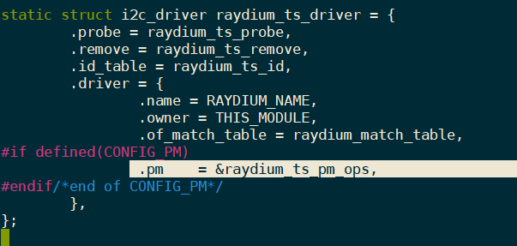
S2R in Linux
Generally, system implements two different models of power management:
System sleep
Runtime power management
The device power management operations at system level or device driver level are implemented by populating objects of type “struct dev_pm_ops” defined in “include/linux/pm.h”
Defining the suspend/resume functions:
Registering with device pm operations:
Ex: Typical suspend callback for a touch driver:

Slide 4
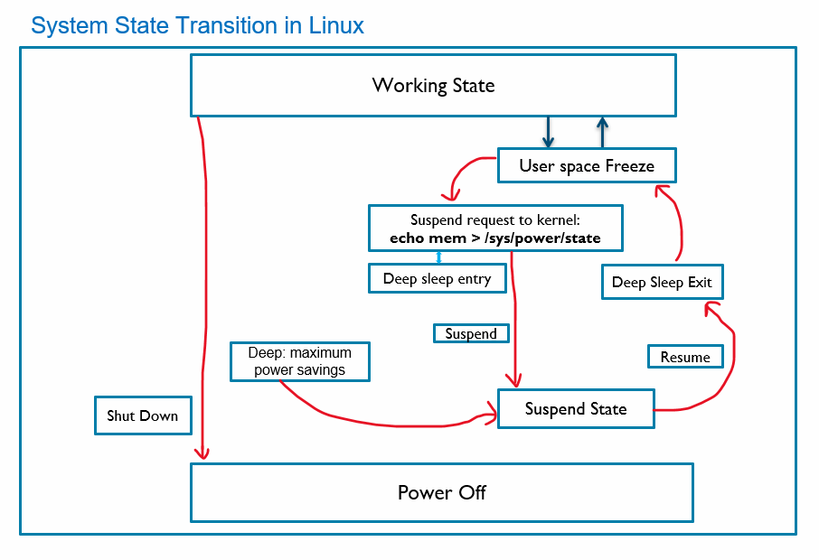


S2R in Linux
We can trigger suspend using sysfs:
“echo mem > /sys/power/state”
The suspend/resume functions are implemented in:
<kernel_top_dir>/kernel/power/suspend.c
Debugging:
echo N > /sys/module/printk/parameters/console_suspend
echo 1 > /sys/module/printk/parameters/ignore_loglevel
echo 1 > /sys/kernel/debug/clk/debug_suspend
echo 1 > /sys/kernel/debug/clk/trace_clocks
cat /sys/kernel/debug/wakeup_sources
suspend | Resume
Prepare Suspend Suspend_late Suspend_noirq | Resume_noirq Resume_early Resume Complete
P1
P2
P3
P4.
.
.
Pn
LDO-1
PMIC
LDO-2
LDO-3

Slide 5
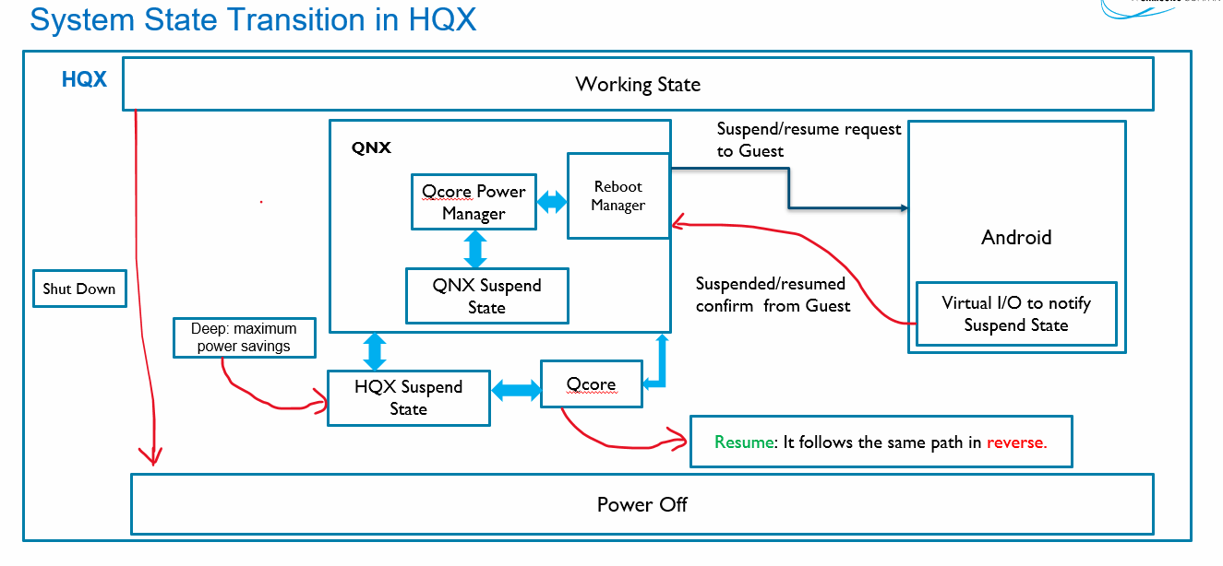
S2R in HQX
HQX: QNX (Host OS) + Android (Guest OS)
In HQX environment QNX is the host, and it is responsible for system suspend/resume. All the communication and notification related to PM happens over the “/dev/pm” path space. It exposes several types of control message (DCMD) via the: <amss/core/dcmd_pm.h> interface file. First, we need to register any new client with Qcore PM using: DCMD_PM_REGISTER. Once guest is suspended, the QNX PM initiates power down sequence by “DCMD_PM_ENTER_STR”. The host initiates guest OS suspend using vitual I/O: echo power > /dev/lcm_demo/display0/key Then waits for guest OS to suspend by monitoring: cat /dev/qvm/la/power_status: 1: Running, 0: suspended
Debugging: screen-pwrmgr off str-ctl -i -e 5000000000 -w 5000000000 | For getting logs : Slog2info slog2info -a -W > /firmware/slog2info_log18.txt & tail -f /tmp/la_gvm.txt &

Slide 6
Use in Automotive
References:
https://docs.kernel.org/admin-guide/pm/suspend-flows.html
https://docs.kernel.org/driver-api/pm/devices.html#driverapi-pm-devices
QC doc 80-PG469-7 Rev. M -> QNX Power Management Software
Uses: | Issues and fixes:
Different modes or state of System → Static mode, one hour mode, sleep state Leakage current/Battery optimization KPI for different peripherals | Everything is managed by IOC controller, so sync between IOC and SOC Power-on sequence at S2R for display and touch BT/Wifi should come up after resume S2R support at Camera

Slide 7
THANK YOU

