Slide 1
PCI Express Basics, Session - 1
By Mir Faisal

Slide 2
Agenda
Introduction
Why PCIe
PCIe Components
PCIe Topology
PCIe Address Space
PCIe Address mapping using DTS
PCIe Enumeration
Interrupts in PCIe
PCIe Transaction Example
PCIe Device driver code walk through

Slide 3
PCI Express(PCIe) Introduction
History: -
PCI Express (Peripheral Component Interconnect Interface) abbreviated as “PCIe” has evolved from older PCI and PCI-X.
First Generation: - The first generation include ISA, EISA, VESA and Micro Channel Bus.
Second Generation: - Second generation bus include PCI, AGP and PCI-X.
Third Generation: - PCIe is third generation I/O bus used to interconnect peripheral devices.
PCIe products currently: -
We have PCIe Gen 5 based products are on market. It can transfer at 4 Giga Bytes per second per lane. If a device uses 4 lanes for example, then it can transfer at 16 GB/s.

Slide 4
PCI Express(PCIe) Introduction
The PCI Express bus connects each device directly to the CPU and other system devices through a pair of high-speed unidirectional differential links (transmit and receive, respectively). PCI Express uses serial interface (compared to the parallel interface used by PCI).
PCIe is a serial point-to-point interconnect between two devices, and it is packet-based protocol for information transfer. Serial bus means fewer pins.
Scalable performance based on number of signal Lanes implemented on the PCIe interconnect
PCIe offers very high data rate. PCIe Gen 5 products can communicate at data rate as high as ~64Gbps using 16 lanes. PCIe 5.0 based SSD has recently launched.
PCIe uses differential signaling on wire or PCB traces. PCIe Gen 1 to Gen 5 use NRZ line coding. New released specification of PCIe that is PCIe 6.0 and PCIe 7.0 use PAM4 line coding.
PCIe is Hot plug.

Slide 5
PCI Express(PCIe) Introduction
PCIe generation and data rate: -
PCIe Generation | Transfer rate | Bandwidth per lane (x1) | Throughput per lane (x1) | Introduced in year | Line Code
PCIe Gen1 | 2.5 GT/s | 250 MB/s | 250 MB/s | 2003 | NRZ
PCIe Gen 2 | 5.0 GT/s | 500MB/s | 500 MB/s | 2007 | NRZ
PCIe Gen 3 | 8.0 GT/s | 1GB/s | 0/98 GB/s | 2010 | NRZ
PCIe Gen 4 | 16 GT/s | 2GB/s | 1.97 GB/s | 2017 | NRZ
PCIe Gen 5 | 32 GT/s | 4GB/s | 3.94 GB/s | 2019 | NRZ
PCIe Gen 6 | 64GT/s | 8GB/s | 7.56 GB/s | 2022 | PAM-4

Slide 6
Why PCIe ?
PCI Express is a very high-speed serial protocol. The protocol is little bit complex. But it is one of the interfaces which offers,
High Speed:
PCIe provides faster data transfer speeds compared to the traditional PCI bus, which can be limited to a maximum of 133 MB/s. PCI-E can provide data transfer speeds of up to 16 GB/s or higher, depending on the version.
Scalability:
PCIe is highly scalable, which is achieved by implementing scalable number of pins and signal lanes per interconnect bus.
Power Management:
PCIe supports good power management features, which can reduce power consumption and extend battery life in mobile devices. It also supports ASPM which is a huge advantage.
Low Pin count: Hot plug, power management, error handling and interrupt signaling are accomplished using packet-based messaging rather than side-band signals. This keeps the device pin count low and reduces system cost.

Slide 7
PCIe Components
PCIe Root Complex: -
CPU communicates with PCIe devices through root complex.
Root complex connects CPU, Memory and PCIe components. Root complex generates transaction requests on behalf of the CPU, which is interconnected through a local bus.
The root complex is either integrated into the CPU directly or is external to the CPU as a discrete component.
A root complex may contain more than one PCI Express port and multiple switch devices can be connected to ports on the root complex or cascaded.
The PCIe Root Complex holds a master copy of a 'Type 1 Configuration Table' that defines the host memory space that is accessible from each Endpoint device.
In addition, each PCIe Endpoint device holds a master copy of their own memory space map in the host system memory as a 'Type 0 Configuration Table', this configuration table in each device allows the host to access the local memory of a PCIe device.

Slide 8
PCIe Components
PCIe Root Complex: - (…continued)
The PCIe Root Complex holds a master copy of a 'Type 1 Configuration Table' that defines the host memory space that is accessible from each Endpoint device.
In addition, each PCIe Endpoint device holds a master copy of their own memory space map in the host system memory as a 'Type 0 Configuration Table', this configuration table in each device allows the host to access the local memory of a PCIe device.
Both the Type 1 and Type 0 configuration tables are set up by the Host Operating System that controls the Root Complex by a process known as enumeration and which acts to build a device memory map for the system by querying each bridge, and endpoint device connected on the bus network.
Root Complex may support various PCIe ports. Each port is connected to an endpoint device or else to a switch that then forms a sub-hierarchy.

Slide 9
PCIe Components
PCIe Root Complex: - (…continued)
A Root complex can be used to implement central system resources such as: hot plug controllers, power management controller, interrupt controller, and error detection and reporting logic.
The root complex has a bus number, device number and function number which are used to form a requester ID or completer ID for its transactions, and these all initialize to zeroes.
The root complex generates transaction requests on behalf of the CPU. In response to CPU commands, it generates configuration, memory and IO requests as well as locked transaction requests on the PCI Express fabric.
The Root complex transmits packets out of its ports and also receives packets into its ports which it then forwards to memory or the CPU.

Slide 10
PCIe Components
PCIe Endpoint: -
The PCIe Endpoints are devices other than root complex and switches that are requesters or completers of PCIe transactions. They are peripheral devices such as GPUs, Network equipment's and storage devices.
Endpoints initiate transactions as a requester or respond to transactions as a completer. In other words, Endpoints are requestor or completer of PCIe transactions.
Endpoints has Type 0 PCI configuration space and respond to configuration transactions as completers.
Each endpoint is initialized with a device ID (requester ID or completer ID) which consists of a bus number, device number, and function number. Endpoints are always device 0 on a bus.
There are two types of Endpoints: -
Legacy Endpoints
Native Endpoints

Slide 11
PCIe Components
PCIe Endpoint (…continued) : -
1. Legacy Endpoints: -
-> Devices that were designed for the operation of an older bus like PCI-X but now have a PCIe interface designate themselves as “Legacy PCIe Endpoints” in a configuration register.
-> Supports PCI transactions to support backward compatibility.
2. Native Endpoints: -
-> Native PCIe Endpoints are PCIe devices designed from scratch as opposed to adding a PCIe interface to old PCI device designs. Native PCIe Endpoints device are memory mapped devices (MMIO devices).
-> Does not support following PCI transactions: -
I/O transactions
32-bit only memory access
Locked transactions

Slide 12
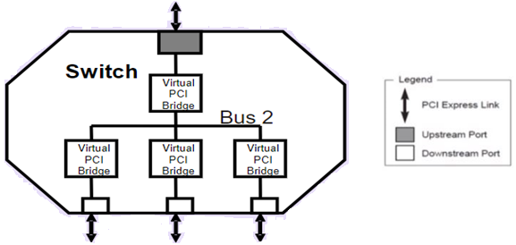
PCIe Components
PCIe Switch: -
PCIe switches have one upstream port that connects to the host, several downstream ports that connect to the devices, and a switching logic that routes the data packets between the ports.
Each downstream port is assigned a set of PCIe lanes and each port is connected to a device. The switch appears to be two or more logical PCI-to-PCI bridges.
There are two types of PCIe switch – fan-out switch and fabric switch.

Slide 13
PCIe Components
PCIe B/D/F: -
PCI BDF (Bus, Device, Function) is a unique identifier assigned to every PCIe device on PCIe fabric. By identifying each device with a unique BDF number, the computer's OS can manage the system's resources efficiently and effectively.
A single system can host up to 256 buses. Each bus hosts up to 32 devices, and each device can have a maximum of 8 functions.
Buses (8 bit) -> 0 – 255
Device (5 bit) -> 0 – 31
Function Number -> 0 - 7
PCIe address domain: -
PCIe address domain represents Physical property of the host. Since 256 buses are not sufficient for many large systems, Linux now supports PCI address domains. Each PCIe domain can host up to 256 buses.
Example: 0000:00:14.0
Here, 0000 is address domain, 00 is bus number, 14 is device number and 0 is the function number.

Slide 14
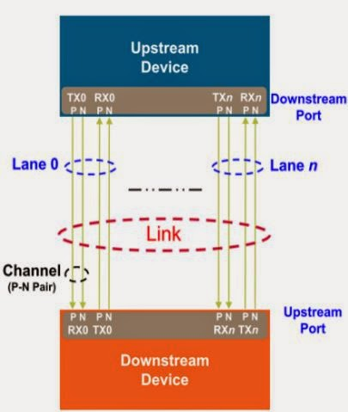
PCIe Components
PCIe Lane: - A PCIe link consists either x1, x2, x4, x8, x12, x16 or x32 signal pairs in each direction. These signals are referred to as Lanes.

Slide 15
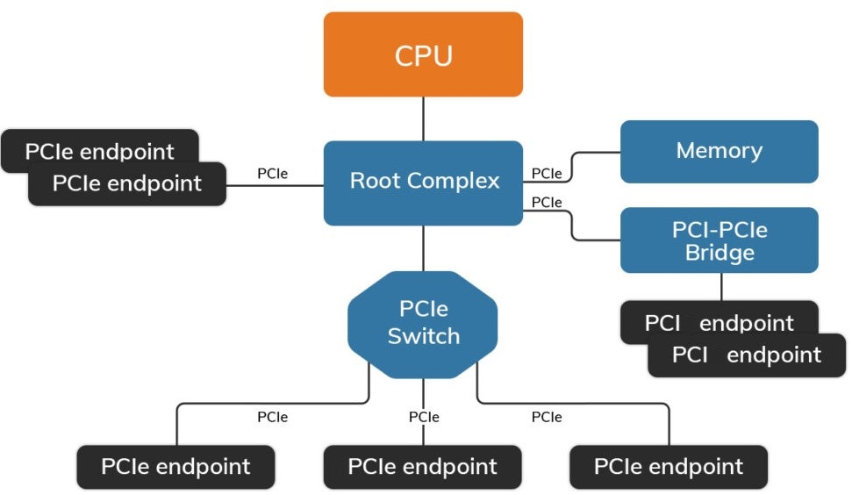
PCIe Topology

Slide 16
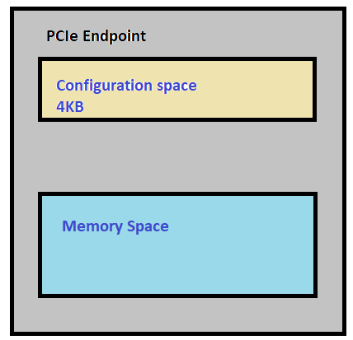
PCIe Address Space
Address Spaces: -
There are four address space in PCIe: -
Memory: Transfer data to and from a memory location. It can use both 32-bit and 64-bit address format.
I/O: Transfer data to and from an I/O location. PCIe supports this for compatibility with legacy devices. It is likely to be deprecated in future.
Configuration Space: Device function configuration/setup. For this, there are Type 0 and Type 1 configuration space, described in next slide.
Message: Messages are used to support in-band communication of events between devices.

Slide 17
PCIe Configuration Space
PCIe Memory-Mapped Address Space: -
During PCIe discovery, software will get the information on how much memory space requirements from device configuration registers. Some of the legacy devices can decode 32-bit addresses, so they require memory region allocated in lower 4GB space.
If a PCIe device can decode 64-bit addresses, then system should provide two memory regions one in the lower 4GB space called MMIOL and another above 4G space called MMIOH.
If PCIe device might need non-prefetchable PCIe Memory-Mapped (MMIO) space which has to be in the lower 4GB space and prefetchable MMIO space which can be anywhere in the system memory.

Slide 18
PCIe Configuration Space
PCIe Configuration Space: -
Configuration space is available in all PCIe components, that is Endpoints, Root complex and switches.
Driver software accesses configuration space to inspect the capabilities and status advertised by the device and to set certain parameters.
There are two types of configuration space: -
I. Type 0 (for Endpoints)
II. Type 1 ( for root complex and switches that have virtual PCI-PCI bridges)
The original PCI configuration space was for 256 bytes. In PCIe it is extended to 4096 bytes, with the first 256 bytes for PCI and the rest for PCIe extended capabilities.

Slide 19
PCIe Configuration Space
Configuration Space (…continued) : -
Again these 256 bytes have two sub-categories: -
First 64 bytes (00h – 3Fh) is called Standard Configuration Header. It has PCI ID i.e., Vendor ID and Product ID registers, to identify device. This configuration header is common for both Type 0 and Type 1.
Remaining 192 byes ( 40h – FFh) represent user-definable configuration space, such as information specific to a PC card. It has capabilities supported by device.
There are two ways to access PCI compatible 256 bytes configuration space registers:
- PCI compatible Configuration Access Mechanism (CAM) - PCIe Enhanced Configuration Access Mechanism (ECAM)
But bytes in configuration space other than first 256 bytes i.e., 257th byte to 4096tH byte can only be accessed using “Memory-mapped I/O”.

Slide 20
PCIe Configuration Space
Enhanced Configuration Space Mechanism (ECAM) : -
In PCIe, registers of Configuration space is mapped to memory locations. In PCIe configuration space is accessed using Enhanced Configuration Space Mechanism.
Each PCIe device function requires 4K bytes of the configuration space. There could be 256 buses, each with up to 32 devices, each supporting eight functions in a device PCIe tree . Each PCIe device tree is called a segment. So, we need total 256MB of contiguous memory region for the config space for this Enhanced Configuration Access method (ECAM) region allocated for each segment.
(256 buses × 32 devices × 8 functions × 4 KB = 256 MB).

Slide 21
PCIe Configuration Space
Enhanced Configuration Space Mechanism (ECAM) : -
In PCIe, registers of Configuration space is mapped to memory locations. In PCIe configuration space is accessed using Enhanced Configuration Space Mechanism.
Each PCIe device function requires 4K bytes of the configuration space. There could be 256 buses, each with up to 32 devices, each supporting eight functions in a device PCIe tree . Each PCIe device tree is called a segment. So, we need total 256MB of contiguous memory region for the config space for this Enhanced Configuration Access method (ECAM) region allocated for each segment.
(256 buses × 32 devices × 8 functions × 4 KB = 256 MB).

Slide 22
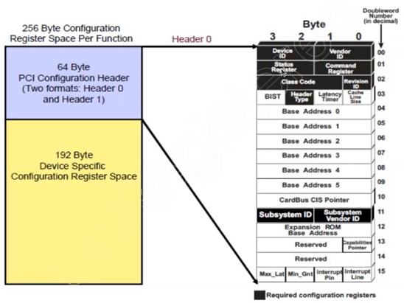
PCIe Configuration Space
View of PCI compatible 256 bytes configuration space: -

Slide 23
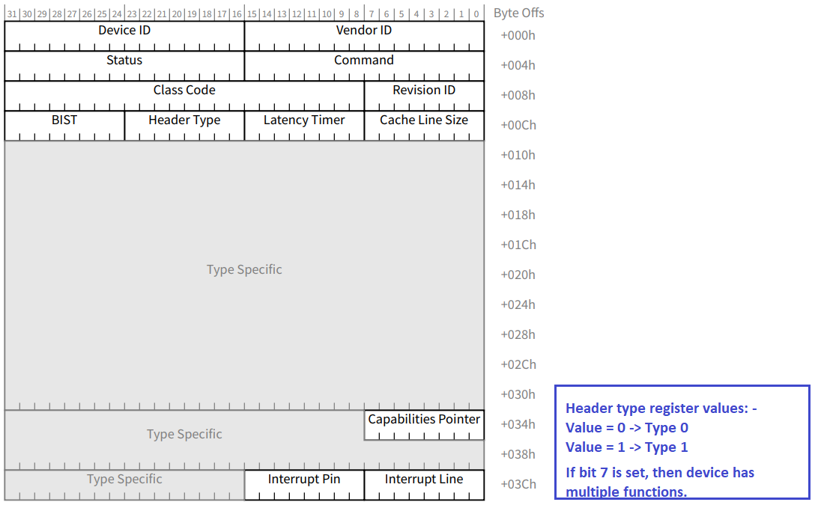
Type 0/1 Common Configuration Header

Slide 24
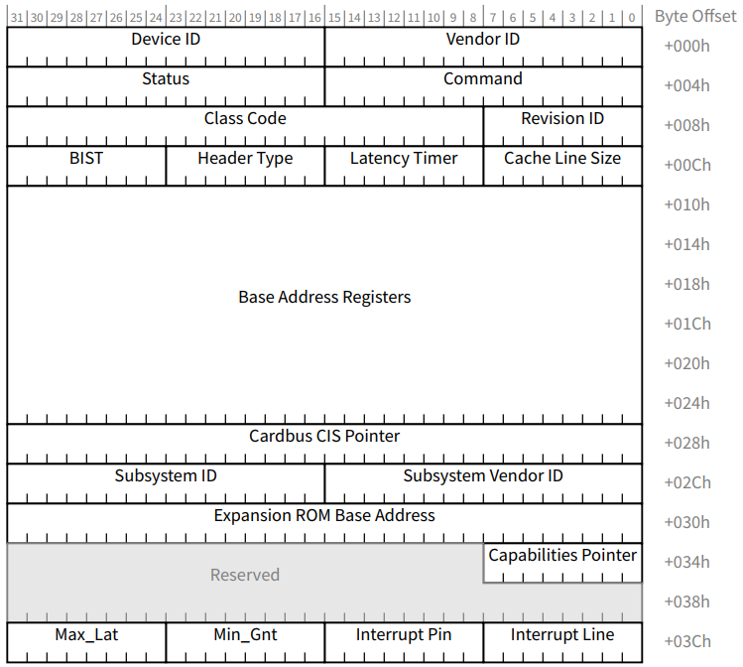
Type 0 Configuration Header

Slide 25
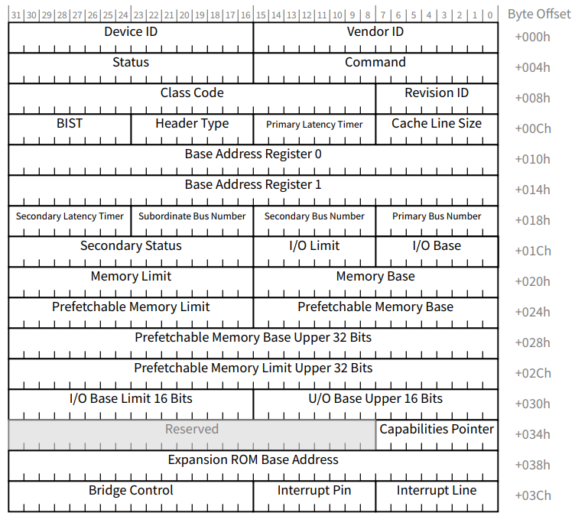
Type 1 Configuration Header

Slide 26
Type 1 Configuration Header
In Type – I configuration header, there are three fields namely: -
Primary bus number: Primary bus number is the bus on which device seats. If transaction has bus number between 1 and 0xFF, then it will come down.
Secondary bus number: Bus number behind the bridge/switch or exactly downstream of current bus.
Sub-ordinate bus number: Sub-ordinate bus number represents depth in hierarchy or how far we go.

Slide 27
PCIe Configuration Space
Capability Pointer Register: -
Capability Pointer Register is at offset 0x34 in configuration space.
The capabilities pointer register indicates an offset, beyond the header registers to further capability register structures. capabilities are arranged as a linked list of structures.
BAR Registers: -
BAR gives the information about address space needed by the device.
After a device is enumerated, each BAR register will be programmed by physical address.
It is done by “drivers/pci/probe.c”.
Endpoint devices can have up to six 32-bit BARs or combine two BARs to a 64-bit BAR.
Root complex or Switch has only 2 BAR registers.

Slide 28
PCIe Configuration Space
BAR Registers (… continued): -
BAR register bits
Bits | Description | Values
0 | Region types | 0 – Memory 1 – I/O
2 - 1 | Type | 00 – Base register is 32 bits wide 01 - Reserved 10 - Base register is 64-bits wide 11 - Reserved
3 | Prefetchable | 0 – No 1 - Yes
31 - 4 | Base address | 16-Byte Aligned Base Address

Slide 29
PCIe Configuration Space
BAR Registers (… continued): -
Determination of Memory size using BAR: -
1. RC does is write to all BARs in all devices a value of 0xFFFF-FFFF. It then reads back the BAR values.
2. If for example BAR size is 4k (for example), then we will read back 0xFFFFF00x.
3. Clear the lower four bits to zeros (0xFFFFF000).
4. Invert all 32 bits (to get 0xfff)
5. Add one to the result (0x1000 = 4096 bytes)
Note: Prefetchable memory means reading a location does not affect the contents, so it can be prefetched, discarded, and read again later with no adverse effects. Prefetchable memory regions are cacheable.

Slide 30
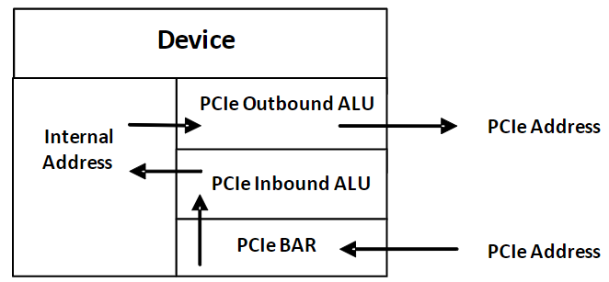
PCIe Address Translation Unit
ATU: -
PCIe devices need to use PCIe addresses to send/receive packets over a PCIe link. But PCIe device’s internal address is other than PCIe address, so Address Translation is required to work on different address spaces.
Address Translation Unit (ATU) within the PCIe module translates the device internal address into a PCIe address and vice versa.

Slide 31
PCIe Address Mapping using DTS
In arm32/arm64 architecture, memory mapped address space for PCIe components including “Configuration Space” can be provided using DTS.
Example: Code snippet of pcie dtsi file for ExynosAuto-v920 SOC.
pcie_3: pcie@161C1000 {
compatible = "samsung,exynos-v920-evt2-pcie-rc";
reg = <0x0 0x161C1000 0x1000 /* elbi base */
……
0x0 0x7FFFD000 0x2000 /* configuration space */
……>;
ranges = <0x82000000 0 0x70000000 0 0x70000000 0 0x0FFFD000>;
}

Slide 32
PCIe Address Mapping using DTS (… continued)
pcie_3: pcie@161C1000 {
ranges = <0x82000000 0 0x70000000 0 0x70000000 0 0x0FFFD000>;
}
PCI addresses or child addresses use 3 cells. The first cell is a bit field, which has pattern as below.
npt000ss bbbbbbbb dddddfff rrrrrrrr
n: relocatable region flag (doesn't play a role here)
p: prefetchable (cacheable) region flag
t: aliased address flag (doesn't play a role here)
ss: space code
00: configuration space
01: I/O space
10: 32-bit memory space
11: 64-bit memory space

Slide 33
PCIe Address Mapping using DTS (… continued)
pcie_3: pcie@161C1000 {
ranges = <0x82000000 0 0x70000000 0 0x70000000 0 0x0FFFD000>;
}
0x82 -> 1000 0010 (npt000ss)
So, the bit field 0x82000000 specifies non-prefetchable, 32-bit memory space. The second and third value i.e., "0 0x70000000" is high and low parts of the 64-bit PCI address to be mapped in. As the high part of address is 0, so actual address is 0x70000000.
The fourth and fifth value specifies the address on the CPU's bus to map the segment of the PCI bus. Thus, PCI address 0x70000000 maps CPU bus at address 0x70000000.
The sixth and seventh value (i.e., "0 0x0FFFD000" = 0x0FFFD000 or 255 MB) specifies size of the segment to map in.
Similarly, Configuration space mapping as per DTS is from memory location “0x7FFFD000” and its size is 8K bytes.
Above resources can be seen in “proc/iomem”.

Slide 34
PCIe Enumeration
PCIe Enumeration: -
PCIe enumeration is a process by which configuration software accesses configuration space registers for each peripherals to discover topology and assigns bus numbers and system resources.
By the time PCI enumeration is complete, address space is fully assigned, link is established, and device is ready for use.
On x86, PCIe hierarchy enumeration is done by BIOS on hardware initialization time. But on ARM64 (for ex. – exynos v920), it is done at user space using a “sysfs” command.
# echo 1 > /sys/devices/platform/161c0000.pcie/pcie_sysfs (For PCIe channel - 2) # echo 1 > /sys/devices/platform/161c1000.pcie/pcie_sysfs (For PCIe channel - 3)

Slide 35
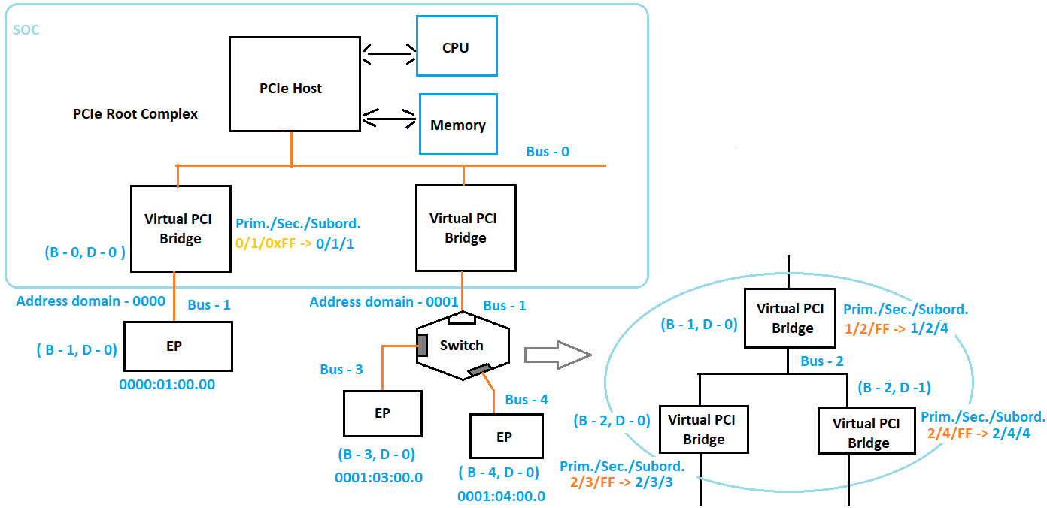
PCIe Enumeration

Slide 36
PCIe Enumeration
“lspci” output: -
console:/data # ./lspci -tvvv
-+-[0002:00]-+-00.0 Device 8086:1237
| +-01.0 Device 1af4:1043
| +-02.0 Device 1af4:1042
| +-03.0 Device 1af4:1044
| +-04.0 Device 1af4:1052
| +-05.0 Device 1af4:1041
| \-06.0 Device 1af4:1053
+-[0001:00]---00.0-[01-ff]----00.0 Device 12be:bd31
\-[0000:00]---00.0-[01-ff]----00.0 Device 12be:bd31

Slide 37
PCIe Enumeration
“lspci” output: -
console:/data # ./lspci -vvv -s 0000:01:00.0
0000:01:00.0 Class 0280: Device 12be:bd31 (rev 01)
Subsystem: Device 12be:bd31
Control: I/O- Mem- BusMaster- SpecCycle- MemWINV- VGASnoop- ParErr- Stepping- SERR- FastB2B- DisINTx-
Status: Cap+ 66MHz- UDF- FastB2B- ParErr- DEVSEL=fast >TAbort- <TAbort- <MAbort- >SERR- <PERR- INTx-
Interrupt: pin A routed to IRQ 0
Region 0: Memory at 60800000 (64-bit, non-prefetchable) [disabled] [size=64K]
Region 2: Memory at 60000000 (64-bit, non-prefetchable) [disabled] [size=8M]
Capabilities: [48] Power Management version 3
Flags: PMEClk- DSI- D1+ D2+ AuxCurrent=0mA PME(D0-,D1-,D2-,D3hot-,D3cold-)
Status: D0 NoSoftRst+ PME-Enable+ DSel=0 DScale=2 PME-
Capabilities: [58] MSI: Enable- Count=1/32 Maskable- 64bit+
Address: 0000000000000000 Data: 0000
Capabilities: [68] Vendor Specific Information: Len=38 <?>
………….
Status: NegoPending- InProgress-
Capabilities: [1b0 v1] Latency Tolerance Reporting
Capabilities: [200 v1] #1f

Slide 38
Interrupts in PCIe
PCIe supports three types of interrupts: -
INTx Emulation for legacy Interrupts
MSI Interrupts
MSI-X interrupts
Legacy Interrupts: -
Legacy interrupts are dedicated side-band signals. Multiple interrupt signals may share a single physical line.
Device 1
PIC
CPU CORE
isr{
….
}
Device 2
Device N
Interrupt vector

Slide 39
Interrupts in PCIe
1. INTx Emulation for legacy Interrupts: -
Legacy PCI introduced INTA#, INTB#, INTC#, INTD#, which are collectively called as INTx.
PCIe mimics this via “virtual wire” messages
Assert_INTx
Deassert_INTx
PCIe devices stop sending Assert_INTx messages once MSI or MSI-X mode is enabled.

Slide 40
Interrupts in PCIe
2. MSI interrupts: -
A Message Signaled Interrupt is a write from the device to a special address which causes an interrupt to be received by the CPU.
Using MSI, a device can support multiple interrupts per function, allowing each interrupts specialized for different purpose.
There can be maximum of 32 MSIs per function.
MSI-X is similar to MSI, which can support maximum of 2048 MSI-X’s per function.
At a time, either MSI or MSI-X can be enabled by a device driver.
PCIe devices are initialized to use pin-based interrupts. The device driver has to set up the device to use MSI or MSI-X.
MSI uses one address with a variable data value indicating which vector is asserting.

Slide 41
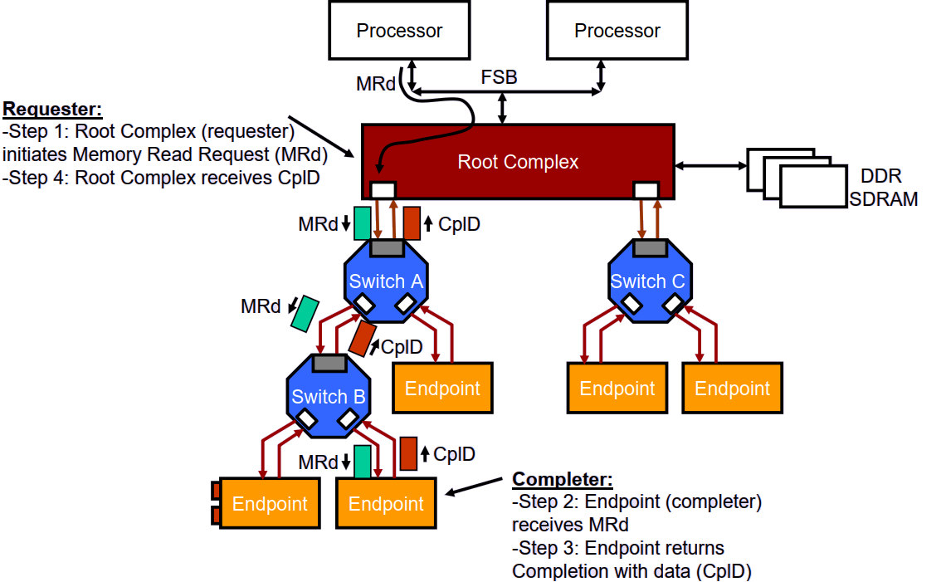
PCIe transaction example
A simple PCIe transaction example: -

Slide 42

PCIe Device driver code walk through

Slide 43
THANK YOU !

