Slide 1
CS 467 MachINE LearnIng
Dr. M. Irfan Uddin

Slide 2
Lecture # 10 Decision Trees

Slide 3
In the previous Lecture ….
Naïve Bayes
Types of NB
Application of NB
NB Rule
Association Rules
Real-World Example solved with NB

Slide 4
Objectives of Today’s Class
To explain the concepts of Decision Trees
To apply the knowledge of Decision Trees to solve problems in ML
To evaluate the performance of Decision Trees in solving real-world problems

Slide 5
Decision Tree
A decision tree is a hierarchical model for supervised learning whereby the local region is identified in a sequence of recursive splits in a smaller number of steps.
A decision tree is composed of internal decision nodes and terminal leaves

Slide 6
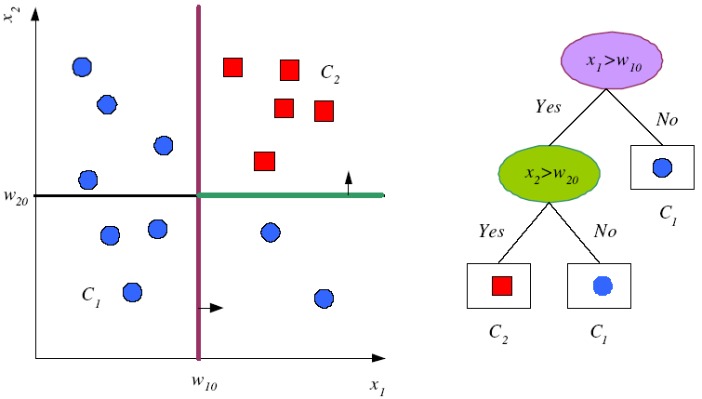
Tree Uses Nodes and Leaves
But this does not look like a tree ☹

Slide 7

This is what a tree look like ☺
Upside down Tree ☺

Slide 8
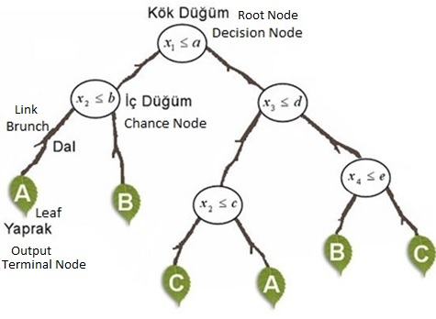
Decision Tree Structure

Slide 9
Divide and Conquer
Internal decision nodes
Univariate: Uses a single attribute, x_{i}
Numeric x_{i} : Binary split : x_{i} > w_{m}
Discrete x_{i} : n-way split for n possible values
Multivariate: Uses all attributes, x
Leaves
Classification: Class labels, or proportions
Regression: Numeric; r average, or local fit
Learning is greedy; find the best split recursively

Slide 10

Decision Tree Example
Debt
Income

Slide 11
Decision Tree Example
Debt
Income > t1
??
t1
Income

Slide 12
Decision Tree Example
Debt
Income > t1
t2
Debt > t2
t1
Income
??

Slide 13
Decision Tree Example
Debt
Income > t1
t2
Debt > t2
t3
t1
Income
Income > t3

Slide 14
Decision Tree Construction
Debt
Income > t1
t2
Debt > t2
t3
t1
Income
Income > t3
Note: tree boundaries are piecewise
linear and axis-parallel

Slide 15
ID3 Algorithm
An algorithm to construct a decision tree
Using Entropy to generate the information gain
The best value then be selected

Slide 16
Decision Tree for Playing Tennis
Consider the following table
Day | Outlook | Temp. | Humidity | Wind | Play Tennis
D1 | Sunny | Hot | High | Weak | No
D2 | Sunny | Hot | High | Strong | No
D3 | Overcast | Hot | High | Weak | Yes
D4 | Rain | Mild | High | Weak | Yes
D5 | Rain | Cool | Normal | Weak | Yes
D6 | Rain | Cool | Normal | Strong | No
D7 | Overcast | Cool | Normal | Weak | Yes
D8 | Sunny | Mild | High | Weak | No
D9 | Sunny | Cold | Normal | Weak | Yes
D10 | Rain | Mild | Normal | Strong | Yes
D11 | Sunny | Mild | Normal | Strong | Yes
D12 | Overcast | Mild | High | Strong | Yes
D13 | Overcast | Hot | Normal | Weak | Yes
D14 | Rain | Mild | High | Strong | No

Slide 17
Decision Tree for Playing Tennis
We want to build a decision tree for the tennis matches
The schedule of matches depend on the weather (Outlook, Temperature, Humidity, and Wind)
So, to apply what we know to build a decision tree based on this table

Slide 18
Decision Tree for Playing Tennis
Attributes and their values:
Outlook: Sunny, Overcast, Rain
Humidity: High, Normal
Wind: Strong, Weak
Temperature:Hot,Mild,Cold
Target concept - Play Tennis: Yes, No

Slide 19
Decision Tree for Playing Tennis
Calculating the information gains for each of the weather attributes:
For the Wind
For the Humidity
For the Outlook
For the Temperature

Slide 20
Decision Tree for Playing Tennis
Outlook
Sunny
Overcast
Rain
Humidity
Yes
Wind
High
Normal
Strong
Weak
No
Yes
No
Yes

Slide 21
Complete Tree
Outlook
Sunny
Overcast
Rain
Humidity
Yes
Wind
[D3,D7,D12,D13]
High
Normal
Strong
Weak
No
Yes
No
Yes
[D1,D2]
[D8,D9,D11]
[D6,D14]
[D4,D5,D10]

Slide 22
OR Complete Tree
Humidity
Normal
High
Wind
Wind
Strong
Weak
Strong
Weak
Outlook
Outlook
Outlook
Outlook
Sunny
Overcast
Rainy
Sunny
Overcast
Rainy
22
Rainy
Sunny
Overcast
Sunny
Overcast
Rainy
Notes:
In parametric estimation, we define a model over the whole input space and learn its parameters from all of the training data. Then we use the same model and the same parameter set for any test input.
In nonparametric estimation, we divide the input space into local regions, defined by a distance measure like the Euclidean norm, and for each input, the corresponding local model computed from the training data in that region is used.
A decision tree is also a nonparametric model in the sense that we do not assume any parametric form for the class densities and the tree structure is not fixed a priori but the tree grows, branches and leaves are added, during learning depending on the complexity of the problem inherent in the data.
Another advantage of the decision tree is interpretability. As we will see shortly, the tree can be converted to a set of IF-THEN rules that are easily understandable.

Slide 23
How to build Decision Tree?
Decision Trees are a good solution but not optimum.
To obtain an optimum decision tree a rule is needed.
We need to find the root node according to some calculations (Entropy & Gain).
After find the root node it will continue up to leaves.
https://towardsdatascience.com/decision-trees-for-classification-id3-algorithm-explained-89df76e72df1

Slide 24
Steps for a desion tree construction:
Decision tree needs a decision (Go to Play Tennis or not)
Entropy calculation of the system
Root Node selection (according to Information Gain)

Slide 25
Another Example
Attributes:
Color(Red, Yellow, Green)
Outline(Dashed, Lined)
Dot(Present, Not Present)
.
.
Classes:
Triangle
Square
.
.
.
.

Slide 26
Classes:
Triangle
Square
Attributes:
Color(Red, Yellow, Green)
Outline(Dashed, Lined)
Dot(Present, Not Present)
.
.
.
.
.
.
Color?
Outline?
Dot?
.
.
.
.
.
.
.
.
.
.
.
.
.
.
.
.
.
.

Slide 27
Attributes:
Color(Red, Yellow, Green)
Outline(Dashed, Lined)
Dot(Present, Not Present)
.
.
.
.
.
.
.
.
red
Color?
Assume that I use ‘some technique’ and decide that on the top-level ‘color’ should be used.
green
.
yellow
.
.
.
Done

Slide 28
.
.
.
.
.
.
.
.
red
Color?
Then I use ‘some technique’ and decide that on the green sample, I should choose ‘outline’ attribute.
green
.
yellow
.
.
.
Done
solid
.
Outline?
Done
dashed
.
Done

Slide 29
Then I used ‘some technique’ and decided that on the red sample, I should choose the ‘Dot’ attribute.
.
.
.
.
.
.
.
.
red
.
yes
Dot?
.
Color?
Done
no
green
.
yellow
Done
.
.
.
Done
solid
.
Outline?
Done
dashed
.
Done

Slide 30
Decision Tree
.
.
.
.
.
.
Color
red
green
yellow
Dot
square
Outline
yes
no
dashed
solid
triangle
square
triangle
square

Slide 31
Let's investigate that ‘Some Technique’
How to decide which node should be the root node?
How to decide which node can be internal?
How to decide which node can be a leaf node?
Answer:
Entropy and Information Gain

Slide 32
Entropy & Gain
Entropy (E) is the minimum number of bits needed in order to classify an arbitrary example as yes or no
E(S) = Σ^{c}_{i=1} –p_{i} log₂ p_{i}
E(S)=0 , if all variables are the same
E(S)=1 , if variables are distributed equally.
0<E(S)<1 , if variables are distributed randomly.
S means the the training dataset
The information gain G(S,A) where A is an attribute
G(S,A) = E(S) – E(S/A)

Slide 33
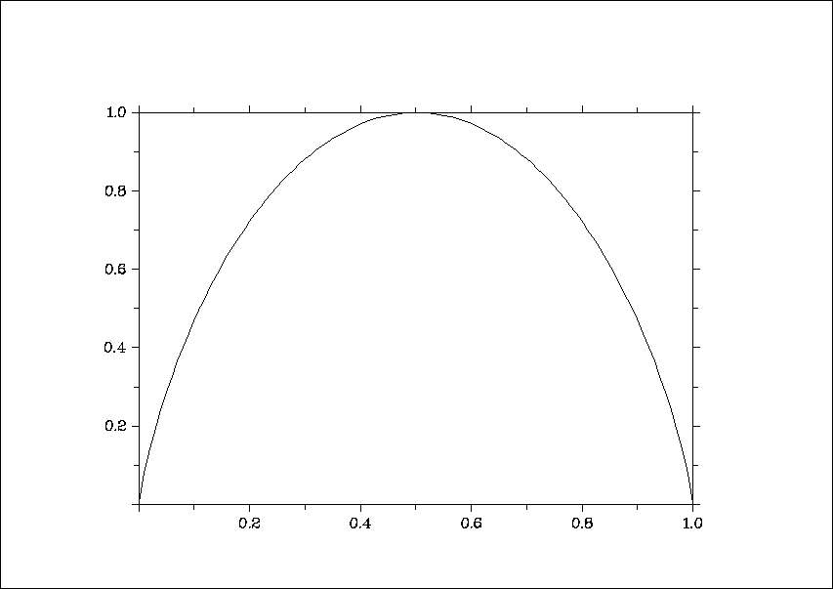
Entropy
Written as: E(S) = -(p+)*log₂(p+ ) - (p_ )*log₂(p_ )
Where p+ is the positive samples
Where p_ is the negative samples
Where S is the sample of attributions
For a two-class problem:
For more than 2-classes, E can be greater than 1
entropy
p(c1)

Slide 34
Example
[29+,35-]
A₁=?
The Entropy of A₁ is computed as the following:
E(A) = -29/(29+35)*log₂(29/(29+35)) –
35/(35+29)log₂(35/(35+29))
= 0.9937
E(TRUE) = -21/(21+5)*log₂(21/(21+5)) – 5/(5+21)*log₂(5/(5+21))= 0.7960
E(FALSE) = -8/(8+30)*log₂(8/(8+30)) –
30/(30+8)*log₂(30/(30+8))
= 0.7426
True
False
The Entropy of True:
[21+, 5-]
[8+, 30-]
The Entropy of False:

Slide 35




Entropy reduction by data set partitioning
.
.
.
.
.
.
.
.
red
Color?
green
.
yellow
.
.
.
*I means Information Entropy

Slide 36






.
.
.
.
.
.
red
.
.
Color?
green
yellow
.
.
.
.
IG(S, Color) = I(S) – I(S/Color)
= I(S) – [red/total * I_{red} + green/total * I_{green} + yellow/total * I_{yellow}]

Slide 37
Information Gain
.
.
.
.
.
.
.
.
red
Color?
green
.
yellow
.
.
.
Tutorial: https://machinelearningmastery.com/information-gain-and-mutual-information/

Slide 38
Gain(Outline) = 0.020
Gain(Dot) = 0.971
.
.
.
.
.
.
.
.
red
.
yes
Dot?
.
Color?
no
green
.
yellow
.
.
.
Gain(Color) = 0.246
Gain(Outline) = 0.151
Gain(Dot) = 0.048
solid
.
Outline?
dashed
Gain(Outline) = 0.971
Gain(Dot) = 0.020
.

Slide 39
Summary
Basic Concepts of Decision Trees
Understanding ID3 Algorithm
Building a decision Tree from a sample data
Understanding Entropy and Information Gain
Calculating Entropy and IG on a sample data

Slide 40
In the next lecture …
Information Gain of an Attribute using PlayTennis data
Building a tree based on Information Gain for the PlayTennis data
Converting a Tree to Decision Rules
Advantages and Disadvantages of DT
Classification Tree (ID3, CART, C4.5)

