Slide 1
CS 467 MachINE LearnIng
Dr. M. Irfan Uddin

Slide 2
Lecture # 10 Decision Trees

Slide 3
In the previous Lecture ….
Naïve Bayes
Types of NB
Application of NB
NB Rule
Association Rules
Real-World Example solved with NB

Slide 4
Objectives of Today’s Class
To explain the concepts of Decision Trees
To apply the knowledge of Decision Trees
To evaluate the performance of Decision Trees in solving real-world problems

Slide 5
Decision Tree
A decision tree is a hierarchical model for supervised learning whereby the local region is identified in a sequence of recursive splits in a smaller number of steps.
A decision tree is composed of internal decision nodes and terminal leaves

Slide 6
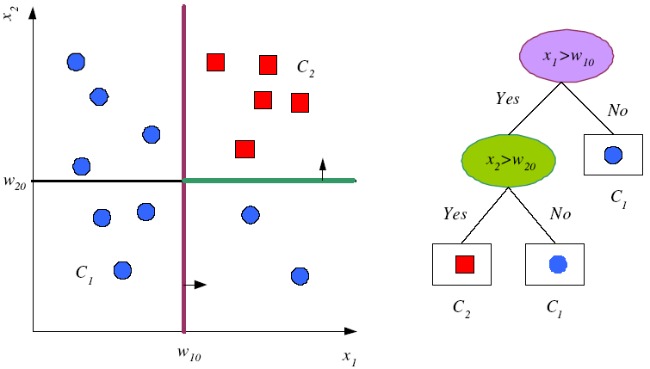
Tree Uses Nodes and Leaves
But this does not look like a tree ☹

Slide 7

This is what a tree look like ☺
Upside down Tree ☺

Slide 8
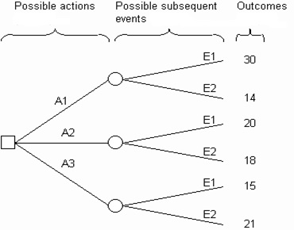
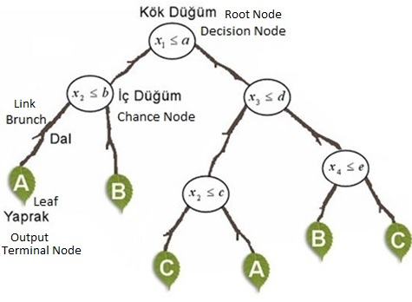
Decision Tree Structure

Slide 9
Divide and Conquer
Internal decision nodes
Univariate: Uses a single attribute, x_{i}
Numeric x_{i} : Binary split : x_{i} > w_{m}
Discrete x_{i} : n-way split for n possible values
Multivariate: Uses all attributes, x
Leaves
Classification: Class labels, or proportions
Regression: Numeric; r average, or local fit
Learning is greedy; find the best split recursively

Slide 10

Decision Tree Example
Debt
Income

Slide 11
Decision Tree Example
Debt
Income > t1
??
t1
Income

Slide 12
Decision Tree Example
Debt
Income > t1
t2
Debt > t2
t1
Income
??

Slide 13
Decision Tree Example
Debt
Income > t1
t2
Debt > t2
t3
t1
Income
Income > t3

Slide 14
Decision Tree Construction
Debt
Income > t1
t2
Debt > t2
t3
t1
Income
Income > t3
Note: tree boundaries are piecewise
linear and axis-parallel

Slide 15
ID3 Algorithm
An algorithm to construct a decision tree
Using Entropy to generate the information gain
The best value then be selected

Slide 16
Top-Down Induction of Decision Trees ID3
A ← the “best” decision attribute for next node
Assign A as decision attribute for node
For each value of A create new descendant
Sort training examples to leaf node according to
the attribute value of the branch
If all training examples are perfectly classified (same value of target attribute) stop, else iterate over new leaf nodes.

Slide 17
Building a Decision Tree
First test all attributes and select the one that would function as the best root;
Break-up the training set into subsets based on the branches of the root node;
Test the remaining attributes to see which ones fit best underneath the branches of the root node;
Continue this process for all other branches until
all examples of a subset are of one type
there are no examples left (return majority classification of the parent)
there are no more attributes left (default value should be majority classification)

Slide 18
Decision Tree for Playing Tennis
Consider the following table
Day | Outlook | Temp. | Humidity | Wind | Play Tennis
D1 | Sunny | Hot | High | Weak | No
D2 | Sunny | Hot | High | Strong | No
D3 | Overcast | Hot | High | Weak | Yes
D4 | Rain | Mild | High | Weak | Yes
D5 | Rain | Cool | Normal | Weak | Yes
D6 | Rain | Cool | Normal | Strong | No
D7 | Overcast | Cool | Normal | Weak | Yes
D8 | Sunny | Mild | High | Weak | No
D9 | Sunny | Cold | Normal | Weak | Yes
D10 | Rain | Mild | Normal | Strong | Yes
D11 | Sunny | Mild | Normal | Strong | Yes
D12 | Overcast | Mild | High | Strong | Yes
D13 | Overcast | Hot | Normal | Weak | Yes
D14 | Rain | Mild | High | Strong | No

Slide 19
Decision Tree for Playing Tennis
We want to build a decision tree for the tennis matches
The schedule of matches depend on the weather (Outlook, Temperature, Humidity, and Wind)
So, to apply what we know to build a decision tree based on this table

Slide 20
Decision Tree for Playing Tennis
Calculating the information gains for each of the weather attributes:
For the Wind
For the Humidity
For the Outlook
For the Temperature

Slide 21
Decision Tree for Playing Tennis
Attributes and their values:
Outlook: Sunny, Overcast, Rain
Humidity: High, Normal
Wind: Strong, Weak
Temperature:Hot,Mild,Cold
Target concept - Play Tennis: Yes, No

Slide 22
Decision Tree for Playing Tennis
Outlook
Sunny
Overcast
Rain
Humidity
Yes
Wind
High
Normal
Strong
Weak
No
Yes
No
Yes

Slide 23
Complete Tree
Outlook
Sunny
Overcast
Rain
Humidity
Yes
Wind
[D3,D7,D12,D13]
High
Normal
Strong
Weak
No
Yes
No
Yes
[D1,D2]
[D8,D9,D11]
[D6,D14]
[D4,D5,D10]

Slide 24
OR Complete Tree
Humidity
Normal
High
Wind
Wind
Strong
Weak
Strong
Weak
Outlook
Outlook
Outlook
Outlook
Sunny
Overcast
Rainy
Sunny
Overcast
Rainy
24
Rainy
Sunny
Overcast
Sunny
Overcast
Rainy

Slide 25
Decision Trees are a good solution but not optimum.
To obtain an optimum decision tree a rule is needed.
We need to find the root node according to some calculations (Entropy & Gain).
After find the root node it will continue up to leaves.
https://towardsdatascience.com/decision-trees-for-classification-id3-algorithm-explained-89df76e72df1

Slide 26
Steps for a desion tree construction:
Decision tree needs a decision (Go to Play Tennis or not)
Entropy calculation of the system
Root Node selection (according to Information Gain)

Slide 27
Entropy & Gain
Determining which attribute is best (Entropy & Gain)
Entropy (E) is the minimum number of bits needed in order to classify an arbitrary example as yes or no
E(S) = Σ^{c}_{i=1} –p_{i} log₂ p_{i}
E(S)=0 , if all variables are the same
E(S)=1 , if variables are distributed equally.
0<E(S)<1 , if variables are distributed randomly.
S means the the training dataset
The information gain G(S,A) where A is an attribute
G(S,A) ≡ E(S) - Σ_{v in Values(A)} (|S_{v}| / |S|) * E(S_{v})
Or simply G(S,A) = E(S) – E(S/A)

Slide 28
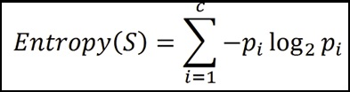
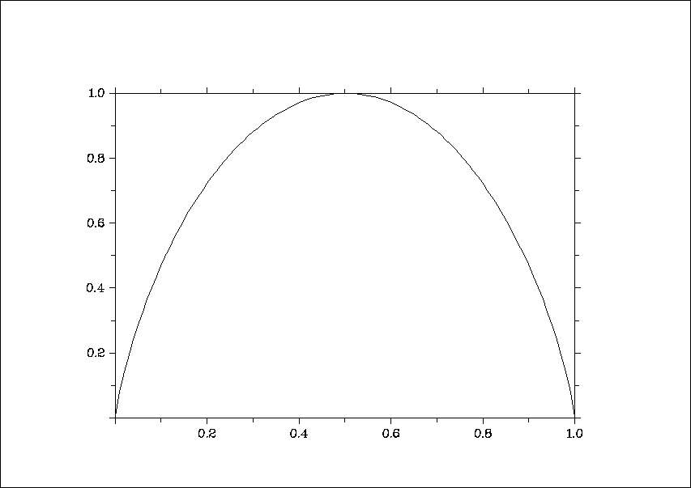
Entropy
The average amount of information I needed to classify an object is given by the entropy measure
Where S is a set of training examples,
c is the number of classes, and
p_{i} is the proportion of the training set that is of class i
Zero Entropy occurs when the entire set is from one class
0 log₂ 0 = 0 also 1 log₂ 1 = 0
Also it can be written as: E(S) = -(p+)*log₂(p+ ) - (p_ )*log₂(p_ )
Where p+ is the positive samples
Where p_ is the negative samples
Where S is the sample of attributions
For a two-class problem:
For more than 2-classes, E can be greater than 1
entropy
p(c1)

Slide 29
Example
[29+,35-]
A₁=?
The Entropy of A₁ is computed as the following:
E(A) = -29/(29+35)*log2(29/(29+35)) –
35/(35+29)log2(35/(35+29))
= 0.9937
E(TRUE) = -21/(21+5)*log2(21/(21+5)) – 5/(5+21)*log2(5/(5+21))= 0.7960
E(FALSE) = -8/(8+30)*log2(8/(8+30)) –
30/(30+8)*log2(30/(30+8))
= 0.7426
True
False
The Entropy of True:
[21+, 5-]
[8+, 30-]
The Entropy of False:

Slide 30




Entropy reduction by data set partitioning
.
.
.
.
.
.
.
.
red
Color?
green
.
yellow
.
.
.
*I means Information Entropy

Slide 31






.
.
.
.
.
.
red
.
.
Color?
green
yellow
.
.
.
.
IG(S, Color) = I(S) – I(S/Color)
= I(S) – [red/total * I_{red} + green/total * I_{green} + yellow/total * I_{yellow}]

Slide 32
Information Gain
.
.
.
.
.
.
.
.
red
Color?
green
.
yellow
.
.
.
Tutorial: https://machinelearningmastery.com/information-gain-and-mutual-information/

Slide 33
Summary
Basic Concepts of Decision Trees
Understanding ID3 Algorithm
Building a decision Tree from a sample data
Understanding Entropy and Information Gain
Calculating Entropy and IG on a sample data

Slide 34
In the next lecture …
Information Gain of an Attribute
Converting a Tree to Rules
Advantages and Disadvantages of DT
Classification Tree (ID3, CART, C4.5)

