Slide 1
CS 467 MachINE LearnIng
Dr. M. Irfan Uddin

Slide 2
Lecture # 21 K- Nearest Neighbour

Slide 3
In the previous Lecture ….
Support Vector Machine Problem
Solving a real-world example with SVM
Problems with Linear SVM
Kernel Trick
Soft Margin Classification
Slack Variables
Hinge Loss
SVM for regression

Slide 4
Objectives of Today’s Class
To understand the concepts of kNN
To analyze different situations of using kNN
To apply kNN in solving problems

Slide 5
Apples vs. Bananas
Weight | Color | Label
4 | Red | Apple
5 | Yellow | Apple
6 | Yellow | Banana
3 | Red | Apple
7 | Yellow | Banana
8 | Yellow | Banana
6 | Yellow | Apple
Can we visualize this data?

Slide 6
Apples vs. Bananas
Turn features into numerical values
Weight | Color | Label
4 | 0 | Apple
5 | 1 | Apple
6 | 1 | Banana
3 | 0 | Apple
7 | 1 | Banana
8 | 1 | Banana
6 | 1 | Apple
1
A
B
B
B
A
Color
0
A
A
0
Weight
10
We can view examples as points in an n-dimensional space where n is the number of features called the feature space

Slide 7
Examples in a feature space
feature₂
label 1
label 2
label 3
feature₁

Slide 8
Test example: what class?
feature₂
label 1
label 2
label 3
feature₁

Slide 9
Test example: what class?
feature₂
label 1
label 2
closest to red
label 3
feature₁

Slide 10
Another classification algorithm?
To classify an example d:
Label d with the label of the closest example to d in the training set

Slide 11
What about this example?
feature₂
label 1
label 2
label 3
feature₁

Slide 12
What about this example?
feature₂
label 1
label 2
closest to red, but…
label 3
feature₁

Slide 13
What about this example?
feature₂
label 1
Most of the next closest are blue
label 2
label 3
feature₁

Slide 14
k-Nearest Neighbor (k-NN)
To classify an example d:
Find k nearest neighbors of d
Choose as the label the majority label within the k nearest neighbors

Slide 15
k-Nearest Neighbor (k-NN)
To classify an example d:
Find k nearest neighbors of d
Choose as the label the majority label within the k nearest neighbors
How do we measure “nearest”?

Slide 16
Euclidean distance
In two dimensions, how do we compute the distance?
(b₁, b₂)
(a₁, a₂₎

Slide 17
Euclidean distance
Euclidean distance! (or L1 or …)
(b₁, b₂,…,b_{n})
(a₁, a₂, …, a_{n)}

Slide 18
Decision boundaries
The decision boundaries are places in the features space where the classification of a point/example changes
label 1
label 2
label 3
Where are the decision boundaries for k-NN?

Slide 19
k-NN decision boundaries
label 1
label 2
label 3
k-NN gives locally defined decision boundaries between classes

Slide 20
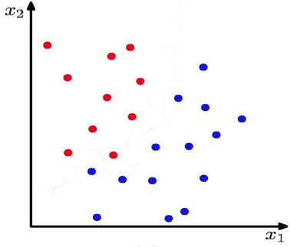
K Nearest Neighbour (kNN) Classifier
K = 1
What is the decision boundary for k-NN for this one?

Slide 21
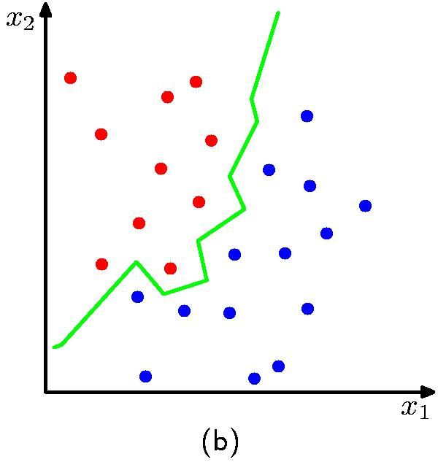
K Nearest Neighbour (kNN) Classifier
K = 1

Slide 22
Choosing k
What is the label with k = 1?
feature₂
label 1
label 2
label 3
feature₁

Slide 23
Choosing k
We’d choose red. Do you agree?
feature₂
label 1
label 2
label 3
feature₁

Slide 24
Choosing k
What is the label with k = 3?
feature₂
label 1
label 2
label 3
feature₁

Slide 25
Choosing k
We’d choose blue. Do you agree?
feature₂
label 1
label 2
label 3
feature₁

Slide 26
Choosing k
What is the label with k = 100?
feature₂
label 1
label 2
label 3
feature₁

Slide 27
Choosing k
We’d choose red. Do you agree?
feature₂
label 1
label 2
label 3
feature₁

Slide 28
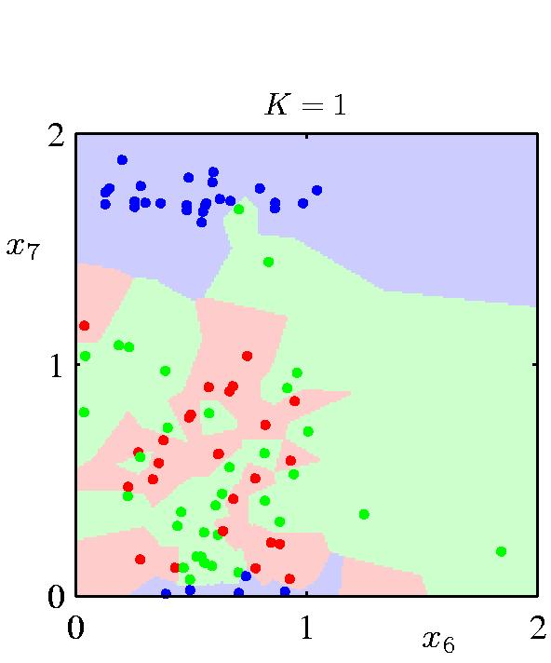
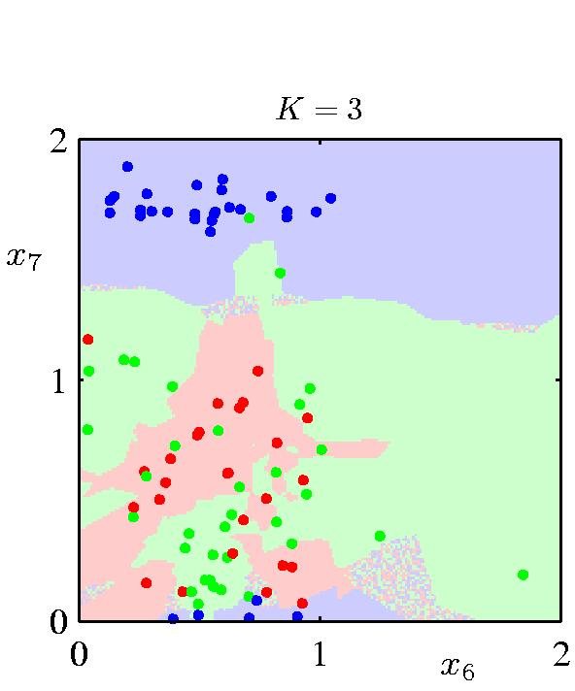
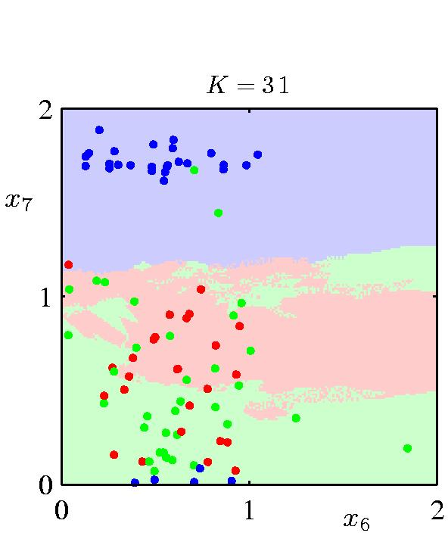
The impact of k
What is the role of k?
How does it relate to overfitting and underfitting?
How did we control this for decision trees?

Slide 29
Summary
Understanding neighbors using an example
How to measure the nearest neighbor?
Euclidean distance
Understanding decision boundaries
How to choose the value of ‘k’ in k-NN?

Slide 30
In the next lecture …
Choosing K
Solving a real-world example with k-NN
Coding of k-NN in Python
Machine Learning System Design

