Slide 1
Sending a downlink packet in Chirpstack

Slide 2
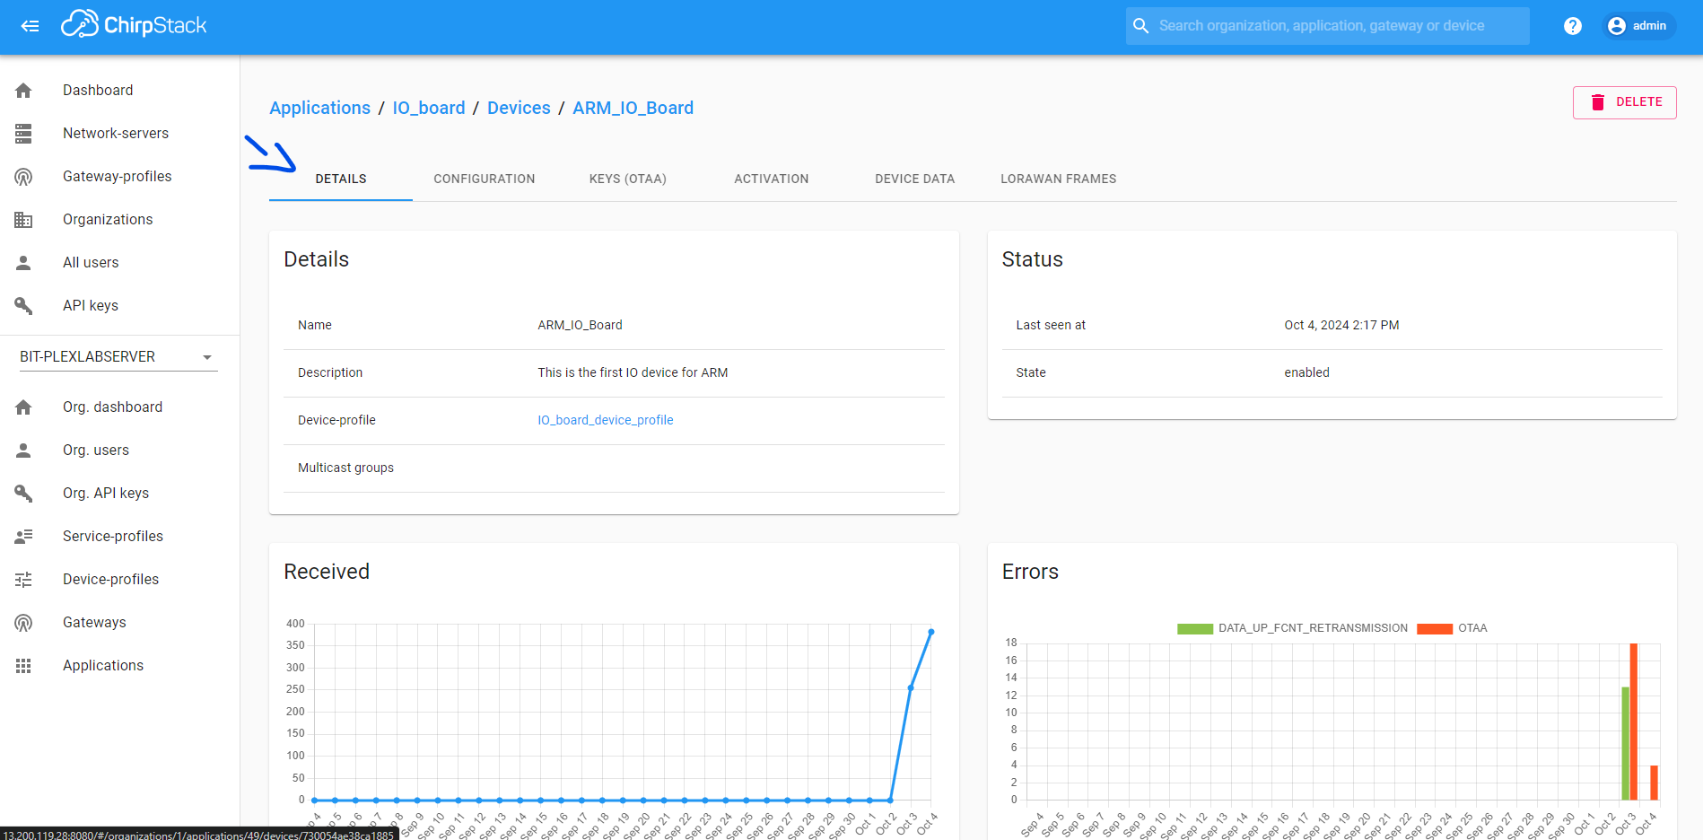
Setting up Encoder

Slide 3
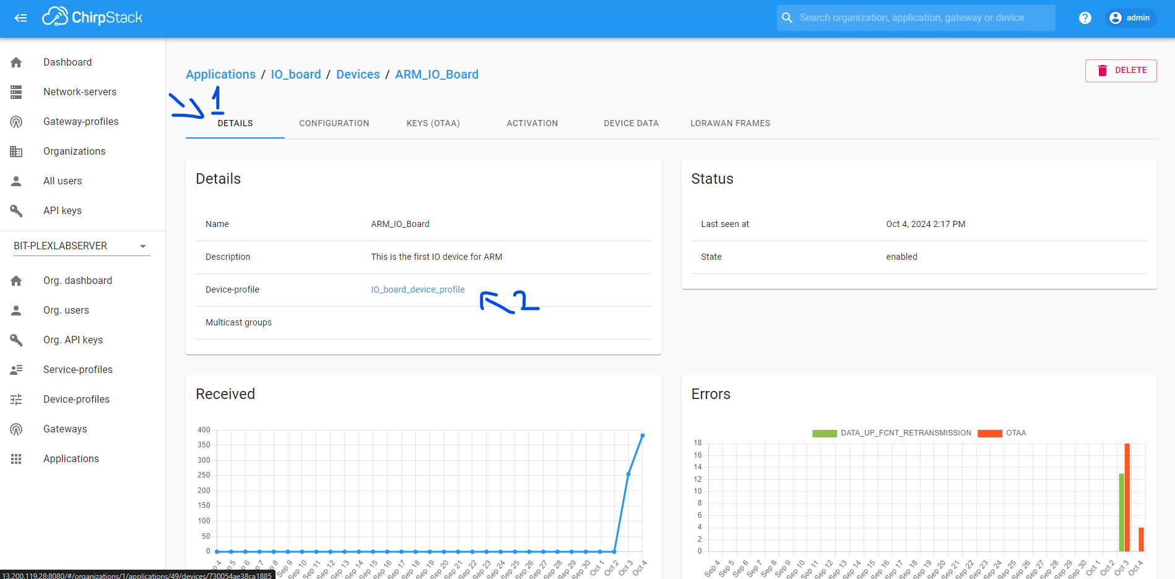
Setting up Encoder

Slide 4
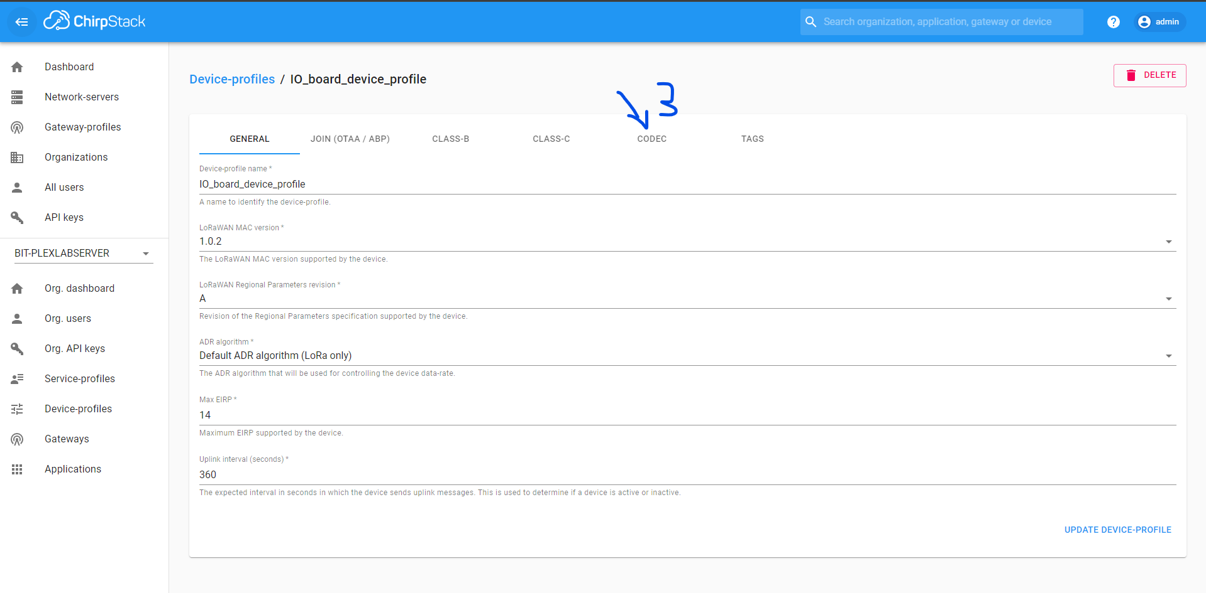
Setting up Encoder

Slide 5
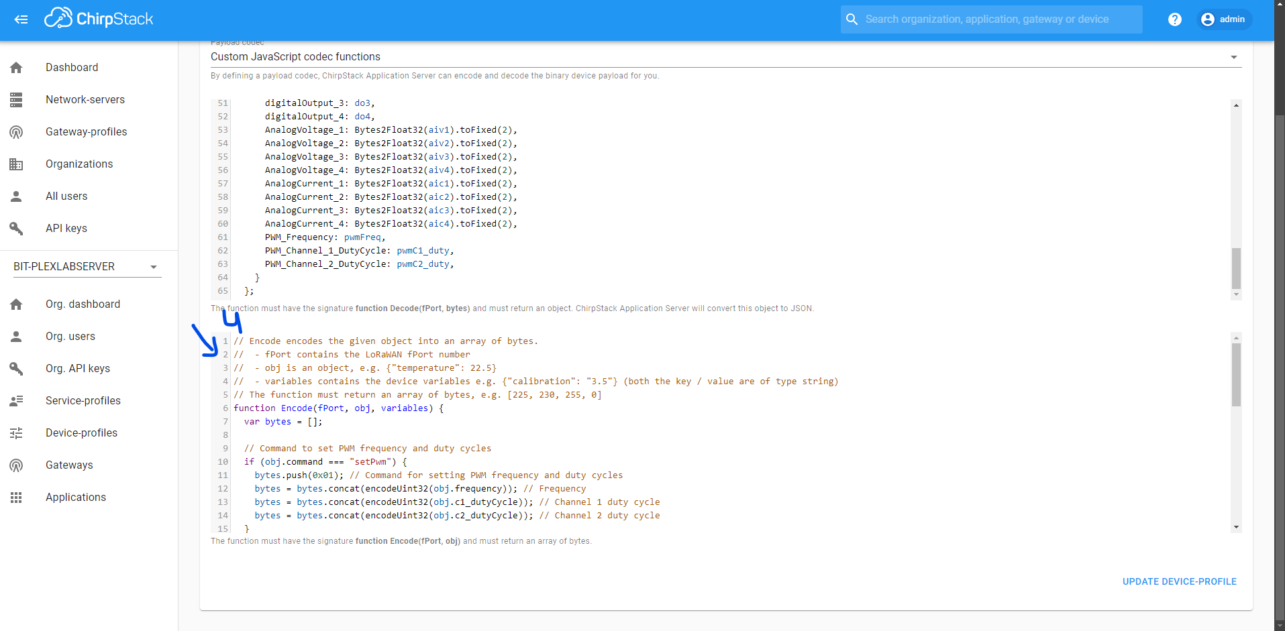
Setting up Encoder

Slide 6
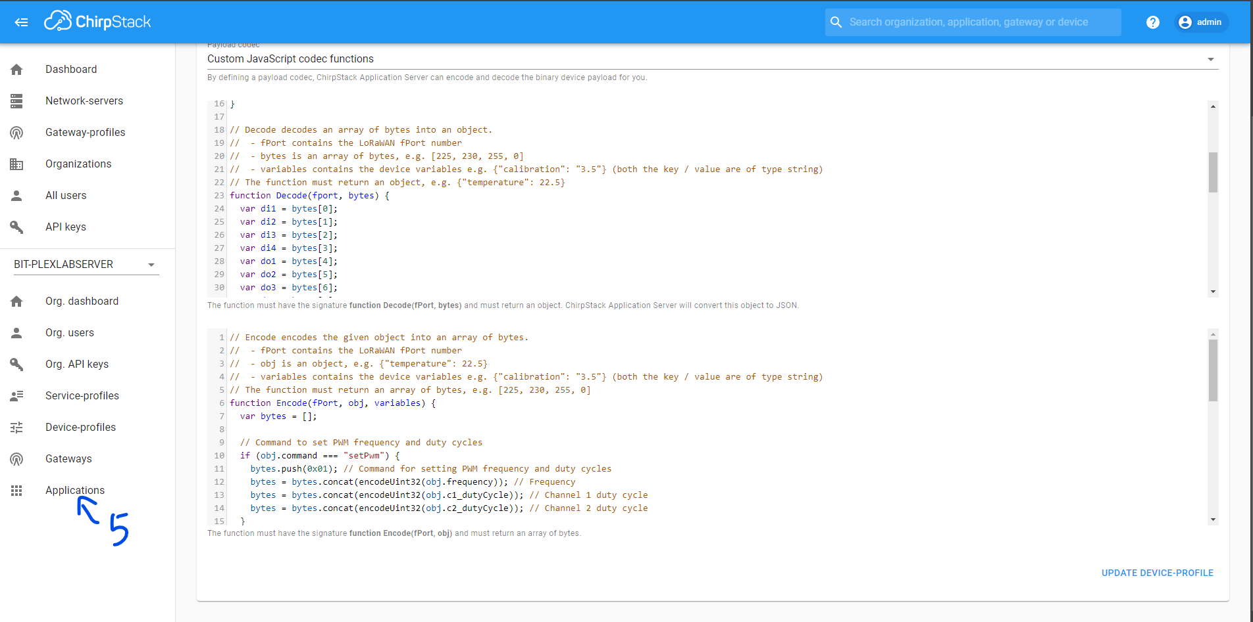
Sending downlink:

Slide 7
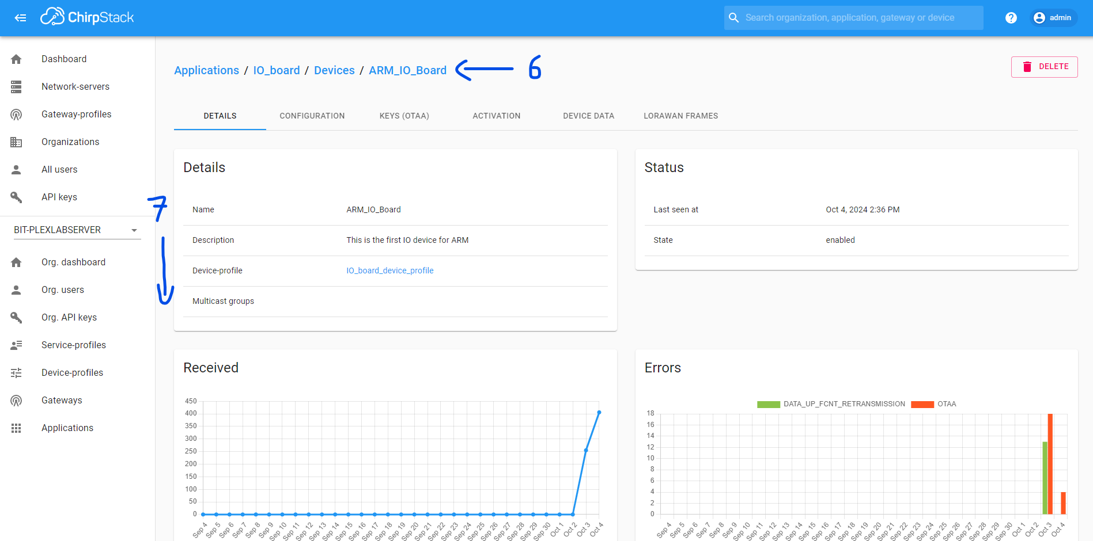
Sending downlink:

Slide 8
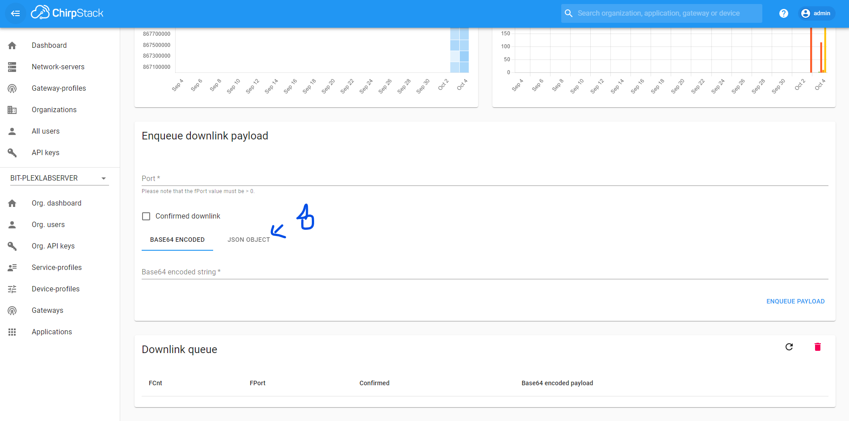
Sending downlink:

Slide 9
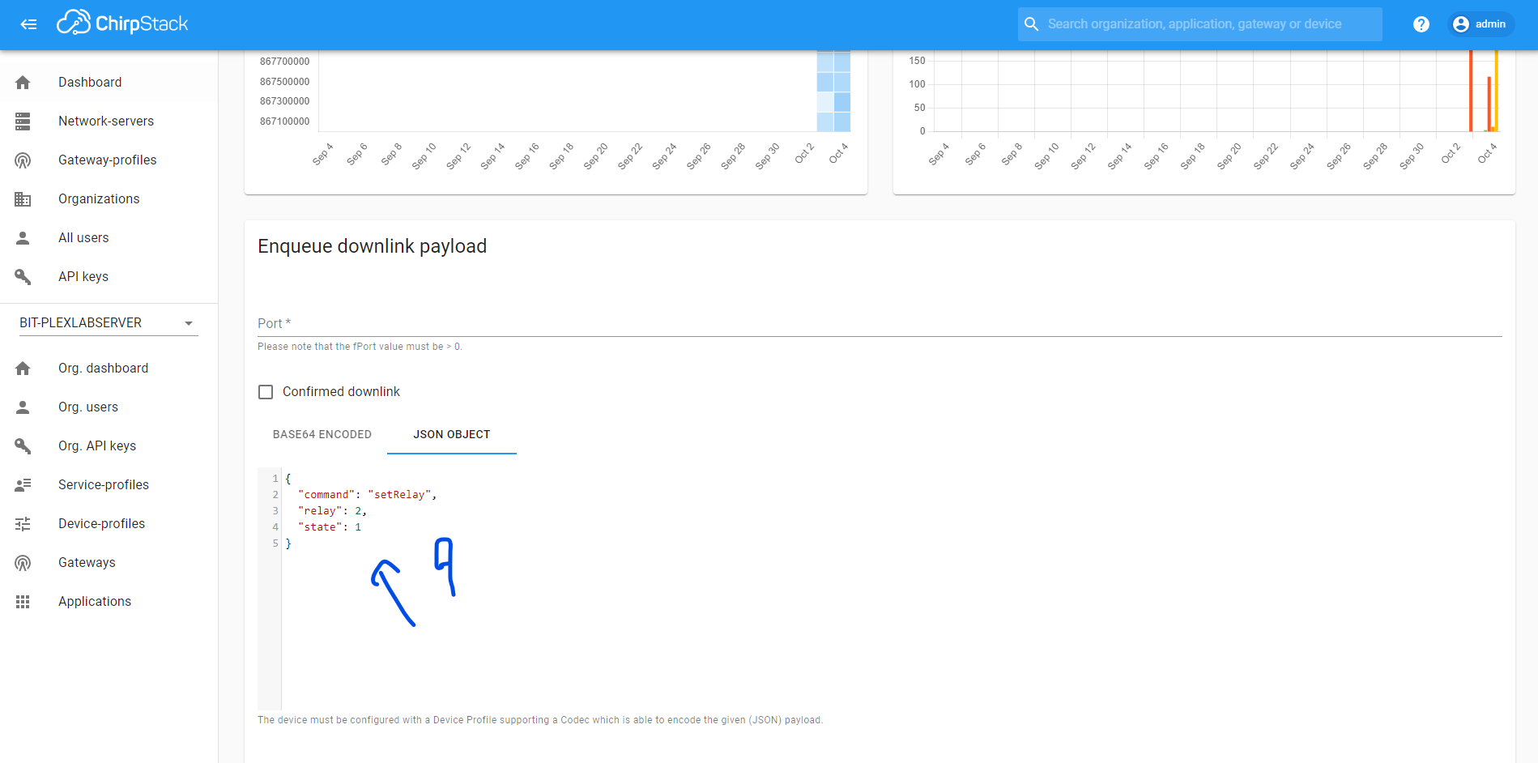
Sending downlink:

Slide 10
Class A Device
In class A device the downlink will be sent quickly after the next uplink frame.

Slide 11
Class C Device
The downlink is sent directly after the user sends it.

Slide 12
Illustration of how downlink is send to node device from chirpstack
Gateway
LoRaWAN
Frame
Chirpstack Server
JsonObject
Encoder
LoRaWAN
Frame
Node

Slide 13
Refer to the “LoRaWAN Command Documentation for IO Board” for reference.

