Slide 1
Linux System Programming
Talking directly to the kernel and C library
File I/O
Adapted from slides of Professor Yongqing Xiang of Brooklyn College.

Slide 2
Chapter 2 – File I/O
The kernel maintains a per-process list of open files – file table.
The table is indexed via file descriptors (fds), used both by user-space and kernel space in file operations as the primary argument.
Each entry in the table includes a pointer to an in-memory inode.
Each process has a configurable upper limit of open files (1k by default), so -1 for fd is often used to indicate an error.
Conventionally, fds for 0, 1, and 2 represent stdin (keyboard), stdout (display) and stderr (display) respectively (they are open by default.)
fds can also refer to special files (“Everything is a file in Linux.")
A child process receives a copy of its parent’s file table.
inode
Notes:
Instead of 0,1,2, one could also use the already-defined constants: STDIN_FILENO, STDOUT_FILENO, and STDERR_FILENO.

Slide 3
Opening files
open()/creat()
#include <sys/types.h>
#include <sys/stat.h>
#include <fcntl.h>
// defines types such as size_t (usually unsigned integer)
// defines modes such as S_IRUSR (=0000400, r for owner)
// defines flags such as O_RDONLY
// Returns -1 for error; ‘flags’ should match permissions:
int open (const char *name, int flags);
// ‘mode’ is a permission bitset argument only used when O_CREATE is given in ‘flags’:
int open (const char *name, int flags, mode_t mode);
flags (bitwise-ORed)
O_RDONLY, O_WRONLY, O_RDWR, O_APPEND, O_CREAT (O_EXCL), O_TRUNC, etc.
The effective uid/gid of the process will be the uid/gid of the created file.
mode (binary-ORed)
S_IRWXU (owner: rwx), S_IRUSR (owner: read), S_IRGRP (group: read), S_IROTH (others: read), etc.
The actual bits on disk are from binary-ANDing the mode with NOT(umask) (umask specifies which bits are turned off, often defaults to 022 (= rwxr-xr-x).

Slide 4
Examples of open/creat
int fd;
fd = open (file, O_WRONLY | O_CREAT | O_TRUNC, S_IWUSR | S_IRUSR | S_IWGRP | S_IRGRP | S_IROTH);
// Note that S_IWUSR | S_IRUSR | S_IWGRP | S_IRGRP | S_IROTH = 110 110 100 = 0664
// The ‘|’ symbols are bitwise ORs.
if (fd == −1) /* error */
// Or equivalently (using numeric mode):
int fd;
fd = open (file, O_WRONLY | O_CREAT | O_TRUNC, 0664);
if (fd == −1) /* error */
/* Handling errors on file open is usually simple. Typically, the program either asks the user for a different filename or just terminates the program. */
/* creat() is equivalent to open() with flags:
O_WRONLY | O_CREAT | O_TRUNC */
int fd;
fd = creat (file, 0644); // much simpler
if (fd == −1) /* error */
// Equivalently:
int fd;
fd = open (file, O_WRONLY | O_CREAT | O_TRUNC,
0644);
if (fd == −1) /* error */
/* This means creat() could be implemented, in some architectures, by invoking open(). */

Slide 5
Reading via read()
#include <unistd.h> // standard symbolic constants and types
ssize_t read (int fd, void *buf, size_t len); // ssize_t = signed size_t
Each call reads up to len bytes into buf from the current file offset.
Then the file position is advanced by the number of bytes that are read in.
buf MUST be allocated with length of len before calling read()!
On success, the syscall returns the number of bytes read (maybe less than len)
On error it returns -1 and sets errno.
unsigned long word; // 4-byte on 32-bit Linux, 8-byte on 64-bit systems
ssize_t nr;
/* read a couple bytes into ‘word’ from ‘fd’ */
nr = read (fd, &word, sizeof(unsigned long));
if (nr == -1) /* error */

Slide 6
Return Values of read()
The results are as intended if the returned value (nr on the previous slide) is equal to len.
Otherwise, if the returned value is between 0 and len, then either:
Less than len bytes were read in, or
A signal interrupted the read midway.
If it is 0, then end-of-file (EOF) has been reached and no bytes were read (not an error).
When reading from a socket or device file, the call will block (wait) if no bytes are available for reading yet and if the open file allows blocking (i.e., O_NONBLOCK wasn’t used as a flag inside the call to open().)
If the returned value is -1, maybe a recoverable error occurred.
Maybe it was interrupted by a signal before any bytes are read. If so, errno will be set to EINTR, and read() can be resubmitted.
Or maybe the read would block because no data is currently available, but the fd is opened in nonblocking mode. If so, errno is set to EAGAIN, and the call should be re-issued later.
Otherwise, if the returned value is -1, a fatal error occurred. In such a case, errno is set to value other than EINTR or EAGAIN. This indicates a more serious, irrecoverable error.

Slide 7
Reading All the Bytes
ssize_t ret;
while (len != 0 && (ret = read (fd, buf, len)) != 0) { // len bytes filled or EOF
if (ret == −1) {
if (errno == EINTR)
continue; perror ("read"); break;
// Signal interrupt: continue without updating len/buf.
// Irrecoverable error: print error, get out of the loop.
}
len -= ret; buf += ret;
}
This code handles all conditions mentioned in previous slide (assuming blocking is allowed so errno will not be set to EAGAIN.)
Partial reads are properly checked and handled.

Slide 8
Nonblocking Reads
Nonblocking reads return immediately from file that doesn’t have data available.
This is achieved via checking errno = EAGAIN and using O_NONBLOCK in open().
This approach is useful in that you can move on to read from other files with data.
char buf[BUFSIZ]; ssize_t nr;
nr = read (fd, buf, BUFSIZ);
if (nr == −1) {
if (errno == EINTR)
goto start; /* oh shush */
if (errno == EAGAIN)
/* resubmit later */
else
/* error */
}

Slide 9
Writing with write()
#include <unistd.h>
ssize_t write (int fd, const void *buf, size_t count);
Write the current position of fd with up to count bytes from buf.
On success, the number of bytes written is returned, and the file position is updated by the number of bytes actually written.
On error it returns -1 and sets errno.
const char *buf = "My ship is solid!";
ssize_t nr;
/* write the string in 'buf' to 'fd' */
nr = write (fd, buf, strlen (buf));
if (nr == −1) /* error */

Slide 10
Partial Writes
The write() syscall is less likely to return a partial write than read() is.
There is no EOF condition for write(), so partial writes are typically not a problem for writing to regular files or to the display.
But for special files like a socket, a write loop may be needed to write out the requested bytes:
ssize_t ret, nr;
while (len != 0 && (ret = write (fd, buf, len)) != 0) {
if (ret == −1) {
if (errno == EINTR)
continue; perror ("write"); break;
}
len -= ret; buf += ret;
}

Slide 11
More Information about Writes
Append Mode
Applied to files opened with the append mode (O_APPEND).
Guarantees that writes occur at the end of the file.
Without it, two processes writing to the same log file have a race condition = unexpected results.
The append mode avoids this problem so that one process doesn’t overwrite the other’s output.
The file position is updated automatically for write(), not for read() though.
Nonblocking Writes
Same as with read(), via O_NONBLOCK, and is usually used with non-regular files.
Instead of blocking, it returns -1 immediately and sets errno to EAGAIN.
Other Error Codes
EBADF, EFAULT (bad buf), EFBIG, EINVAL, EIO, ENOSPC, EPIPE (reading closed).
Size Limits on write()
If count is larger than SSIZE_MAX, the results of write() are undefined.
If count is 0, the call returns immediately with a return value of 0.

Slide 12
Details about the Behavior of write()
write() only guarantees copying data from user space buf to a kernel buffer, but no guarantee that data
is written out to disk immediately.
In the background, the kernel gathers up all dirty buffers, those containing data newer than what’s on disk, sorts them optimally, and writes them out to disk (writeback) at some later point in time.
Why?
Delayed writes allow write() to return immediately, without waiting for the data to be written to disk.
Actual writes can take place in idle periods (when Linux is not doing much) and are batched = grouped optimally.
Reads from such a file are also faster (reading from the dirty buffer, not from the disk.)
Problems?
System crash – data may never make it to disk if the writing is delayed.
Application’s own write ordering can’t be enforced as the kernel reorders write requests on its own to increase performance. Write ordering is usually a concern for databases to avoid inconsistent states.
Any I/O error due to physical drive failure can’t be reported back to the process issuing the write, as the kernel’s dirty buffers are not associated with processes which may have exited earlier. Again, the data will never make it to disk in this case.
To address these issues:
The kernel institutes a maximum buffer age and writes out all the dirty buffers before they grow past this max age. The configuration file where the max age is set is: /proc/sys/vm/dirty_expire_centisecs.
It is possible to force the write back (i.e., make all writes synchronous.) See next slide for details.

Slide 13
Synchronized I/O
There is a trade-off between performance and the control of when data reaches the disk.
The system calls fsync() and fdatasync():
fsync() flushes both data and metadata to disk and returns only after the hard drive confirms that data were successfully copied to the disk.
Disks usually have 'write' caches, so data may not be physically on the disk, though it is a matter of a very short time for write cache to be committed to the disk.
fdatasync() flushes data and only essential metadata required to properly access the file in the future (such as file’s size, but not the recent access timestamp or modification timestamp.)
The performance boost comes from the fact that fsync() needs two I/O operations (modifying both the file’s data and the data in the inode) which are not adjacent on disk, so extra search time is needed.
fdatasync() likely skips synchronizing the non-essential metadata, making it potentially faster than fsync().
Both won’t guarantee sync of directory entries. To ensure this, fsync() need to be called on an fd representing the file’s directory.
#include <unistd.h>
int fsync (int fd);
int fdatasync (int fd);
// Both return 0 on success and -1 on error.
// In case of an error, errno is set to either of:
// EBADF, EIO, ENOSPC, or EINVAL.

Slide 14
More on Synchronization
sync() will synchronize all buffers to disk (not tied up to any fd.)
#include <unistd.h>
void sync (void);
It has no parameters or a return value, always succeeds, and will only return after all the dirty buffers are saved to disk.
It may take several minutes or longer to complete on a busy system.
The O_SYNC flag:
Tells open() that all I/O on the file should always be synchronized.
Equivalent to calling fsync() after each write() -> significantly increases time!
O_DSYNC and O_RSYNC:
On Linux, both are the same behavior as O_SYNC.

Slide 15
Direct I/O
Generally, the I/O managed by the operating system has good performance of its caching and buffering.
However, certain applications, such as database systems, often prefer to perform their own I/O caching.
Using O_DIRECT flag to open() will instruct the kernel to minimize the presence of system-level I/O management.
I/O will initiate directly from user-space buffers to the device, bypassing the page cache.
All I/O will be synchronous – operations won’t return until completed.
Request length, buffer alignment, and file offsets must be multiples of underlying device’s sector size – generally 512 bytes.
Earlier kernels (versions less than 2.6) may be stricter: they may align on logical block size (usually 4KB), so application should use the larger logical block size for maximum compatibility.

Slide 16
Closing Files
#include <unistd.h>
int close (int fd);
It unmaps the open fd and disassociates the file from the process.
The kernel is free to reuse this fd integer for other files that will be opened.
Returns 0 on success and -1 on error, setting errno.
Closing a file doesn’t affect when the file will be flushed to disk.
But it may result in an unlinked file being finally physically erased from the disk.
The most common error value is EIO – indicating low-level I/O error probably happening earlier (due to delayed writeback.)
But the file always gets closed.
if (close (fd) == −1) perror ("close");

Slide 17
Seeking with lseek()
Implicit updates to the file position via read/write lead to linear access.
That means that, when you want to reach a byte inside the file, you will need to traverse all the bytes that come before it.
Random access requires lseek():
#include <sys/types.h>
#include <unistd.h>
off_t lseek (int fd, off_t pos, int origin); // off_t = signed long integer
The origin argument can be either of:
SEEK_CUR: sets fd’s position to current value + pos (pos could be any integer).
SEEK_END: the position is set to the end of file + pos.
SEEK_SET: sets fd’s position to pos.
Returns the new file position on success, -1 on error and sets errno.

Slide 18
Examples of lseek()
To set the file position of fd to byte 1825:
To obtain the current file position of fd:
int pos;
pos = lseek (fd, 0, SEEK_CUR);
if (ret == (off_t) −1) /* error */
off_t ret;
ret = lseek (fd, (off_t) 1825, SEEK_SET);
if (ret == (off_t) −1) /* error */
To set the file position of fd to the end of the file:
To prevent errors/warnings, we implicitly convert some number literals to the off_t data type by including: (off_t) to the left of the number before comparing the results with ret.
off_t ret;
ret = lseek (fd, 0, SEEK_END);
if (ret == (off_t) −1) /* error */

Slide 19
More on lseek()
You can seek past the end of a file. In such a case:
A subsequent read will return EOF.
A write request will automatically pad zeros (null characters) in the skipped space.
Such zero padding (called hole), doesn’t occupy any physical disk space, which saves space.
A read request to the hole will return the correct number of zeros.
Possible errno values in case of an error:
EBADF: bad fd.
EINVAL: invalid parameters in origin, or the resulting file position would be negative.
EOVERFLOW: offset can’t be represented in an off_t (C signed long). Internally, the kernel stores offsets in the C long long type, causing this error on 32-bit systems.
ESPIPE: fd associated with an unseekable object – pipe/fifo/socket.

Slide 20
Positional Reads and Writes
Both of the following system calls access files at specific positions but the current position is NOT updated:
#define _XOPEN_SOURCE 500 // includes extra function definitions from X/Open. #include <unistd.h>
ssize_t pread (int fd, void *buf, size_t count, off_t pos);
ssize_t pwrite (int fd, const void *buf, size_t count, off_t pos);
Otherwise, they are identical to read()/write() (as if doing lseek first).
Work best in multithreaded applications:
Threads share file tables that include the current file position.
What if Thread 1 updates file position after Thread 2 finishes lseek() but before
calling read()/write()?
Positional reads/writes eliminates accidental overwrites of one thread by the other.
Return # of bytes read/written on success (0 for EOF) and -1 for error and sets errno.

Slide 21
Truncating Files
Two system calls can truncate files:
#include <unistd.h> #include <sys/types.h>
int ftruncate (int fd, off_t len);
int truncate (const char *path, off_t len);
One operates on an fd, the other operates on the filename (path). In either case, the file needs to have been opened for writing.
On success, they return the file’s new length (which is len,) and all bytes beyond len are erased, thus cutting the file to the size of len.
While it’s less common, both functions can use a len that’s larger than the original file length – the extended space will be padded with ‘\0’s.
Neither function changes the current file position.

Slide 22
Example of truncate()
#include <unistd.h> #include <stdio.h> int main()
{
int ret;
ret = truncate ("./pirate.txt", 45);
if (ret == −1) {
perror ("truncate");
return −1;
}
return 0;
}
pirate.txt with 74 bytes:
Edward Teach was a notorious English pirate. He was nicknamed Blackbeard.
^45
After the truncation, the file will turn into:
Edward Teach was a notorious English pirate.

Slide 23
Multiplexed I/O - Motivation
Without threads, one process cannot block on more than one fd.
Inefficiency ensues if blocking lasts for seconds (insanely long!)
What if blocking takes an indefinite amount of time?
Solutions:
How about using nonblocking I/O?
Still inefficient
The process needs to continuously re-issue the calls, hoping one of them becomes ready.
In doing so, the processor (CPU) is not freed to do other tasks.
It would be better if the program can sleep, freeing the processor, waking up when one of the files is ready to do I/O.
This better solution is called multiplexed I/O.

Slide 24
Multiplexed I/O - Steps
Allows an application to concurrently block on multiple fds.
Receives a notification when at least one of them becomes ready to read/write without blocking.
Works as in the following loop:
Tell me when any of these fds become ready for I/O.
If none is ready, sleep.
Woken up! Which one/ones are ready?
Handle all fds ready for I/O without blocking.
Go back go step 1.
Main system calls: select(), poll() (covered here) and epoll() (covered in Chapter 4, but not in our course’s scope.)

Slide 25
select()
Provides a mechanism for implementing synchronous multiplexing I/O.
It blocks until the given fds are ready to perform I/O or until the timeout is reached.
Watched fds are broken into 3 sets (readfds, writefds, and exceptfds.)
#include <sys/select.h>
int select (int n,
fd_set *readfds,
fd_set *writefds,
fd_set *exceptfds,
struct timeval *timeout);
// = 1 + highest-valued fd in any set, caller determined
// fd’s with data available for reading, NULL=not watched
// writing can proceed without blocking
// exception has occurred or out-of-band data available
// points to a timeval structure (in sec and micro-sec)
FD_CLR(int fd, fd_set *set); FD_ISSET(int fd, fd_set *set); FD_SET(int fd, fd_set *set); FD_ZERO(fd_set *set);
// removes a fd from a given set – rarely used.
// tests whether a fd is a part of a given set: returns nonzero int if true.
// adds a fd to a given set.
// remove all fd’s from a set, called before invocation of select().
On success, select() returns the # of fds ready for I/O, and each set is modified and contains ONLY the ready fds. On Linux, the timeout structure will be updated so that it contains the remaining time. 0 will be returned if timeout occurred.
All sets are manipulated using macros: FD_CLR, FD_ISSET, etc., as shown above.

Slide 26
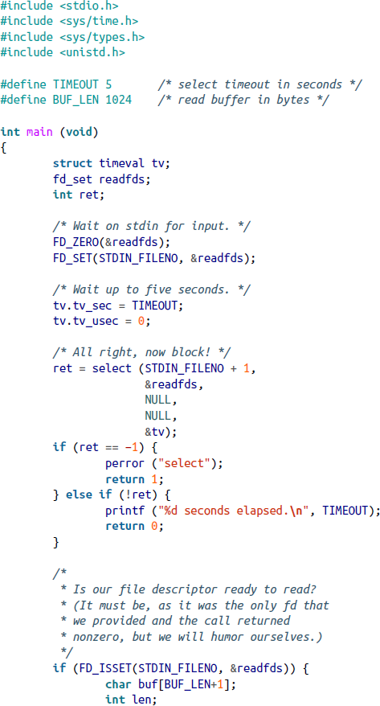
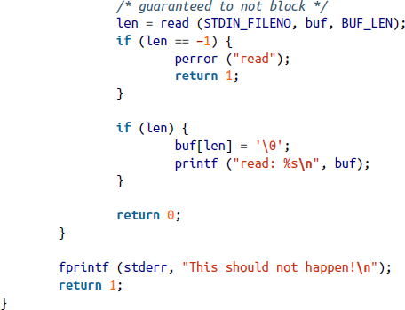
select() example
Blocks for input from stdin (keyboard) for up to 5 sec.
Only a single fd was used here for illustrative purposes.
There is also a pselect() defined in POSIX which is very similar to select() except for
Using a timespec structure that employs nanoseconds.
timeout parameter is not changed.
Has a sigmask parameter which tries to solve a race condition between waiting on fd and signals.
The better alternative to select() is poll().

Slide 27
poll()
Solves several deficiencies in select().
#include <poll.h>
int poll (struct pollfd *fds, nfds_t nfds, int timeout);
Where select() uses inefficient 3 bitmask-based sets of fds, poll() uses a single array of pollfd structures of size nfds:
#include <poll.h>
struct pollfd {
int fd; /* file descriptor */
short events; /* requested events to watch */
short revents; /* returned events witnessed */
};
Each pollfd specifies one fd to watch, with the events field being a bitmask of events to watch for; the user/programmer will set this field.
The revents field is a bitmask of events that were witnessed; the kernel will set this field.

Slide 28
More on poll()
Some events:
POLLIN: there is data to read.
POLLPRI: there is urgent data to read.
POLLOUT: writing will not block.
POLLWRBAND: writing priority data will not block.
Equivalents to select():
POLLIN | POLLPRI is select()’s read event.
POLLOUT | POLLWRBAND is select()’s write event.
timeout is the wait time in milliseconds before returning regardless of ready I/O. A negative number means infinite timeout, and 0 means return immediately with pending I/O info.
On success, poll() returns the # of fds that have non-zero revents fields. Returning 0 indicates timeout occurred.
On failure, -1 is returned and errno is set (refer to the book, p. 59-60, for details.)

Slide 29
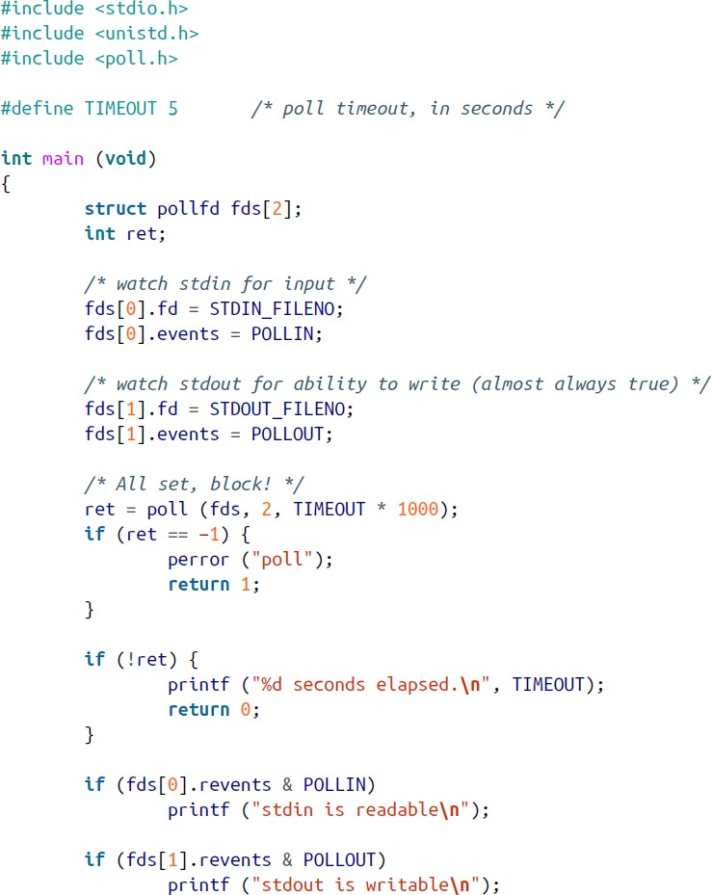



Example of poll()
This example uses poll() to check
whether either of stdin and stdout will block. Running examples:

Slide 30
poll() vs select()
Benefits of poll()
No need to pass in the highest-numbered fd plus 1 as we do in select().
More efficient for large-valued fds (select() must check every bit up to the passed-in n.)
select()’s fd sets are statically sized (either too small or wasting space,)
whereas poll() has the exact, right size.
The fd sets for select() are reconstructed on return, so subsequent call must reinitialize them, whereas for poll() the events and revents fields are separate.
The timeout field in select() is overwritten, requiring re-initialization.
Benefits of select()
More portable - some Unix systems don’t support poll().
Has better timeout resolution (microseconds vs. milliseconds.)

Slide 31
Kernel Internals
Linux kernel implements I/O with these primary subsystems:
Virtual filesystem (VF)
Page cache
Page writeback
Together, they help make I/O seamless, efficient and optimal.

Slide 32
The Virtual Filesystem
An abstraction that allows the kernel to call filesystem functions without knowing the specific type of the used filesystem.
The common file model provides a framework which forces certain commonality between filesystems: Linux supports many filesystems such as FAT (File Allocation Table), NTFS (New Technology File System), etc.
Generic system calls – read(), write(), etc., can manipulate files on any supported filesystems and on any supported media.

Slide 33
The Page Cache
Is an in-memory storage of recently accessed data from an on-disk filesystem.
Allows kernel to fulfill subsequent requests without repeated disk access (temporal locality).
Kernel always checks page cache first, going to disk only on a miss.
Linux page cache is dynamic in size, growing if needed, but also releasing its least-used pages
(pruning) if needed.
Pruning could be avoided by swapping (the action of storing seldom-used memory data on disk.) Linux will balance between pruning and swapping using heuristics = approximations.
Readahead (reading extra data off the disk - sequential locality) is also used (as seeking is not needed) and managed dynamically (readahead window could grow or shrink between 16KB to 128KB.)
Page cache is transparent to system programmers, unless they want to implement one in user space themselves. If possible, sequential file I/O is always preferred to random access.

Slide 34
Page Writeback
Kernel delays writes via buffers.
Write data is copied into a buffer, which is then marked as dirty = ‘modified’.
The write request returns right away.
More write requests to the same area -> updating the buffer.
Write requests elsewhere in the file -> creating new buffers.
Writeback (committing to disk, synchronization) does happen:
When free memory shrinks below a threshold.
When a dirty buffer is older than a threshold.
Starting from kernel v2.4, the page cache and buffer cache are unified (so reading from recently written data accesses the same memory.)
To avoid the risk of data loss from power failure, critical applications can use synchronized I/O after calls to write() and pwrite().

