Slide 1
Linux System Programming
Talking directly to the kernel and C library
Buffered I/O
Adapted from slides of Professor Yongqing Xiang of Brooklyn College.

Slide 2
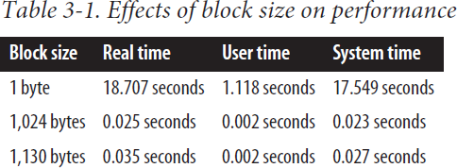
Ch3 – Buffered I/O
The smallest unit of storage for a filesystem is a block: a chunk of data.
All I/O operations must be in an integer (>= 1) multiple of the block size.
Most applications operate in terms of higher-level abstractions, such as variables and strings → might become very time-inefficient!
The solution is user-buffered I/O:
Done either manually or transparently using a library to improve performance.
This is separate from the kernel’s buffering (write delays, reads ahead, etc.)
Example
// dd = a Linux terminal command to copy files:
time dd bs=1 count=2097152 if=/dev/zero of=pirate1
time dd bs=1024 count=2048 if=/dev/zero of=pirate2

Slide 3
Block Size
Usually in multiples of 512 bytes (use stat command to figure out.)
Extracting 4K = 4096 or 8K = 8192 bytes at a time works great.
But programs work with variables, lines of text, and single chars. What should be done to keep file access efficient?
User-buffered I/O uses a buffer in the program’s address space (= memory chunk.)
For writing, data is stored in this buffer and is written out in one single operation when it reaches the buffer size.
For reading, data is read into this buffer using buffer-sized and block-aligned chunks to increase efficiency.
It’s possible to implement this in your own programs. However, using the standard I/O library: <stdio.h> is better!

Slide 4
Standard I/O (stdio)
A platform-independent (= portable), user-buffering solution since 1989.
It uses file pointers:
Standard I/O routines don’t operate directly with file descriptors (fds).
A file pointer is used as the file’s unique identifier (and mapped to the fd internally.)
Represented by a pointer to the FILE type, which is defined in <stdio.h>.
The FILE type is a struct whose implementation is hidden.
In stdio, an open file is called a stream.
Streams may be opened for reading (input streams), writing (output streams), or both (input/output streams.)

Slide 5
Opening Files
#include <stdio.h>
FILE * fopen (const char *path, const char *mode); // path is the filename
/* Example: */
FILE *stream = fopen("myfile.txt", "r"); /* fopen() is a function, not a syscall. */
if (!stream) /* Check for an error. It is the same as: if (stream == NULL). */
Modes
"r": reading from the file. The stream is positioned at the file’s start in all modes except "a".
"r+": reading and writing (but not truncating or creating the file.)
"w": writing to the file. If the file exists, it truncates the file to zero length; if not, it creates it.
"w+": reading and writing, together with truncating and creating as in mode "w".
"a": writing in append mode, and creating if file doesn’t exist. Only with "a", the stream is positioned at EOF (i.e., all writes will append to the file – no truncation occurs.)
"a+": reading and writing in append mode; like mode "a", but also allows reading.
On success, returns a valid FILE pointer. On failure, returns NULL and sets errno.

Slide 6
Opening a Stream via File Descriptor
#include <stdio.h>
FILE * fdopen (int fd, const char *mode);
The function fdopen() converts an already open fd to a stream.
Modes are the same as for fopen(), but no truncation occurs for "w"/ "w+", and file position is not changed.
Modes must be compatible with those used in the system call open() for getting the descriptor.
From now on, I/O should be performed via the stream and not via the fd.
Closing the stream will close the fd, too.
FILE *stream;
int fd;
fd = open ("/home/kidd/map.txt", O_RDONLY);
if (fd == -1) /* checks for errors */
stream = fdopen (fd, "r");
if (!stream) /* checks for errors */

Slide 7
Closing Streams
Closing a single stream:
#include <stdio.h>
int fclose (FILE *stream);
Any buffered data is first flushed (= saved) to disk (which is not guaranteed to happen when using the close() system call.)
Returns 0 on success and EOF (= a constant, usually -1) on failure and sets errno.
Closing all streams at once:
#define _GNU_SOURCE /* non-standard GNU/Linux-specific extension functions. */
#include <stdio.h>
int fcloseall (void);
All streams are flushed before closing. Returns 0 on success and EOF on failure.

Slide 8
Reading from a Stream
Opened streams (except for modes "w" or "a") can be read in 3 ways:
Reading a character, an entire line at a time, or as binary data.
Reading a character at a time:
#include <stdio.h>
int fgetc (FILE *stream);
The returned unsigned char is cast to an int to be able to detect EOF (-1).
int c;
c = fgetc (stream); /* stream should’ve been opened for reading. */
if (c == EOF) /* check for errors */
else printf ("c=%c\n", (char)c); /* (char)c casts int to char. */

Slide 9
More on Reading from a Stream
Putting the character back using ungetc():
#include <stdio.h>
int ungetc (int c, FILE *stream);
Returns c on success and EOF on failure.
The next read from stream will return c.
Multiple pushbacks work in LIFO (“Last in First Out”) fashion: e.g., pushing ‘a’, ‘b’ and ‘c’ will result in reading ‘c’, ‘b’, and ‘a’.
If after calling ungetc(), a seeking function is called (more on seeking in the following slides,) it will cause all pushed-back characters to be discarded.
This function allows you to peek at the stream and return the character if it turns out that you don’t want to use it.

Slide 10
Reading an Entire Line
#include <stdio.h>
char * fgets (char *str, int size, FILE *stream);
It reads up to one less than size bytes from stream, storing them in str.
A null char ('\0') will be added in the buffer (thus the "one less" above.)
Reading stops after an EOF or '\n' is read ('\n' will be part of str.)
Returns a pointer to str on success, NULL on failure.
char buf[LINE_MAX]; /* buffer on the stack */
if (!fgets (buf, LINE_MAX, stream)) /* call fgets() and check for errors */
LINE_MAX is defined in POSIX (<limits.h>), but Linux has no such limit, so it’s used for portability only. You need to #include <limits.h> to use LINE_MAX .

Slide 11
Replacement for fgets()?
Accepting delimiter other than '\n', and leaving it out of buffer str:
char *s;
int c = 0;
s = str; // str is the buffer, and n is the buffer’s size.
while (--n > 0 && (c = fgetc (stream)) != EOF && (*s++ = c) != d) ;
if (c == d)
*--s = '\0';
else
*s = '\0';
// checking if it’s the delimiter d.
// if so, replacing d with '\0'.
// all n-1 chars or EOF were read; add NULL to end of str.
Replacing d with '\n' behaves the same as fgets() minus storing '\n'.
This version incurs repeated function calls to fgetc(), but it doesn’t incur the unaligned I/O penalty (like the dd with bs=1 example; why?)

Slide 12
Reading Binary Data
#include <stdio.h>
size_t fread (void *buf, size_t size, size_t nr, FILE *stream);
It reads up to nr elements of data, each of size bytes, from stream.
The file position is advanced by the number of bytes that are read-in.
On success, it returns the number of elements read (not the bytes.) On failure or at the end-of-file, it returns a value less than nr. You can’t tell, therefore, if it’s an error or end-of-file without calling additional functions.
You must call ferror() and feof() to tell failure apart from EOF.
char buf[64];
size_t nr;
nr = fread (buf, sizeof(buf), 1, stream); /* 1 element of a group of bytes */
if (nr == 0) /* Since we tried reading 1 element, 0 < 1 indicates error. */

Slide 13
Writing to a Stream
To write into a stream, it must be opened with a mode other than "r".
Writing a single character:
#include <stdio.h>
int fputc (int c, FILE *stream);
if (fputc('p', stream) == EOF) /* check for errors */
Returns c (which is 'p' in the example above) on success and EOF on failure.
Writing an array of characters:
#include <stdio.h>
int fputs (const char *str, FILE *stream);
Writes the null-terminated string str to the stream, but '\0' is not written!
On success returns non-negative value (likely 0) and on failure returns EOF.

Slide 14
More on Writing to a Stream
An example of fputs():
FILE *stream;
stream = fopen ("journal.txt", "a");
if (!stream) /* error check */
if (fputs ("The ship is made of wood.\n", stream) == EOF) /* error check */
if (fclose (stream) == EOF) /* error check */
Writing binary data
#include <stdio.h>
size_t fwrite (void *buf, // Write up to nr elements to stream.
size_t size, // Each element is size bytes in length.
size_t nr, // The data is taken from buf.
FILE *stream);
Returns the number of written items on success or a value less than nr on failure.

Slide 15
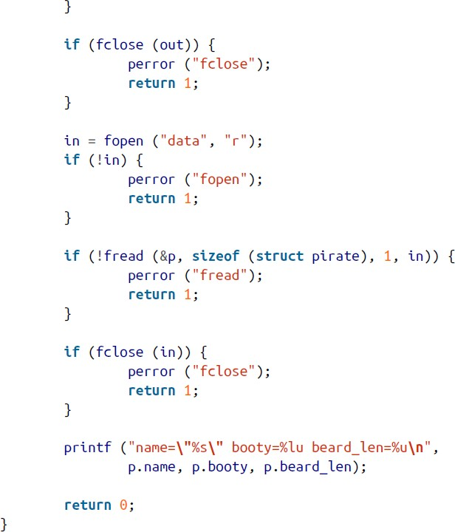
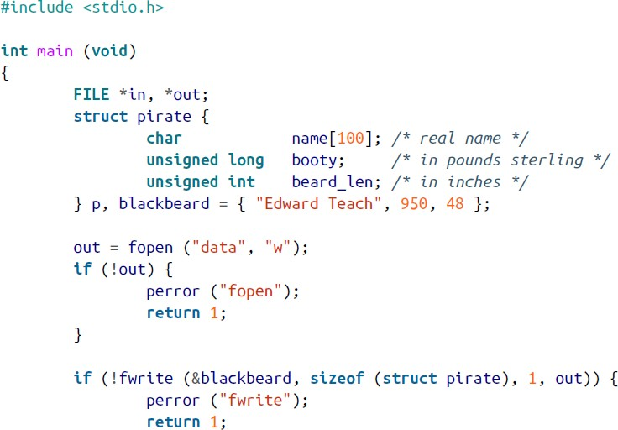
Sample Program
The output of this program is:

Slide 16
Seeking a Stream
#include <stdio.h>
int fseek (FILE *stream, long offset, int whence);
Choices for whence:
SEEK_SET: sets the file position to offset.
SEEK_CUR: sets the file position to current position + offset.
SEEK_END: sets the file position to the end + offset.
On success it returns 0, and on error returns -1 and sets errno.
To obtain the current stream position:
#include <stdio.h>
long ftell (FILE *stream);
On success it returns an integer standing for current position. On error it returns -1.

Slide 17
Seeking a Stream – Cont’
fsetpos() sets the stream position of stream to pos:
#include <stdio.h>
int fsetpos (FILE *stream, fpos_t *pos);
Same as fseek (stream, pos, SEEK_SET);
On success it returns 0, and on error it returns -1 and sets errno.
fsetpos() is the one to use on non-Unix systems, for portability.
rewind() resets the position back to the start of stream:
#include <stdio.h>
void rewind (FILE *stream);
Same as fseek (stream, 0, SEEK_SET);
It doesn’t return a value. Instead, you must set errno = 0 before the call, and, after the call, check if errno is non-zero to check for errors.

Slide 18
Flushing a Stream
#include <stdio.h>
int fflush (FILE *stream);
Writes out the user buffer to the kernel buffer.
If you put NULL as stream, all the open streams of the process are flushed:
fflush (NULL);
On success it returns 0, and on failure it returns EOF and sets errno.
Note that here, what’s being flushed is data in the user space, and it’s being written to the kernel buffer in memory – different from fsync(), which ensures the kernel’s buffer being written out to the disk.

Slide 19
Errors and End-of-File
To tell errors apart from EOF (a problem with fread()), we use ferror():
#include <stdio.h>
int ferror (FILE *stream);
Returns a nonzero integer if an error occurred, and 0 if there’s no error.
Another function feof() tests for EOF:
#include <stdio.h>
int feof (FILE *stream);
Returns a nonzero integer for EOF, and 0 if we didn’t reach the end-of-file.
The clearerr() function clears both the error and the EOF indicators:
#include <stdio.h>
void clearerr (FILE *stream);
clearerr() cannot fail; Call this function only after checking for errors/EOF.

Slide 20
Getting File Descriptor and Buffering
If you need to make a syscall on a stream, use the following to get the fd:
#include <stdio.h>
int fileno (FILE *stream);
It returns the fd on success and -1 on failure (with errno being set to EBADF.)
However mixing stdio calls with syscalls is not advised normally.
Syscalls may conflict with the user buffering.
A good practice is to flush the stream to the kernel buffer before issuing system calls.
Controlling the buffering: stdio calls implement 3 types of user buffering.
Unbuffered: is not commonly used except for standard error, which is usually unbuffered.
Line-buffered: the buffer is submitted to the kernel for each '\n' character; default for terminals.
Block-buffered: the default for streams associated with disk files; another name: fully-buffered.

Slide 21
More on Buffering
To control the type of buffering:
#include <stdio.h>
int setvbuf (FILE *stream, char *buf, int mode, size_t size);
mode must be one of the following: _IONBF, _IOLBF, _IOFBF.
For the latter two modes, buf with size bytes is used as the buffer.
If buf is NULL, a buffer of size bytes is allocated automatically by glibc.
Must be called after opening stream but before any file operation.
Returns 0 on success, and a nonzero value otherwise.
Make sure the buffer exists when the stream is closed (so make buf global.)
Generally, developers don’t need to mess with buffering on a stream.
The default buffer size for block buffering (BUFSIZ) is defined in <stdio.h>.

Slide 22
Thread Safety
Multi-threaded processes (= running programs) are like several processes sharing the same address space.
On multi-processor system, multiple threads could run concurrently.
Threads may overwrite shared data unless the measures below are taken:
Synchronize access to data (locking), or
Make the data thread-local (thread confinement).
An OS provides locking mechanisms to allow concurrent stdio calls, but you may want to have more refined control.
While individual stdio functions are thread-safe, you may want to lock a whole code section so that only 1 thread accesses it at a time, to prevent race conditions.

Slide 23
Manual File Locking
#include <stdio.h>
void flockfile (FILE *stream);
void funlockfile (FILE *stream); int ftrylockfile (FILE *stream);
The flockfile() function waits (blocks) until stream is no longer locked, increases the lock count, and then acquires the lock, thus becoming the thread that owns of stream.
The funlockfile() function decreases the lock count, and if the lock count reaches zero, the current thread relinquishes ownership of the stream.
These calls can nest-up ( lock(lock -> unlock) -> unlock ) by the same thread.
The ftrylockfile() function is a nonblocking version of flockfile(), so it will return nonzero immediately if the stream is currently locked. Otherwise, it returns 0 and works similarly to flockfile().

Slide 24
Unlocked Stream Operations
Individual stdio functions are internally locked, which incurs overhead.
Linux provides a family of unlocked counterparts of stdio functions for boosting performance (this is Linux-specific, not POSIX.)
fgets_unlocked(), fread_unlocked(), etc. See page 88 in textbook for the list.
It’s the programmer’s responsibility to manually acquire and release locks for them if desired.
How to gain in performance without using locks:
Relegating all I/O to a single thread, or
Relegating all I/Os to a pool of threads, where each stream is mapped to exactly one thread in the pool.

Slide 25
Issues of Standard I/O
Double copy:
When reading, stdio functions call read() to get data from disk to the kernel, then copy data from the kernel to the stdio buffer, then from the stdio buffer to supplied buffer as the parameter:
disk → (read) kernel buffer → (copy) stdio buffer → (copy) char* buf
write() requests work in the opposite direction but in a similar fashion:
const char* buf → (copy) stdio buffer → (copy) kernel buffer → (write) disk
Alternative proposed implementations
For read(), return a pointer directly into the stdio buffer. Local copy is only needed if the data need to be written (i.e., not using the user buffer – char* buf.)
For write(), record the pointers (to data) and flush the data by walking the list of stored pointers, writing out the data to the kernel without the stdio buffer.

Slide 26
Conclusion
Standard I/O is a powerful and popular user-buffering library that is a part of the standard C library.
Best used for:
Minimizing overhead (incurred penalty) by combining many system calls.
Performance gain by ensuring all I/O occurs in block-sized chunks.
When your access patterns are character or line-based (fgets() is easier to use.)
When you prefer a higher-level interface to the low-level Linux syscalls.
A great website for reading about <stdio.h>’s functions: https://cplusplus.com/reference/cstdio/

