Slide 1
Linux System Programming
Talking directly to the kernel and C library
Advanced File I/O
Adapted from slides of Professor Yongqing Xiang of Brooklyn College.

Slide 2
Ch4 – Advanced File I/O
In this chapter, we cover only the topics below that are NOT grayed-out:
Scatter/gather I/O [= Vectored I/O]
Allows a single call to read/write data to many buffers at once, which is useful for filling fields of different data structures in one I/O transaction.
Epoll
An improved version of poll()/select(), useful for handling 100’s of fds
Memory-mapped I/O
Allows file I/O to occur via simple memory manipulation.
File advice
Allows a process to provide hints to kernel on intended uses for a file (better I/O
performance)
Asynchronous I/O
Allows a process to issue I/O requests without waiting for them to complete, useful
for handling heavy I/O workloads without the use of threads

Slide 3
Scatter/Gather I/O
A method of I/O where a single syscall reads/writes a vector (array) of buffers from a single data stream (also called vectored I/O.)
Advantages over original (linear I/O) methods are:
More natural coding pattern: intuitive for naturally segmented data.
Efficiency: single vectored I/O operation is used instead of multiple linear I/O operations.
Performance: via internal optimization, which makes this operation faster.
Locked: there is no risk of interleaving (= messing up) I/O from another process.

Slide 4










Scatter/Gather I/O: Analogy
Consider the route of some school bus in the morning: having the school bus pick up the kids from their homes, and, only after all the kids are on the bus, driving to the school is going to be considerably faster than picking up one kid, driving to the school and dropping the kid off at the school, picking up the next kid, and then driving to the school again, etc.

Slide 5
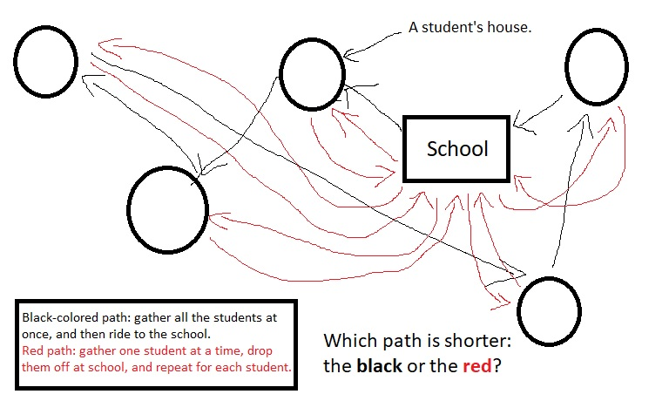

Slide 6
readv() and writev()
#include <sys/uio.h>
ssize_t readv (int fd, const struct iovec *iov, int count);
ssize_t writev (int fd, const struct iovec *iov, int count);
readv() reads count segments from fd into the array of structures iov.
writev() writes at most count segments from the array iov into fd.
Each iovec structure describes a segment of data (a vector):
#include <sys/uio.h>
struct iovec {
void *iov_base; /* pointer to start of a buffer of any data type */
size_t iov_len; /* size of the buffer in bytes */
};
Both readv() and writev() process each buffer of iov_len bytes completely before moving on to the next buffer, which is done in the following order: iov[0], iov[1], …, iov[count-1].
Both return the # of bytes read/written (= sum of all iov_lens) on success and -1 on failure.

Slide 7
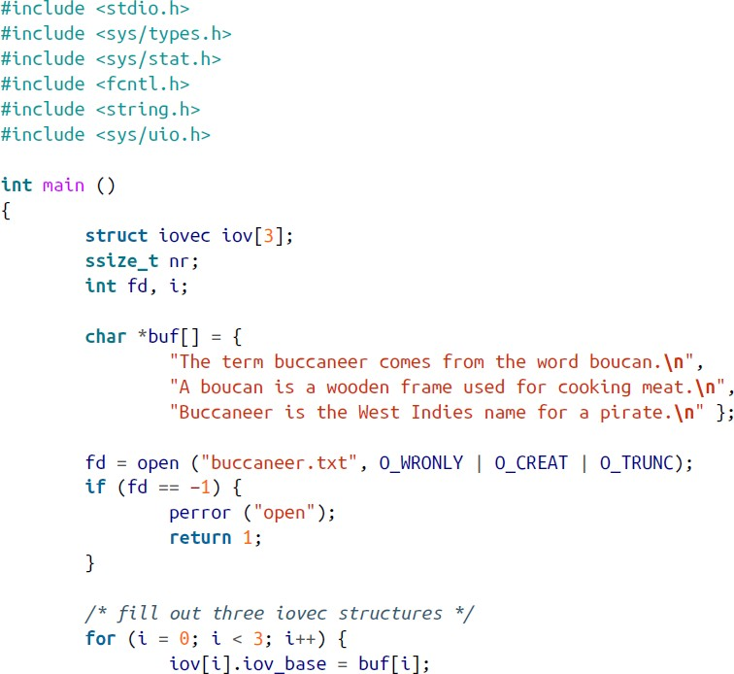
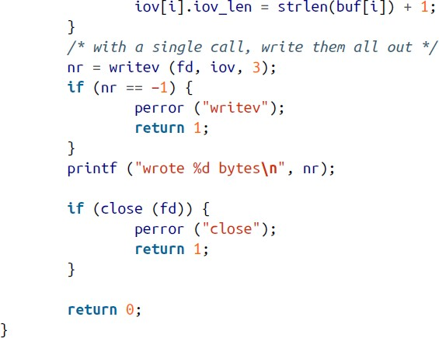
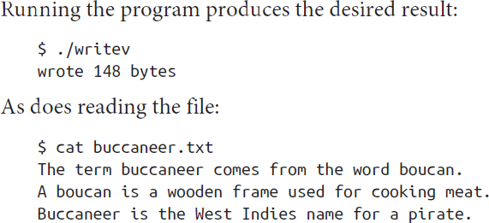
writev() example

Slide 8
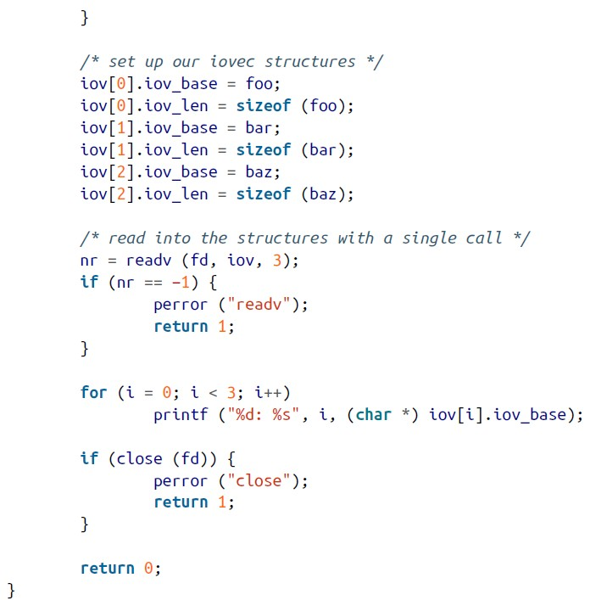
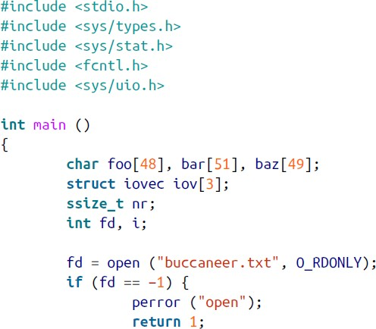

readv() example

Slide 9
Mapping Files into Memory
This is an alternative to standard file I/O.
The mapped file has a one-to-one correspondence between a memory address and a word in the file. That is, everything is copied from the file to memory.
Writing to this memory region could be transparently mapped back to file on disk.
We use the mmap() system call to request this mapping/copying:
#include <sys/mman.h>
void * mmap (void *addr, // hint to kernel where to map file, usually 0
size_t len, int prot, int flags, int fd,
off_t offset);
// number of bytes in the object represented by fd
// memory protection: PROT_READ, PROT_WRITE, PROT_EXEC
// type of mapping: MAP_FIXED, MAP_PRIVATE, MAP_SHARED
// the file to be mapped
// offset of bytes (= how deep inside) the file
On success, it returns the address (pointer) in memory to the beginning of the file’s content.
On failure, it returns MAP_FAILED [defined as the pointer ((void*) -1)] and sets errno.

Slide 10
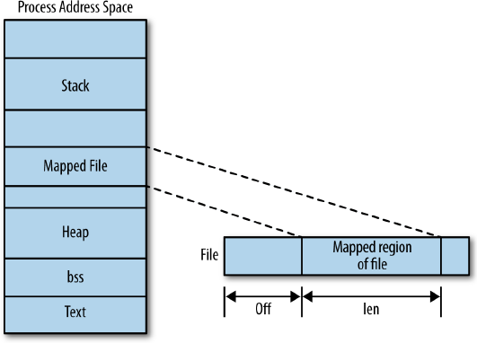
Example of mmap()
void *p;
p = mmap (0, len, PROT_READ, MAP_SHARED, fd, 0);
if (p == MAP_FAILED)
perror ("mmap");
A page is the unit of granularity for memory management.
mmap() syscall operates on pages.
Both addr and offset must be aligned on it.
Non-aligned len will be rounded up to next page.
The extra space will be filled with zeros.
See book pages 108-109, for possible errno values.

Slide 11
Page Size
To get the page size (POSIX):
#include <unistd.h>
long sysconf (int name); /* Returns some OS configuration info. */
Returns value of name (type _SC_PAGESIZE for the page size), or -1 if name is invalid.
Since -1 could be valid value, it is best to set errno to 0 before calling sysconf().
Linux also provides:
#include <unistd.h>
int getpagesize (void);
Not all Unix systems support this function though.
For portability, using sysconf() is recommended.

Slide 12
Removing a Mapping Made by mmap()
munmap()
#include <sys/mman.h>
int munmap (void *addr, size_t len);
if (munmap (addr, len) == −1) /* Example of munmap(). */
perror ("munmap");
It removes any mappings whose pages are in addresses [addr, addr+len].
Afterwards, further access attempts result in a SIGSEGV signal/error.
Typically, the parameter addr is the value that was returned from mmap().
On success, munmap() returns 0, and on failure it returns -1 and sets errno which could only be EINVAL, indicating invalid parameters.

Slide 13
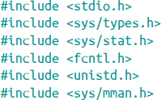
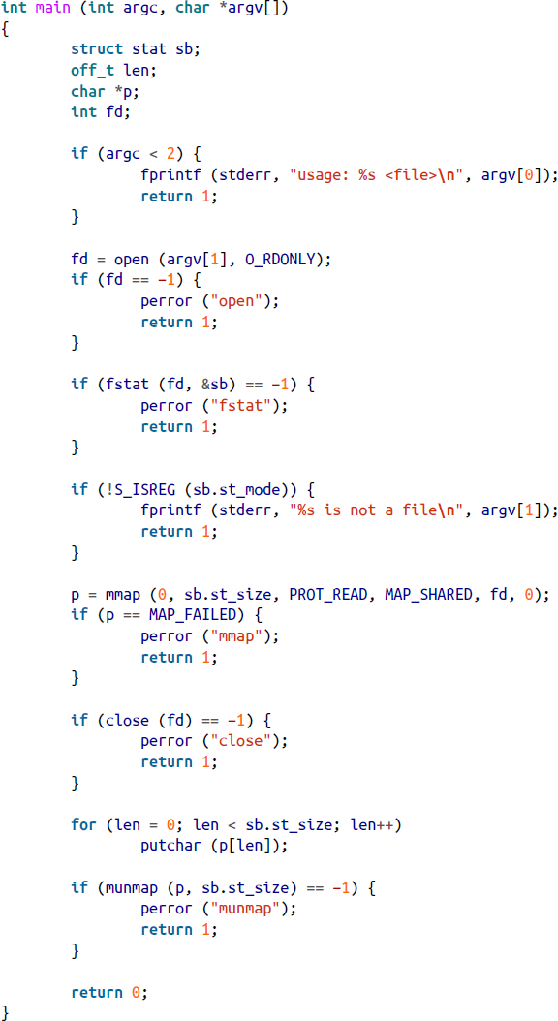
Mapping Example
The program uses mmap() to print a file chosen by the user to stdout.
fstat(fd, &sb) returns information about a given file.
The S_ISREG() macro checks if the given file is a
regular file (as opposed to a device file or a directory.)
The behavior of non-regular files when mapped depends on the backing device.
If a device file is not mmap-able, errno will be set to EACCESS.
The function putchar(c) prints char c to stdout.

Slide 14
Advantages/Disadvantages of mmap()
Advantages:
Reads/writes avoid the extraneous copy into a user-space buffer (char *buf).
Avoid incurring more syscalls (though may incur potential page faults.)
When multiple processes map the same object into memory, the data is shared among all of them.
Seeking through the content involves trivial pointer manipulations (faster).
Disadvantages:
“Wasted” space between a small file and the integer number of pages (4K).
Large # of mappings may increase fragmentation of the address space.
Overhead in creating/maintaining mappings and associated data structures in kernel, though the elimination of double copy helps reducing the overhead.
Using memory mapping is, therefore, advised when (1) the mapped file is relatively large, (2) the total size of the mappings is a multiple of the page size, and (3) the file is frequently accessed.

Slide 15
Resizing a Mapping
A Linux-specific mremap() system call:
#define _GNU_SOURCE #include <sys/mman.h>
void * mremap (void *addr, size_t old_size, size_t new_size,
unsigned long flags);
It expands/shrinks mapping from [addr, addr+old_size) to new_size.
The kernel may move the mapping (addr) depending on how much space is available and what was passed in flags.
The flags parameter can be either 0 or MREMAP_MAYMOVE.
Returns the pointer to the newly sized memory on success and returns MAP_FAILED on failure and sets errno.

Slide 16
Other Use for mremap()
glibc often uses mremap() to implement realloc(), which resizes a block of memory obtained via malloc().
Here is a possible definition of realloc() using mremap():
void * realloc (void *addr, size_t len)
{
size_t old_size = look_up_mapping_size (addr); // from libc
void *p;
p = mremap (addr, old_size, len, MREMAP_MAYMOVE);
if (p == MAP_FAILED)
return NULL;
return p;
}

Slide 17
Changing the Protection of a Mapping
#include <sys/mman.h>
int mprotect (const void *addr, size_t len, int prot);
It changes the protection mode for the page-aligned memory in the addresses range [addr, addr+len).
prot is the same as given to mmap(): PROT_NONE, PROT_READ, PROT_WRITE, and PROT_EXEC.
On Linux, mprotect() can operate on any regions of memory, regardless if addr was mapped through mmap() or not.
Returns 0 on success and -1 on failure and sets errno.

Slide 18
Synchronizing a File with a Mapping
The equivalent to fsync() for memory-mapped files:
#include <sys/mman.h>
int msync (void *addr, size_t len, int flags);
if (msync (addr, len, MS_ASYNC) == −1) perror ("msync"); /* Example */
Flushes back to disk any changes made to a file mapped via mmap().
Could be just a subset of the file that is mapped.
There is no guarantee that writing into a memory mapped file is backed up to disk, so use this function to force synchronization to disk.
The flags parameters control the behavior of the synchronization.
MS_SYNC: msync() won’t return (= will block) until all the pages are written back to disk (you must choose one of either MS_SYNC or MS_ASYNC.)
MS_ASYNC: returns immediately without waiting for writes to take place.
MS_INVALIDATE: invalidates all other cached mappings of the same file (to force updating.)
Returns 0 on success and -1 on failure and sets errno.

Slide 19
Giving Advice on a Mapping
Hints on how mapping will be used to allow kernel to optimize its behavior:
#include <sys/mman.h>
int madvise (void *addr, size_t len, int advice);
int ret = madvise (addr, len, MADV_SEQUENTIAL); /* Example */
if (ret < 0) perror ("madvise");
If len is 0, kernel applies the advice to the entire mapping.
Values of advice:
MADV_NORMAL: kernel performs a moderate amount of readahead.
MADV_RANDAM: random access; kernel disables readahead.
MADV_SEQUENTIAL: kernel performs aggressive readahead.
MADV_WILLNEED: access foreseen in the near future; kernel initiates readahead.
MADV_DONTNEED: access not foreseen in the near future; kernel frees resources.
Returns 0 on success and -1 on failure and sets errno.

