Slide 1
Linux System Programming
Talking directly to the kernel and C library
Process Management
Adapted from slides of Professor Yongqing Xiang of Brooklyn College.

Slide 2
Ch5 – Process Management
Programs are binary code files that lie dormant on disk.
Large and significant ones are called applications.
Processes are running programs loaded into memory.
These include any instances of virtualized memory, kernel resources (such as open files, threads, etc.)
Threads are units of activity inside processes.
Each thread has its own virtualized processor, including a stack, processor state such as registers, and an instruction pointer (= program counter).
In a multi-threaded process, there are multiple threads, and they all share the same memory address space.

Slide 3

The Process ID
Each process has a unique identifier – process ID (pid, of type: pid_t.)
The idle process has the pid 0 (runs when no other processes are running.)
The init process has the pid 1 (first running process after booting the system), and could be any of the following (in the given order below)
/sbin/init: the preferred and most likely location for the init process.
/etc/init: another likely choice.
/bin/init: a fallback choice.
/bin/sh: last choice if the kernel fails to find an init process.
If all four fail to execute, the Linux kernel shuts the system down.
Otherwise, the init process initializes the system, starts various services (= daemons), and launches a login process.
By default, the kernel imposes a max pid value of 32768 (signed 16-bit), and increments them linearly, reusing pid values after it wraps around from the top.
Examples: 2, 3, 4, …, 32766, 32767, 32768, 2, 3, 4, etc. [0 = idle and 1 = init are running.]

Slide 4
The Process Hierarchy
A process that spawns a new process is called the parent; the new process is called the child and keeps a record of its parent process ID (ppid).
Every process is spawned from another process except for init.
Each process is owned by a user and a group, and this ownership is used to control access to (= permission to use) resources.
Each child process inherits its parent’s user and group ownership.
Each process is also a part of a process group.
E.g., “ls | less”: all commands in the pipeline belong to the same process group.
This makes it easy to send signals to an entire pipeline, as well as child processes.

Slide 5
Obtaining the pid and ppid
To get the pid of the process:
#include <sys/types.h> #include <unistd.h>
pid_t getpid (void);
To get the ppid of the process’s parent:
#include <sys/types.h> #include <unistd.h>
pid_t getppid (void);
Neither call will return an error. Examples:
printf ("My pid = %jd.\n", (intmax_t) getpid ());
printf ("Parent's pid = %jd.\n", (intmax_t) getppid ());
Here, intmax_t is a C/C++ type guaranteed to be capable of storing any signed integer.
It must be paired with the printf() variable specifier %j, which prints an intmax_t.

Slide 6
Running a New Process
In Unix/Linux, loading and executing a program is separate from creating a new process!
The creation is called forking and is provided by the fork() syscall.
The execution functionality is provided by the exec family of calls.
fork() creates a new process, which initially is a near-duplicate of its parent process. Then, exec() loads a new program image (code, variables, etc.) into the child process’s memory.
In short, a new process is executed by calling exec() after fork().
We describe the exec family of calls first.

Slide 7
The exec Family of Calls
A family of exec functions are built on and internally invoke a single syscall, the simplest one of them:
#include <unistd.h>
int execl (const char *path, const char *arg, ...);
It loads the code of the program whose name is given by path into main memory. The argument arg should contain what you want to be the 1st argument to this new program (that is, its argv[0]).
The ellipsis (...) represents variadic parameters, which must end with NULL. Example:
int ret;
ret = execl ("/bin/vi", "vi", "/home/text.txt", NULL); // Same as typing: vi /home/text.txt in the terminal.
if (ret == −1) { perror ("execl"); exit(EXIT_FAILURE); } // Error checks.
Normally, execl() doesn’t return – a successful invocation ends by jumping to the 1st code line of the new program (since this entire, parent-resembling code is replaced by the new program’s instructions.)
On error, it returns -1 and sets errno.
While certain attributes of the process are lost (like pending signals), the pid, ppid, priority, and owning user/group are all preserved and are accessible by the child.
Open files are inherited as well (with the same fds), but this may not be desired. One usually closes files before exec by using the O_CLOEXEC flag on open() or by calling fcntl() with FD_CLOEXEC.

Slide 8
The Rest of the exec Family
The five other (function, not syscall) members of the exec family are:
#include <unistd.h>
int execlp (const char *file, const char *arg, ...);
int execle (const char *path, const char *arg, ..., char * const envp[]);
int execv (const char *path, char *const argv[]);
int execvp (const char *file, char *const argv[]);
int execve (const char *path, char *const argv[], char *const envp[]);
The l and v endings signify a list or a vector (array) of arguments, respectively.
The p ending denotes a full path search (just include the filename in file), and e denotes that a new environment is supplied for the new process.
Example:
int ret;
const char *args[] = { "vi", "/home/text.txt", NULL };
ret = execvp ("vi", args); // Same as: vi /home/text.txt in the terminal.
if (ret == −1) { perror ("execvp"); exit(EXIT_FAILURE); } // Error checks.

Slide 9
The fork() System Call
#include <sys/types.h>
#include <unistd.h>
pid_t fork (void);
Creates a new process that runs the same code as the invoking one (= parent.)
The new process is called the “child” of the parent process.
On success, it returns 0 inside the child and the child’s pid inside the parent.
The parent/child processes are identical in every way except for:
pid of the child vs ppid of the parent.
Resource statistics are reset to zero in the child.
Any pending signals are cleared and not inherited by the child.
Any acquired file locks are not inherited by the child.
On error, it returns -1 inside the parent, and the child process is not created.

Slide 10
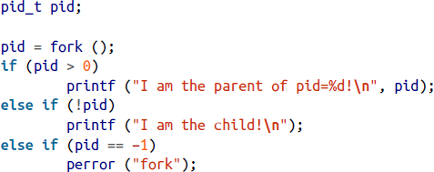
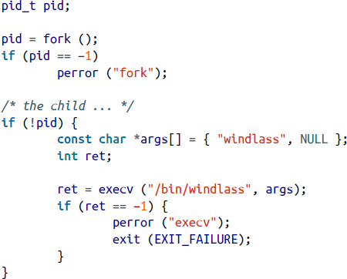
Examples of fork()
fork only
fork plus exec
The parent process continues running normally after the child is spawned.

Slide 11
Copy-on-Write
In early Unix systems, the page-by-page copy of the parent’s address space to the child’s memory was time-consuming.
Modern UNIX/Linux systems employ copy-on-write (COW) pages:
A lazy optimization strategy: copying only happens when the page is changed (written to.)
If no attempt is made to modify the page, no duplicate is ever made.
In virtual memory, copy-on-write is implemented on a per-page basis.
The pages are marked as 'read-only' or 'copy-on-write' in the kernel.
If either process attempts to modify a page, a page fault interrupt occurs, which triggers the kernel to make a copy of the page.
Copy-on-write is especially beneficial in forking since in most times, fork() is followed by some exec call, meaning that the previous copying a waste of time and space.
Before COW, there was a vfork() system call in 3.0BSD that required an immediate exec call.

Slide 12
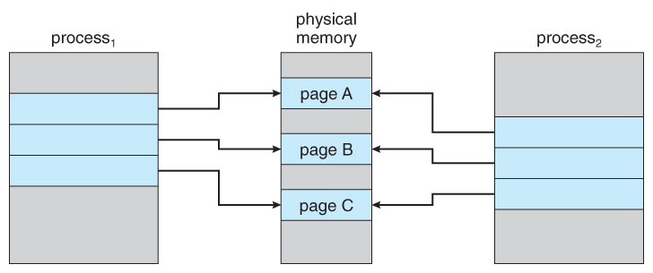
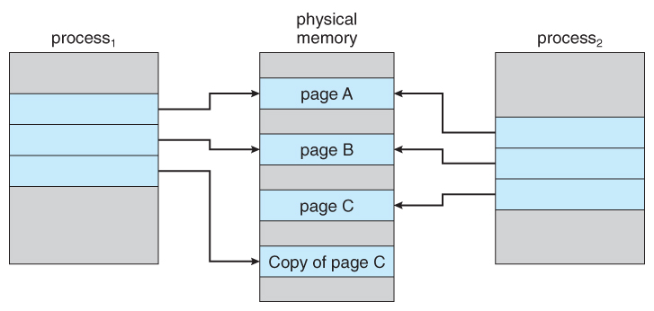
Copy-on-Write: Illustration
Processes 1 and 2 have a parent-child relationship. So far, the memory of both processes is identical, and no page was changed, so no page copying was made. Taken from Bell, John T. "Virtual Memory." University of Illinois, Chicago.
Only when Process 1 decides to change the content of page C, a copy of page C is created. Taken from Bell, John T. "Virtual Memory." University of Illinois, Chicago.

Slide 13
Terminating a Process
#include <stdlib.h>
void exit (int status);
This function performs some basic shutdown steps and then asks the kernel to terminate the process.
It doesn’t return and no instructions should follow it.
The status denotes the process’s exit status (use EXIT_SUCCESS/EXIT_FAILURE instead of 0 and 1 for portability.)
The status can be checked by other programs (including the parent) or the shell.
The C library performs the shutdown steps below as part of exit() in the following order:
Calls any functions registered with atexit() (see slide 15 here) in the reverse order of registration.
Flushes (saves) all the open standard I/O streams to the kernel, which will later save them to disk.
Removes any temporary files created with the tmpfile() function.
Lets the kernel terminate the process by issuing the following syscall inside exit()’s definition:
#include <unistd.h>
void _exit (int status);

Slide 14
Other Ways for a Process to Terminate
When returning from main():
Behind the scenes, the compiler inserts a call to exit() where return appears.
When a signal whose default action is to terminate the process is sent:
Either of the SIGTERM and SIGKILL signals.
When executing some illegal/erroneous instruction that causes a segmentation fault, stack fault, division-by-0 error, etc.

Slide 15
Functions Called upon Termination
Registering termination functions with atexit()
#include <stdlib.h>
int atexit (void (*function)(void));
The registered function takes no parameters and returns no value:
void my_function (void); // You must create such a function in the C file.
The function will be called via either exit() or the return inside main().
If a process invokes exec, the list of registered functions by atexit() is erased.
If a process terminates via a signal, the registered functions are not called.
Functions are called in the reverse order that they are registered (LIFO).
They must not call exit() themselves (this avoids infinite loops!)
On success, atexit() returns 0, and on error, it returns -1 (errno isn’t set.)

Slide 16
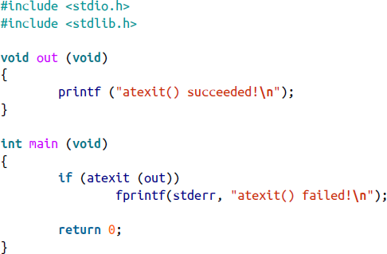
Examples of atexit()
#include <stdio.h>
#include <stdlib.h>
void bye (void)
{
printf ("Signing off!\n");
}
int main (void)
{
short unsigned boroughs = 5;
printf ("NYC has %hu boroughs.\n", boroughs);
if (atexit (bye) != 0)
{
fprintf (stderr, "Cannot register function!\n");
exit (EXIT_FAILURE);
}
exit (EXIT_SUCCESS); // bye() will be called here!
}

Slide 17

Waiting for Terminated Child Processes
Generally, the parent receives a SIGCHLD signal when a child terminates.
But a parent may want to obtain more info, such as the child’s return status.
By design, when a child dies before its parent, the kernel puts the child into a special process state (known as a zombie) since the child is supposed at this moment to be terminated but is still alive (and hence the name zombie!)
A zombie waits for its parent to make an inquiry about its status (known as
waiting on the child process.)
Only after the parent obtains the info, the zombie formally exits and ceases to exist.
Linux provides several ways for waiting, with the simplest being wait().

Slide 18
wait()
#include <sys/types.h> #include <sys/wait.h>
pid_t wait (int *status);
It returns the pid of a terminated child, or -1 on error and sets errno.
It blocks if no child has terminated yet or returns immediately if some child did terminate and the SIGCHILD signal was received.
If it is not NULL, the status pointer contains additional info about the child, which can be obtained via a family of macros:
#include <sys/wait.h>
int WIFEXITED (status); int WIFSIGNALED (status); int WIFSTOPPED (status);
int WEXITSTATUS (status); int WTERMSIG (status); int WSTOPSIG (status);
int WIFCONTINUED (status); int WCOREDUMP (status);
Refer to the book at pages 152-153 for details on these macros.

Slide 19
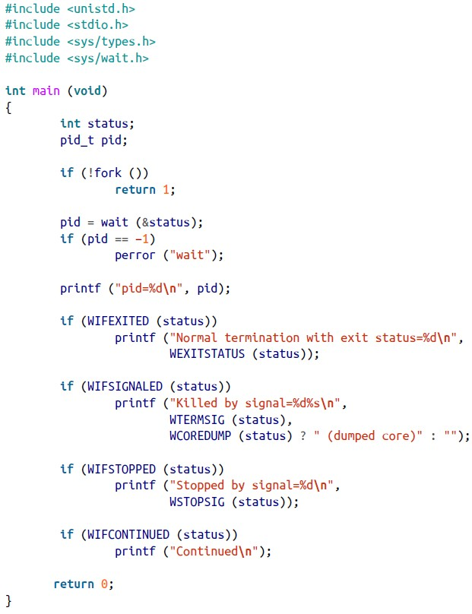


Example of wait()
The program forks a child which
immediately exits via return 1; since fork() returns 0 inside the child.
The wait() syscall determines the status of its child and prints how it died.
If the child calls abort(), sending the parent a SIGABRT signal, we’ll see:

Slide 20
Waiting for a Specific Process – waitpid()
If a parent has multiple children and wants to wait for a specific pid:
#include <sys/types.h> #include <sys/wait.h>
pid_t waitpid (pid_t pid, int *status, int options);
It’s a more powerful version of wait(); its parameters allow fine-tuning.
pid specifies which process/processes to wait for:
< -1: wait for any child process whose process group ID is |pid| (e.g., -500 means 500.)
-1: wait for any child process (the same exact behavior as wait().)
0: wait for any child process that belongs to the same process group as the parent process.
> 0: wait for any child process with the exact process id as given in pid.
The options parameter is a binary OR of zero or more of the following:
WNOHANG (doesn’t block), WUNTRACED (sets WIFSTOPPED), WCONTINUED (sets
WIFCONTINUED). Refer to the book on page 155 for more details on these.

Slide 21

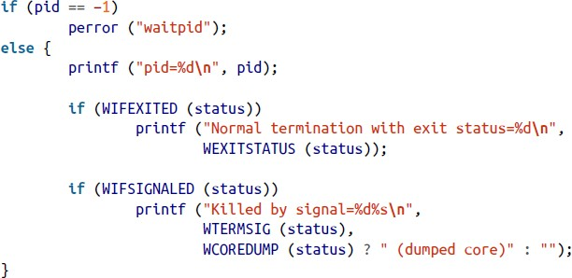
More on waitpid()
On success, it returns the pid of the process whose state has changed.
If WNOHANG is specified and no child(ren) changed state, it returns 0.
On error, it returns -1 and sets errno.
The example on the right assumes your program wants to find the return value of a child with pid=1742.
waitpid(-1, &status, 0) is equivalent to wait(&status).
Above, -1 means any child, and 0 means no special options requested.

Slide 22
Launching and Waiting for a New Process
Synchronous process creation (spawns then waits for a new process:)
#define _XOPEN_SOURCE /* if we want WEXITSTATUS, etc. */
#include <stdlib.h>
int system (const char *command); // command is a Linux terminal command.
Also called shelling out to the system – runs a simple command with the explicit goal of obtaining the command’s return value.
It’s the equivalent of typing “/bin/sh –c command” in the terminal, where command also consists of any command-line arguments.
Returns the status of the command as done in wait() and -1 on error.
If command is NULL, it returns a nonzero value if the shell interpreter /bin/sh is installed on the computer, and 0 if it isn’t installed.

Slide 23
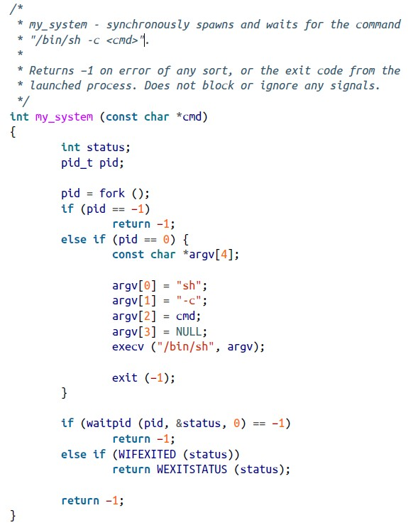
Implementing system()
This is just a fun exercise using fork(), execv(), and waitpid().
A good example to tie together many concepts in this chapter.
Compared to the official system() implementation, it doesn’t block/disable any signals.

Slide 24
Zombies (Also Called: Ghosts)
A terminated process but not yet waited upon by its parent.
Zombie/ghost processes continue to consume small portion of the operating system’s resources.
Be a responsible parent: if you fork a child process, you must wait on the child – even if you merely discard the child’s obtained return status.
But what happens if the parent dies before the child? Whenever a process terminates, the kernel walks its children and reparents them to the init process (pid = 1).
The init process periodically waits on all its children and allows them to exit normally and fully, ensuring zombies don’t live for long.

Slide 25

Users and Groups
Processes are associated with users and groups.
The process’s uid and gid dictate the operations the process can do.
The best practice is to use least-privileged rights for a process and only to elevate them when necessary.
Real (ruid), Effective (euid), and Saved UIDs (suid) (also applies to GIDs):
The real uid is that of the user who originally ran the process. It is set to the real uid of the process’s parent and doesn’t change during an exec call.
The login process sets the uid of the user’s shell process (e.g., /bin/bash) to that of the user.
The effective uid is the uid that the process is currently using. It could be different
from it’s real uid after executing a command/program that internally calls setuid() (such as passwd, whose owner is root, to modify the user’s password.) Thus, the effective uid becomes the root’s uid!
The saved uid is the process’s original effective user ID, but upon an exec call, the kernel sets the saved uid to the new effective uid, facilitating switches between them.
Ultimately the effective uid is the value that matters in dealing with permissions.

Slide 26
Changing the Real (ruid) or Saved (suid) UID
#include <sys/types.h> #include <unistd.h>
int setuid (uid_t uid);
Sets the effective user ID of the current process to uid.
If the current effective user ID is 0 (the root ran this program!), then all 3 user IDs (real, effective, and saved) are set to uid, which could be any value, and once they are changed into a nonzero ID, it’s impossible to re-gain root privileges.
A non-root user can only pass its real or saved user ID for uid.
It returns 0 on success. On error, it returns -1 and sets errno.
This also applies to groups. Use: int setgid (gid_t gid);

Slide 27
Changing the Effective UID
#include <sys/types.h> #include <unistd.h>
int seteuid (uid_t euid);
Sets the effective user ID of the current process to euid.
If the root runs this process, it may provide any value for euid.
Nonroot users can only use their real or saved user IDs.
For nonroot users, seteuid() is equivalent to a setuid() call.
But for the root user, this version doesn’t change real/saved IDs.
It returns 0 on success. On error, it returns -1 and sets errno.
This also applies to groups. Use: int setegid (gid_t egid);

Slide 28
More on User/Group IDs
Well, which of these system calls should I use in my program?
Nonroot processes should use seteuid() to change their effective user IDs.
Root processes should use setuid() if all 3 IDs need to be changed, and seteuid() if only the effective user ID needs to be changed.
Getting the User and Group IDs:
#include <unistd.h> #include <sys/types.h>
uid_t getuid (void); // Get the real user ID.
gid_t getgid (void); // Get the real group ID.
uid_t geteuid (void); // Get the effective user ID.
gid_t getegid (void); // Get the effective group ID.
These system calls always succeed: they never fail.

Slide 29
Sessions and Process Groups
Each process is a member of a process group:
A collection of one or more processes associated with each other.
Signals can be sent to all the processes in the group (e.g., terminating them all at once.)
Each process group has a process group ID (pgid) and a process group leader.
The process group will keep existing as long as there is one remaining member in the group.
It continues to exist even if the process group leader terminates.
When a new user logs into a Linux machine, the login process creates a new session that consists of a single process – the user’s shell (e.g., sh or bash.)
The shell becomes the session leader.
The pid of the session leader is the session ID.
A session is a collection of one or more process groups.
Sessions arrange a logged-in user’s activities and associate it with a controlling terminal.

Slide 30
Sessions and Process Groups (cont’)
Sessions exist to relate logins with the terminals in which actions take place.
Process groups in a session are divided into a single foreground process group and zero or more
background process groups.
When a user exits a terminal, a SIGQUIT is sent to all processes in the foreground process group.
Example:
A user logs into the system. The shell that starts running, bash, has the pid of 1700.
The user’s bash instance is now the sole member and leader of a new process group (pgid = 1700.)
This process group is inside a new session with the session ID = 1700, and bash is also the sole member and the leader of this session.
Commands that this user runs in the shell run in a new process groups but still within session 1700.
One of these process groups is the foreground process group. All the other process groups are
background process groups.
On a given system, there are many sessions: one for each user session, and others for processes that are not tied to user sessions, such as daemons.

Slide 31
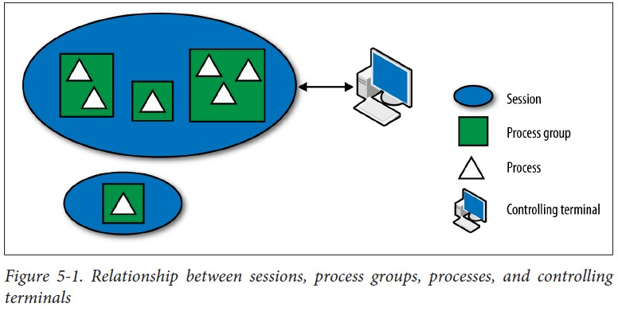
Sessions and Process Groups (cont’)
A command in the terminal such as this one:
cat ship-inventory.txt | grep booty | sort
results in one process group containing three processes, which can receive signals from the shell all at once.
Since no ‘&’ is used at the end, this group will
run in the foreground.
The figure shows the relationship between:
Sessions,
Process groups,
Processes, and
Controlling terminals.

Slide 32
Session System Calls
Shells create new sessions during login via a system call:
#include <unistd.h>
pid_t setsid (void);
It creates a new session (assuming that the current process is not already a process group leader,) in which the calling process becomes the session leader and the sole member of the new session, which has no associated controlling tty (terminal).
This call also creates a new process group inside the session and makes the calling process the process group leader and its sole member.
Both the session/process group IDs are set to the calling process’s pid.
It returns the session ID on success. On error, it returns -1 and sets errno (the only possible error is EPERM, indicating that the process is some process group’s leader already.)

Slide 33
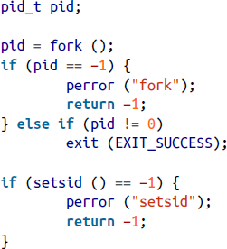
More on setsid()
To ensure that current process is NOT a process group leader and to eliminate the error possibility when calling setsid():
From the current process, call fork().
Terminate the parent.
Make the child call setsid().
Why does this help?
Because a child isn’t a leader of any group.
As such, the EPERM error won’t occur.

Slide 34
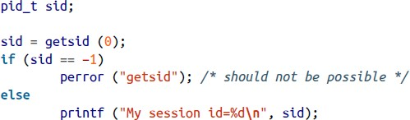
Obtaining the Current Session ID
#define _XOPEN_SOURCE 500 #include <unistd.h>
pid_t getsid (pid_t pid);
It returns the session ID of the process identified by pid.
If pid is 0, it returns the session ID of the calling process. On error, it returns -1 and sets errno (the only error is ESRCH – invalid pid.)
One would use getsid() primarily for diagnostic purposes. Example:

Slide 35
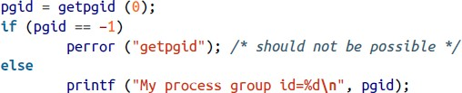
Process Group System Calls
To set the process group ID of the process identified by pid to pgid (i.e., assign a process with pid to a new group of pgid):
#define _XOPEN_SOURCE 500 #include <unistd.h>
int setpgid (pid_t pid, pid_t pgid);
If pid is 0, the current process is used. If gpid is 0, pid is used (i.e., it become the new group leader!)
pid must be the calling process or a child of the calling process yet to issue exec() and is in the same session as the calling process. The process with pid can’t be a session leader itself (i.e., can’t change a session leader to a new group.) The to-be-assigned pgid must be in the same session as the calling process.
It returns 0 on success. On error, it returns -1 and sets errno.
To find a process’s pgid:
#define _XOPEN_SOURCE 500
#include <unistd.h>
pid_t getpgid (pid_t pid);
If pid is 0, the pgid of the current process is returned.
Returns the pgid on success or -1 on error, in which case it sets errno.

Slide 36
Daemons
A process that runs in the background, not connected to any controlling terminal.
Usually, it starts at boot (launch) time, runs as root, and handles system-level tasks.
Conventionally named with a ‘d’ as the last letter (e.g., sshd, httpd.)
To be called a daemon, a process must satisfy 2 general requirements:
Must run as a child of init.
Must not be connected to a terminal.

Slide 37
Steps to Become a Daemon
Call fork() – this creates a new process.
In the parent, call exit() – so that init, the grandparent, recognizes that the parent of the daemon is no longer running, and that the daemon is not a process group leader.
Call setsid() – this gives the daemon a new process group and session, both of which it leads. This ensures the process has no associated controlling terminal.
Change the working directory to the root directory (/) via chdir().
Close all fds – you don’t want to keep them open anymore.
Open fds 0, 1, and 2 and redirect all three to /dev/null.

Slide 38
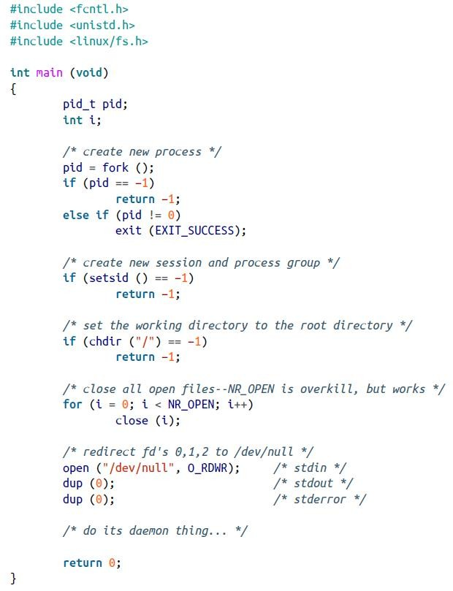

Example of Daemonizing
Here is a program that demonizes itself.
dup(0) copies fd 0 using the lowest unused fd as the new descriptor (then 1, and then 2.)
Most Unix systems provide a daemon() function in their C library that automates these steps:
#include <unistd.h>
int daemon (int nochdir, int noclose);
If nochdir is nonzero, the daemon won’t change the directory to the root folder.
If nonclose is nonzero, the daemon won’t close all the open fds.
It returns 0 on success. On failure, it returns -1 and sets errno.

