Slide 1
Linux System Programming
Talking directly to the kernel and C library
Advanced Process Management
Adapted from slides of Professor Yongqing Xiang of Brooklyn College.

Slide 2
Ch6 – Advanced Process Management
Process Scheduling
The process scheduler is the kernel subsystem software that divides processor time among the system’s processes,
It is responsible for maximizing processor usage, and
It providing the illusion that multiple processes are running concurrently.
Runnable processes
A runnable process is one that’s not blocked (not waiting for I/O, e.g., keyboard input.)
Processes that interact with users, read/write files, respond to network events are often blocked (and are, therefore, not runnable.)
A scheduler is essential when there are more runnable processes than processors.
It decides which processes run, when, and for how long.
On a single-CPU machine, multitasking interleaves (switches) execution of multiple processes.
On a multiprocessor machine, processes can run in parallel!

Slide 3
Ch6 – Advanced Process Management
If the above GIF file doesn’t play within your version of PowerPoint, you may instead play this GIF via the browser by opening: https://www.sci.brooklyn.cuny.edu/~briskman/cisc/3320/lecture_notes/topic_05/concurrency_vs_parallelism.gif

Slide 4
Multitasking: Cooperative or Preemptive
In cooperative multitasking:
A process doesn’t stop running until it voluntarily decides to pause (yield.)
Ideally, processes yield often, but the OS can’t enforce it.
E.g., a broken program could run indefinitely (e.g., using while(1);) to bring down the whole system.
Modern Operating Systems are almost always preemptively multitasked.
Linux implements preemptive multitasking.
The Scheduler decides when a process must pause, and another must run.
Preemption = suspending one process in place of another.
The length of time a process is allowed to continually run is called the time slice.
The modern Linux Scheduler is called Completely Fair Scheduler (CFS), where fair queuing refers to a scheduling algorithm enforcing fair access to resources.

Slide 5
Time Slices
A time slice is an important constant determining the overall performance of a system.
If it’s too large, processes must wait a long time in between executions, which minimizes the appearance of concurrent execution.
If it’s too small, the OS will spend a lot of time on switching, and benefits such as temporal locality will be lost.
Temporal locality = the reuse of specific data and/or resources within a relatively small-time duration by the same process.
Determining the ideal time slice is not easy!
It depends on the OS: whether it favors maximizing system throughput and
overall performance, or
Whether it favors providing excellent interactive (I/O) performance/responses.
Linux’s CFS addresses this conflict by… eliminating time slices!

Slide 6
I/O-Bound Versus Processor-Bound
Processes are processor-bound if they continually consume time slices entirely. Examples:
The infinite loop while(1);
or those processes doing intense scientific computation, video processing, etc.
Processes are I/O-bound if they spend more time blocked, waiting for some resource to become available, such as in:
Waiting for file or network I/O (e.g., Linux file commands such as cp or mv.)
Blocking on keyboard input or waiting for mouse move (most GUI apps.)
The two types of processes benefit from different scheduler behaviors:
The processor-bound need the largest time slices possible (= maximizes cache hit rates.)
The I/O-bound need the scheduler to run them as soon as possible on the CPU to after such processes return from waiting, so they benefit from smaller time slices.
Most apps are a mixture of I/O-bound and process-bound behaviors:
Audio/video editing, games, etc.

Slide 7
Preemptive Scheduling
Preemptive scheduling is the traditional Unix process scheduling.
Each process is assigned a time slice.
When a process exhausts its time slice, the kernel suspends it and runs another process on the CPU (i.e., switches between the processes.)
If there are no other processes ready to run on the CPU, expired processes get their time slices replenished and start running again.
Processes pause execution when they block on (wait for) I/O.
Lower-priority processes must wait for higher-priority process to either exhaust their time slices or block, but all the processes eventually get to run.
The most important rule: all processes must make forward progress!

Slide 8
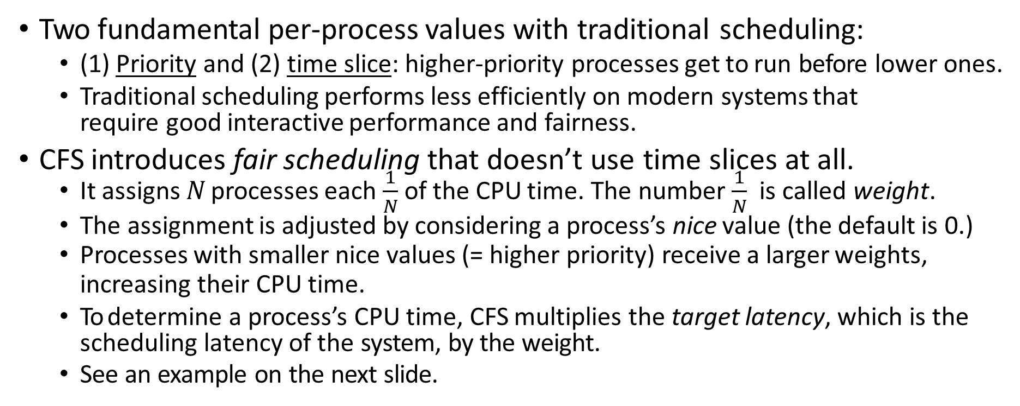
The Completely Fair Scheduler (CFS)
Two fundamental per-process values with traditional scheduling:
(1) Priority and (2) time slice: higher-priority processes get to run before lower ones.
Traditional scheduling performs less efficiently on modern systems that require good interactive performance and fairness.
CFS introduces fair scheduling that doesn’t use time slices at all.
It assigns N processes each $\frac{1}{N}$ of the CPU time. The number $\frac{1}{N}$ is called weight.
The assignment is adjusted by considering a process’s nice value (the default is 0.)
Processes with smaller nice values (= higher priority) receive a larger weights,
increasing their CPU time.
To determine a process’s CPU time, CFS multiplies the target latency, which is the scheduling latency of the system, by the weight.
See an example on the next slide.

Slide 9
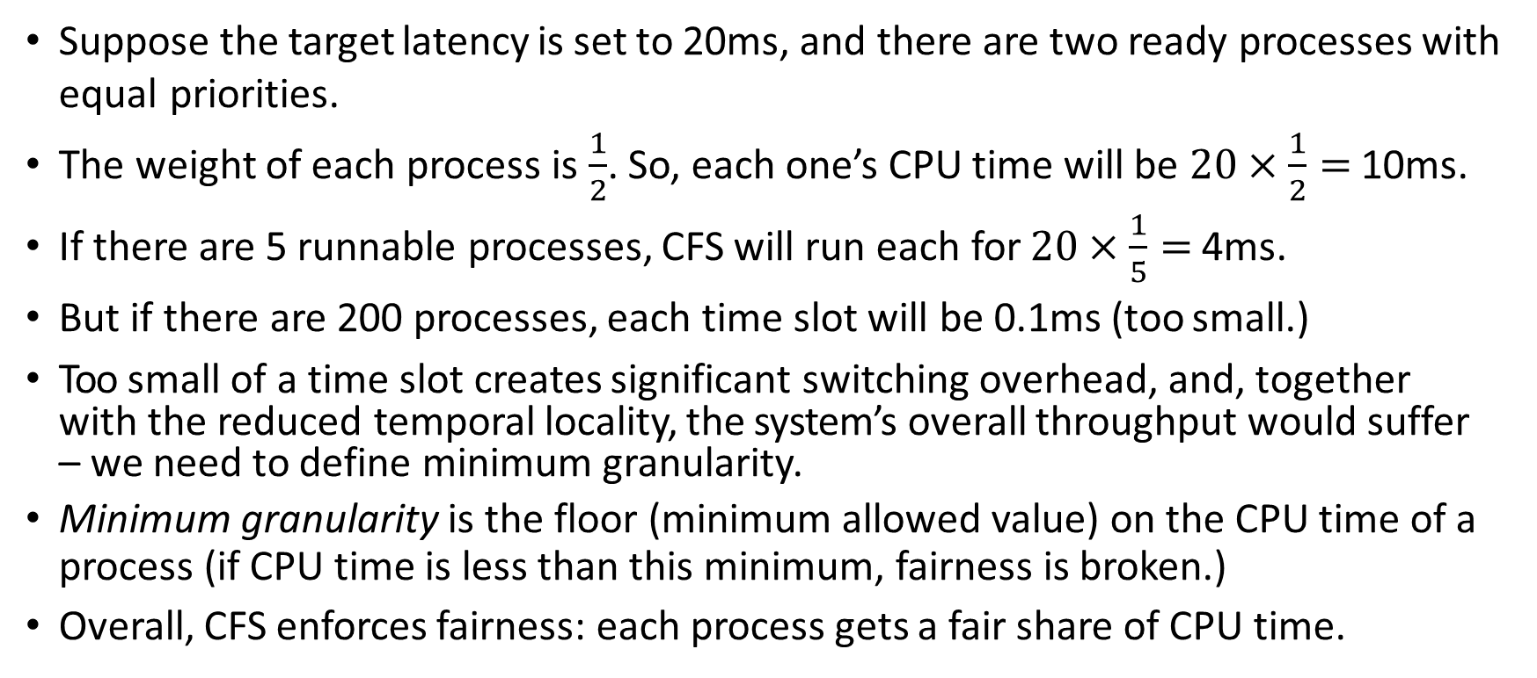
Target Latency: Example
Suppose the target latency is set to 20ms, and there are two ready processes with equal priorities.
The weight of each process is $\frac{1}{2}$. So, each one’s CPU time will be $20×\frac{1}{2}=$10ms.
If there are 5 runnable processes, CFS will run each for $20×\frac{1}{5}=$4ms.
But if there are 200 processes, each time slot will be 0.1ms (too small.)
Too small of a time slot creates significant switching overhead, and, together with the reduced temporal locality, the system’s overall throughput would suffer – we need to define minimum granularity.
Minimum granularity is the floor (minimum allowed value) on the CPU time of a process (if CPU time is less than this minimum, fairness is broken.)
Overall, CFS enforces fairness: each process gets a fair share of CPU time.

Slide 10
Yielding the Processor
The syscall to explicitly yield execution (so scheduler can run another process:)
#include <sched.h>
int sched_yield (void);
It works as if the kernel had itself preempted the currently running process.
But if no other ready processes exist, the yielding process immediately resumes execution.
It returns 0 on success and -1 on failure (though on Linux, it always returns 0.)
Legitimate Uses:
Very few uses – generally, the kernel does a better job in determine when to preempt.
But if an app must wait for external events (e.g., consumer/producer when producer is not ready,) it could busy-loop.
Though modern Unix programs should aim toward an event-driven solution using blockable mechanism such as pipes, allowing the kernel to manage the coordination.
See pages 180-181 in the book for other extra uses.

Slide 11
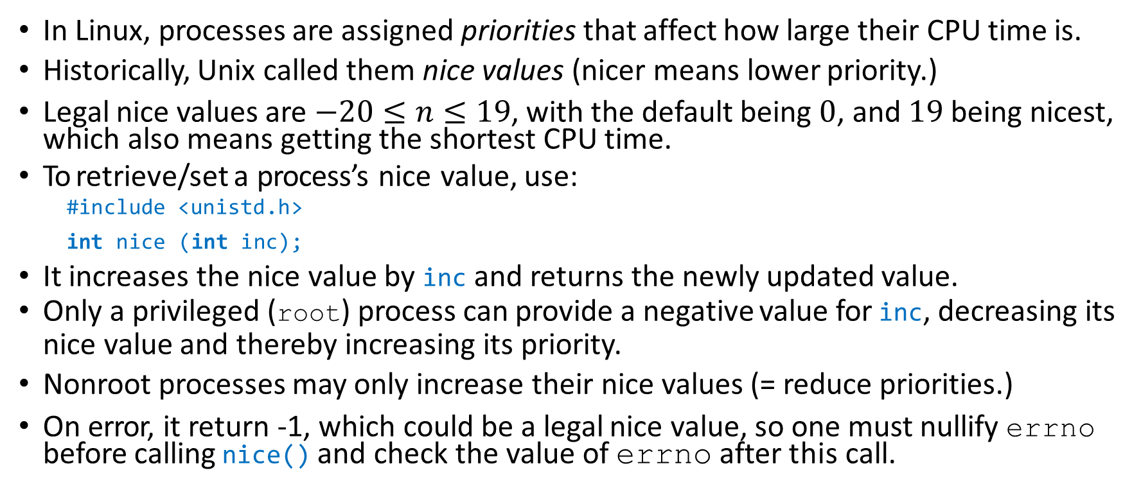
Process Priorities
In Linux, processes are assigned priorities that affect how large their CPU time is.
Historically, Unix called them nice values (nicer means lower priority.)
Legal nice values are $−20≤n≤19$, with the default being $0$, and $19$ being nicest, which also means getting the shortest CPU time.
To retrieve/set a process’s nice value, use:
#include <unistd.h>
int nice (int inc);
It increases the nice value by inc and returns the newly updated value.
Only a privileged (root) process can provide a negative value for inc, decreasing its nice value and thereby increasing its priority.
Nonroot processes may only increase their nice values (= reduce priorities.)
On error, it return -1, which could be a legal nice value, so one must nullify errno before calling nice() and check the value of errno after this call.

Slide 12
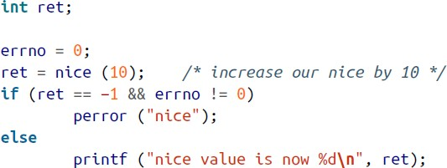
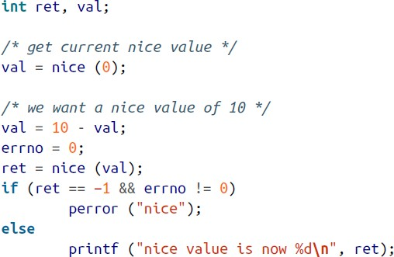
Examples of Setting Nice Values
To check for errors: • To change the nice value’s sign:
To obtain the current nice value:

Slide 13
getpriority() and setpriority()
Two other syscalls allow more control – a preferable solution:
#include <sys/time.h>
#include <sys/resource.h>
int getpriority (int which, int who);
int setpriority (int which, int who, int prio);
They operate on a process, a process group, or a user (with which and who.)
which choices: PRIO_PROCESS, PRIO_PGRP, PRIO_USER.
who choices: pid, pgid, uid, or 0 (which represents the current pid/pgid/uid.)
getpriority() returns the highest priority (lowest nice value) of the specified processes.
setpriority() sets the priority (= nice value) of all the specified processes to prio.
Only the privileged user (root) may raise priority or modify it for an unowned process.
setpriority() return 0 on success and -1 on error, but getpriority() must check errno for errors, as -1 could be a legally returned priority value.

Slide 14
Examples of getpriority()/setpriority()
To return the current process’s priority (= nice value):
int ret;
ret = getpriority (PRIO_PROCESS, 0); printf ("nice value is %d\n", ret);
To set the priority of all processes in the current process group to 10:
int ret;
ret = setpriority (PRIO_PGRP, 0, 10);
if (ret == −1)
perror ("setpriority");

Slide 15
Processor Affinity
The process scheduler must decide which processes run on each CPU.
The scheduler faces 2 challenges/goals:
Fully utilizing all CPUs (= don’t let one sit idle while a process is waiting.)
Avoid migrating a process from one processor to another since it is costly:
Cache effects of migration: data in one processor’s cache is not in another’s cache.
Moved process must invalidate old cache and re-cache new memory, which takes time.
These two goals potentially contradict one another.
Load balancing (= the decision to move processes due to imbalances) requires migrating.
Processor affinity refers to the likelihood of a process to continue running on the
same CPU after it returned from waiting or its CPU time was replenished.
Soft affinity: refers to the scheduler’s natural tendency to continue running a process on same processor; migration only happens in an extreme load imbalance.
Hard affinity: user/app chooses to bind a process to a particular CPU via the kernel’s help.

Slide 16
sched_getaffinity() and sched_setaffinity()
Processes inherit the CPU affinities of their parents, but they may choose to run on any CPU via the following system calls that set hard affinity:
#define _GNU_SOURCE #include <sched.h>
typedef struct cpu_set_t;
size_t CPU_SETSIZE;
int sched_setaffinity (pid_t pid, size_t setsize, const cpu_set_t *set);
int sched_getaffinity (pid_t pid, size_t setsize, cpu_set_t *set);
A call to sched_getaffinity() retrieves the CPU affinity of process pid and stores it in the cpu_set_t type (which is opaque). pid=0 is how you refer to the current process, and setsize is the size of the cpu_set_t type (in bytes.)
Each of the functions returns 0 on success and -1 on failure and sets errno.
// Must be included for the below functions to work.
// This type is already defined inside <sched.h>.
// This constant is already defined inside <sched.h>.
void CPU_SET (unsigned long cpu, cpu_set_t *set);
void CPU_CLR (unsigned long cpu, cpu_set_t *set);
int CPU_ISSET (unsigned long cpu, cpu_set_t *set);
void CPU_ZERO (cpu_set_t *set);

Slide 17
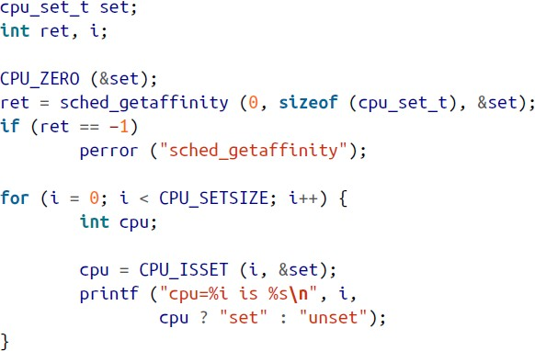
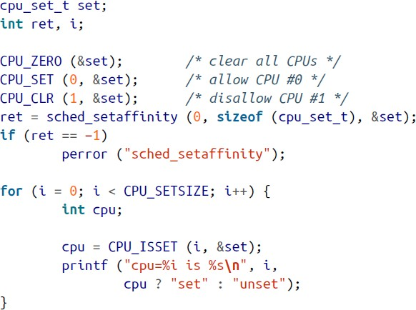
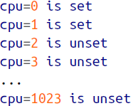
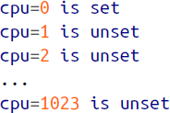
Example of Getting and Setting Affinity
To get the affinity of the current process:
To set affinity of the current process to CPU-0 only:
↓ Returns nonzero if any CPU-i is bound (set).
CPU_SETSIZE is the # of processors representable by the set and is currently equal to 1024:
} ← The computer has only 2 physical CPUs.
← CPU-1 is now unbound, so the
process will never run on it.

Slide 18
Real-Time Systems
A “real-time” system is subject to operational deadlines.
It enforces minimum and mandatory times between stimuli and responses.
Such as the ABS (anti-lock braking system) on modern cars to prevent accidents.
Hard vs. Soft Real-Time Systems:
Hard real-time systems require absolute adherence to operational deadlines.
Anti-lock braking system, weapons systems, medical devices, etc.
Soft real-time systems don’t consider overrunning a deadline as a critical failure.
Video-processing or multimedia apps, games, networking programs, etc.
A real-time system is not necessarily fast.
A nuclear reactor can allow several seconds for correction, which is quite long.
But video games may have noticeable quality drop when frames are skipped.

Slide 19
Latency, Jitter, and Deadlines
Latency: the time between the stimulus and the system’s response.
If the latency is smaller than operational deadline, the system is operating correctly.
In hard real-time systems, the operational deadline and latency are usually equal (the system handles stimuli in fixed intervals, at exact times.)
But it is usually hard to measure latency.
Jitter: the time between two consecutive events.
Generally computed as the maximum difference between two responses.
This is not latency, but it’s still useful and easy to measure.
Hard real-time systems often exhibit very low jitter (aiming for 0.)
Soft real-time systems are more susceptible to jitter (some responses are within the operational delay, but some aren’t.)
Jitter is often a good replacement for latency as performance measurement.

Slide 20
Linux’s Real-Time (RT) Support
The POSIX standard doesn’t dictate whether its RT support is hard or soft.
It only describes several scheduling policies that respect priorities.
The exact timing constraints associated with the policies is up to each OS.
The Linux kernel has improved its RT support a lot, achieving lower latency and more consistent jitter, and is used a lot in embedded real-time systems.
Next, we’ll discuss some Linux scheduling policies.

Slide 21
Linux Scheduling Policies and Priorities
In addition to the normal default policy, Linux provides 2 real-time scheduling policies.
In <sched.h> defined are three policies: SCHED_FIFO, SCHED_RR, SCHED_OTHER, with the last one being the default non-RT policy.
Each process also has a static priority (different from the nice value:)
0 for normal priority.
1-99 (inclusive) for real-time processes (higher values means higher priorities.)
The Linux scheduler always runs higher priority processes before running lower priority processes.
A process must wait for of any processes of a higher priority to block (on I/O or wait for a child to terminate) before it can run on the CPU.
This means that any ready, real-time process will preempt a normal priority one.

Slide 22
The First-in, First-out Policy
The first in, first out (FIFO) policy is represented by SCHED_FIFO.
This is a simple real-time policy without time slices.
In this policy, a process will keep running forever until a higher-priority process becomes ready, or it blocks itself, or until it calls sched_yield().
If it blocks and then becomes ready again, or when it yields, it will be placed at the tail of the ready queue that contains processes of the same priority.
If preempted by a higher priority process, a process stays where it is in the ready queue that contains processes of the same priority.
A newly joining process will always be put at the head of the ready queue that contains processes of the same priority.

Slide 23
The Round-Robin Policy
The round-robin (RR) policy is represented by SCHED_RR.
It works similarly to FIFO but differs in that it assigns time slices.
When the time slice of a process is exhausted, the scheduler moves the process to the end of the ready queue of processes of the same priority.
Round-robin is applied to processes of the same priority.
If there is only one process in the ready queue, it will continue running.
With either policy, a lower-priority process won’t ever run if a higher-priority one exists.
That is, a higher-priority process will never be removed from the CPU for a process of a lower priority to run instead.

Slide 24
The Normal and the Special Idle Policy
SCHED_OTHER represents the standard scheduling policy.
All normal-classed processes have a static priority of 0.
Such a process will be preempted by either FIFO or RR-classed processes.
The nice value are used to decide the order of running normal-classed processes.
A change in the nice value doesn’t affect the static priority (which remains 0.)
SCHED_BATCH is the batch or idle scheduling policy.
The opposite of real-time policy.
Such a process will only run when there are no other runnable processes.
It won’t run even if other processes have exhausted their time slices.

Slide 25
Setting the Linux Scheduling Policy
#include <sched.h>
struct sched_param {
/* ... */
int sched_priority; // Only used for FIFO and RR policies.
/* ... */
};
int sched_getscheduler (pid_t pid);
int sched_setscheduler (pid_t pid, int policy, const struct sched_param *sp);
sched_getscheduler() returns the policy of process pid. If pid is 0, it returns the policy of the invoking process, and returns -1 on error.
sched_setscheduler() sets the policy to policy, and any parameters of the choice are set via sp. Returns 0 on success and -1 on failure.
See examples on the next slide.

Slide 26
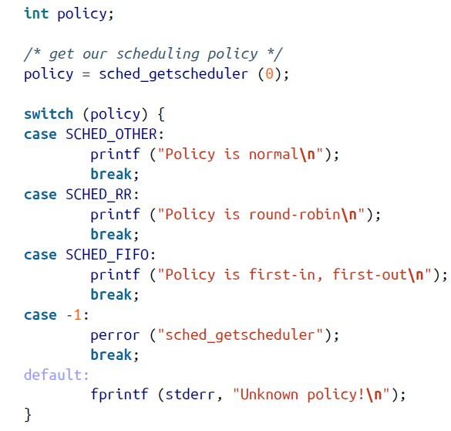
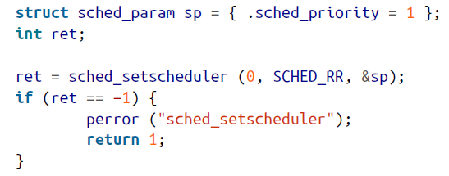
Examples of Getting/Setting the Policy
The first line above is equivalent to:
struct sched_param sp; sp.sched_priority = 1;
Typically, only the root user runs RT processes, but in newer kernels, nonroot users are also allowed to set RT policies up to certain priority ceiling (= setting of some very high priorities are not permitted.)

Slide 27
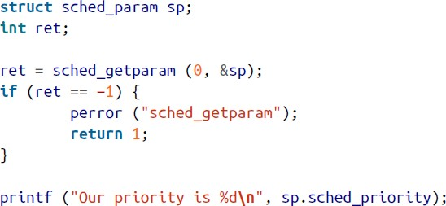
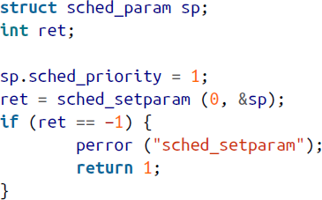
Setting Scheduling Parameters
#include <sched.h>
struct sched_param {
/* ... */
int sched_priority;
/* ... */
};
sched_getparam() gets the policy’s parameters.
sched_setparam() sets them (usually called after sched_setscheduler(), which we covered above.)
Return 0 on success and -1 on failure.
As before, the pid of 0 refers to the calling process.
int sched_getparam (pid_t pid, struct sched_param *sp);
int sched_setparam (pid_t pid, const struct sched_param *sp);
← Examples →

Slide 28
Determining the Range of Valid Priorities
The previous example assumed that 1 is a valid priority value.
POSIX only says that there should be at least 32 priorities but doesn’t elaborate on what numbers should be used.
Linux uses the range 1-99, inclusively, for its real-time policies.
Two system calls retrieve the min and max priority values that are possible for the specified policy on that Linux OS.
#include <sched.h>
int sched_get_priority_min (int policy);
int sched_get_priority_max (int policy);
They return the min/max value on success and -1 on failure.

Slide 29
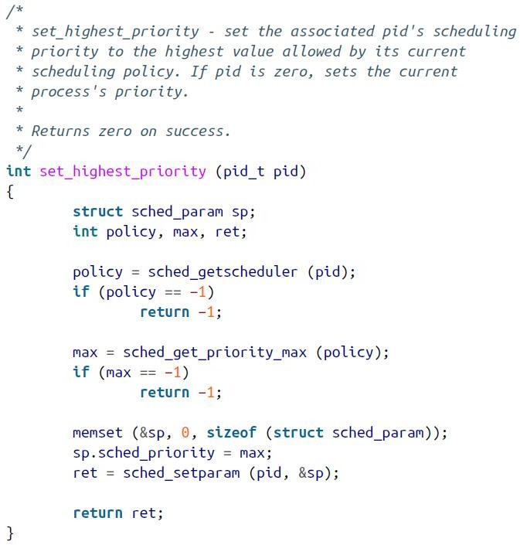
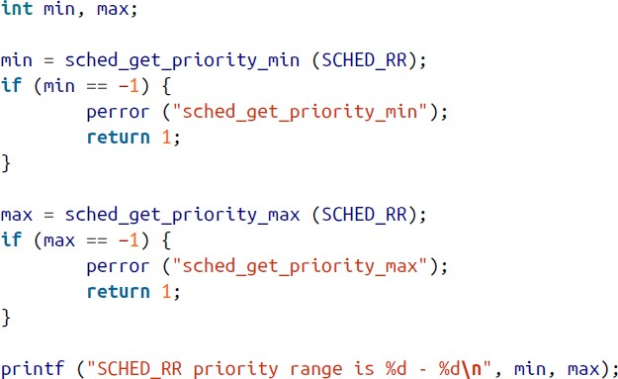
Examples of Getting/Setting Priority
The above code will output the following:

Slide 30
sched_rr_get_interval()
Recall that the Round-Robin scheduler assigns time slices for processes.
POSIX defines an interface for getting a process’ time slice:
#include <sched.h>
struct timespec {
time_t tv_sec; /* seconds */
long tv_nsec; /* nanoseconds */
};
int sched_rr_get_interval (pid_t pid, struct timespec *tp);
On success, it returns 0 and tp is set to the time slice allotted to pid (use 0 for pid to find the time slice of the invoking process.)
It returns -1 on failure.
This function is supposed to work only with SCHED_RR processes according to POSIX.
Yet, Linux allows it to retrieve the length of any process’ time slice, except for a FIFO process, in which both tv_sec and tv_nsec are 0, denoting infinity (the process can run forever!)

Slide 31
Precautions with Real-Time Processes
A real-time program may make the operating system irresponsive.
Any CPU-bound loop that doesn’t block may run forever if no higher-priority real-time processes become runnable.
Care and attention are needed in designing real-time programs.
Be very careful with busy waiting (waiting while not releasing CPU.)
A real-time process may forever busy-wait for a resource held by a lower-priority process.
While developing a real-time process, keep a terminal open as a real-time process with a higher priority than the process in development.
This allows you to kill the runaway real-time process (the terminal waiting for keyboard input is blocking, thus won’t affect other real-time processes.)

Slide 32
Determinism
Definition: A real-time process is deterministic if, given the same input, it always produces same result in the same amount of time.
Most computers are not deterministic because:
Whether data exists in cache or must be searched in main memory is unpredictable.
Multiple processors, paging, swapping, and multitasking, etc. complicate the estimation of how long a given action will take.
A process running inside a critical region in the kernel can’t be preempted by the kernel.
To reduce indeterminism, operating systems take the following actions:
Prefaulting data and locking memory: pages that are locked into memory will not be
swapped out to disk by the kernel, so no page fault will happen (chapter 4’s discussion on mapping file to memory is a form of prefaulting.)
Binding one or more CPUs to your real-time processes will shield from multitasking.

Slide 33
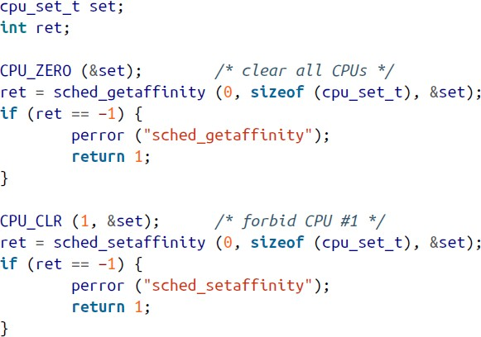

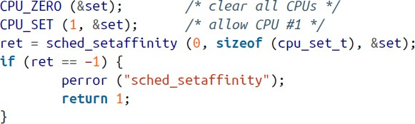
Assigning the RT Process to Run on CPU #1 Only
Modify Linux’s init program:
Modify your RT program to run on CPU #1 only:

Slide 34
Resource Limits
The Linux kernel imposes hard ceiling (maximum) on the resources a process can use.
Open files, pages of memory, pending signals, etc., are all types of resources.
Hard limits are strictly enforced.
#include <sys/time.h> #include <sys/resource.h> struct rlimit {
rlim_t rlim_cur; /* soft limit (unsigned integer type) */
rlim_t rlim_max; /* hard limit (unsigned integer type) */
};
int getrlimit (int resource, struct rlimit *rlim);
int setrlimit (int resource, const struct rlimit *rlim);
getrlimit() saves the soft/hard limits on resource in the structure rlim and returns 0 on success and -1 on failure.
setrlimit() sets the soft/hard limits on resource to the values pointed at by rlim and returns 0 on success and -1 on failure. The kernel will update the limits as requested.

Slide 35
More on Resource Limits
Resources are represented by integer constants, like RLIMIT_CPU.
The rlimit structure represents the actual limits with two ceilings: a soft limit and a hard limit.
Kernel enforces soft limits on processes, but a process may change its soft
limit to any value from 0 to hard limit.
A nonroot process can only lower its hard limit, which is also irreversible, but root process can set a higher limit.
All resource limits have two special values:
0, which disables the use of the resource altogether, and
Infinity (-1), which removes any limit on the resource.

Slide 36
The Limits
Linux currently provides 16 resource limits (some are listed here:)
RLIMIT_AS: max size of a process’s address space (memory chunk), in bytes.
RLIMIT_CORE: max size of core dump files, in bytes (if 0, core dumps are never created.)
RLIMIT_CPU: max CPU time that a process can consume, in seconds.
RLIMIT_DATA: max size of a process’s data segment of the address space, in bytes.
RLIMIT_FSIZE: max file size that a process may create, in bytes.
RLIMIT_LOCKS: max amount of file locks that a process may hold.
RLIMIT_NICE: max value to which a process can lower its nice value (raise its priority.)
RLIMIT_NOFILE/RLIMIT_NPROC: max # of fds open and # of processes running.
RLIMIT_RTTIME: a limit on CPU time a real-time process may consume without blocking (in microseconds.)
RLIMIT_RTPRIO: max real-time priority level a nonroot process may request.
Refer to pages 205-207 for a detailed discussion on all 16 limit types.

Slide 37
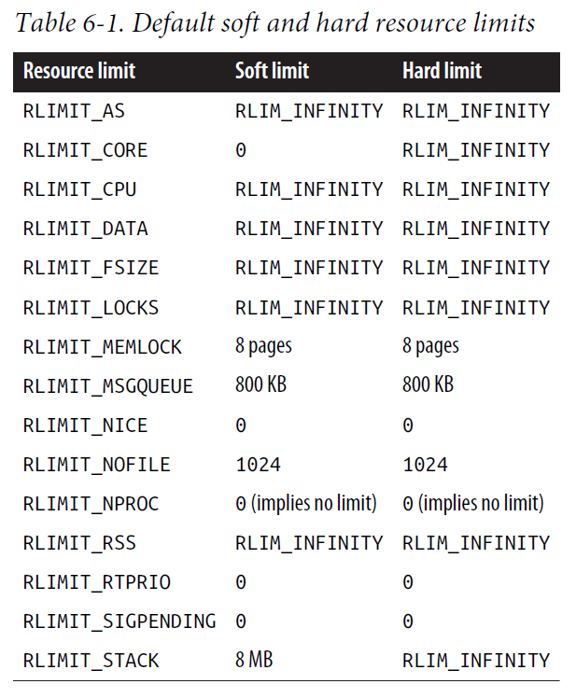
Defaults
Taken from page 208 in our textbook.

Slide 38
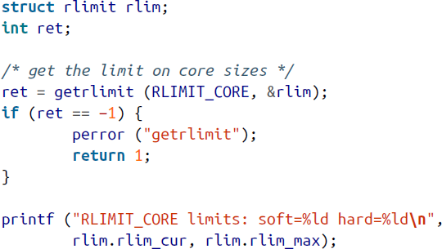
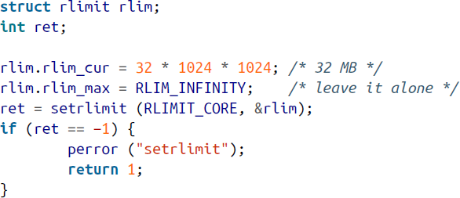
Examples of Setting/Retrieving Limits
The above program’s output is:
Above, the limit of the size of a core dump file is set to 32 MB.
-1 denotes RLIM_INFINITY.

