Slide 1
Linux System Programming
Talking directly to the kernel and C library
Signals
Adapted from slides of Professor Yongqing Xiang of Brooklyn College.

Slide 2
Ch10: Signals
Signals are software interrupts that provide a mechanism for handling asynchronous events.
Examples:
A user pressing Ctrl+C during the execution of a program.
A process executing code that divides a number by zero.
A process sending a signal to another process (e.g., its child process.)
Not only do the events occur asynchronously (a user can press Ctrl+C during the execution of any statement,) but also the signals are handled asynchronously: code keeps executing until the OS addresses the signal.
POSIX has standardized signal handling, which Linux implementations follow.
Most serious applications interact with signals, and you too may be required to work with them (e.g., handling program termination signals.)

Slide 3
Signal Concepts
A signal is first raised (also: sent or generated.)
The kernel then stores the signal until it can deliver it.
When it’s free to do so, the kernel handles the signal as appropriate.
There are 3 actions the kernel may choose to perform:
Ignore the signal. However, there are 2 signals cannot be ignored: SIGKILL and SIGSTOP since the administrator must have the power to kill/stop processes (Think of a cyber attack that the sysadmin must stop.)
Catch and handle the signal. The kernel suspends the process’s current execution and jumps to a registered function (handler) and executes that. Once the process returns from the handler, it jumps back to the instruction that was executing when the signal was caught. SIGKILL/SIGSTOP also cannot be caught.
Perform the default action. Each signal has its own default action. Often it is to terminate (exit) the process, as with SIGKILL.

Slide 4
Signal Identifiers
Every signal has a symbolic name that starts with the prefix SIG. Examples:
SIGINT: the user presses Ctrl+C.
SIGABRT: a process calls the abort() function.
These signals are all defined in <signal.h>, with preprocessor definitions that represent positive integers, e.g., #define SIGHUP 1.
However, the name-to-integer mapping for signals depends on the implementation (though some are fixed, such as SIGKILL, which is always 9). Therefore, a portable program should not use integer values (e.g., use SIGHUP instead of 1.)
Signal numbers start at 1 and grow linearly upward. There is no signal with the value 0, which is known as the null signal.
There are about 31 signals in total supported by Linux, but only a handful of them are used by most programs.
The command kill –l will display a list of signals supported by your system.

Slide 5
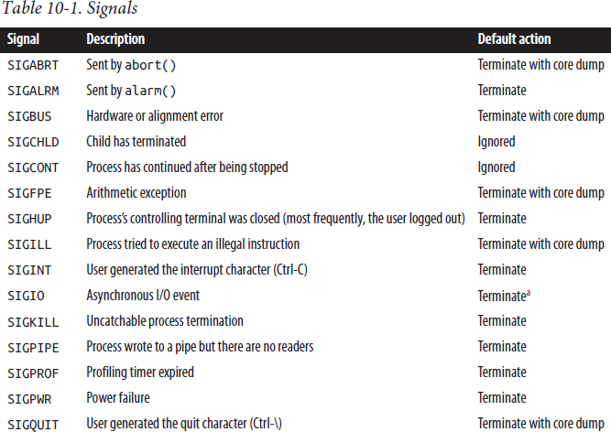
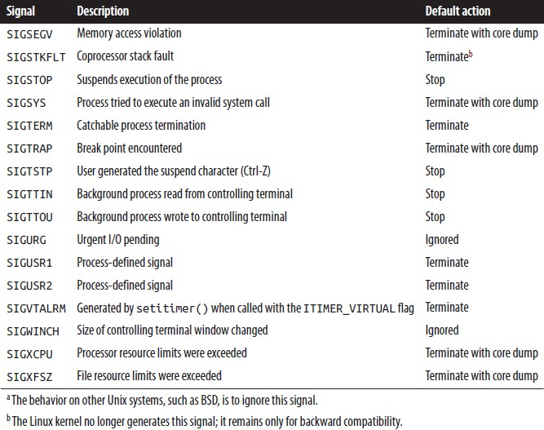
Signal Supported by Linux

Slide 6
Explanations of All 31 Signals
(The underlined ones are can be sent to more than one process.)
SIGABRT: the abort() function sends this signal to the process that invokes it. The process terminates and generates a core dump file.
SIGALRM: the alarm()/setitimer() functions send this signal to the invoking process after a specified amount of time elapse.
SIGBUS: the kernel raises this signal when the process incurs a hardware fault other than memory protection (SIGSEGV).
SIGCHLD: whenever a process terminates or stops, the kernel sends this signal to its parent process. It’s ignored by default, but you can catch it via calling wait().
SIGCONT: the kernel sends this signal to a process when it is resumed after being stopped. It’s ignored by default but is commonly used by terminals and editors to refresh a screen (e.g., a terminal) that wasn’t used for a while.

Slide 7
Explanations of All Signals (cont’)
SIGFPE: represents any arithmetic exception, not solely related to floating-point operations (e.g., division by 0.) The default action is to terminate the process.
SIGHUP: the kernel sends this signal to the session leader process whenever the session’s terminal disconnects. The kernel also sends it to each process in the foreground process group when the session leader terminates. The default action is to terminate, as the signal suggests that the user has logged out.
SIGILL: the kernel sends the signal when a process attempts to execute an illegal machine instruction. The default action is to terminate the process.
SIGINT: it is sent to all the foreground group’s processes when the user presses the interrupt character (Ctrl+C). The default behavior is to terminate.

Slide 8
Explanations of All Signals (cont’)
SIGIO: this signal is sent when a BSD-style async I/O event is generated. This style of I/O is rarely used on Linux.
SIGKILL: it is sent from the kill() syscall; it exists to let the sysadmin kill a process unconditionally. This signal cannot be caught/ignored, and it always results in terminating the process.
SIGPIPE: the kernel raises it when a process writes to a pipe, but the reader has terminated. The default action is to terminate.
SIGPROF: it is generated when a timer using setitimer()expires. The default action is to terminate the process.
SIGPWR: it is system-dependent. On Linux, it represents a low-battery
condition. A power daemon sends this signal to init, which cleans-up and shuts the system down.

Slide 9
Explanations of All Signals (cont’)
SIGQUIT: the kernel raises this signal for all the foreground group’s processes when the user provides the terminal quit character (usually Ctrl+\). The default action is termination and creating a core dump.
SIGSEGV: segmentation-violation is set to a process when it attempts an invalid memory access. The default action is to terminate the process.
SIGSTOP: it is sent only by kill(). It unconditionally stops a process and cannot be caught or ignored.
SIGSYS: the kernel sends this signal to a process when it attempts to invoke an invalid system call, such as when a binary created on a newer system executes on an older system that doesn’t support a syscall.

Slide 10
Explanations of All Signals (cont’)
SIGTERM: it is sent only by kill(); it allows a user to gracefully terminate a process (the default action.)
SIGTRAP: the kernel sends this to a process when it reaches a break point. Generally, debuggers catch this signal, and other processes ignore it.
SIGTSTP: the kernel sends this to all the foreground group’s processes when the user provides the suspend character (Ctrl+Z).
SIGTTIN: it is sent to a process in the background when it attempts to read from its controlling terminal. The default action is to stop the process.
SIGTTOU: it is sent to a process in the background when it attempts to write to its controlling terminal. The default action is to stop the process.
Notes:
Control-Z suspends the most recent foreground process (the last process to interact with the tty) (unless that process takes steps to ignore suspension, like shells normally do).

Slide 11
Explanations of All Signals (cont’)
SIGURG: the kernel sends this to a process when out-of-band (OOB) data has arrived on a socket. OOB data is a topic beyond the scope of this book.
SIGUSR1 and SIGUSR2: user-defined signals: the kernel never raises them. Processes may use them for any purpose. The default action is termination.
SIGVTALRM: setitimer() sends this when a timer created with the
ITIMER_VIRTUAL flag expires (decrements only when process is executing.)
SIGWINCH: the kernel raises this for all the foreground group’s processes when the size of terminal window changes. By default, processes ignore this.
SIGXCPU: the kernel raises this when a process exceeds its soft processor limit. The kernel will continue to raise this once per sec until the process exits or exceeds its hard processor limit, upon which kernel sends SIGKILL.
SIGXFSZ: the kernel raises this when a process exceeds its file size limit. The default action is termination.

Slide 12
Basic Signal Management
The basic interface is the signal() function, though Linux offers substantially more control over signals via other interfaces:
#include <signal.h>
typedef void (*sighandler_t)(int);
sighandler_t signal (int signo, sighandler_t handler);
A successful call removes the current action associated with the signal
signo and instead registers the new handler specified by handler.
The handler function must return void, as there is nowhere for this function to return. And it takes one int argument which is the signal identifier: this allows a single function to handle multiple signals.
A prototype of the handler:
void my_handler (int signo);

Slide 13
Basic Signal Management (cont’)
The typedef, sighandler_t, which represents the type of the signal handler function, is used by Linux and may not be shared by other Unix systems. So, for portability purpose, don’t manipulate this type directly.
If a signal is raised to a process that has registered a signal handler, the kernel suspends the regular execution and calls the signal handler with signo passed as a parameter.
If you call signal() but pass the following in place of the handler parameter:
SIG_DFL: this sets the behavior of the signal signo to its default.
SIG_IGN: this ignores the signal given by signo.
On success, signal() returns the previous behavior of the signal, which could be either a pointer to handler, SIG_DFL, or SIG_IGN. On error, the function returns the SIG_ERR constant. It doesn’t set errno.

Slide 14
Waiting for Any Signal
#include <unistd.h>
int pause (void);
This syscall puts a process to sleep until it receives a signal that is either handled or terminates the process.
It returns only if a signal is received, in which case the signal is handled. Specifically, pause() returns -1 and sets errno to EINTR.
If the kernel raises an ignored signal, the process doesn’t wake up.
This function is useful for debugging and writing demonstrative code.

Slide 15
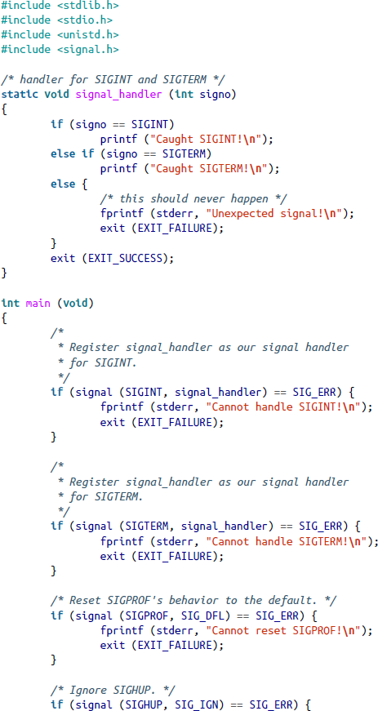
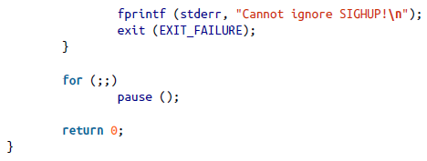
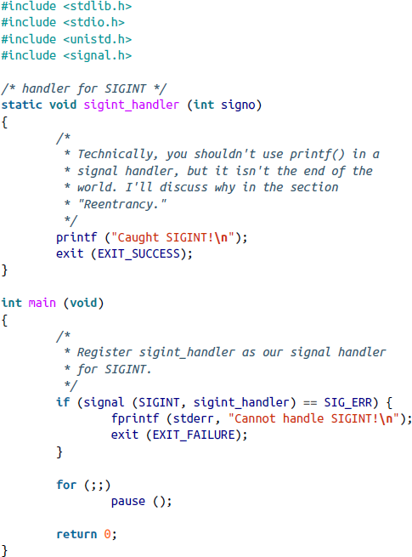
Ex-1
Ex-2
Examples
Ex-1 handles SIGINT by printing a message, then terminating the program.
Ex-2 handles SIGTERM and SIGINT, resets the behavior for SIGPROF (profiling timer expiration) to default (termination), and ignores SIGHUP (the default was termination.)
Copyright (c) 2013 Robert Love. All rights reserved, O'Reilly

Slide 16
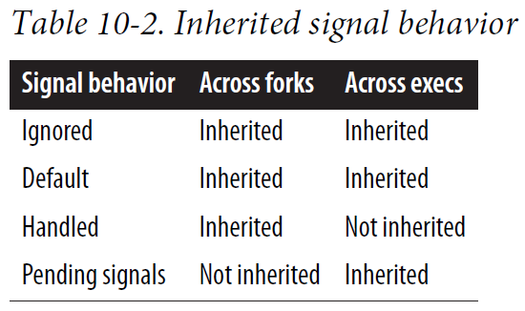
Execution and Inheritance
On fork(), a child process inherits the signal actions of its parent.
Child copies all the registered actions (ignore, default, handles) for each signal from its parent, but pending signals are not inherited.
Afterwards, when one of the exec family is called to create a new process image, all signals are set to their default actions unless the parent is ignoring them, which will be ignored by the child as well.
So, in short, any signal caught (handled) by the process before exec was called is reset to the default action after exec, and all other signals remain the same (default or ignored.)

Slide 17
Mapping Signal Numbers to Strings
Sometimes, we are required to use a string representation of a signal number.
This is available via the sys_siglist array, which holds the names of all signals supported by the system, indexed by signal number:
extern const char * const sys_siglist[];
static void signal_handler (int signo) {
printf ("Caught %s\n", sys_siglist[signo]); }
There are two more functions that can do similar things:
#include <signal.h>
void psignal (int signo, const char *msg);
which directly prints to stderr the signal name (preceded by msg), or
#define _GNU_SOURCE
#include <string.h>
char * strsignal (int signo);
which returns a pointer to a string of the signal name but isn’t thread-safe.

Slide 18
Sending a Signal
The kill() syscall sends a signal from one process to another:
#include <sys/types.h>
#include <signal.h>
int kill (pid_t pid, int signo);
The signal signo is sent to another process identified by pid.
If pid = 0, signo is sent to every process in the caller’s process group. If pid = -1, signo is sent to every process the caller is permitted (refer to next slide) to send a signal, except itself and init. If pid < -1, signo is sent to the process group given by -pid.
On success, kill() returns 0. On failure (no signal sent), it returns -1 and sets errno.
Example of sending SIGHUP to the process with pid = 1722:
int ret;
ret = kill (1722, SIGHUP);
if (ret)
perror ("kill");
This is equivalent to the Linux command kill -HUP 1722.

Slide 19
Permissions
A process needs proper permissions to send a signal to another process.
A process (usually run by the root) with the CAP_KILL capability can send a signal to any process.
Otherwise, a user can send a signal only to a process that he/she owns.
If signo = 0 (the null signal), the call doesn’t send a signal, but it still performs error checking. This is useful to test whether a process has suitable permissions to send a signal.
Example (checking if we can send a signal to 1722 without sending a real signal:)
int ret;
ret = kill (1722, 0);
if (ret)
; /* We lack permissions: perhaps print an error message. */
else
; /* we have permission: we can proceed to sending a signal. */

Slide 20
Sending a Signal to Yourself or a Process Group
The raise() function is for a process to send a signal to itself:
#include <signal.h>
int raise (int signo);
Which is equivalent to calling:
kill (getpid(), signo);
It returns 0 on success and a nonzero value on failure. It doesn’t set errno.
There is another way to send a signal to a process group instead of using negative process group IDs:
#include <signal.h>
int killpg (int pgrp, int signo); // This is equal to: kill(-pgrp, signo);
On success, killpg() returns 0; on failure it returns -1 and sets errno.

Slide 21
Reentrancy
When kernel raises a signal, a process could be executing code anywhere, which may not be interrupted. E.g., it could be in the middle of handling another signal.
Thus, the signal handler must be careful about what data it touches/changes.
A signal handler should never modify global variables.
Sometimes, it’s necessary to block the delivery of signals to keep data safe.
What if process is in syscalls, like writing to files or allocating memory, and a signal handler tries to do the same? → We must discuss reentrancy.
A reentrant function is one that is safe to call from within itself. Basically, such function can only manipulate stack-allocated data or data provided to it by the caller. It must not manipulate static data or call any non-reentrant function.
Some functions are not reentrant, and a handler calling the same function will lead to chaos.
A function calling itself forever might lead to infinite recursion.

Slide 22
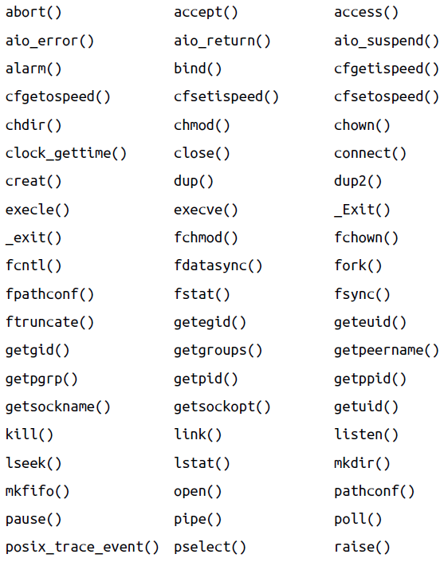
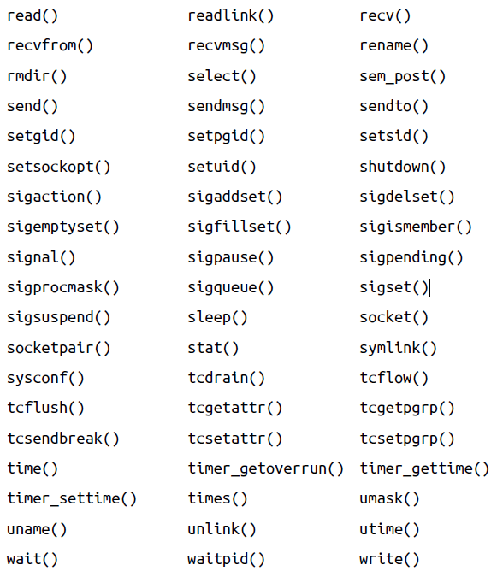
Reentrant-Guaranteed Functions
Signal handlers must make use only of functions that are reentrant.
POSIX dictates a list of functions that are guaranteed to be reentrant and signal- safe on all compliant platforms.
The functions listed here are guaranteed by Linux to be reentrant.

Slide 23
Signal Sets
To address sets of signals, there are signal set operations (POSIX):
#include <signal.h>
int sigemptyset (sigset_t *set); // Empties the signal set set.
int sigfillset (sigset_t *set); // Includes all the signals in set.
int sigaddset (sigset_t *set, int signo); // Add signo to set.
int sigdelset (sigset_t *set, int signo); // Removes signo from the set.
int sigismember (const sigset_t *set, int signo); // Checks if signo is
// in set.
The first 4 functions return 0 on success and -1 on failure and set errno.
sigismember() returns 1 if signo is in the signal set given by set, 0 if it’s not, and -1 on error (+ sets errno).

Slide 24
More Signal Set Functions
Linux added several nonstandard functions:
#define _GNU_SOURCE
#define <signal.h>
int sigisemptyset (sigset_t *set);
int sigorset (sigset_t *dest, sigset_t *left, sigset_t *right);
int sigandset (sigset_t *dest, sigset_t *left, sigset_t *right);
sigisemptyset() returns 1 if the set is empty and 0 otherwise.
sigorset() sets dest to the union (binary OR) of sets left and right.
sigandset() sets dest to the intersection (binary AND) of sets left and right. Both return 0 on success and -1 on error.
Avoid using these if POSIX compliance is desired.

Slide 25
Blocking Signals
What should you do if somewhere in your program you don’t want any interruptions, including from signal handlers?
These parts of a program are called critical regions, which can be protected by suspending the delivery of signals (blocking them).
Any signals that are raised while being blocked are not handled until unblocked.
A process may block any number of signals; the set of signals blocked by a process is called its signal mask:
#include <signal.h>
int sigprocmask (int how, const sigset_t *set, sigset_t *oldset);
The value of how determines the behavior of the function:
SIG_SETMASK: the signal mask for the caller is changed to set.
SIG_BLOCK: the signals in set are added to the caller’s signal mask.
SIG_UNBLOCK: the signals in set are removed from the caller’s signal mask.
If oldset is not NULL, it returns with the previous signal set. If set is NULL, the function ignores how and doesn’t change the mask, but it does place the previous one in oldset.
It returns 0 on success, -1 on failure. Blocking SIGKILL/SIGSTOP is not allowed.

Slide 26
Retrieving Pending Signals
When the kernel raises a blocked signal, it is not delivered and said to be pending. When it’s later unblocked, the kernel will deliver it to the process.
POSIX defines a function to retrieve set of pending signals:
#include <signal.h>
int sigpending (sigset_t *set);
It returns 0 and places the set of pending signals in set on success and returns -1 and sets errno to EFAULT on failure.

Slide 27
Waiting for a Set of Signals
POSIX allows a process to temporarily change its signal mask and then wait until a signal is raised that either terminates the process or is handled thereby:
#include <signal.h>
int sigsuspend (const sigset_t *set);
Here, set is the mask temporarily in effect. If a signal terminates the process, sigsuspend() doesn’t return. If a signal is handled, it returns -1 after the signal handler returns and sets errno to EINTR. If set is an invalid pointer, errno is set to EFAULT.
This function is commonly used in the following scenario:
The process first uses sigprocmask() to block a set of signals since it enters a critical region. It saves the old mask in oldset.
After exiting the critical region, during which there might be signals that arrived but were blocked, the process calls sigsuspend() using oldset to retrieve those signals.

Slide 28
Advanced Signal Management
The signal() function is very basic. POSIX also standardizes the
sigaction() syscall, which provides much greater capabilities.
#include <signal.h>
int sigaction (int signo, const struct sigaction *act,
struct sigaction *oldact);
This call changes the behavior of the signal signo as follows:
If act is not NULL, this call changes the current behavior of signo as specified by act.
If oldact is not NULL, the call stores the previous behavior of the given signal in the variable oldact. But if act is NULL, oldact stores the current behavior.

Slide 29
The sigaction Structure
The sigaction structure allows for fine-grained control over signals and is defined in
<sys/signal.h>, which is included in <signal.h>.
struct sigaction {
void (*sa_handler)(int); /* signal handler or action */
void (*sa_sigaction)(int, siginfo_t *, void *);
sigset_t sa_mask;
int sa_flags;
void (*sa_restorer)(void);
/* set of signals to block */
/* flags */
/* obsolete and non-POSIX */
};
The sa_handler field specifies the action to take on receiving the signal, and it could also be SIG_DFL (default) or SIG_IGN (ignore).
If you set sa_flags to be SA_SIGINFO, then sa_sigaction is used instead of sa_handler, which has the prototype:
void my_handler (int signo, siginfo_t *si, void *ucontext);
The siginfo_t structure provides a lot of information to the signal handler (see a later slide,) whereas the ucontext points to some signal context info, ucontext_t structure, usually unused by the handler (refer to sigaction(2) man page.)

Slide 30
The sigaction Structure (cont’)
The sa_mask field provides a set of signals the system should block while the signal handler is executing. The signal currently being handled is also blocked (if it’s in sa_mask,) unless the SA_NODEFER flag is set in sa_flags. However, you cannot block SIGKILL or SIGSTOP.
The sa_flags field is a bitmask of zero, one, or more flags that change the handling of signal signo (refer to pages 354-355 for the complete list.)
SA_SIGINFO: uses sa_sigaction instead of sa_sighandler.
The sa_restorer field is obsolete and no longer used in Linux.
sigaction() returns 0 on success; on failure, it returns -1 and sets errno.

Slide 31
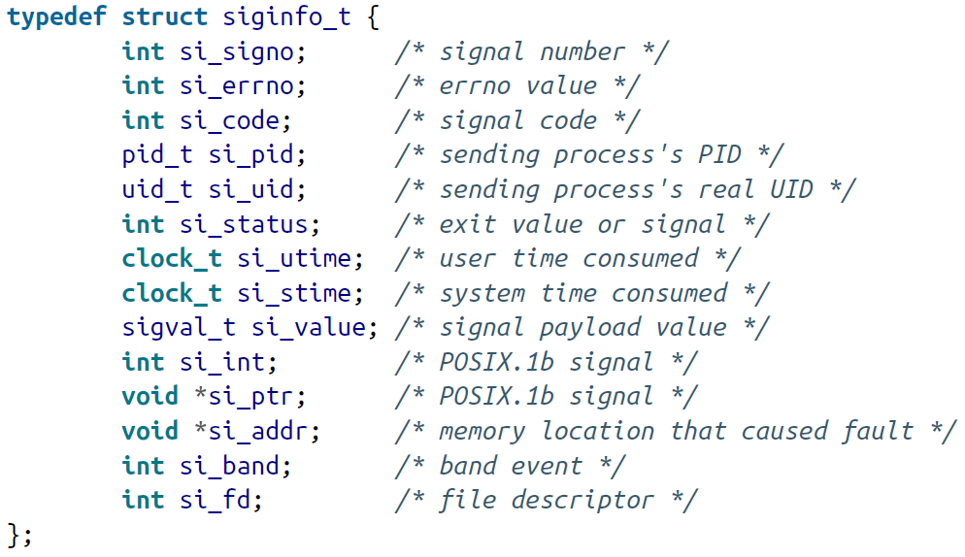
The siginfo_t Structure
The siginfo_t structure is defined in <sys/signal.h> (POSIX only guarantees the first 3 fields are valid for all types of signals.)
Provides info to the signal handler, sa_sigaction:
→ Same as the first argument to sa_sigaction.
→ If nonzero, will contain the error code associated with this signal.
→ An explanation of why/where the process received the signal.
→ For SIGCHLD, the pid of the process that terminated.
→ For SIGCHLD, the owner uid of the process that terminated.
→ For SIGCHLD, the exit status of the process that terminated.
→ For SIGCHLD, the user time consumed of the process that terminated.
→ For SIGCHLD, the system time consumed of the process that terminated.
→ A union of si_int and si_ptr.
→ Payload (data you wish to pass) in a form of an integer.
→ Payload (data you wish to pass) in a form of a void pointer.
→ For SIGBUS, SIGFPE, SIGILL, SIGSEGV, and SIGTRAP only.
→ For SIGPOLL (pollable events), out-of-band/priority info for si_fd.
→ For SIGPOLL, the fd for the file whose operation completed.

Slide 32
What is in si_code?
The si_code field indicates the cause of the signal.
For user-sent signals, it indicates how the signal was sent.
For kernel-sent signals, it indicates why the signal was sent.
Choices of si_code that are valid for any signal (refer to page 358 for complete list:)
SI_ASYNCIO (async I/O finished), SI_KERNEL (signal raised by kernel), SI_QUEUE, SI_TIMER, SI_SIGIO, SI_USER (signal was sent by kill() or raise().)
Choices of si_code that are valid only for SIGBUS (bad memory access). They indicate the type of hardware error that occurred:
BUS_ADRALN (alignment error), BUS_ADDRERR (invalid addr), BUS_OBJERR (hardware error)
Choices of si_code valid only for SIGCHLD identifying what the child did:
CLD_CONTINUED, CLD_DUMPED, CLD_EXITED, CLD_KILLED, CLD_STOPPED, CLD_TRAPPED
Choices of si_code valid only for SIGFPE (floating-point exception:)
FPE_FLTDIV (division by 0), FPE_FLTOVF, FPE_FLTINV, FPE_FLTRES, FPE_FLTSUB, …
Pages 359-361 also describe choices of si_code that are valid only for SIGILL, SIGPOLL, SIGSEGV, SIGTRAP.

Slide 33
A Basic Example of Using sigaction()
#include <signal.h>
#include <stdio.h>
#include <stdlib.h>
#include <unistd.h>
int main() {
struct sigaction act;
// Find the current action of SIGINT:
if (sigaction (SIGINT, NULL, &act) == -1) {
perror ("Could not obtain old disposition for SIGINT");
exit (EXIT_FAILURE);
}
// If the action is the default (termination), change it to ignore:
if (act.sa_handler == SIG_DFL) {
act.sa_handler = SIG_IGN;
if (sigaction (SIGINT, &act, NULL) == -1) {
perror ("Could not ignore SIGINT");
exit (EXIT_FAILURE);
}
}
// Invoke sleep to try and kill the process with Ctrl+C:
sleep (10); // Ctrl+C won't kill the program!
printf (“\nThe result is %d.\n", 10/5);
return EXIT_SUCCESS;
}
This program reads the previous sigaction into act.
If the previous action is default (termination) for the SIGINT signal (triggered by user pressing Ctrl+C), it changes it to Ignore (so Ctrl+C has no effect.)
It then tests the new action by sleeping for 10 seconds before doing a simple arithmetic.
You can test this by running it then immediately hitting Ctrl+C, trying to interrupt it.
If you can’t terminate it by Ctrl+C, it means the SIG_IGN (ignoration) action that we set is working, and you will see the result of the arithmetic being printed:
The result is 2.

Slide 34
Sending a Signal with a Payload
With sa_sigaction as the handler, the si_value field is an optional payload (data) passed from the signal generator to the signal receiver.
The sigqueue() function (POSIX) allows a process to send a signal with this payload.
#include <signal.h>
int sigqueue (pid_t pid, int signo, const union sigval value);
It works similarly to kill(). On success, the signal signo is queued to the process or process group identified by pid, and it returns 0.
The signal’s payload is given by value, which is a union:
union sigval { // About unions: www.tutorialspoint.com/cprogramming/c_unions.htm
int sival_int;
void *sival_ptr; };
On failure, it returns -1 and sets errno. As with kill(), you may pass null signal for
signo to test permissions.

Slide 35
Signal Payload Example
The example below sends process 1722 with a SIGUSR2 signal (a user-defined signal) with a payload of an integer 404.
sigval value; int ret;
value.sival_int = 404;
ret = sigqueue (1722, SIGUSR2, value); if (ret)
perror ("sigqueue");
If process 1722 handles SIGUSR2 with an SA_SIGINFO handler, i.e. sa_sigaction(), it will set signo to SIGUSR2, si->si_int to 404, and si->si_code to SI_QUEUE.

