Slide 1
Linux System Programming
Talking directly to the kernel and C library
Memory Management
Adapted from slides of Professor Yongqing Xiang of Brooklyn College.

Slide 2
Ch9 Memory Management
Memory is among the most basic, yet essential resources of processes.
Management entails allocation, manipulation, and release of memory.
A process’s address space:
Processes do not directly address (access) physical memory (RAM).
Instead, the kernel associates each process with a unique virtual address space.
Virtual address space is both linear and flat (has no levels and depth.)
Pages and Paging:
Memory hierarchy: bits → bytes → words → pages.
A page is the smallest addressable unit of memory the memory management unit software (MMU) can manage.

Slide 3
Pages and Paging
The virtual (also: logical) address space is divided into pages.
Machine architecture determines the page size. Typical sizes include 4KB on 32-bit systems and 8KB for 64-bit systems.
A page is valid if it’s associated with an actual page of data, either in physical RAM or on secondary storage such a swap partition.
An invalid page is not associated with anything and represents unallocated address space – accessing it results in segmentation fault.
A Page fault happens with a valid page, but one that is associated with secondary storage and is accessed before it’s brought into physical RAM – the kernel will page-in (copy) the data from the disk into RAM.
The location in RAM that stores a page is called a frame.
Paging-out is the process of moving data from RAM to secondary storage
(to make room for new pages). Usually, such data are unlikely to be used soon.

Slide 4
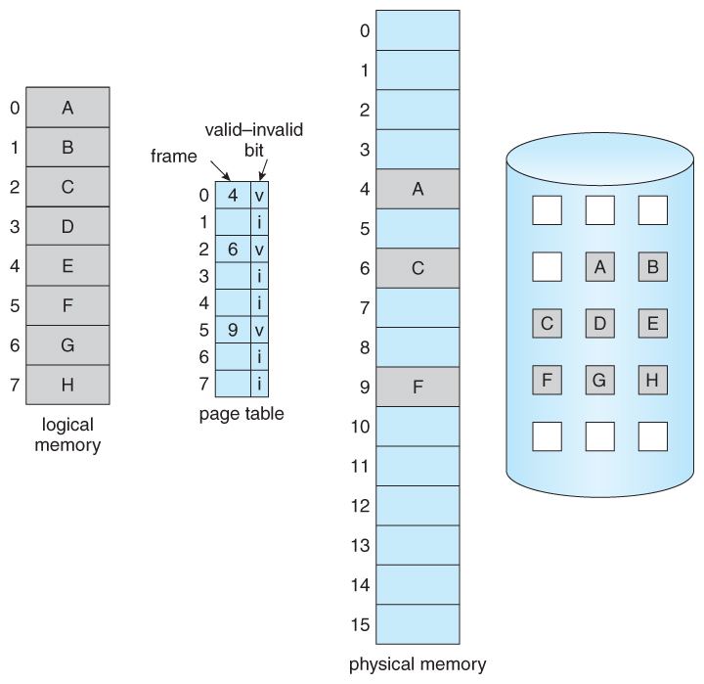

Slide 5
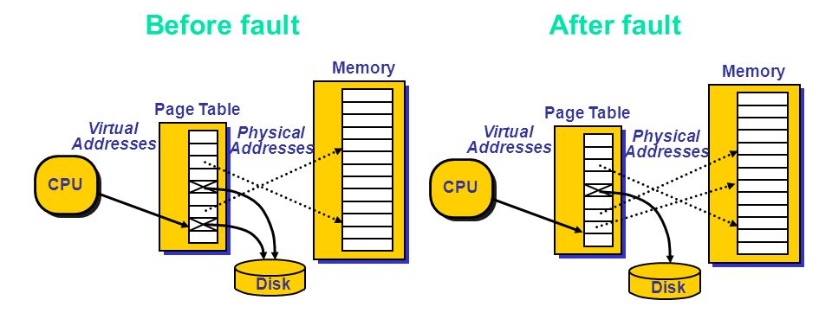

Slide 6
Sharing and Copy-on-Write
Multiple pages of virtual memory (VM), even owned by different processes, could map to a single physical page – this is called sharing.
When processes need to write to a shared writable page, the kernel either maintains some level of coordination and synchronization, or
The MMU of the kernel might raise an exception which allows a new copy of the page to be created – this is called copy-on-write (COW).
We spoke about COW in Chapter 5 in the aspect of copying the memory of a parent process to its child after the parent calls fork().

Slide 7
Memory Regions
The kernel arranges pages into blocks that share certain properties.
These blocks are called mappings, or memory regions (sections).
Certain types of memory regions can be found in every process:
Text segment contains a process’s program code, string literals, constant variables and other read-only data. In Linux, this segment is marked read-only and mapped from the object file (executable).
Data segment contains initialized variables.
bss segment (“block started by symbol”) contains uninitialized global variables (no space is occupied by these values in the binary and will be mapped to a page of zeros when loaded into memory.)
Heap contains a process’s dynamic memory. malloc() can request memory to be allocated in this segment.
Stack contains local variables and function data (parameters, return value, addresses, etc.)
Lowest Address (0)
Highest Address

Slide 8
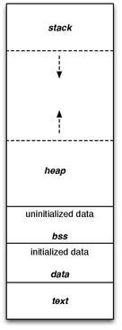
max
0
Typical memory layout of a program

Slide 9
Allocating Dynamic Memory
Dynamic memory is allocated at runtime, not at compile time.
The classic C interface for obtaining dynamic memory is malloc():
#include <stdlib.h>
void * malloc (size_t size);
On success, it allocates size bytes of memory and returns a pointer to its
start. The contents of the memory are undefined (junk). On failure, it returns
NULL, and set errno to ENOMEM (you must check for errors on malloc().)
Usage (to allocate a structure):
struct treasure_map *map;
map = malloc (sizeof (struct treasure_map)); // Note: in C, you don’t
// need to typecast the returned pointer from void* to the correct
// type (it’s done automatically.) In C++, you must do it explicitly.
if (map == NULL)
perror ("malloc");

Slide 10
Allocating Arrays
To allocate an array with a fixed number of a certain data type:
#include <stdlib.h>
void * calloc (size_t nr, size_t size); // c stands for contiguous.
On success, it returns a pointer to a block of memory suitable for holding an array of nr elements, each of size bytes.
Moreover, calloc() zeros all bytes in the returned chunk of memory. And on all common platforms, it’s zero even for floating-point types (e.g., double), and NULL for pointer types.
On failure, it returns NULL and sets errno to ENOMEM.

Slide 11
Resizing Allocations
For resizing existing allocations (making them larger or smaller):
#include <stdlib.h>
void * realloc (void *ptr, size_t size);
On success, it resizes the memory pointed at by ptr, which must be from a previous call to malloc()/calloc()/realloc(), to a new size of size bytes, and returns a pointer to the newly sized memory, which may or may not be at the same spot in RAM.
If ptr is NULL, this is the same as just calling malloc().
On failure, it returns NULL and sets errno to ENOMEM, but the state of the memory pointed at by ptr is unchanged.

Slide 12
Examples of Shrinking Memory
Only one element is retained via realloc():
struct map *r;
/* We now need memory for only one map: */
r = realloc (p, sizeof (struct map));
if (r == NULL) {
/* note that 'p' is still valid and needs to be freed later. */
perror ("realloc");
free (p); // p is now freed.
return −1;
}
/* Proceed to use r. */
free (r); // r is now freed.
Below, two elements of map are allocated via calloc():
struct map *p;
/* Allocate memory for two map structure instances: */
p = calloc (2, sizeof (struct map));
if (p == NULL) {
perror ("calloc");
return EXIT_FAILURE;
}
/* After the above executes, we can now proceed to use p[0] and p[1]. */

Slide 13
Freeing Dynamic Memory
To return dynamically allocated memory back to the OS:
#include <stdlib.h>
void free (void *ptr);
The parameter ptr must have been previously returned by malloc()/calloc()/realloc(); it can’t be an arbitrary pointer halfway into an allocated block.
But ptr can be NULL, in which case free() silently returns. Thus, you don’t need to check for non-NULL to use free().
Not calling free() on allocated memory could lead to memory leak, if the pointer goes out of scope. On the contrary, a pointer after the memory it points at is freed becomes a dangling pointer and should not be used.

Slide 14
Manipulating Memory
Setting Bytes:
#include <string.h>
void * memset (void *s, int c, size_t n);
On success, it sets the n bytes starting at s to the character c and returns s.
So, to zero out a block of memory:
/* Zero out everything from s (including) to s+256 (excluding s+256): */
memset (s, '\0', 256);
Comparing Bytes:
#include <string.h>
int memcmp (const void *s1, const void *s2, size_t n);
It compares the first n bytes of s1 to s2 and returns 0 if they are equal, <0 if s1
is less than s2, and >0 if s1 is greater than s2.

Slide 15
Manipulating Memory
Moving Bytes:
#include <string.h>
void * memmove (void *dst, const void *src, size_t n);
It copies the first n bytes of src to dst, returning dst.
It can safely handle overlapping memory regions. The variant:
#include <string.h>
void * memcpy (void *dst, const void *src, size_t n);
is faster than memmove(), but dst and src must not overlap.
Searching Bytes:
#include <string.h>
void * memchr (const void *s, int c, size_t n);
It scans n bytes of memory pointed at by s for the character c and returns a pointer to the first match, or NULL if c is not found.

