Slide 1
Linux System Programming
Talking directly to the kernel and C library
File and Directory Management
Adapted from slides of Professor Yongqing Xiang of Brooklyn College.

Slide 2
Ch8 File and Directory Management
Ch2, 3 and 4 focused on reading from and writing to files.
This chapter deals with manipulating/managing files and their metadata.
Each file is referenced by an inode, which is addressable via a filesystem unique numerical value known as inode number.
An inode is both a physical object located on disk, and
A conceptual entity represented by a data structure in the Linux kernel.
The inode stores the metadata associated with a file:
A file’s access permissions, last access timestamp, owner’s username, group name, size in bytes, location of file’s data on disk, etc.
However, it doesn’t include the filename and directory information!
Using the Linux command ls -i will display the files’ inode numbers.

Slide 3
The Stat Family
Unix systems provide a family of functions obtaining a file’s metadata:
#include <sys/types.h> #include <sys/stat.h> #include <unistd.h>
int stat (const char *path, struct stat *buf);
int fstat (int fd, struct stat *buf);
int lstat (const char *path, struct stat *buf);
stat() is the basic version for a quoted file location specified by path, fstat() refers to the file by its file descriptor fd, and lstart() is identical to stat() except that, for a symbolic link, it returns information about the link itself, not the target file.
On success, each returns 0 and stores the metadata in the stat structure pointed to by buf. On error, each returns -1 and sets errno.

Slide 4
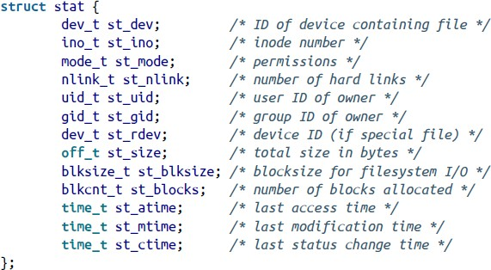
The stat Structure
(defined in <bits/stat.h> but included in <sys/stat.h>)
If a regular file, it will be a zero (0).
A.k.a., the last metadata change time.

Slide 5
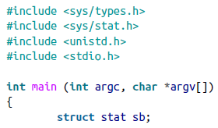
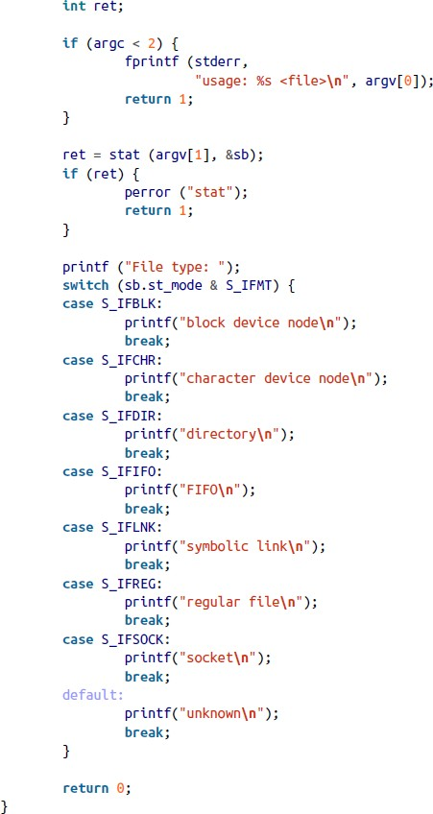
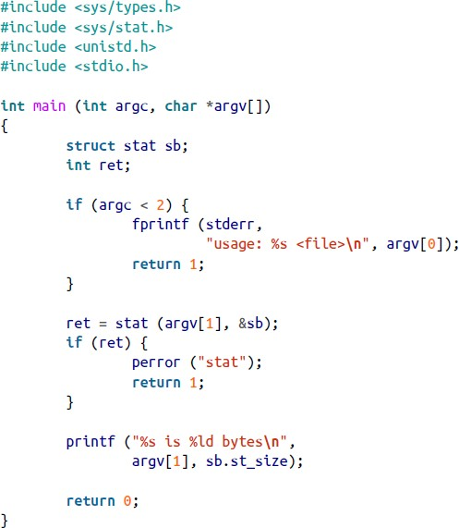

Getting file size
Getting file types
Examples of stat()
Possible output:

Slide 6
Permissions
To set permission values:
#include <sys/types.h> #include <sys/stat.h>
int chmod (const char *path, mode_t mode);
int fchmod (int fd, mode_t mode);
Both set a file’s permissions to mode. fchmod() specifies the file using an fd.
mode_t is an opaque integer type specific to each Unix implementation.
POSIX defines a set of constants to be binary-ORed to form the legal values for mode (e.g., S_IRUSR | S_IRGRP for both owner- and group-readability.)
To change permissions, the effective ID of the process must match file’s owner.
On success, either call returns 0. On failure, either returns -1 and sets errno.

Slide 7
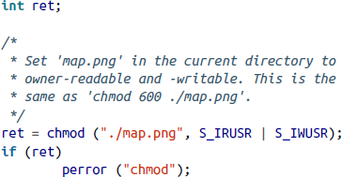
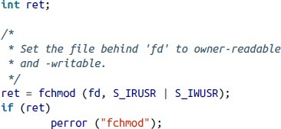
Examples of Setting Permissions
Set file map.png to be readable and writable by the owner:
Calling fchmod() instead, assuming map.png had been opened with an fd:

Slide 8
Ownership
To change the st_uid/st_gid fields:
#include <sys/types.h> #include <unistd.h>
int chown (const char *path, uid_t owner, gid_t group); int lchown (const char *path, uid_t owner, gid_t group); int fchown (int fd, uid_t owner, gid_t group);
The differences between these versions are similar to those of the stat() family, e.g., the lchown version changes the soft link rather than the link’s target.
On success, each sets the file’s owner to owner, or group to group, and return 0. If either owner or group is -1, it won’t be changed.
On failure, each returns -1 and sets errno.

Slide 9
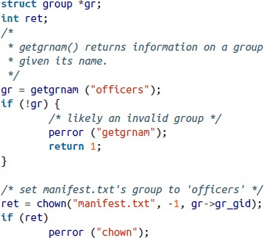
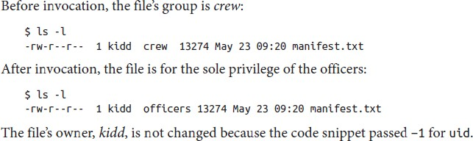
Example of chown()
This snippet changes the group of the file manifest.txt to officers.
The invoking user either must have the right to change owners (usually the root user has such rights) or must be the user kidd and a member of the officers group.
struct group {
char char gid_t char
*gr_name; /* group name */
*gr_passwd; /* group password */
gr_gid;
**gr_mem;
/* group ID */
/* NULL-terminated array of pointers to names of group members */
};

Slide 10
Extended Attributes
Also called xattrs, provide a mechanism for associating key/value pairs with files beyond the metadata covered so far.
This allows existing filesystems to add new features not included in their original designs (such as access controls.)
Any user-space applications may arbitrarily create, read from, and write to these key/value pairs.
The standard interface that apps to use manipulate these attributes is not specific to any filesystem and is standardized for the user space.
Of course, the implementation of extended attributes is very filesystem- specific, but the kernel hides these specifics and exposes only the standard interface.

Slide 11
Keys and Values
A unique key identifies each extended attribute.
Must be valid UTF-8 and take the form of namespace.attribute.
Must be fully qualified: begin with a valid namespace, followed by a period.
Example: user.mime_type.
A key is either defined or undefined.
A defined key with an empty value is different from an undefined key.
The value could be any arbitrary array of bytes (need not be null-terminated.)
Thus, all writing operations require you to specify the size of the value (reading operations will return the value’s size in bytes to you.)
Linux doesn’t enforce any limits on number of keys, length of a key, size of a value, and the total size of all pairs associated with a file.
Filesystems have practical limits though, such as storage space limitations.

Slide 12
Extended Attribute Namespace
Namespaces are more than just organizational tools: they are used to enforce different access policies by the kernel.
Linux defines 4 extended attribute namespaces:
system: for kernel features that use xattrs, such as access control lists (ACLs).
Example: system.posix_acl_access.
security: for security modules. By default, all processes can read these attributes, but only processes run by a system administrator user can write to them.
trusted: stores restricted information in user space. Only processes run by a system administrator user can read from or write to these attributes.
user: standard for use by regular processes. Can only be used for attributes of regular files, not those of symbolic links or device files.

Slide 13
Extended Attribute Operations
POSIX defines 4 operations on a given file’s xattrs:
Given a file, return a list of all its assigned xattrs keys.
Given a file and a key, return the corresponding value.
Given a file, a key, and a value, assign that value to the key.
Given a file and a key, remove that xattr from the file.
For each operation, POSIX provides 3 system calls:
A syscall that accepts a path as an argument. If it’s a symbolic link, works on the target file of the link (not the symbolic link itself.)
Same as above, except for working on a symbolic link rather than the target file (the l (lowercase L) variant.)
A version operating on an fd (the f variant.)

Slide 14
Retrieving an Extended Attribute
#include <sys/types.h>
#include <attr/xattr.h>
ssize_t getxattr (const char *path, const char *key, void *value, size_t size); ssize_t lgetxattr (const char *path, const char *key, void *value, size_t size); ssize_t fgetxattr (int fd, const char *key, void *value, size_t size);
On success, they store the xattr with key from file path in the buffer value, which is size bytes in length. All return the actual size of the value.
If size is 0, the calls return the size of the value without storing the value – useful to determine the correct size for the buffer.
On error, all return -1 and set errno.

Slide 15
Setting an Extended Attribute
#include <sys/types.h> #include <attr/xattr.h>
int setxattr (const char *path, const char *key, const void *value, size_t size, int flags); int lsetxattr (const char *path, const char *key, const void *value, size_t size, int flags); int fsetxattr (int fd, const char *key, const void *value, size_t size, int flags);
All functions are the counterparts to their get versions, except for the field flag.
The flag field modifies the behavior of the call in the following way:
If you pass XATTR_CREATE, the call will fail if the xattr already exists.
If you pass XATTR_REPLACE, the call will fail if the xattr doesn’t exist.
If you pass 0 (the default), both creations and replacements are allowed.
On success, they all return 0. On failure, they return -1 and set errno.

Slide 16
Listing the Extended Attributes on a File
#include <sys/types.h>
#include <attr/xattr.h>
ssize_t listxattr (const char *path, char *list, size_t size); ssize_t llistxattr (const char *path, char *list, size_t size); ssize_t flistxattr (int fd, char *list, size_t size);
All return a list of xattr keys associated with the file path and store them in list with size bytes.
On success, they return the size of the list in bytes. On failure, they return -1 and set errno.
Each key in list is terminated by a null character. For example:
"user.md5_sum\0user.mime_type\0system.posix_acl_default\0"
Therefore, the returned total size is needed to dissect the list of keys.
Passing 0 for size returns the size of the buffer you should create.

Slide 17
Removing an Extended Attribute
#include <sys/types.h> #include <attr/xattr.h>
int removexattr (const char *path, const char *key); int lremovexattr (const char *path, const char *key); int fremovexattr (int fd, const char *key);
Each of these removes the key from the file specified by fd.
On success, each returns 0. On failure, each returns -1 and sets errno.

Slide 18
Directories
filename
inode
Each contains a list of filenames and their mapping to the inode numbers.
Names are called directory entries (“dentries”), and mappings are called links.
When a file is opened, the kernel looks up the filename in the containing directory to find the matching inode number.
From this moment and on, only the inode number is used by the filesystem to find the physical location of the file on the device.
Directories can contain subdirectories. Except for the root directory, every directory itself is a subdirectory.
A pathname consists of a filename along with all its parent directories.
An absolute pathname starts with the root directory.
A relative pathname starts with the current working directory.

Slide 19
Directories (cont’)
File and directory names can contain any character except ‘/’ and null.
But it’s standard practice to only use printable (keyboard) characters.
All modern Unix filesystems allow at least 255 bytes for each filename. Notice that some languages use multibyte characters.
Every directory contains two special directories:
dot . represents the current directory itself.
dot-dot .. represents the current directory’s parent directory, so
/home/kidd/gold/.. refers to /home/kidd.
The root directory’s . and .. directories all point to itself, like in the tree data structure, in which the root has no parent, so it points back to itself.

Slide 20
The Current Working Directory (cwd)
Every process inherits the current directory from its parent, using which the kernel resolves relative pathnames.
A process can obtain/change its current working directory (cwd).
Obtaining the cwd:
#include <unistd.h>
char * getcwd (char *buf, size_t size);
On success, it copies the cwd as an absolute pathname into the buffer pointed at by buf, which is of length size bytes, and returns a pointer to buf.
On failure, it returns NULL and sets errno.

Slide 21
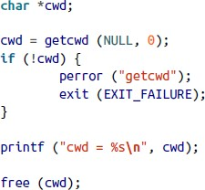
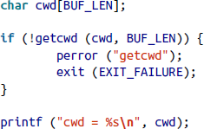
Example of getcwd()
POSIX dictates buf can’t be NULL.
But Linux’s implementation supports a greater flexibility:
If buf is NULL, it will automatically allocate a buffer of length size.
If size is 0, it will allocate a buffer large enough to store the cwd.
You program must free the created buffer using free() when it’s done.
For portability, use POSIX version.
← POSIX version
Linux-specific C library →

Slide 22
Changing the current working directory (cwd)
At login time, the cwd is set to be the user’s home directory (which is specified in /etc/passwd.) View this file using: cat /etc/passwd.
Linux provides two syscalls for changing cwd:
#include <unistd.h>
int chdir (const char *path);
int fchdir (int fd);
The chdir() version accepts the pathname of a new directory, path, and the fchdir() version accepts a file descriptor, fd, representing an open directory file.
On success, either function returns 0. On failure, either returns -1.
Note: a process can change only its own cwd but not others’ directories.

Slide 23
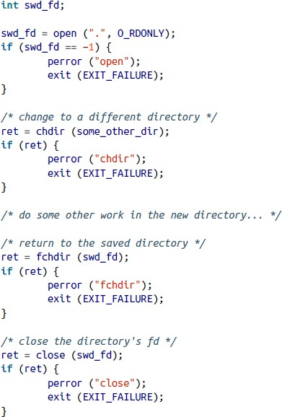
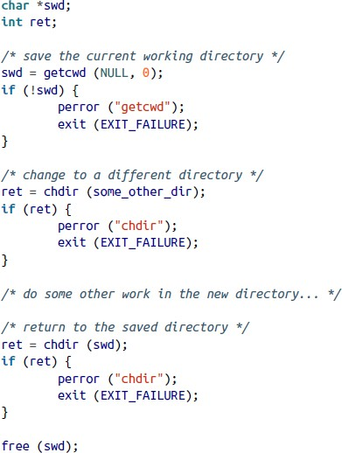
Saving cwd and Restoring to It Later
Both versions do pretty much
the same thing.
But the one on the right is preferred. Why?
Answer: the one on the left needs to save a pathname, whereas the other only needs to save an fd (integer) which is mapped to inode in file table.
Retrieving the pathname is costly as kernel must walk the directory structure and since the pathname is discarded once the directory is opened.

Slide 24
Creating Directories
#include <sys/stat.h> #include <sys/types.h>
int mkdir (const char *path, mode_t mode);
A successful call creates the directory path, which may be relative or absolute, with the permission bits mode and returns 0.
In Linux, the permission bits of the newly created directory are:
mode & ~umask & 01777
Above, umask is a set of permissions that the OS excludes from mode. E.g.: disallowing other users from executing this file. [umask is also a Linux command.]
On failure, this function returns -1 and sets errno.

Slide 25
Removing Directories
#include <unistd.h>
int rmdir (const char *path);
On success, it removes path from the filesystem and returns 0.
The directory, path, must be empty, and not the dot and dot-dot ones.
There is no syscall that implements the recursive delete, as with rm –r.
That is, if you want to delete a directory that contains files, you must manually implement it using a depth-first traversal of the directory, removing all files/directories inside it, using rmdir() and chdir().
On failure, the function returns -1 and sets errno.

Slide 26
Reading a Directory’s Contents
You must create a directory stream first, which is a DIR object:
#include <sys/types.h> #include <dirent.h>
DIR * opendir (const char *name);
A directory stream consists of an fd, some metadata, and a buffer to hold the directory’s contents.
One can obtain the fd behind a given directory stream using dirfd():
#define _BSD_SOURCE /* or _SVID_SOURCE */
#include <sys/types.h> #include <dirent.h>
int dirfd (DIR *dir);
However, this is not standard POSIX, and in generally should be avoided since the directory stream functions use this fd internally and you don’t want to mess it up.

Slide 27
Reading a Directory’s Contents – Cont’
Once opendir() is called successfully, you can read the files one by one from the directory:
#include <sys/types.h> #include <dirent.h>
struct dirent * readdir (DIR *dir);
A successful call to readdir() returns the next entry in the directory represented by dir.
The dirent structure represents a directory entry and defined in <dirent.h>:
struct dirent {
ino_t d_ino; /* inode number */
off_t d_off; /* offset to the next dirent */ → should be treated as opaque
unsigned short d_reclen; /* length of this record */
unsigned char d_type; /* type of file */
char d_name[256]; /* filename */ → only field required by POSIX
};

Slide 28
Reading a Directory’s Contents – Cont’
Applications successively invoke readdir(), obtaining each file in the directory, until:
They find the file they are searching for, or
The entire directory was read, at which time readdir() returns NULL.
On failure, readdir() also returns NULL. To tell apart from an error and having read all files, your program must set errno to 0 before each call to readdir(), then check both the return value and errno.
The only errno value set by readdir() is EBADF – which happens if dir is invalid. Thus, many applications don’t bother checking for errors and assume NULL means no more files remain.

Slide 29
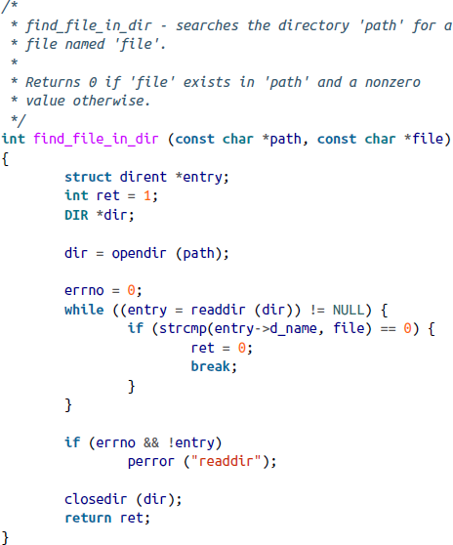
Closing the directory stream and an example
#include <sys/types.h> #include <dirent.h>
int closedir (DIR *dir);
A successful call closes the directory stream dir, including the used fd, and returns 0.
On failure, it returns -1 and sets errno to EBADF.
The example to the right implements a function that searches a given directory for a given filename. It returns 0 if the file is found.

Slide 30
Links
Recall that each name-to-inode mapping in a directory is called a link.
These are called hard links (discussed in ch1.)
A file can have 0, 1, or many links – most have a link count of 1.
A file with a link count of 0 is marked as 'free' and its disk blocks are made available for reuse, unless the file is still open by a process. Once no process has the file open, the file is deleted from disk.
The Linux kernel implements this behavior by using a 'usage count' together with the 'link count'. The usage count is the number of instances where the file is open by some process. A file is not removed until both the link and usage counts hit 0.

Slide 31
Creating Hard Links
To create a new hard link for an existing file:
#include <unistd.h>
int link (const char *oldpath, const char *newpath);
A successful call creates a new link under the path newpath for the existing file oldpath and returns 0 – both now refer to the same file.
On failure, it returns -1
and sets errno.
int ret;
/*
* create a new directory entry that points at
* the same inode as '/home/kidd/pirate'.
*/
ret = link ("/home/kidd/privateer", "/home/kidd/pirate");
if (ret)
perror ("link");

Slide 32
Creating Symbolic Links
A symbolic link is a special file contains the pathname for a different
file, called the symbolic link’s target.
A symbolic link may be relative or absolute; it may contain the dot or dot-dot directory; and it can span filesystems; it can point at nonexistent files (dangling = broken symlink.)
To create a symbolic link:
#include <unistd.h>
int symlink (const char *oldpath, const char *newpath);
A successful call creates the symbolic link newpath pointing at the target oldpath and returns 0. On error, it returns -1 and sets errno.

Slide 33
Unlinking
To remove a pathname from the filesystem:
#include <unistd.h>
int unlink (const char *pathname);
A successful call deletes pathname from the filesystem and returns 0.
If the name was the last reference to the file, the file is deleted from disk.
If the pathname refers to a symlink, then the link, not the target, is destroyed.
On error, unlink() returns -1 and sets errno.
unlink() doesn’t remove directories – rmdir() is used for that purpose.
The C language provides remove(), which calls unlink() for a file and rmdir() for a directory:
#include <stdio.h>
int remove (const char *path);

Slide 34
Copying Files
Surprisingly, Unix doesn’t have a system or library call similar to the terminal’s cp command that does copying of files and directories.
Instead, your program must implement it. To copy a file src to dst:
Open src,
Open dst, creating it if it doesn’t exist, truncating it if it does exist,
Read a chunk of src into an array in memory,
Write that chunk to dst,
Continue until the entire src has been read and written to dst,
Close dst,
Close src.
To copy a directory, the directory/subdirectories are created via mkdir() and then each file therein is then copied to the new directory.

Slide 35
Moving Files
However, Unix provides a syscall for moving files:
#include <stdio.h>
int rename (const char *oldpath, const char *newpath);
A successful call renames oldpath to newpath (both must be on the same filesystem, otherwise the call will fail.) The file’s contents and inode remain the same.
On success, it returns 0. On failure it returns -1, sets errno, and doesn’t change oldpath or newpath.

Slide 36
Device Nodes
Device nodes are special files that allow applications to interface with device drivers.
When an application performs I/O on a device node, the kernel passes such requests to a device driver, which handles the I/O and returns the results to the user.
This provides the standard mechanism for accessing hardware on Unix system.
To identify device driver, each device node is assigned two numerical values – a major number and a minor number. The pair maps to a specific device driver loaded into the kernel.

Slide 37
Special Device Nodes
Are part of the Linux development environment and a part of the Linux ABI:
The null device (major #1, minor #3): /dev/null. The kernel silently discards any writes to the device, and all the reads return EOF.
The zero device (major #1, minor #5): /dev/zero. The kernel drops all writes, but reading from the device returns an infinite stream of null bytes.
The full device (major #1, minor #7): /dev/full. Reads return null characters. But writes always trigger the ENOSPC error (no space), signifying that the underlying device is full.
See more at https://www.kernel.org/doc/Documentation/admin-guide/devices.txt.
These device have varied purposes. They are useful for testing how an application handles corner and problem cases – e.g., a full filesystem. Null and zero devices provide a no-overhead way to discard unwanted I/O.

Slide 38
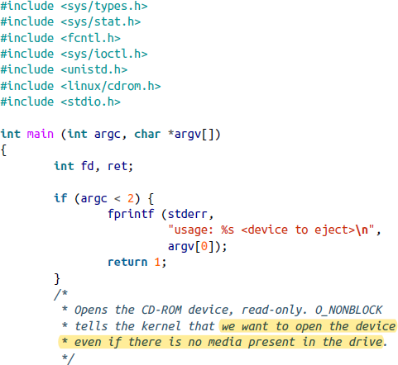
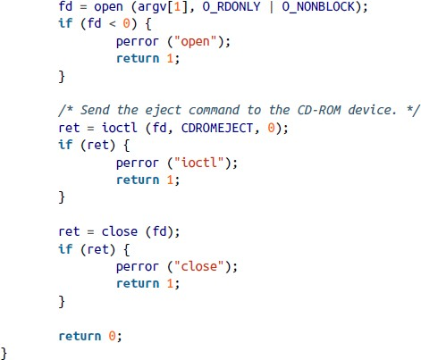
An Example of Ejecting the CD-ROM

